Slide 1
Functions and Graphs
Combining Transformations
Chapter 2
(Part 6 of 6)

Slide 2
It is often helpful to
sketch the graph in stages.
When applying more
than one transformations.

Slide 3
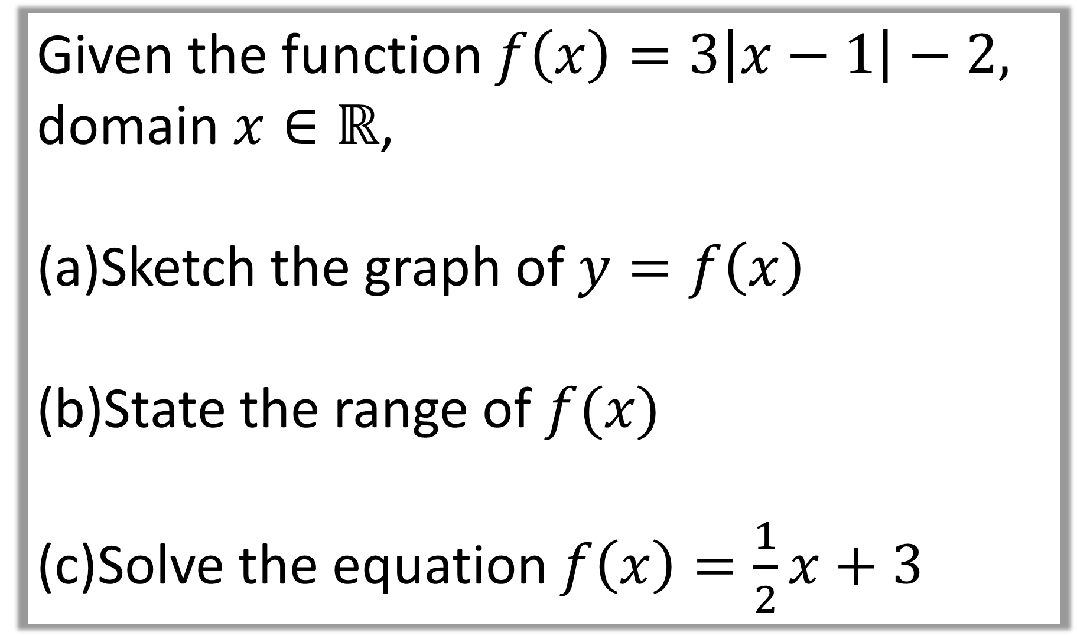
Given the function $f\left(x\right)=3\left|x−1\right|−2,$
domain$x∈ℝ$,
Sketch the graph of $y=f\left(x\right)$
State the range of $f(x)$
Solve the equation $f\left(x\right)=\frac{1}{2}x+3$

Slide 4






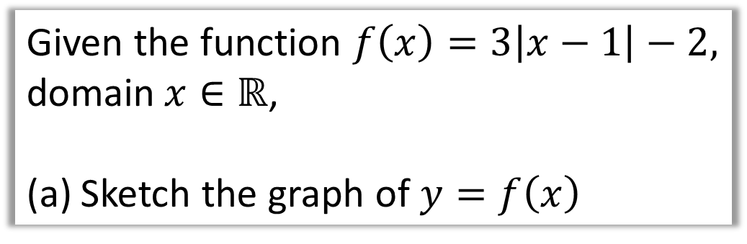









Given the function $f\left(x\right)=3\left|x−1\right|−2,$
domain$x∈ℝ$,
Sketch the graph of $y=f\left(x\right)$
a)
$$y=3\left|x−1\right|$$
$$y$$
$$y=\left|x−1\right|$$
$$y$$
$$y$$
$$y=3\left|x−1\right|−2$$
$$3$$
$$1$$
$$1$$
$$x$$
$$x$$
$$x$$
$$1$$
$$1$$
$$\left(1,−2\right)$$
3f(x)
(x, 3y)
f(x) – 2
Shift the graph down 2.

Slide 5
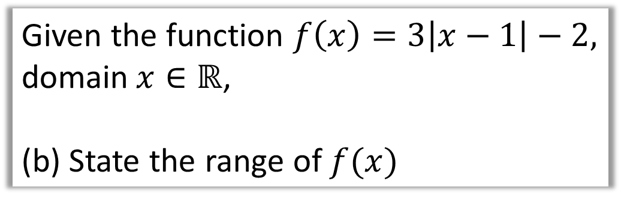

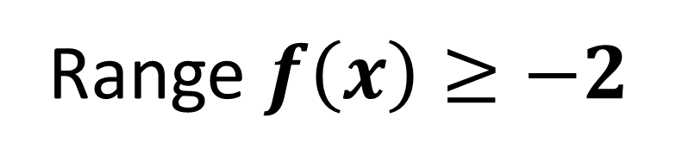


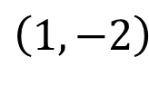

Given the function $f\left(x\right)=3\left|x−1\right|−2,$
domain$x∈ℝ$,
(b) State the range of $f(x)$
b)
$$y$$
$$y=3\left|x−1\right|−2$$
$$1$$
Range $f\left(x\right)≥−2$
$$x$$
$$\left(1,−2\right)$$

Slide 6

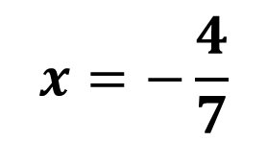


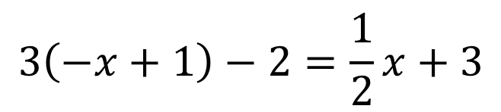


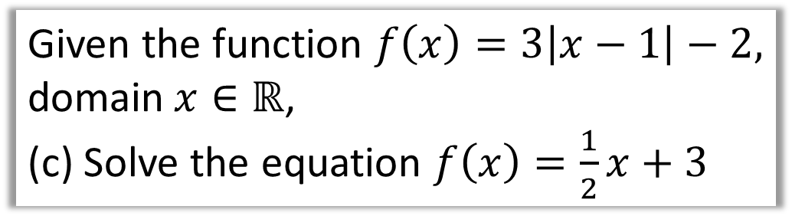
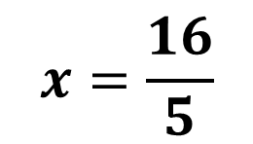


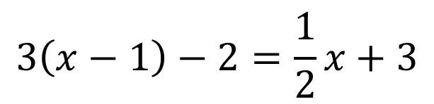
Given the function $f\left(x\right)=3\left|x−1\right|−2,$
domain$x∈ℝ$,
(c) Solve the equation $f\left(x\right)=\frac{1}{2}x+3$
Solution A
$$3\left(−x+1\right)−2=\frac{1}{2}x+3$$
$$y$$
$$A$$
$$x=−\frac{4}{7}$$
$$3$$
Solution B
$$B$$
$$1$$
$$3\left(x−1\right)−2=\frac{1}{2}x+3$$
$$x$$
$$x=\frac{16}{5}$$
$$\left(1,−2\right)$$

Slide 7

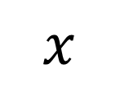




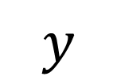
Here is a graph of $y=f(x)$.
Sketch the graph of:
a) $y=2f\left(x+2\right)$
b) $y=−f\left(2x\right)$
c) $y=\left|f\left(−x\right)\right|$
$$y$$
$$y=f(x)$$
$$B\left(6,4\right)$$
$$x$$
$$O$$
$$A\left(2,−1\right)$$

Slide 8




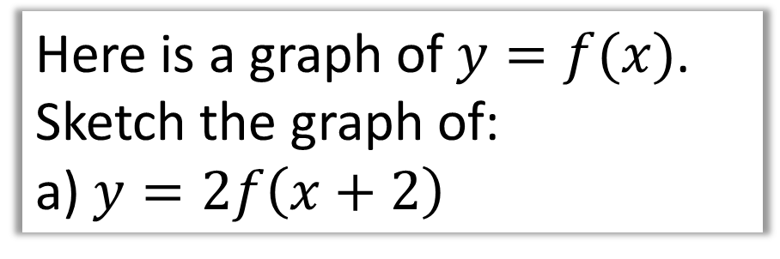








Here is a graph of $y=f(x)$.
Sketch the graph of:
a) $y=2f\left(x+2\right)$
Subtract 2 from $x$ values.
$y$ values multiplied by 2.
$$y$$
$$y$$
$$y=f(x)$$
$$y=f(x)$$
$$\left(4,8\right)$$
$$B\left(6,4\right)$$
$$B\left(6,4\right)$$
$$x$$
$$x$$
$$O$$
$$O$$
$$A\left(2,−1\right)$$
$$A\left(2,−1\right)$$
$$\left(0,−2\right)$$

Slide 9


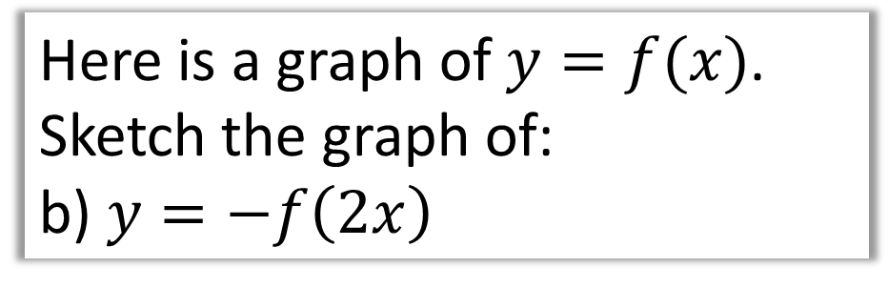





Here is a graph of $y=f(x)$.
Sketch the graph of:
b) $y=−f\left(2x\right)$
Halve $x$ values.
$y$ values negated.
$$y$$
$$y$$
$$y=f(x)$$
$$y=f(x)$$
$$B\left(6,4\right)$$
$$\left(1,1\right)$$
$$x$$
$$O$$
$$x$$
$$O$$
$$A\left(2,−1\right)$$
$$\left(3,−4\right)$$

Slide 10


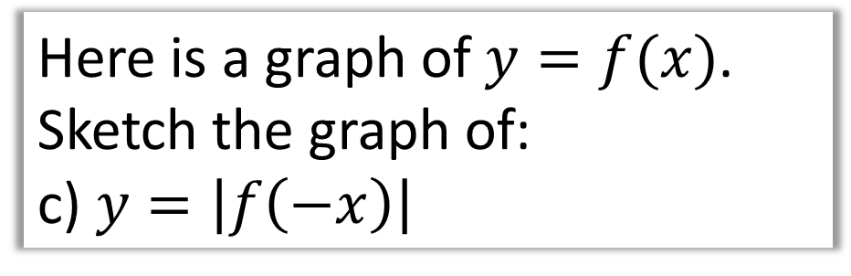
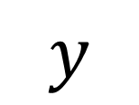

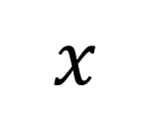
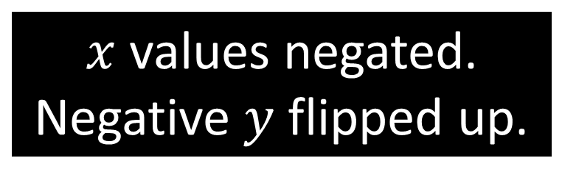

Here is a graph of $y=f(x)$.
Sketch the graph of:
c) $y=\left|f\left(−x\right)\right|$
$x$ values negated.
Negative $y$ flipped up.
$$y$$
$$y$$
$$y=f(x)$$
$$B\left(6,4\right)$$
$$B\left(−6,4\right)$$
$$A\left(−2,1\right)$$
$$y=f(x)$$
$$x$$
$$x$$
$$O$$
$$O$$
$$A\left(2,−1\right)$$

Slide 11
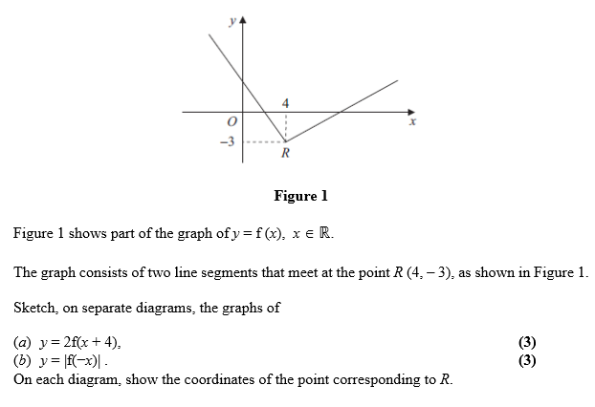

Slide 12
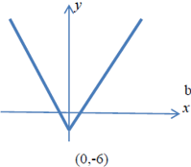
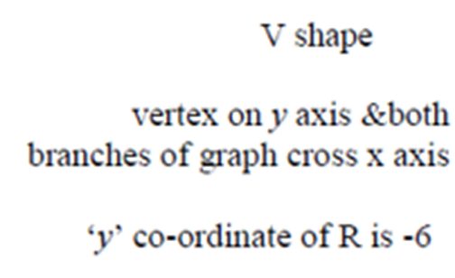

Slide 13
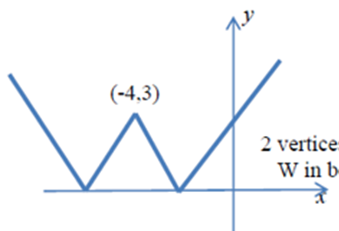
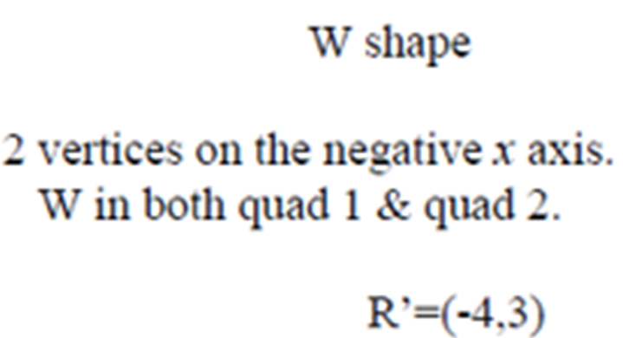

Slide 14
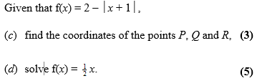
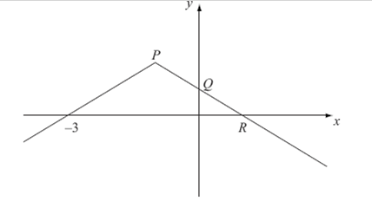

Slide 15

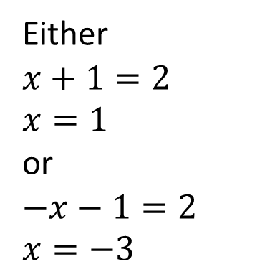
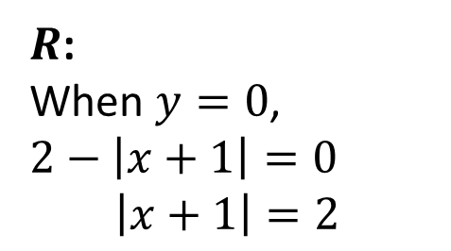
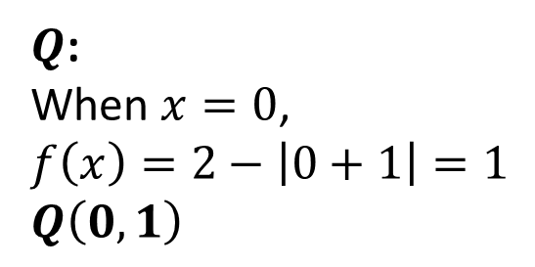
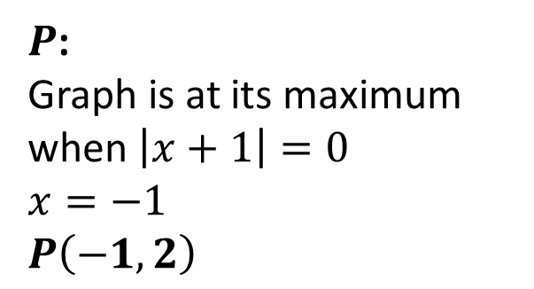
a)
$Q$:
When $x=0$,
$$f\left(x\right)=2−\left|0+1\right|=1$$
$$Q\left(0,1\right)$$
$R$:
When $y=0$,
$$2−\left|x+1\right|=0$$
$\left|x+1\right|=2$
$P$:
Graph is at its maximum
when $\left|x+1\right|=0$
$x=−1$
$$P\left(−1,2\right)$$
Either
$$x+1=2$$
$$x=1$$
or
$$−x−1=2$$
$$x=−3$$
$$R\left(1,0\right)$$

Slide 16
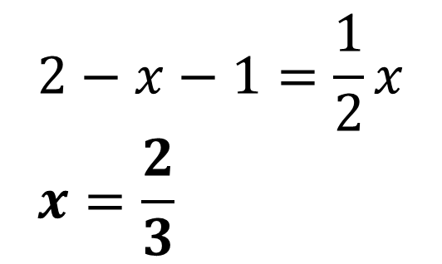
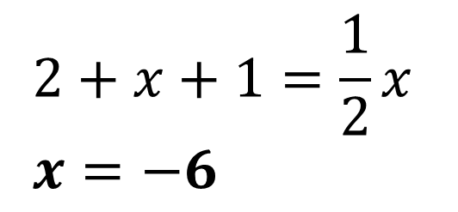
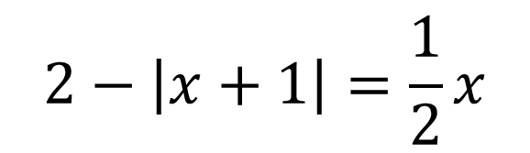
$$2−\left|x+1\right|=\frac{1}{2}x$$
b)
$$2−x−1=\frac{1}{2}x \\ x=\frac{2}{3}$$
$$2+x+1=\frac{1}{2}x \\ x=−6$$

