Slide 1
LO: Cylinders

Slide 2
Skills Needed:

Slide 3
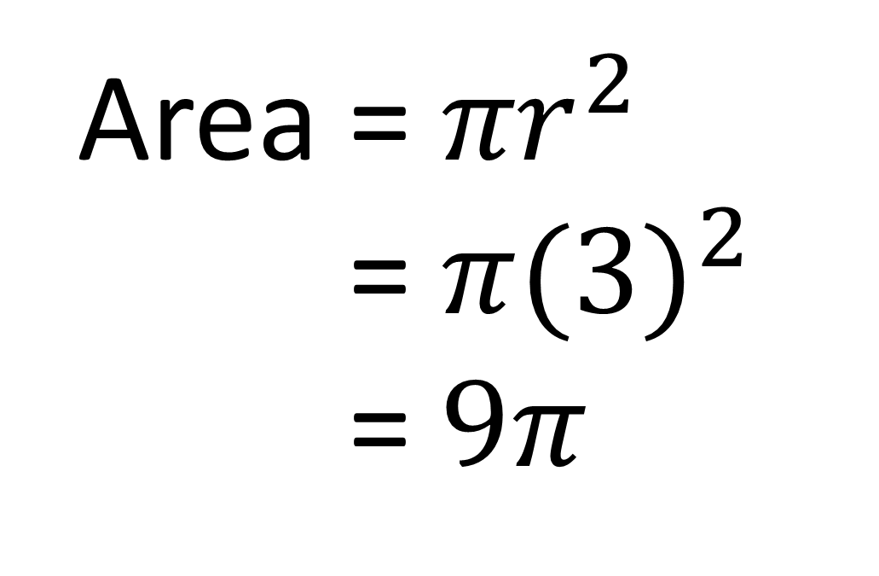
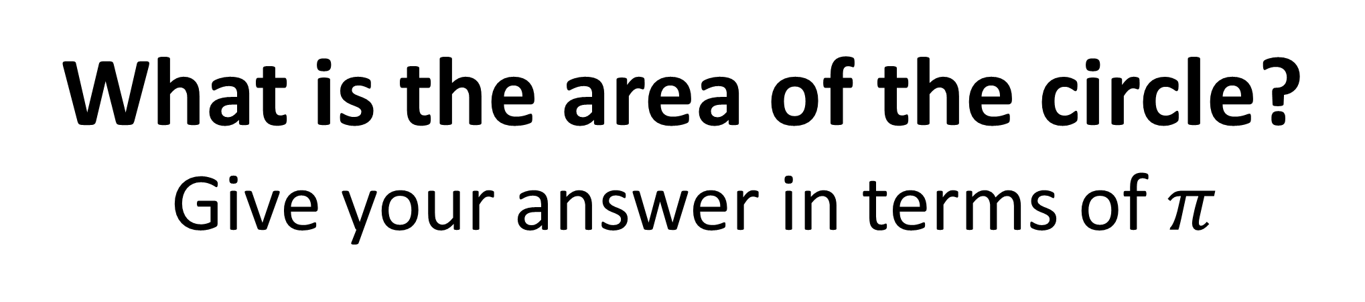
What is the area of the circle?
Give your answer in terms of $π$
Area = ${πr}^{2}$
Area = ${π(3)}^{2}$
Area = $9π$
3cm

Slide 4
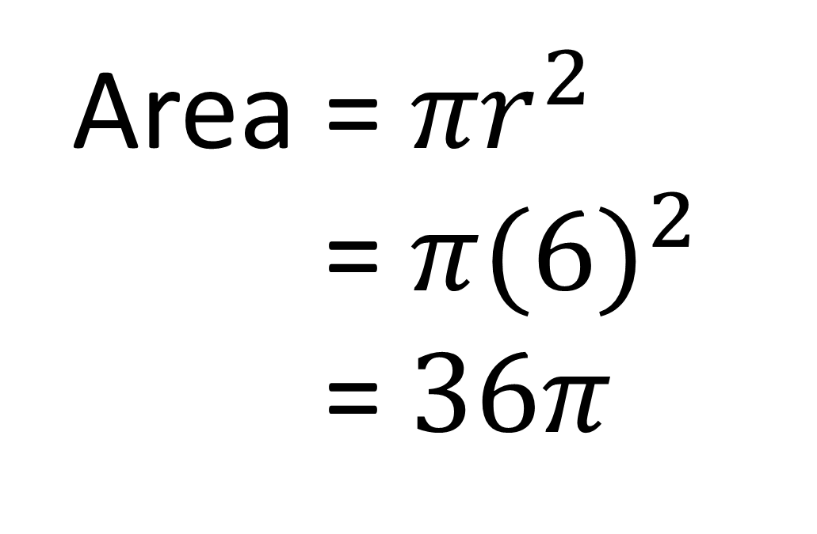
What is the area of the circle?
Give your answer in terms of $π$
Area = ${πr}^{2}$
Area = ${π(6)}^{2}$
Area = $36π$
12m

Slide 5
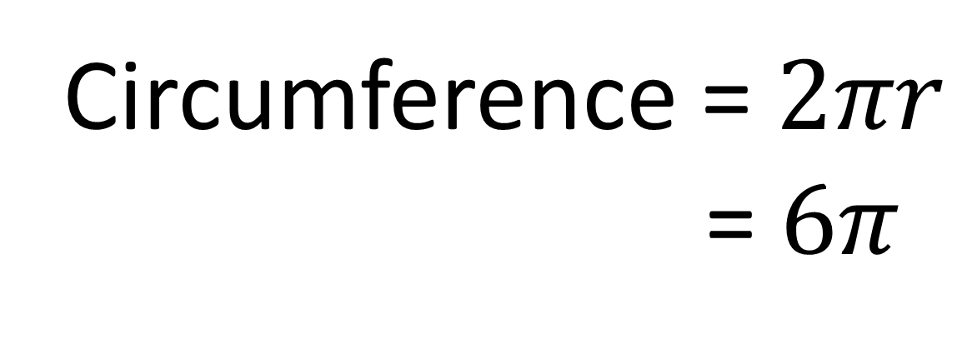
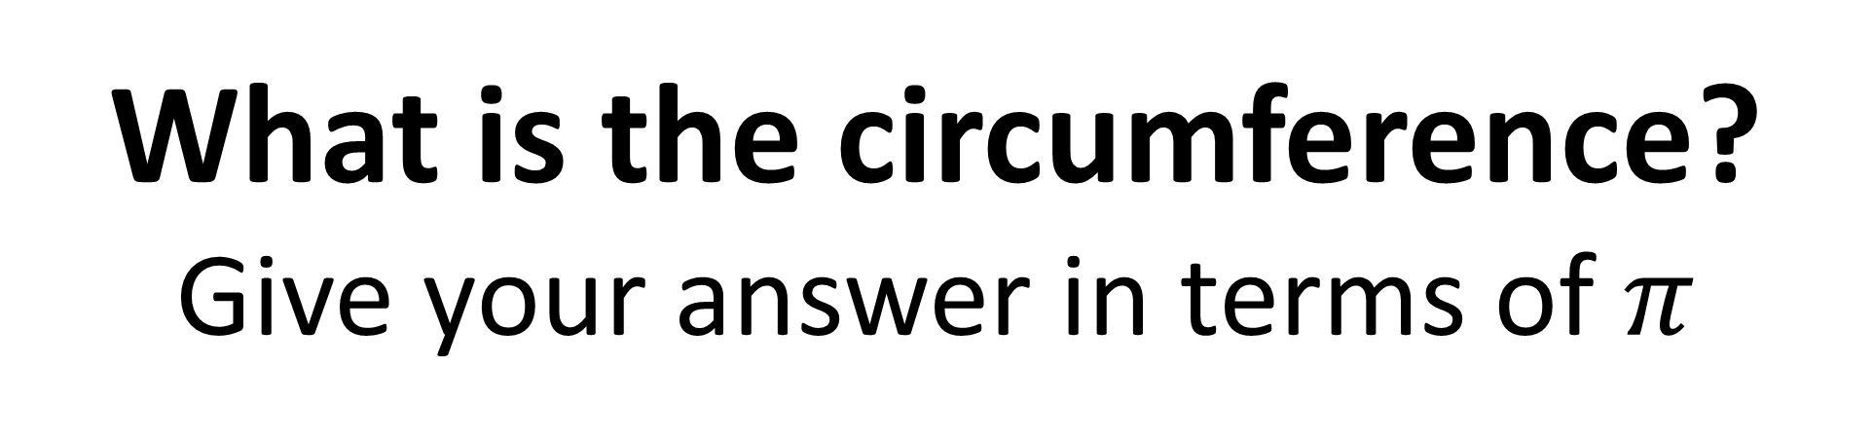
What is the circumference?
Give your answer in terms of $π$
3cm
Circumference = $2πr$
Area =$6π$

Slide 6
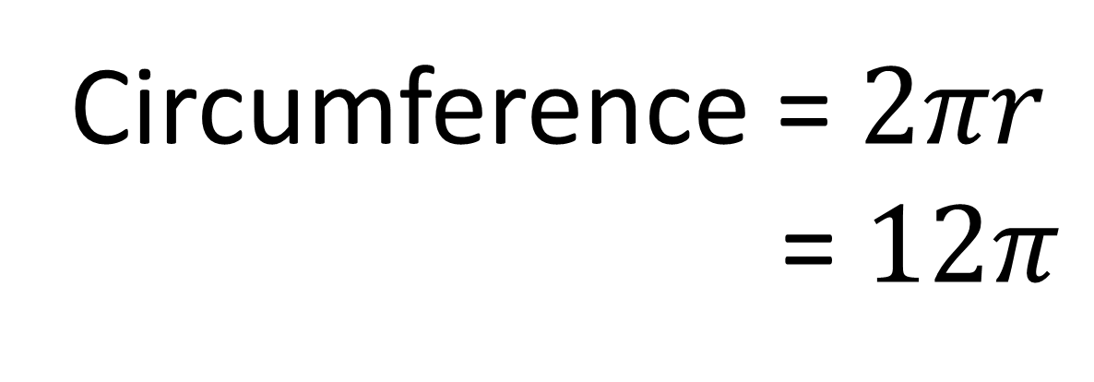
What is the circumference?
Give your answer in terms of $π$
Circumference = $2πr$
Area = $12π$
12m

Slide 7
What is the volume
of the prism?
Volume
= 3 x 3 x 10
= 90 m³
10m
3m
3m

Slide 8
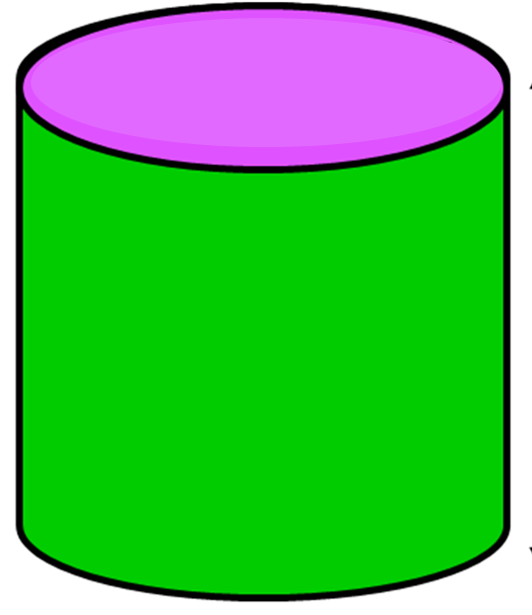
Prism or Not?

Slide 9
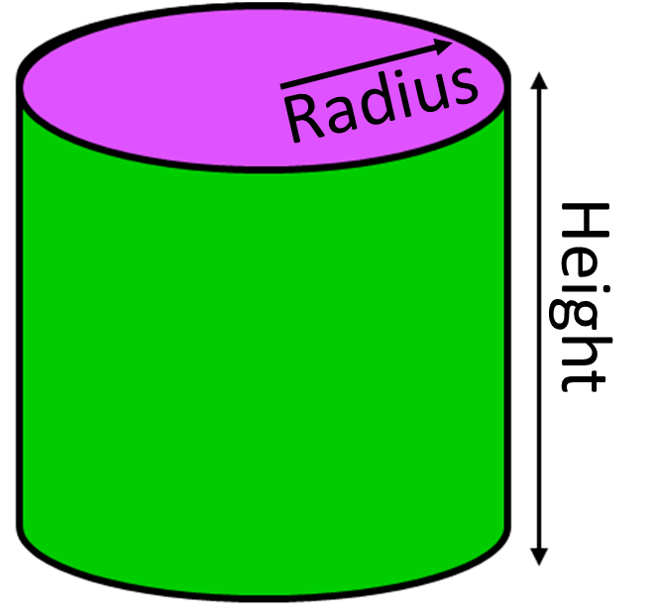
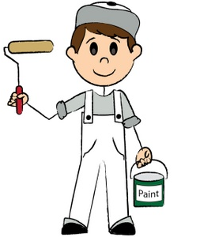

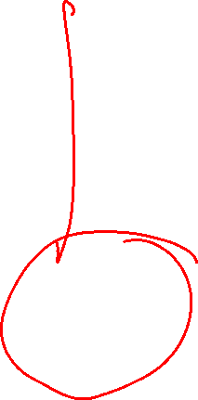
How would you work out
the amount of paint the tin holds?
Volume = ${πr}^{2}$ x height

Slide 10
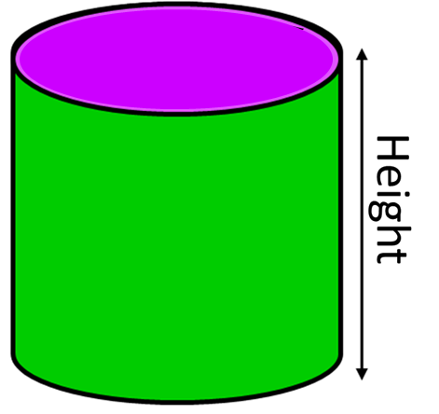
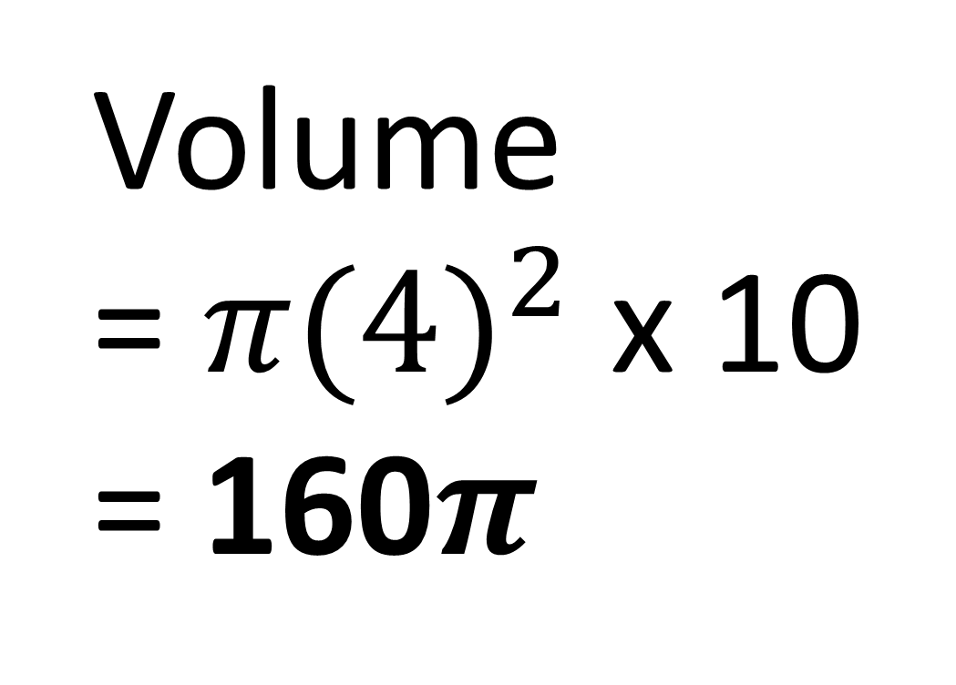

What is the volume
in terms of $π$?
4 cm
Volume
= ${π(4)}^{2}$ x 10
= 160$π$
10 cm

Slide 11
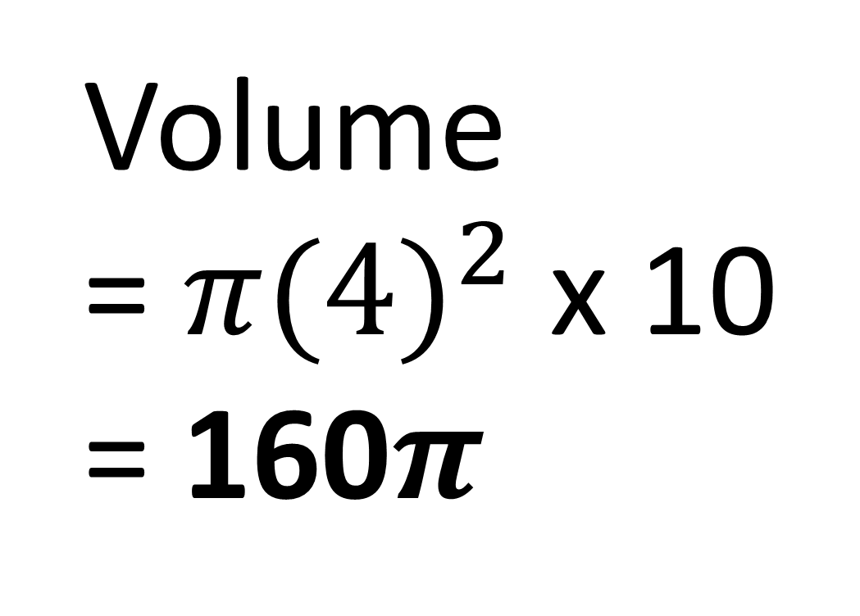
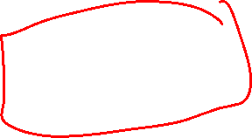
What is the volume
in terms of $π$?
8 cm
Volume
= ${π(4)}^{2}$ x 10
= 160$π$
10 cm

Slide 12
Draw the net of the cylinder?

Slide 13
How would you work out the paint needed to paint the tin (with a lid)?

Slide 14
How would you work out
the area of each shape?
πr²
Circumference x Height
Height
πr²

Slide 15
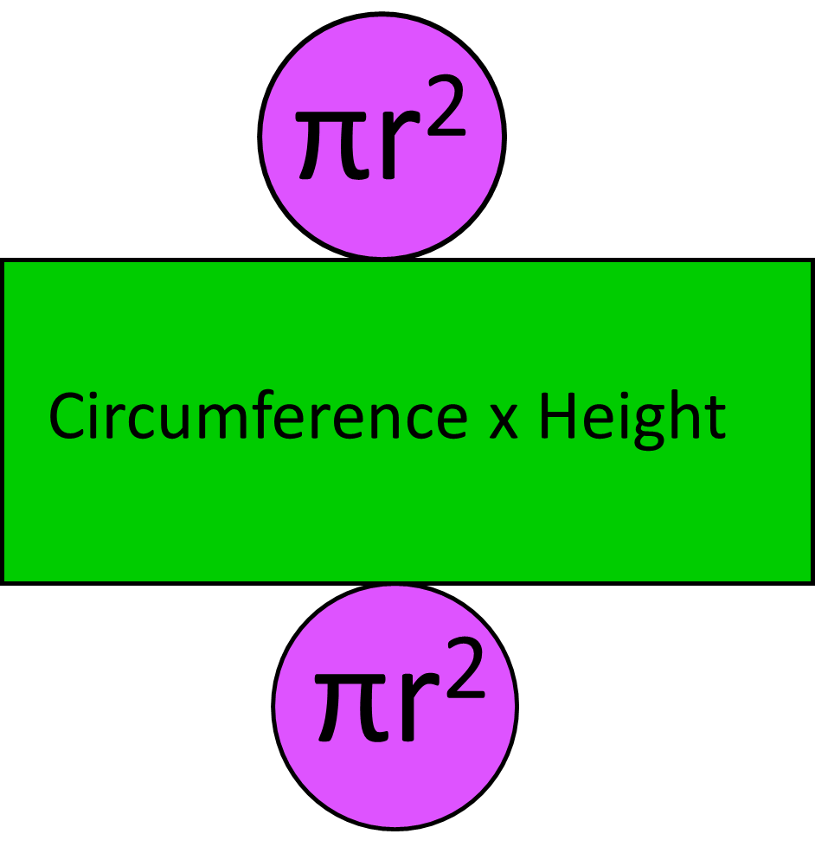
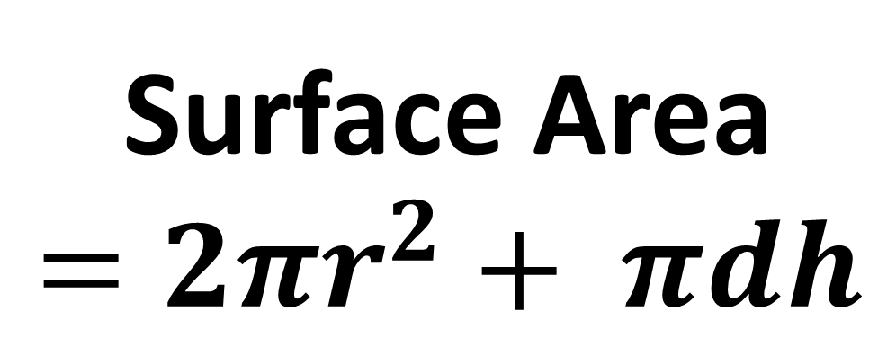
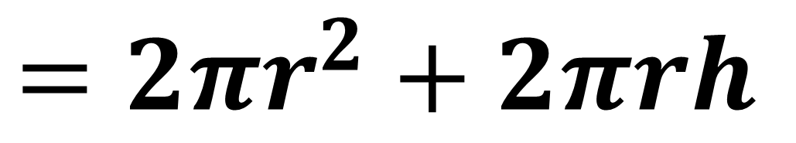
Write a formulae for calculating
the total surface area of a cylinder?
Surface Area
$$=2πr^{2}+ πdh$$
$$=2πr^{2}+2πrh$$

Slide 16
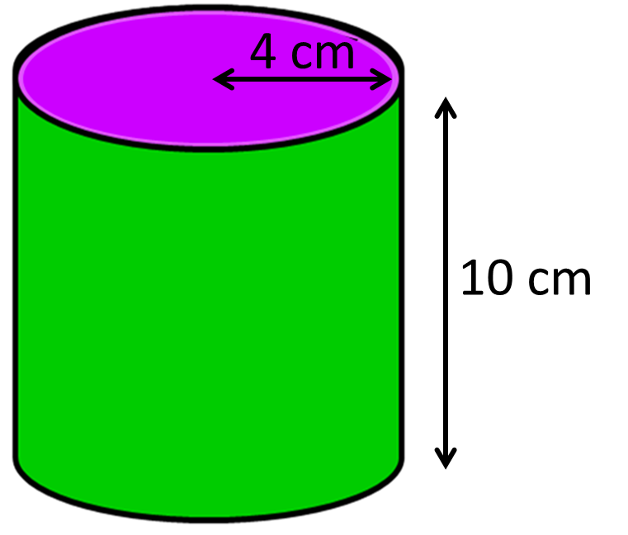

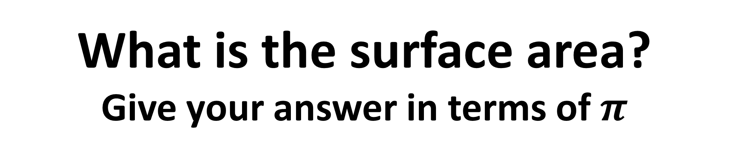
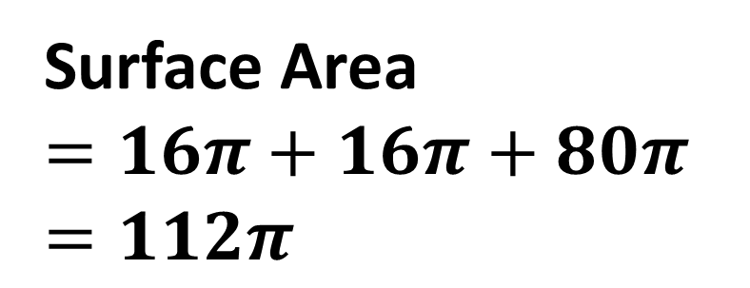


What is the surface area?
Give your answer in terms of $π$
$$π4^{2}$$
$$=16π$$
$$π\text{8} \text{x} 10=80π$$
Surface Area
$$=16π+16π+80π$$
$$=112π$$
$$π4^{2}$$
$$=16π$$

Slide 17
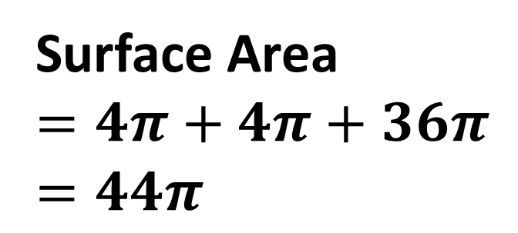
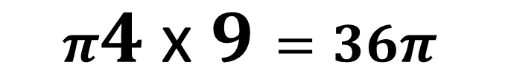


What is the surface area?
Give your answer in terms of $π$
$$π2^{2}$$
$$=4π$$
4 cm
$$π4 \text{x} 9=36π$$
9 cm
Surface Area
$$=4π+4π+36π$$
$$=44π$$
$$π2^{2}$$
$$=4π$$

