Slide 1
Modelling in Mechanics
Assumptions
Chapter 8
(Part 2 of 4)

Slide 2
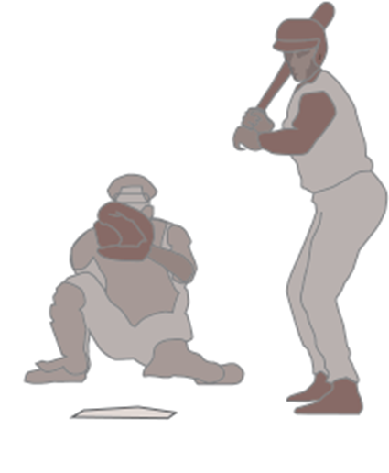
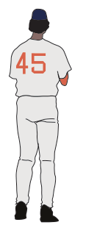

What factors could affect the motion of the baseball?
Ignore air resistance
No rotation on the ball (no spin)
Model the baseball as a particle.
We often have to make various modelling assumptions,
to make the maths user friendly.

Slide 3
Definitions
Particle
Smooth/light pulley
Smooth and Rough Surface
Rod
Inextensible string

Slide 4

Particle
Dimensions of object are negligible
Mass of object concentrated at single point.
Rotational forces/air resistance can be ignored.

Slide 5


Smooth Surface
Objects in contact with a surface
do not experience friction.
Friction = 0 N

Slide 6
Rough Surface
Objects in contact with a surface
experience friction.
Friction = 10 N

Slide 7

Rod
Thickness is negligible.
Mass is concentrated at a single point.
Rigid.
mass

Slide 8

Inextensible String
String does not stretch.
Acceleration the same for both objects.

Slide 9
Smooth/Light Pulley
No friction.
Tension the same in string either side of pulley.

Slide 10
What assumptions could you make
to create a simple model for the motion of the baseball?
Ignore air resistance
No rotation on the ball (no spin)
Model the baseball as a particle.

Slide 11

What assumptions could you make
to create a simple model for the motion of the skier?
Ignore air resistance
Snow is smooth/no friction
Model the skier as a particle.

