Slide 1
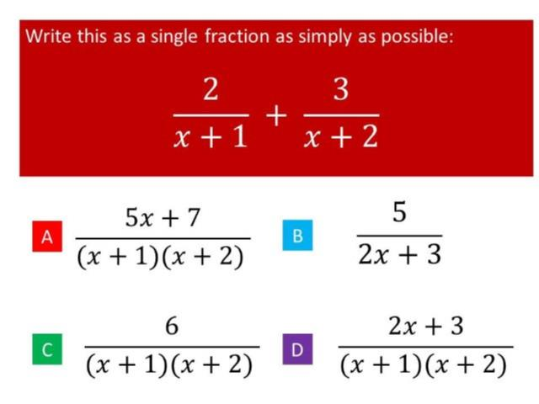
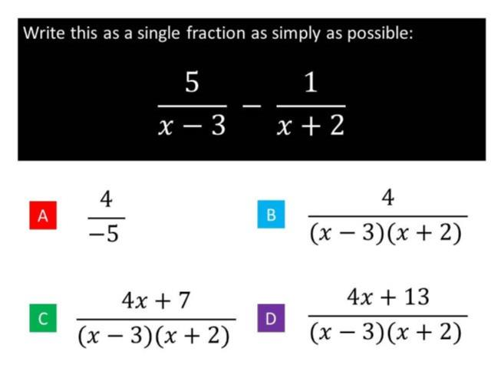
Worst answered question?
Most common wrong answer?

Slide 2
ANSWERS

Slide 3
Worst answered question?

Slide 4
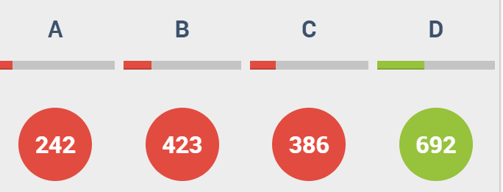
B
They did not
cross multiply
the numerators.

Slide 5
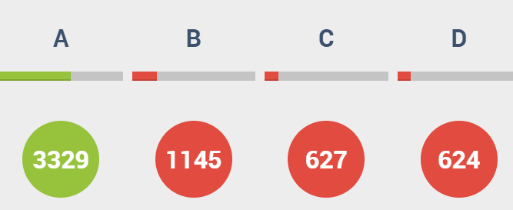
B
They added with out finding a common denominator.

