Slide 1
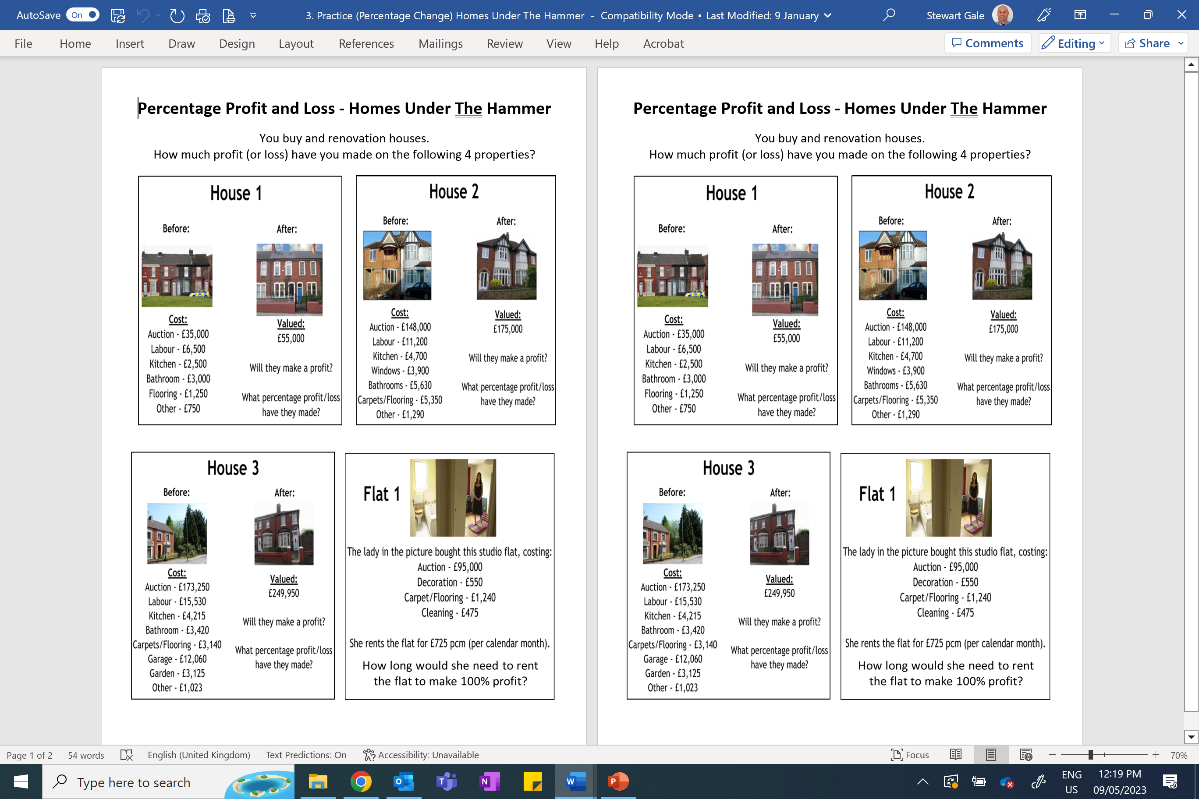

Slide 2
ANSWERS

Slide 3
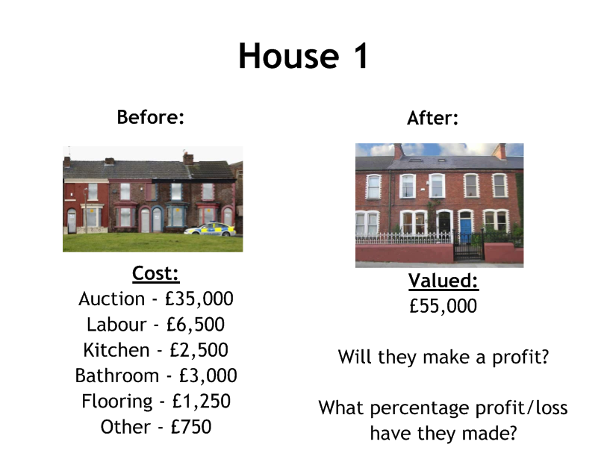
Profit of £6000 or 12.2%

Slide 4
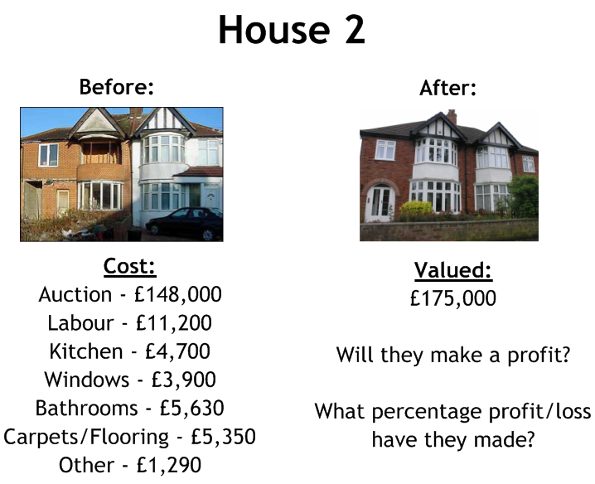
Loss of £5070 or 2.8%

Slide 5
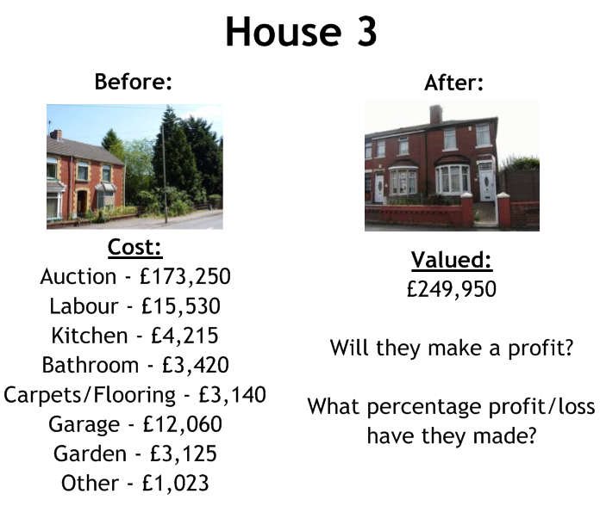
Profit of £34,187 or 15.8%

Slide 6
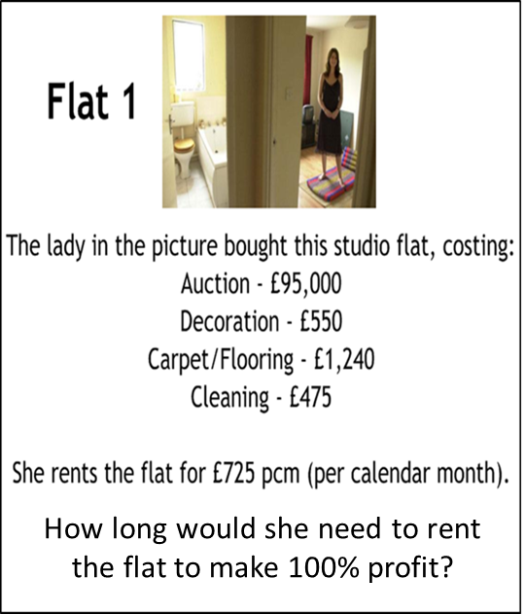
It takes 269 months
or
22 years, 5 months

