Slide 1
Sequences and Series
Sigma Notation
Chapter 3
(Part 6 of 8)

Slide 2
Sum of the Series - Sigma Notation
∑
The Greek letter, sigma, means ‘sum’.

Slide 3
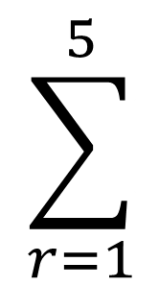
Sum of terms 1 to 5

Slide 4
Sum of terms 3 to 5
3

Slide 5
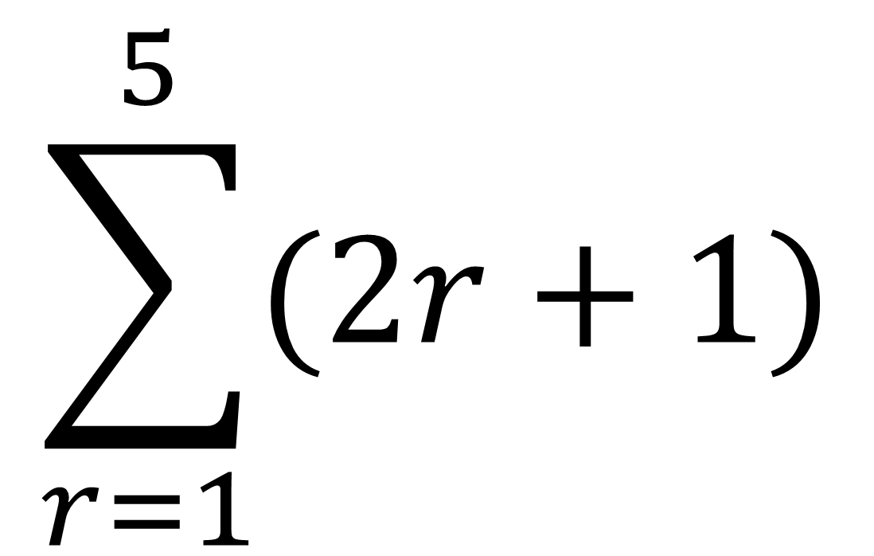
$$\sum_{r=1}^{5}{(2r+1)}$$
This expressions calculates each individual term

Slide 6


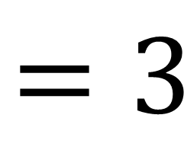
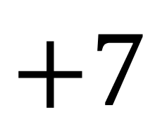


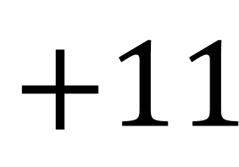
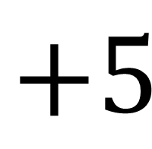


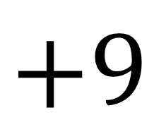
$$\sum_{r=1}^{5}{(2r+1)}$$
$$r=1$$
$$r=2$$
$$r=3$$
$$r=4$$
$$r=5$$
$$=3$$
$$+5$$
$$+7$$
$$+9$$
$$+11$$
$$=35$$

Slide 7

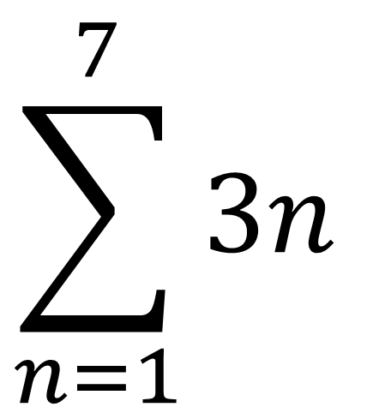
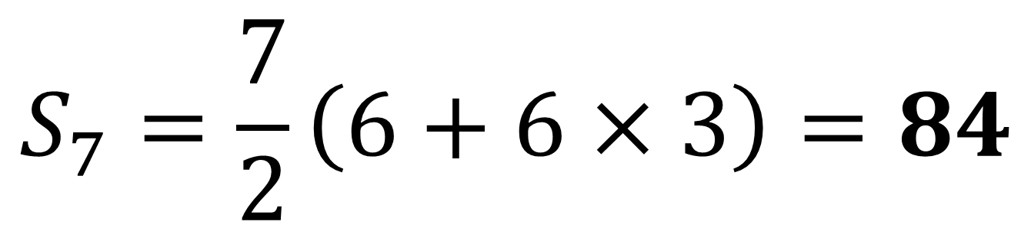
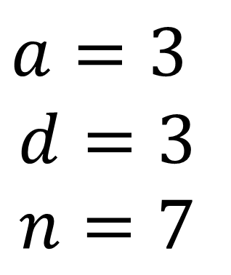
$$\sum_{n=1}^{7}{3n}$$
$$=3+6+9+…$$
$$a=3$$
$$d=3$$
$$n=7$$
$$S_{7}=\frac{7}{2}\left(6+6×3\right)=84$$

Slide 8

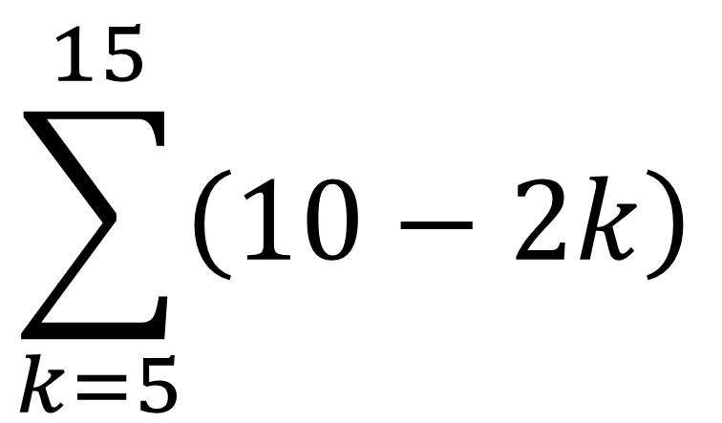
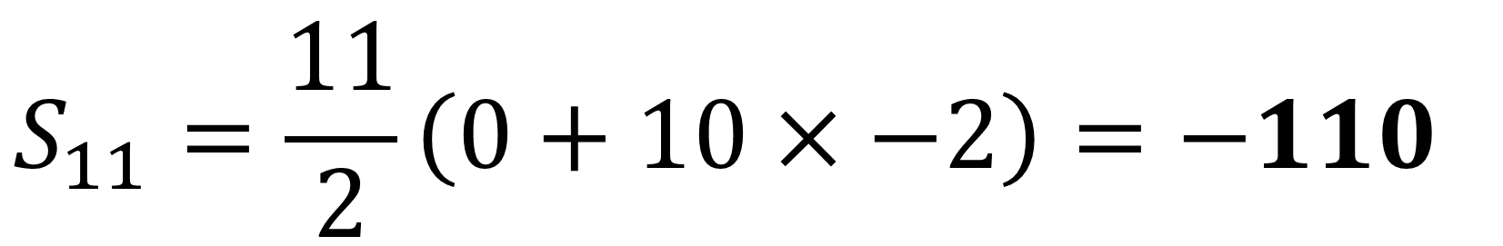
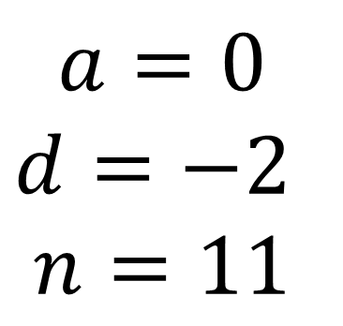
$$\sum_{k=5}^{15}{\left(10−2k\right)}$$
$$=0+\left(−2\right)+\left(−4\right)+…$$
$$a=0$$
$$d=−2$$
$$n=11$$
not 10
$$S_{11}=\frac{11}{2}\left(0+10×−2\right)=−110$$

Slide 9

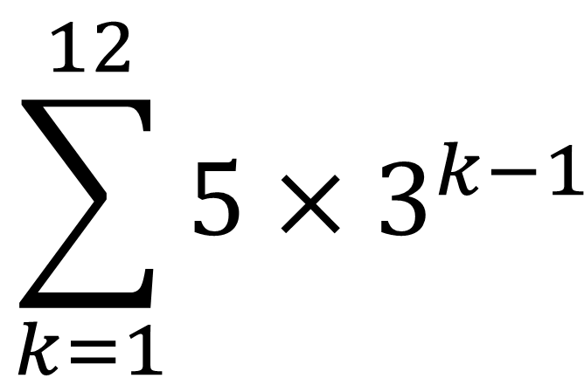
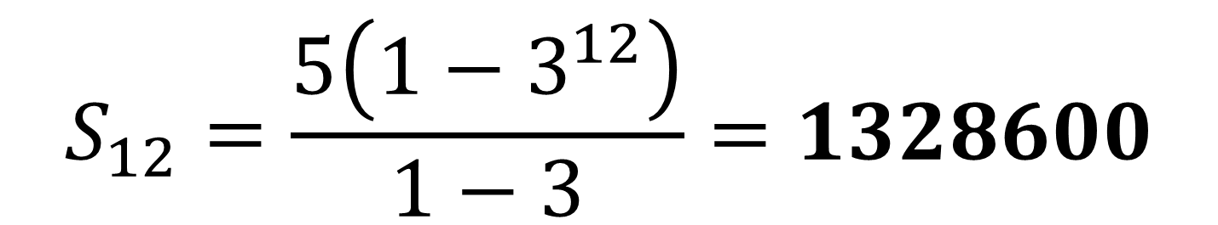
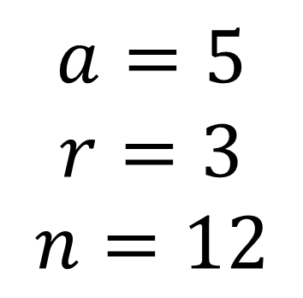
$$\sum_{k=1}^{12}{5×3^{k−1}}$$
$$=5+15+45+…$$
$$a=5$$
$$r=3$$
$$n=12$$
not 11
$$S_{12}=\frac{5\left(1−3^{12}\right)}{1−3}=1328600$$

Slide 10
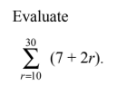
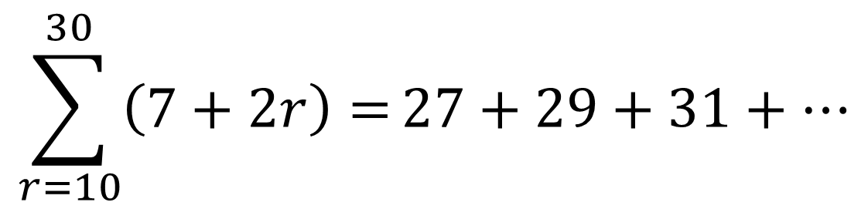
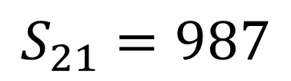
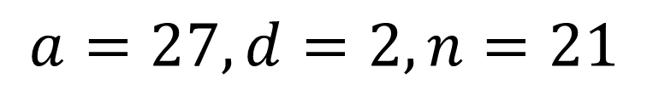
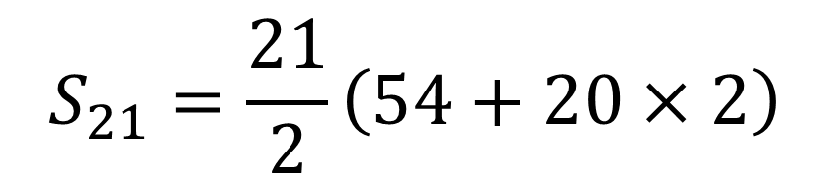
$$\sum_{r=10}^{30}{\left(7+2r\right)=}27+29+31+…$$
$$S_{21}=\frac{21}{2}\left(54+20×2\right)$$
$$a=27, d=2, n=21$$
$$S_{21}=987$$

Slide 11
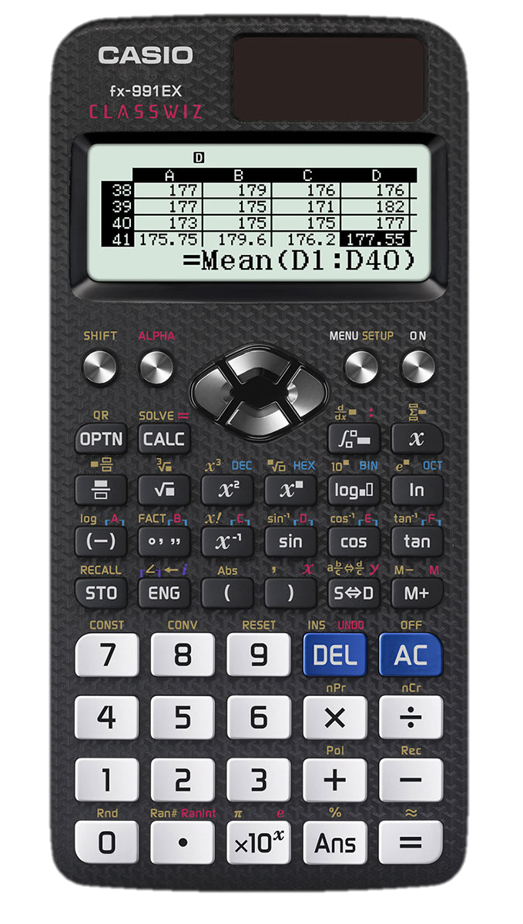
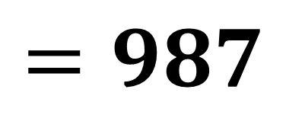
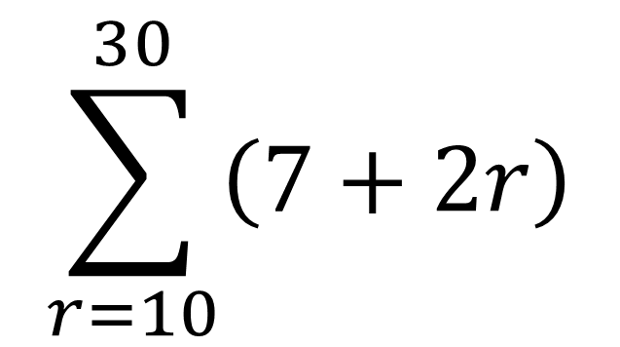

Sum of the Series on the Calculator
The Classwiz calculator has a $Σ$ button.
$$\sum_{r=10}^{30}{\left(7+2r\right)}$$
$$=987$$

