Slide 1
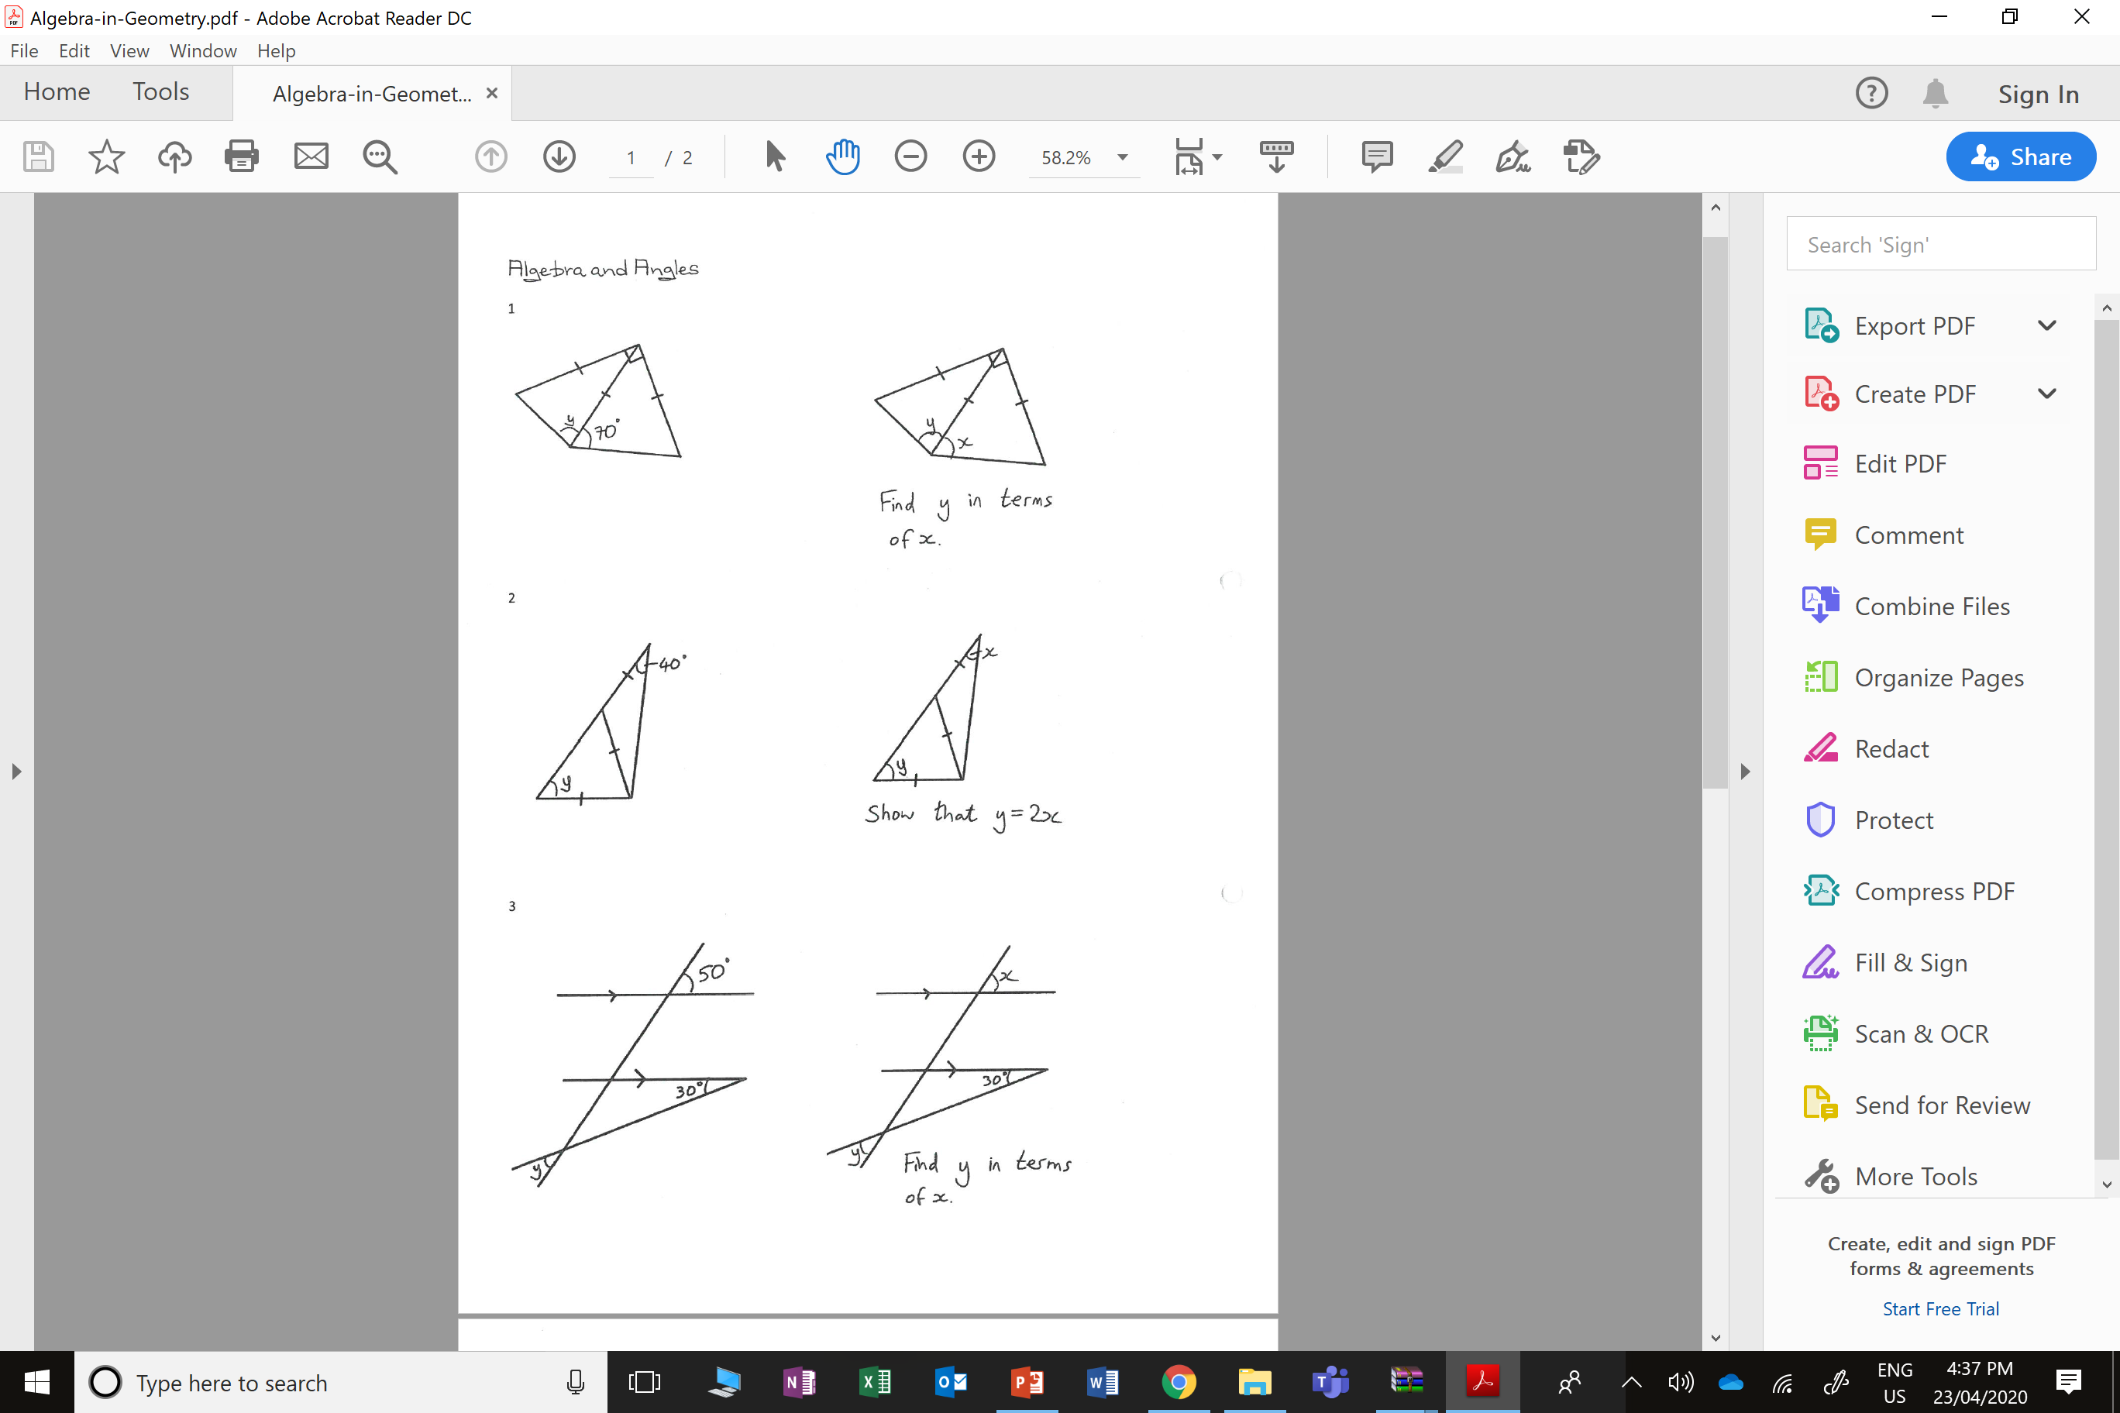
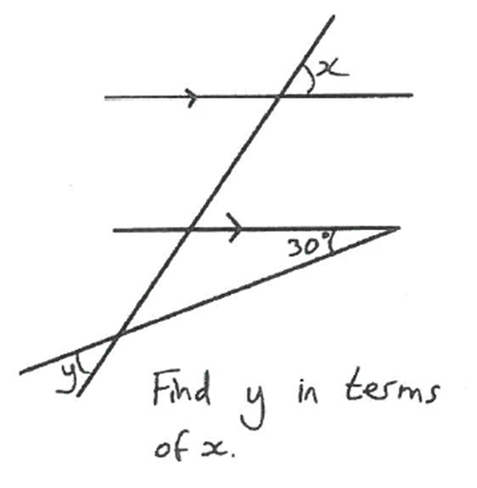

Slide 2
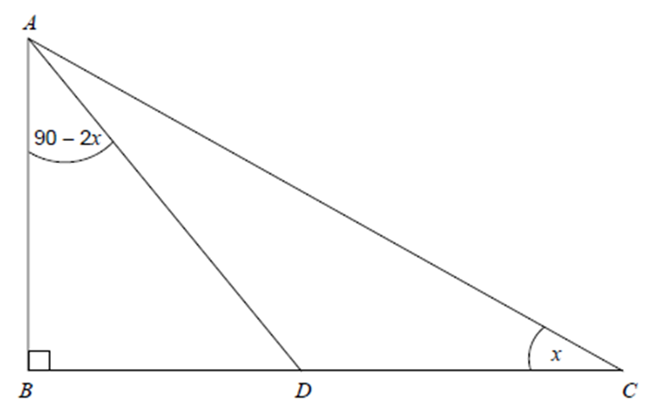
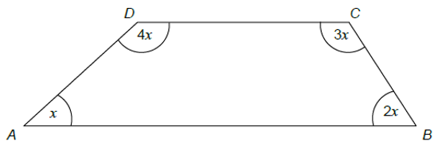
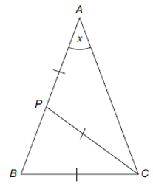
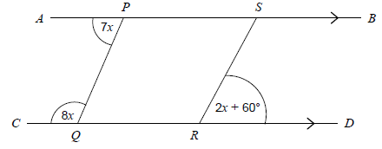

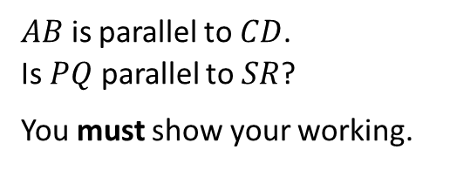
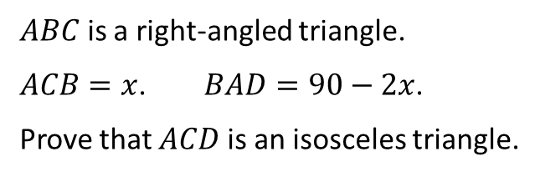
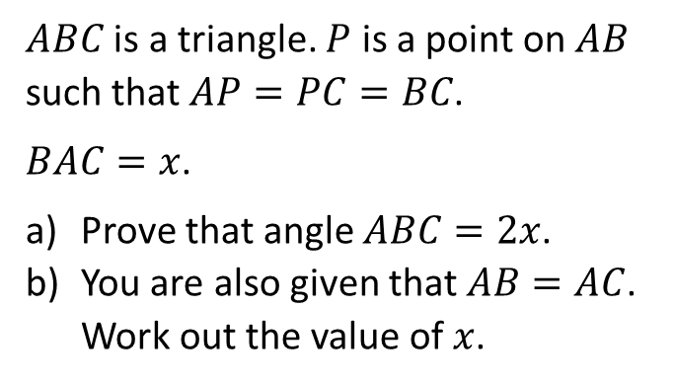
$ABC$ is a right-angled triangle.
$ACB=x$. $BAD=90−2x$.
Prove that $ACD$ is an isosceles triangle.
Prove that $AB$ is parallel to $DC$.
$ABC$ is a triangle. $P$ is a point on $AB$ such that $AP=PC=BC$.
$BAC=x$.
Prove that angle $ABC=2x$.
You are also given that $AB=AC$. Work out the value of $x$.
$AB$ is parallel to $CD$.
Is $PQ$ parallel to $SR$?
You must show your working.

Slide 3
ANSWERS

Slide 4
180 – 2y + 180 – 2x = 90
360 – 2y – 2x = 90
180 – 2y
180 – 2x
270 – 2x = 27
y
x

Slide 7
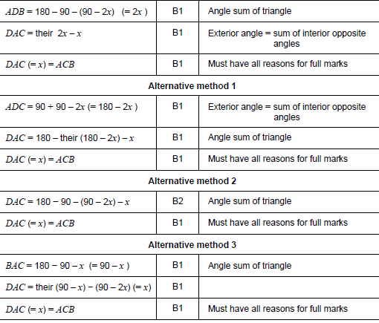
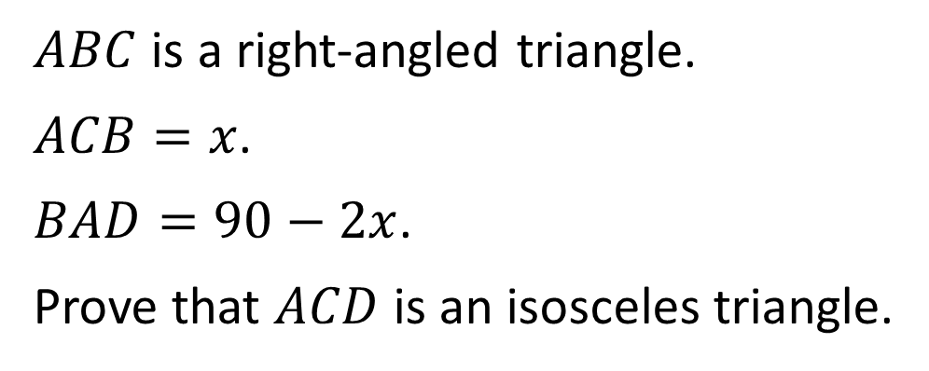
$ABC$ is a right-angled triangle.
$ACB=x$.
$BAD=90−2x$.
Prove that $ACD$ is an isosceles triangle.

Slide 8
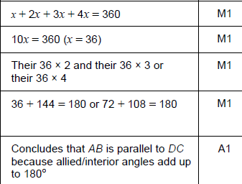
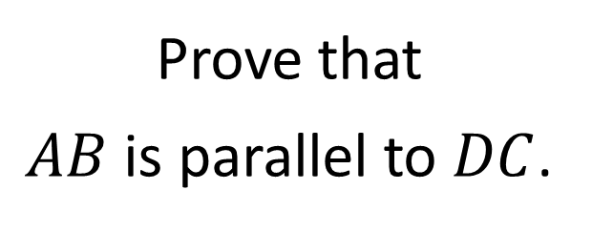
Prove that
$AB$ is parallel to $DC$.

Slide 9
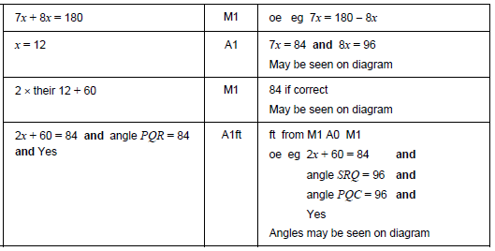
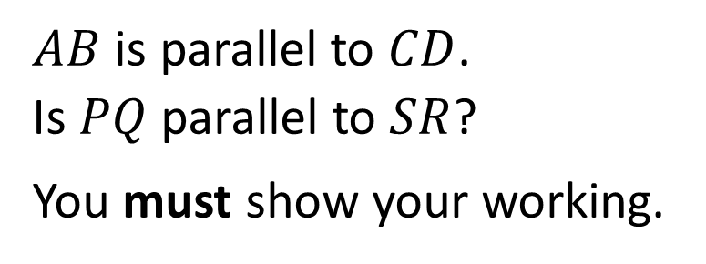
$AB$ is parallel to $CD$.
Is $PQ$ parallel to $SR$?
You must show your working.

Slide 10
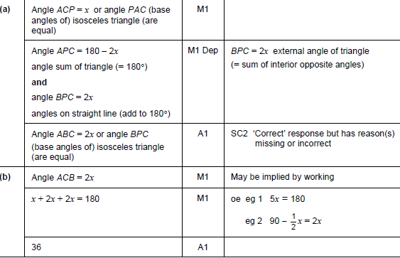
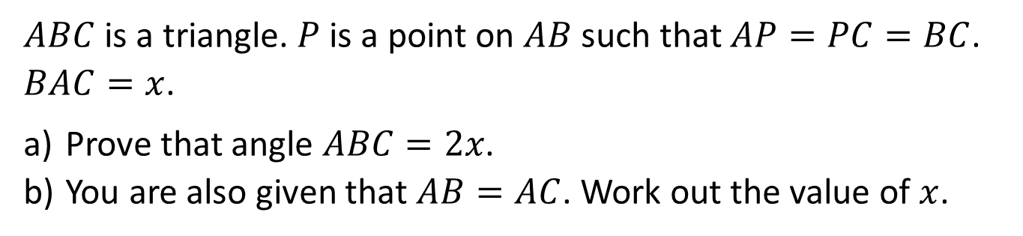
$ABC$ is a triangle. $P$ is a point on $AB$ such that $AP=PC=BC$. $BAC=x$.
Prove that angle $ABC=2x$.
You are also given that $AB=AC$. Work out the value of $x$.

