Slide 1
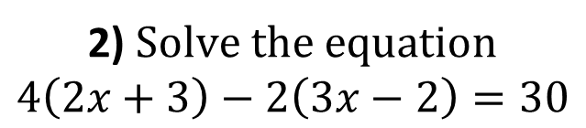
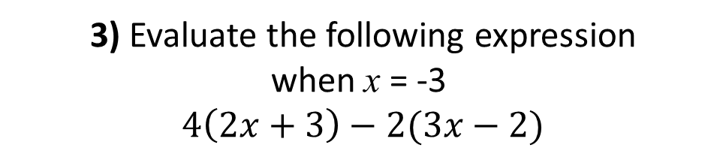
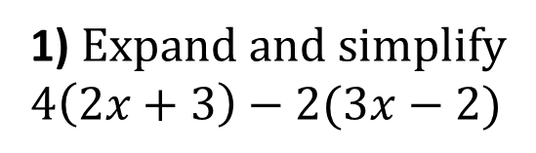

1) $Expand and simplify$
$$4\left(2x+3\right)−2(3x−2)$$
2) $Solve the equation$
$$4\left(2x+3\right)−2\left(3x−2\right)=30$$
3) Evaluate the following expression
when x = -3
$$4\left(2x+3\right)−2(3x−2)$$
4) Solve the equation
$$4\left(2x+3\right)−2\left(3x−2\right)=3x$$

Slide 2
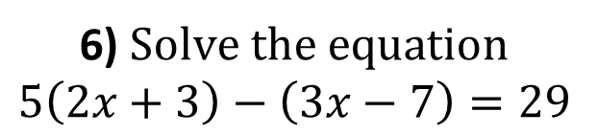
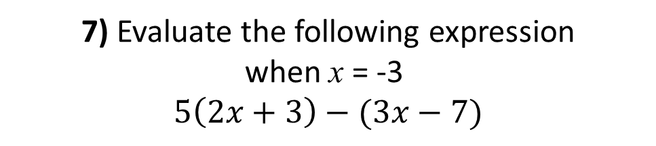
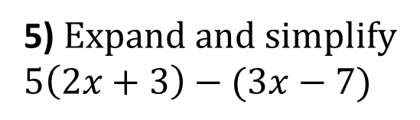

5) $Expand and simplify$
$$5\left(2x+3\right)−(3x−7)$$
6) $Solve the equation$
$$5\left(2x+3\right)−\left(3x−7\right)=29$$
7) Evaluate the following expression
when x = -3
$$5\left(2x+3\right)−(3x−7)$$
8) Solve the equation
$$5\left(2x+3\right)−\left(3x−7\right)=3x$$

Slide 3
ANSWERS

Slide 4
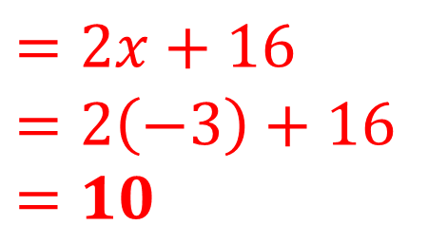




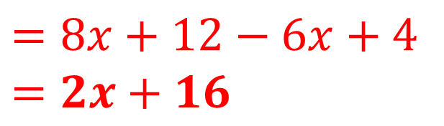
1) $Expand and simplify$
$$4\left(2x+3\right)−2(3x−2)$$
2) $Solve the equation$
$$4\left(2x+3\right)−2\left(3x−2\right)=30$$
$$2x+16=30$$
$$=8x+12−6x+4$$
$$=2x+16$$
$$x=7$$
3) Evaluate the following expression
when x = -3
$$4\left(2x+3\right)−2(3x−2)$$
4) Solve the equation
$$4\left(2x+3\right)−2\left(3x−2\right)=3x$$
$$2x+16=3x$$
$$=2x+16$$
$$=2\left(−3\right)+16$$
$$=10$$
$$16=x$$

Slide 5
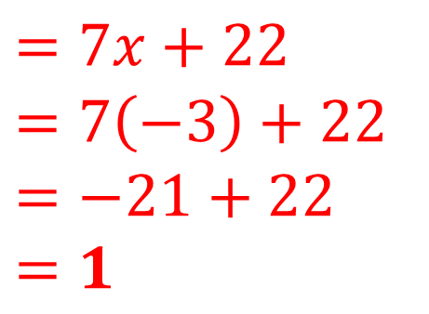





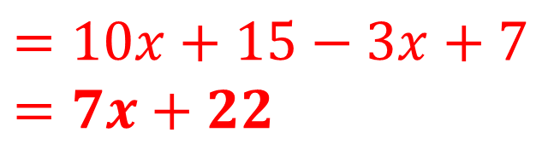
5) $Expand and simplify$
$$5\left(2x+3\right)−(3x−7)$$
6) $Solve the equation$
$$5\left(2x+3\right)−\left(3x−7\right)=29$$
$$7x+22=29$$
$$=10x+15−3x+7$$
$$=7x+22$$
$$x=1$$
7) Evaluate the following expression
when x = -3
$$5\left(2x+3\right)−(3x−7)$$
8) Solve the equation
$$5\left(2x+3\right)−\left(3x−7\right)=3x$$
$$7x+22=3x$$
$$=7x+22$$
$$=7\left(−3\right)+22$$
$$=−21+22$$
$$=1$$
$$22=−4x$$
$$x=−5.5$$

