Slide 1
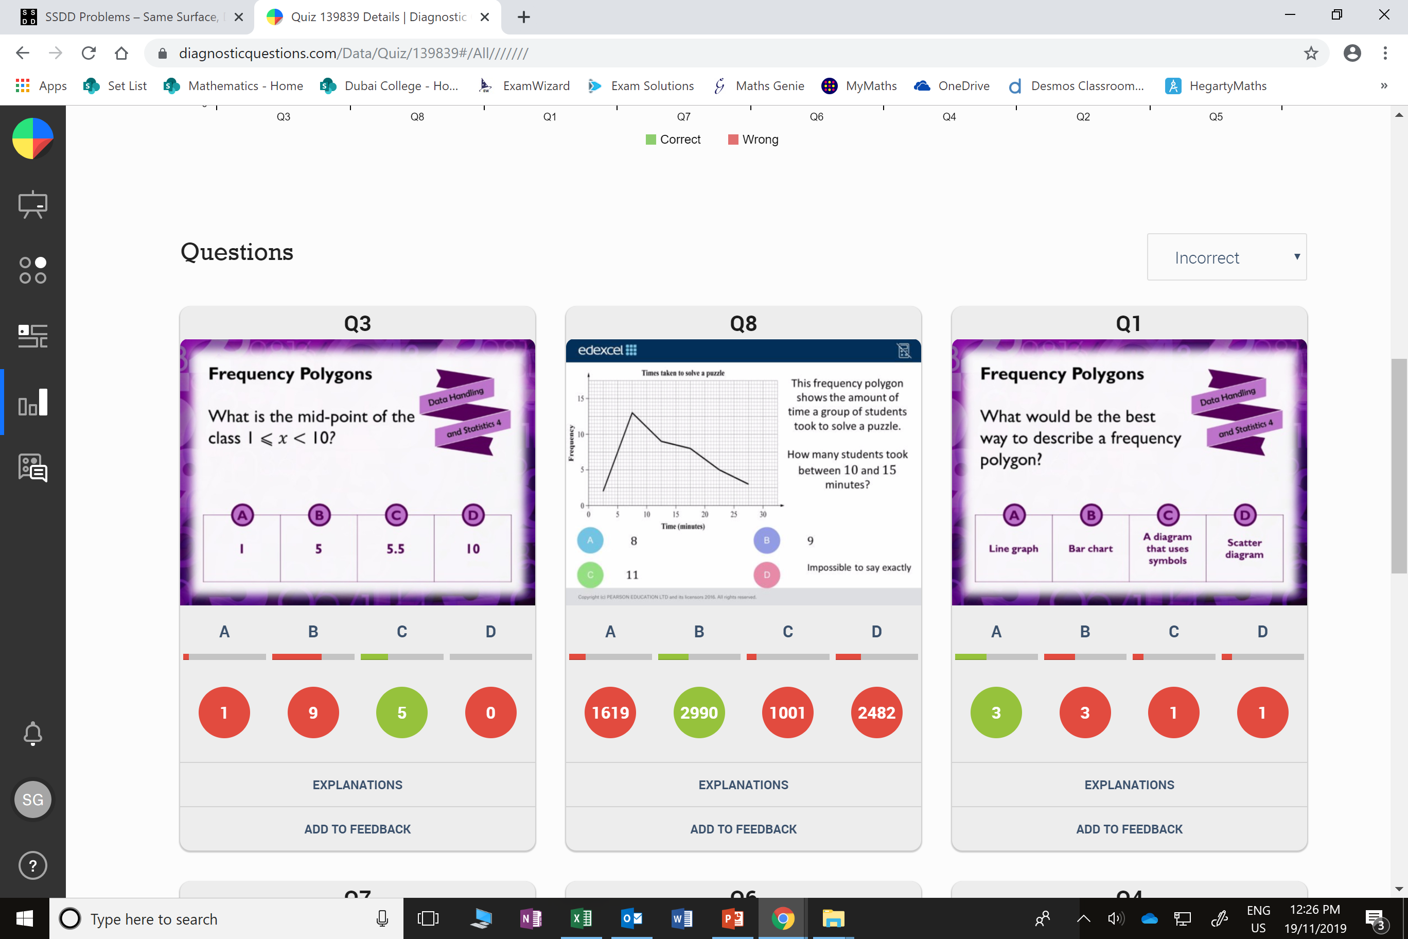
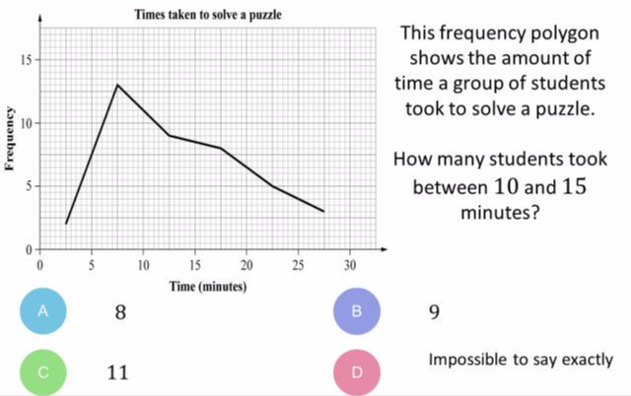
Which question had the lowest percentage of
correct answers?
For each question, what was the most common
wrong answer?

Slide 2
ANSWERS

Slide 3
Which question had the lowest percentage of
correct answers?

Slide 4
B
They halved 10 rather than 11.

Slide 5
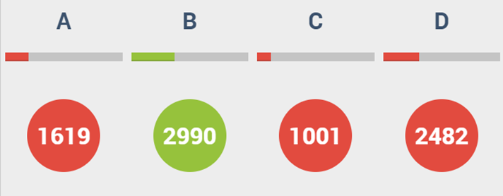
D
The students may not understand how a frequency polygon works.

