Slide 1
FM: Rearranging Formula
(with factorising)

Slide 2
Is x the subject of the formula?
x = y + ax
x = y + ax
No

Slide 3
Make x the subject of the formula.
x = y + ax
x = y + ax
What makes this question tricky?

Slide 4
What do you do with multiple subjects?
- get all the subjects on one side
- factorise out the subject
- take the bracket across and divide

Slide 5
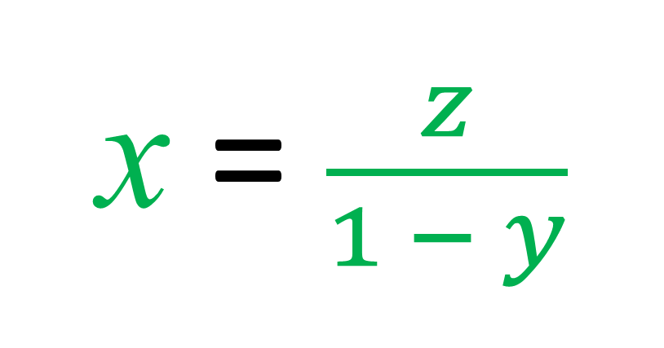
x = xy + z
Make x the subject
x – xy = z
x(1 – y) = z
x = $\frac{z}{1 − y}$

Slide 6
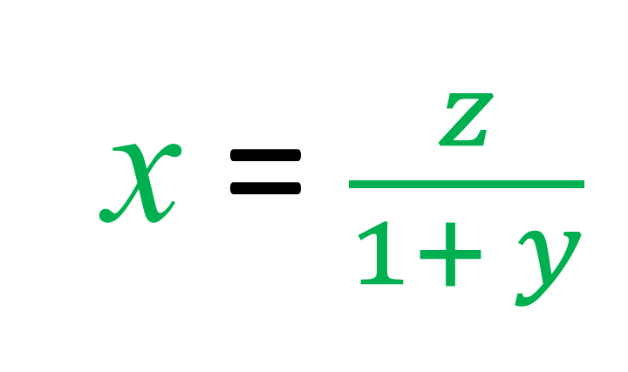
x = z – xy
Make x the subject
x + xy = z
x(1 + y) = z
x = $\frac{z}{1+ y}$

Slide 7
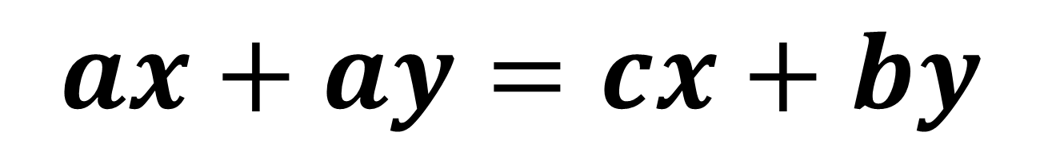
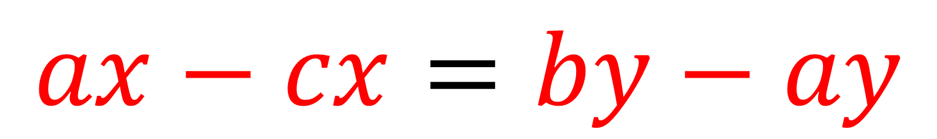
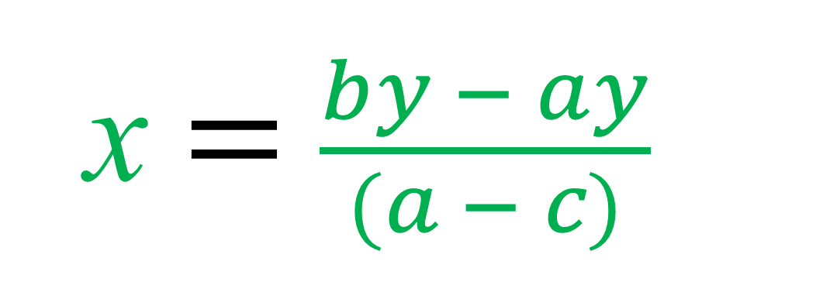
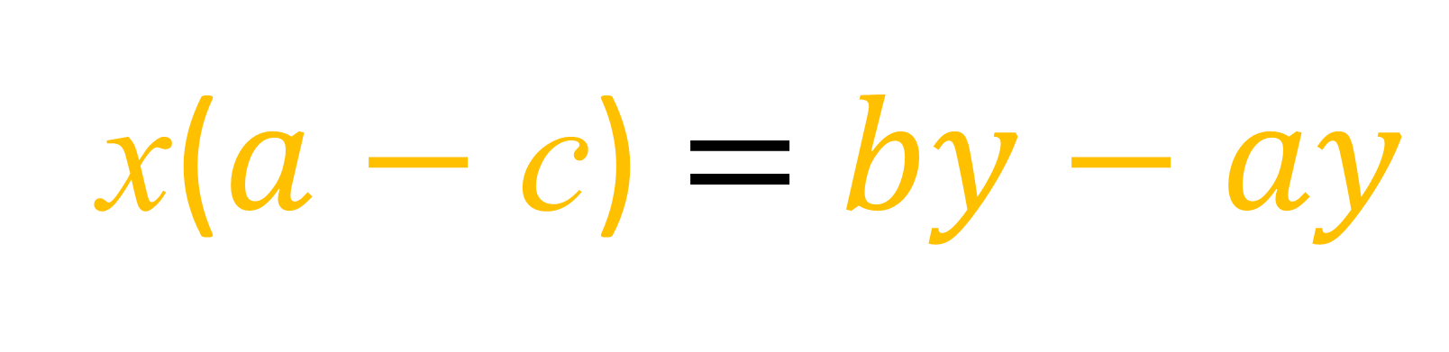
$$ax+ay=cx+by$$
Make x the subject
$$ax−cx=by−ay$$
x($a$ $−$ c) $=$ $by−ay$
x $=$ $\frac{by − ay}{(a − c)}$

Slide 8
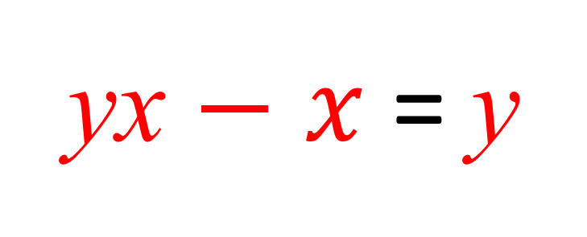
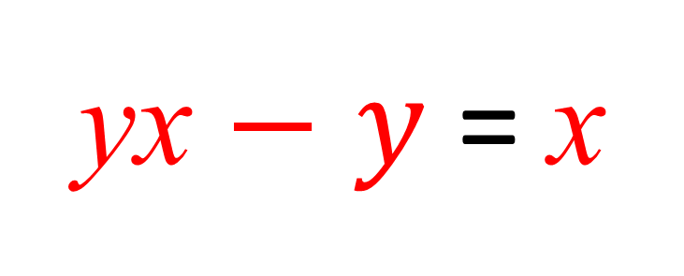
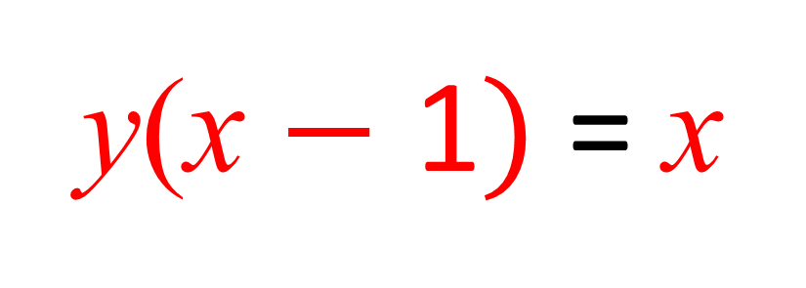
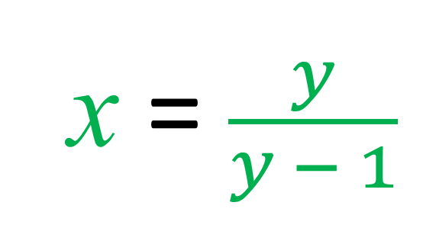
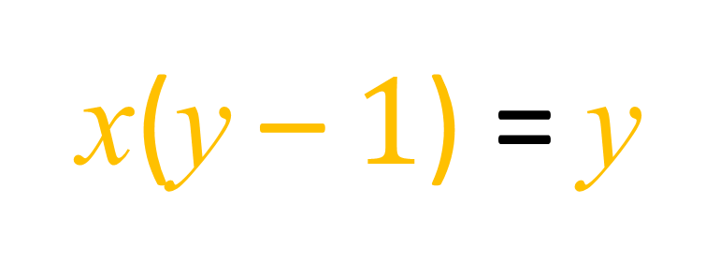
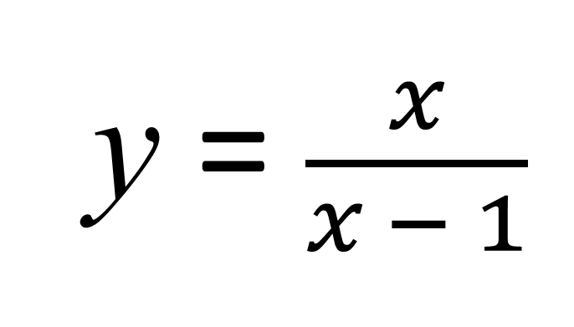
y = $\frac{x}{x − 1}$
Make x the subject
y(x $−$ 1$)$ = x
x(y – $1$) = y
yx $−$ $y$ = x
x = $\frac{y}{y − 1}$
yx $−$ $x$ = y

Slide 9
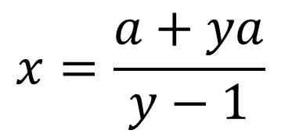
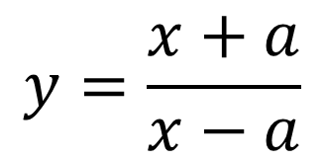

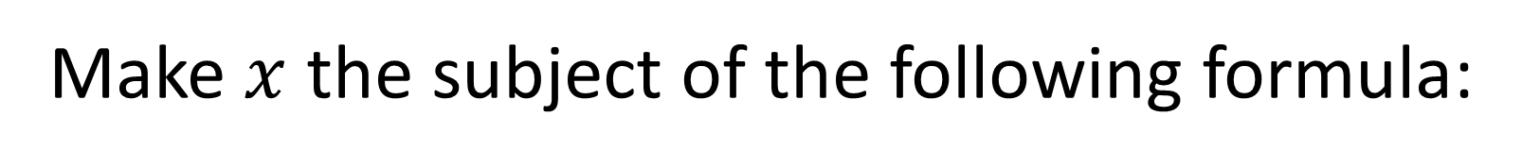



Make $x$ the subject of the following formula:
$$y=\frac{x+a}{x−a}$$
$$y\left(x−a\right)=x+a$$
$$yx−ya=x+a$$
$$yx−x=a+ya$$
$$x(y−1)=a+ya$$
$$x=\frac{a+ya}{y−1}$$

