Slide 1
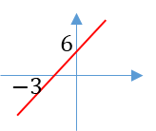

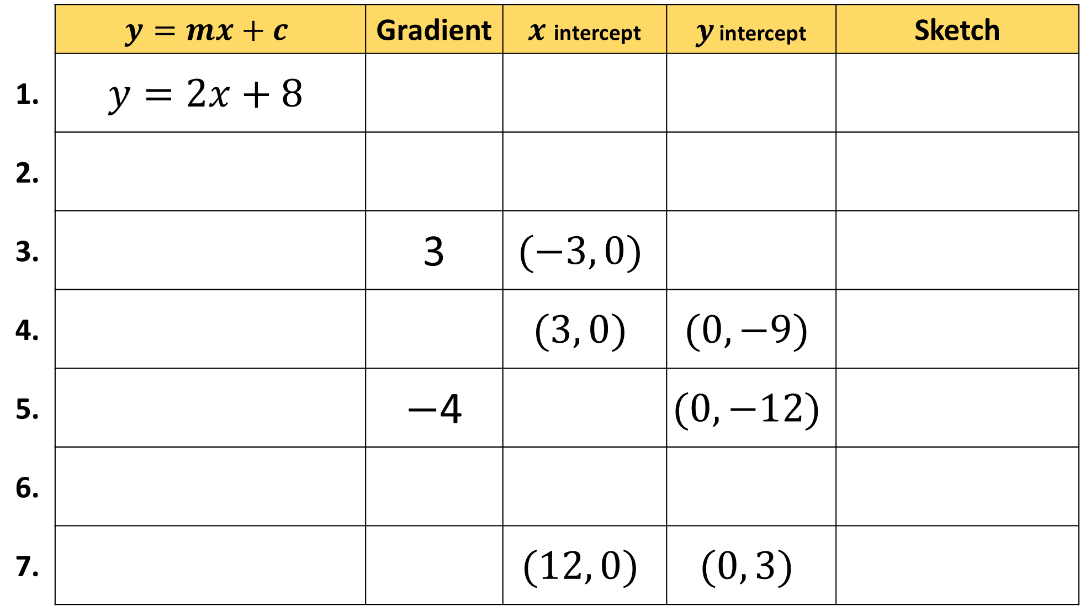

 | $$y=mx+c$$ | Gradient | $x$ intercept | $y$ intercept | Sketch
1. | $$y=2x+8$$
2.
3. |  | 3 | $$(−3, 0)$$
4. |  |  | $$(3, 0)$$ | $$(0, −9)$$
5. |  | $−$4 |  | $$(0, −12)$$
6.
7. |  |  | $$(12, 0)$$ | $$(0, 3)$$
$$12$$
$$3$$

Slide 2
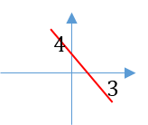
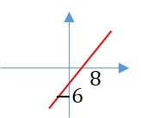
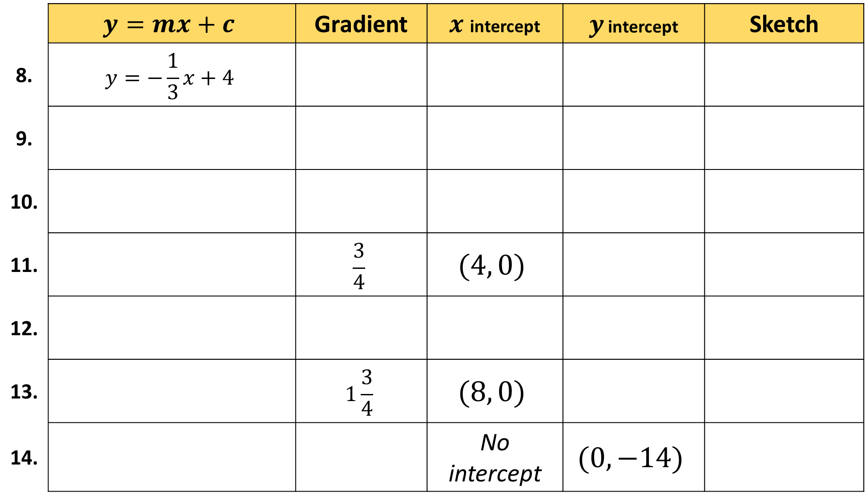

 | $$y=mx+c$$ | Gradient | $x$ intercept | $y$ intercept | Sketch
8. | $$y=−\frac{1}{3}x+4$$
9.
10.
11. |  | $$\frac{3}{4}$$ | $$(4, 0)$$
12.
13. |  | $$1\frac{3}{4}$$ | $$(8, 0)$$
14. |  |  | No intercept | $$(0, −14)$$
$$3$$
$$4$$

Slide 3
ANSWERS

Slide 4
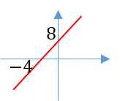
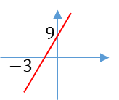
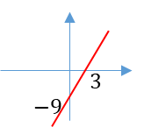
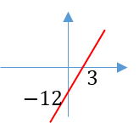
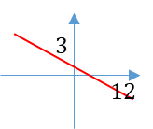
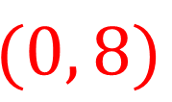
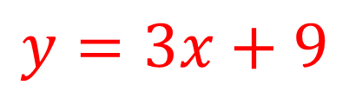
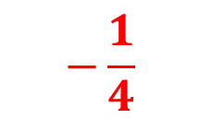
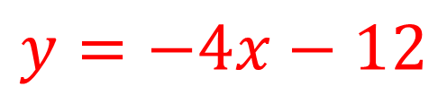
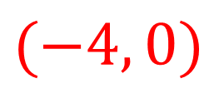
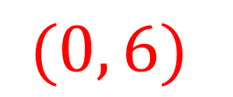
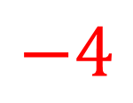

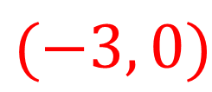
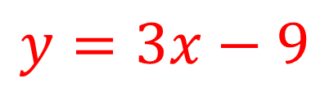
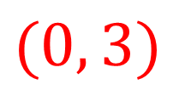



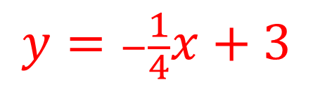
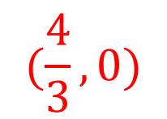
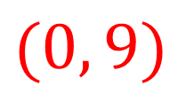
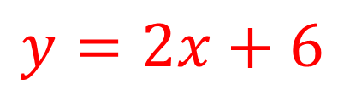
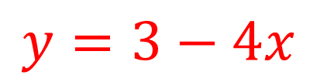
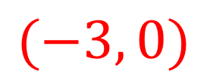
 | $$y=mx+c$$ | Gradient | $x$ intercept | $y$ intercept | Sketch
1. | $$y=2x+8$$
2.
3. |  | 3 | $$(−3, 0)$$
4. |  |  | $$(3, 0)$$ | $$(0, −9)$$
5. |  | $−$4 |  | $$(0, −12)$$
6.
7. |  |  | $$(12, 0)$$ | $$(0, 3)$$
$$2$$
$$(−4, 0)$$
$$(0, 8)$$
$$y=2x+6$$
$$2$$
$$(−3, 0)$$
$$(0, 6)$$
$$y=3x+9$$
$$(0, 9)$$
$$y=3x−9$$
$$3$$
$$y=−4x−12$$
$$(−3, 0)$$
$$y=3−4x$$
$$−4$$
$$(\frac{4}{3}, 0)$$
$$(0, 3)$$
$$12$$
$$3$$
$$y=−\frac{1}{4}x+3$$
$$−\frac{1}{4}$$

Slide 5
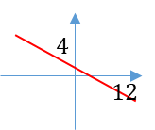
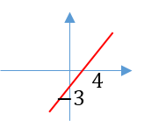
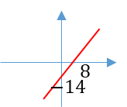
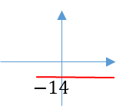
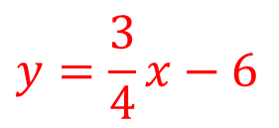
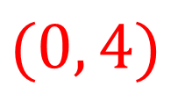
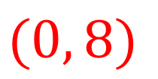
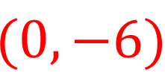
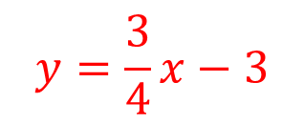
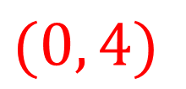
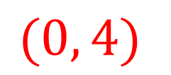
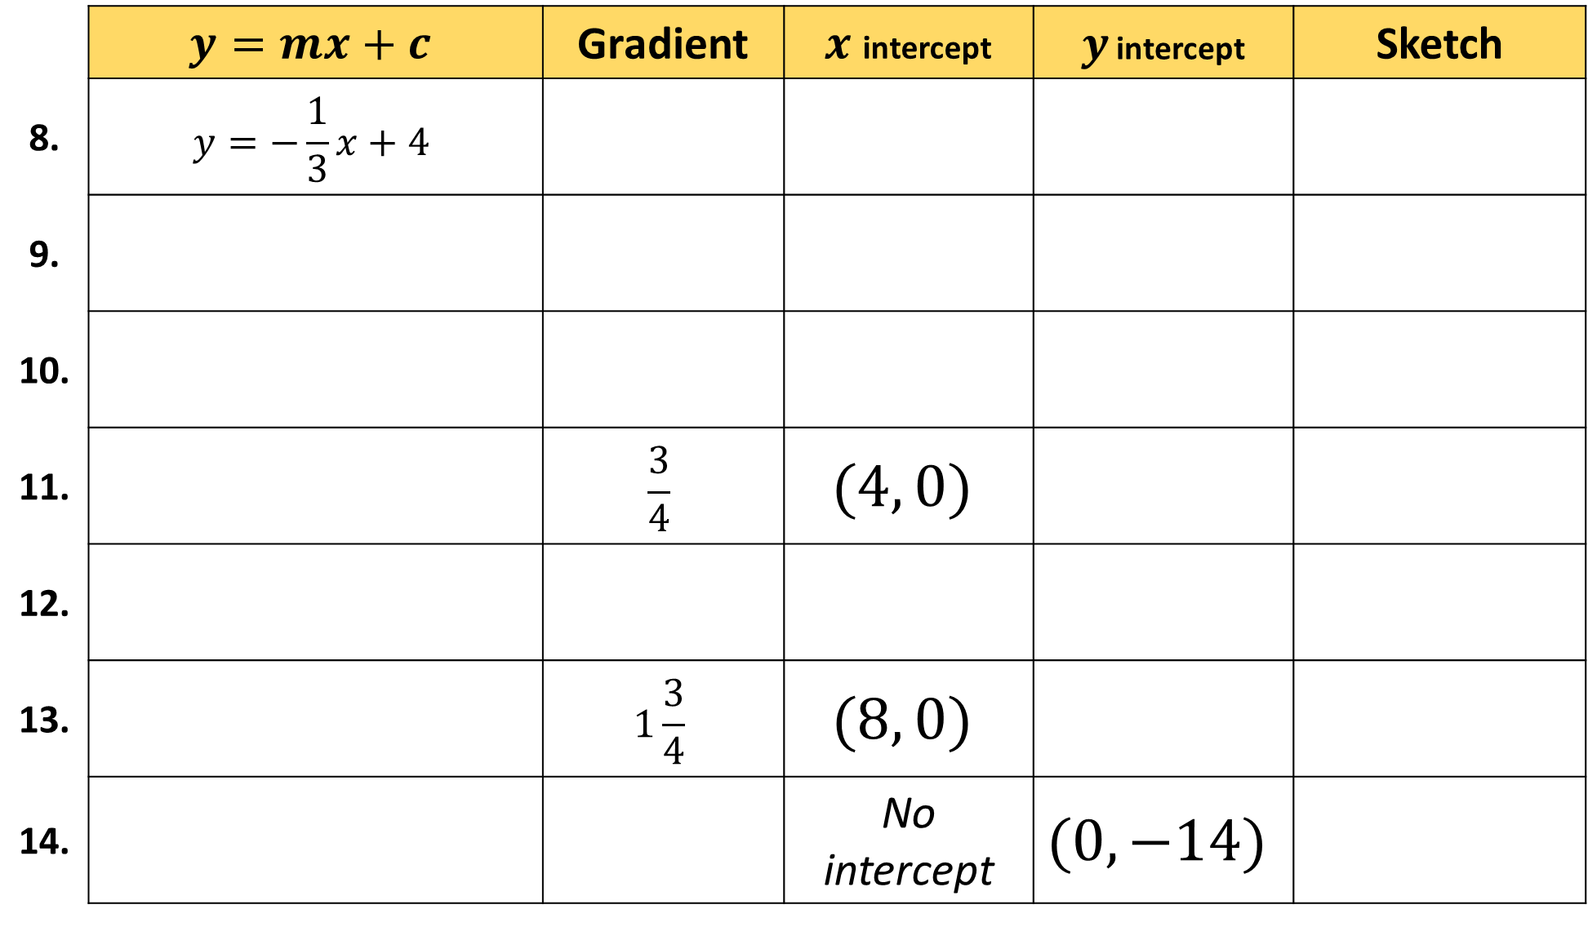
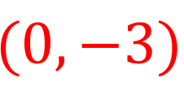
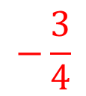
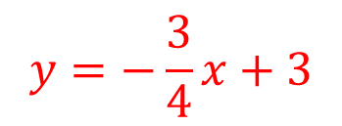
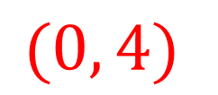
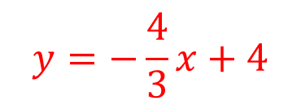
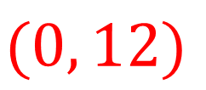
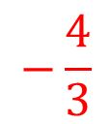

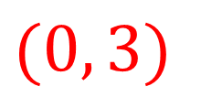


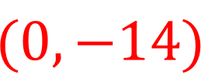
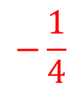
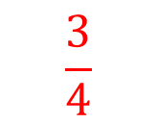
 | $$y=mx+c$$ | Gradient | $x$ intercept | $y$ intercept | Sketch
8. | $$y=−\frac{1}{3}x+4$$
9.
10.
11. |  | $$\frac{3}{4}$$ | $$(4, 0)$$
12.
13. |  | $$1\frac{3}{4}$$ | $$(8, 0)$$
14. |  |  | No intercept | $$(0, −14)$$
$$−\frac{1}{4}$$
$$(0, 12)$$
$$(0, 4)$$
$$y=−\frac{4}{3}x+4$$
$$−\frac{4}{3}$$
$$(0, 4)$$
$$(0, 4)$$
$$y=−\frac{3}{4}x+3$$
$$−\frac{3}{4}$$
$$(0, 4)$$
$$(0, 3)$$
$$3$$
$$4$$
$$y=\frac{3}{4}x−3$$
$$(0, −3)$$
$$y=\frac{3}{4}x−6$$
$$\frac{3}{4}$$
$$(0, 8)$$
$$(0, −6)$$
$$y=1.75x−14$$
$$(0, −14)$$
$$y=−14$$
$$0$$

