Slide 1
LO: Frustums

Slide 2
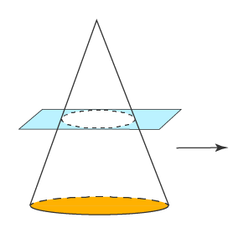
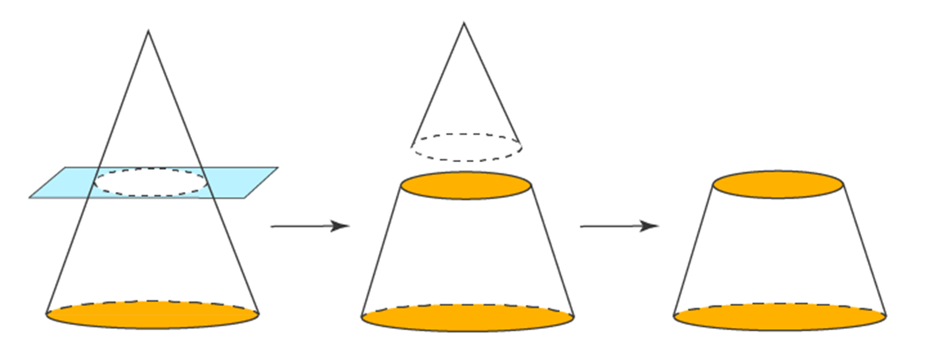
A frustum is a Pyramid that has a cut off.
Pyramid
Cut in two
Frustum

Slide 3
To calculate the volume of the frustum you need
to know the height of the original pyramid.
Can you calculate x?
Hint: Ratio
x + 5 6
x 4
x
=
x
4x + 20
=
6x
4cm
Original Cone
=
5cm
x
2x
20
Small Cone
5cm
x
=
10
6cm
6cm
4cm

Slide 4
Calculate the volume of the frustum.
Give you answer to the nearest whole number.
Big Cone
V = ¹/₃ x π x 6² x 15
V = 180π
10cm
Small Cone
V = ¹/₃ x π x 4² x 10
4cm
V = ¹⁶⁰/₃ ^{π}
5cm
Frustum
6cm
V = 180π - ^{160π}/₃
V = 398 cm³

Slide 5
Calculate the volume of the frustum.
Give you answer in terms of π.
Find x
x 5
x + 9 8
=
8x
=
5x + 45
xcm
3x
=
45
3x
=
15
Big Cone
5cm
V = ¹/₃ x π x 8² x 24
V = 512π
9cm
Frustum
Small Cone
8cm
V = 512π - 125π
V = ¹/₃ x π x 5² x 15
V = 387π cm³
V = 125π

