Slide 1

Mobile Phone Investigation

Slide 2
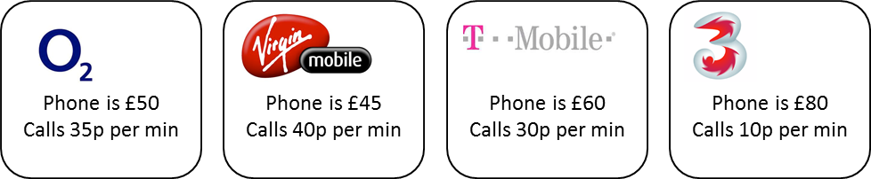
Which is the best mobile phone package?

Slide 3
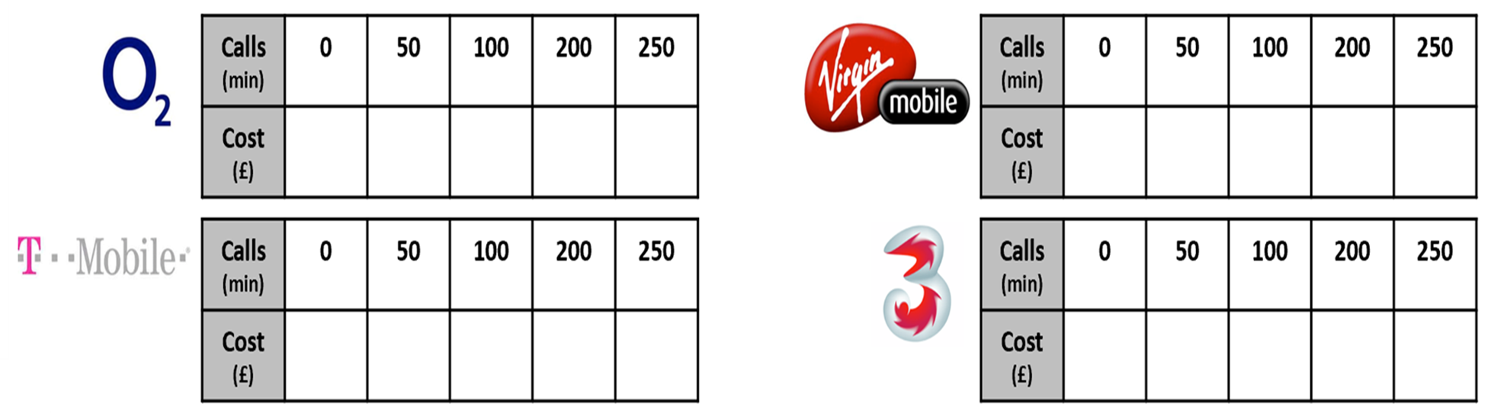
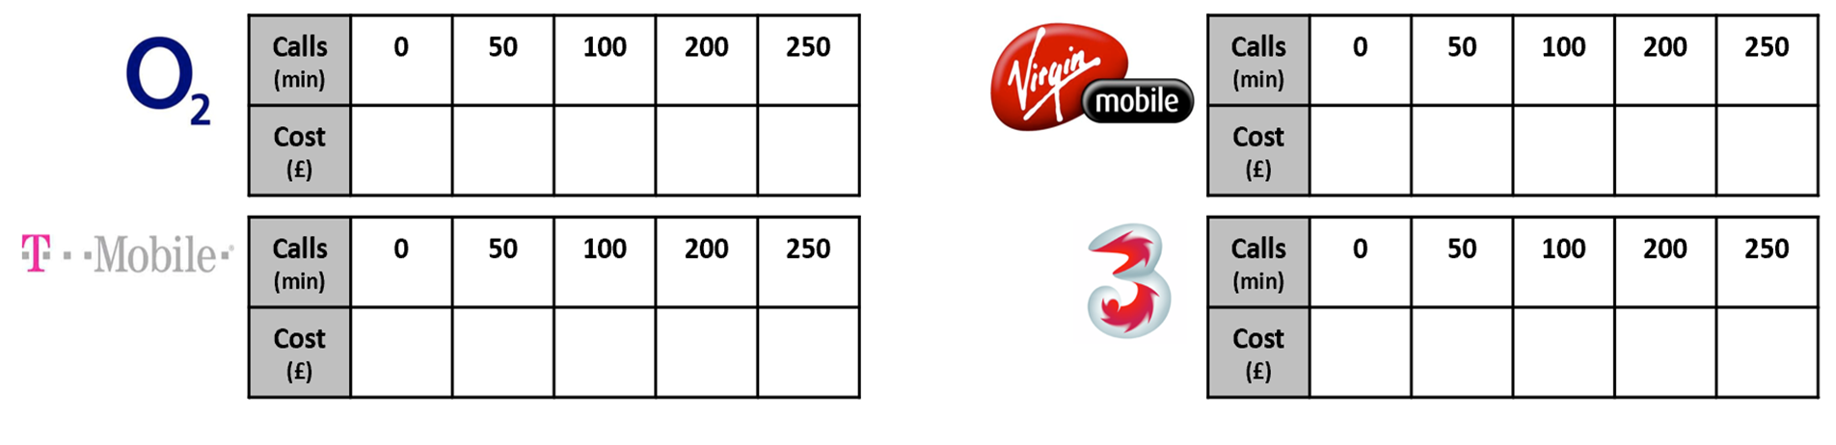
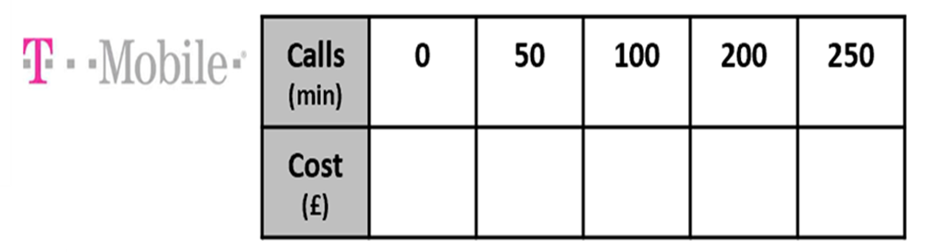
Complete the tables.

Slide 4
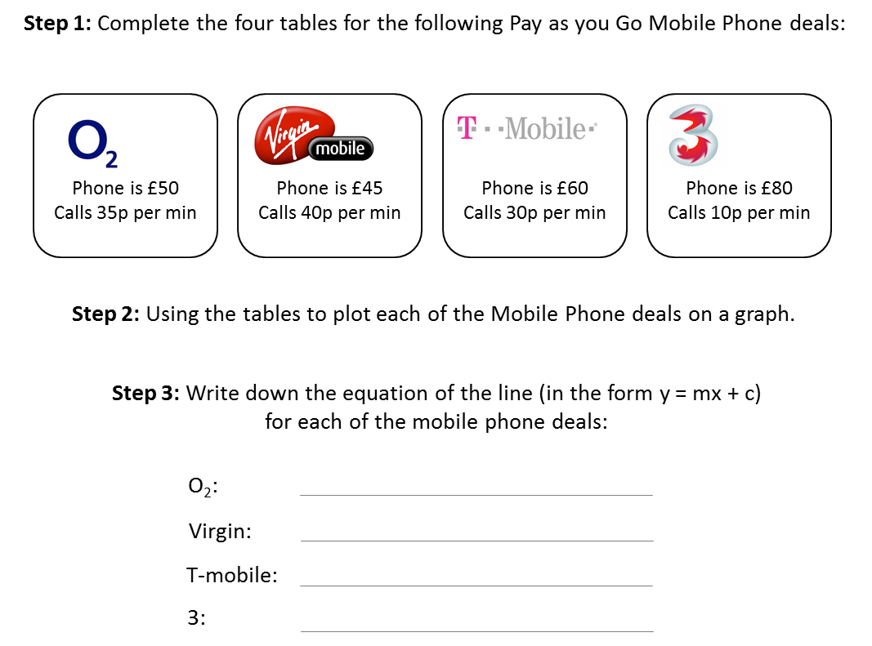
Write an equation for each
mobile phone deal.

Slide 5
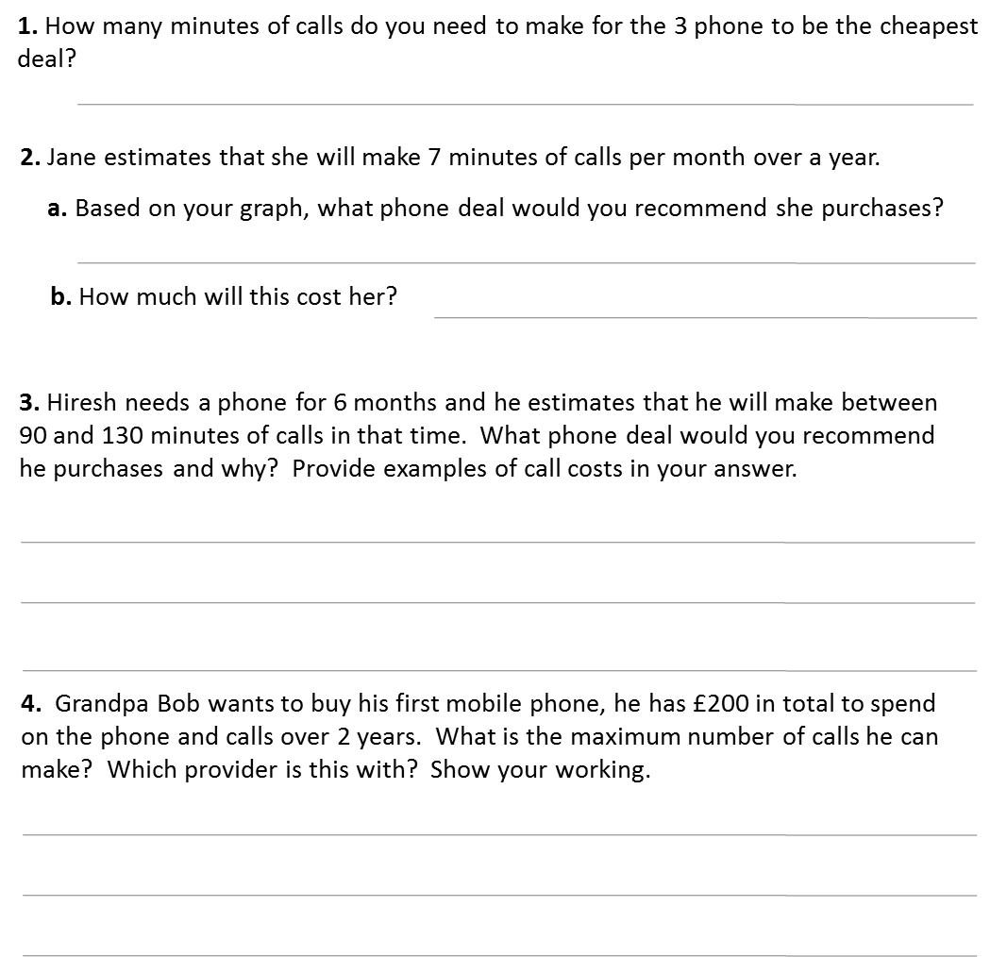
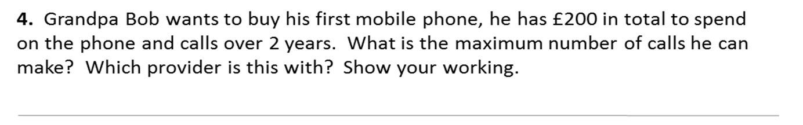

Slide 6
Answers

Slide 7
Complete the tables.
50 | 67.5 | 85 | 120 | 137.5
45 | 65 | 85 | 125 | 145
60 | 75 | 90 | 120 | 135
80 | 85 | 90 | 100 | 105

Slide 8
Write an equation for each
mobile phone deal.
C = 0.35m + 50
C = 0.4m + 45
C = 0.3m + 60
C = 0.1m + 80

Slide 9
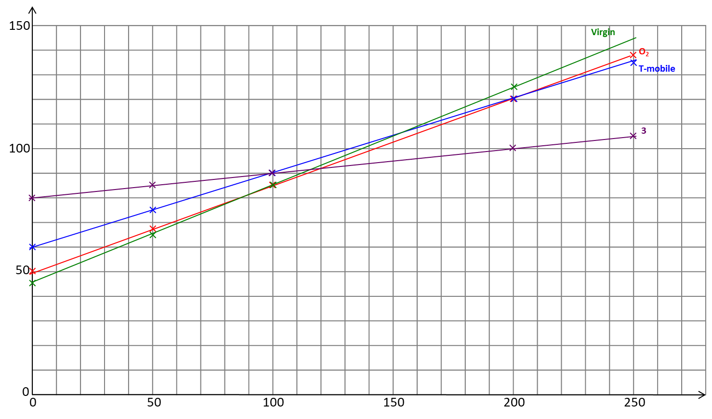
Cost (£)
Calls (minutes)

Slide 10
120 minutes or more
Virgin mobile
£78.60

Slide 11
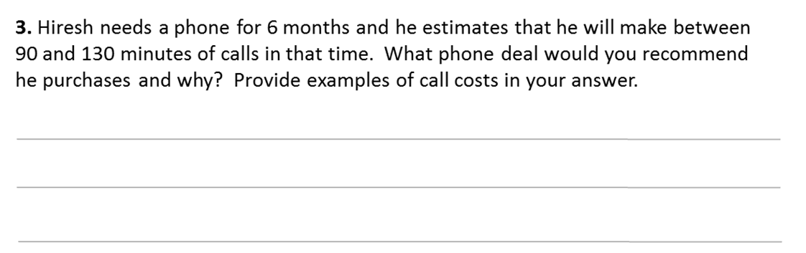
90 mins to 100 mins Virgin mobile
100 mins to 120 mins O2
120 mins or more Three
02 = 426.6 mins Virgin Mobile = 387.5 mins
T Mobile = 466.7 mins Three = 1200 mins

