Slide 1
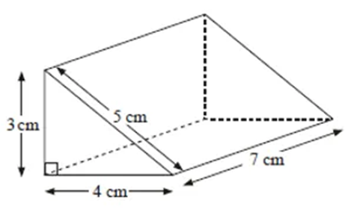
1) Work out the volume of the triangular prism.
Give your answer in cm³.
2) Work out the surface area of the triangular prism.
3) Work out the volume of the triangular prism.
Give your answer in mm³.
4) Sketch the net of the triangular prism.

Slide 2
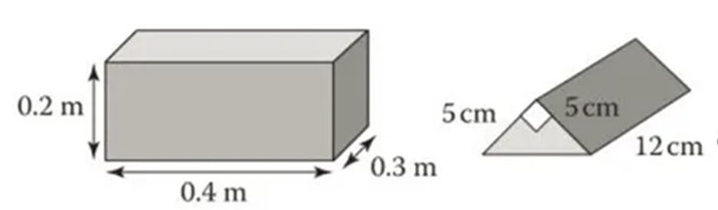
5) Find the ratio of the volumes, in its simples terms.
6) How much bigger, by volume, is the cuboid compared to the triangular prism?
7) A metal cuboid is melted and made into triangular prisms.
How many prisms can be made?
8) How many times bigger is the volume of the triangular prism compared to the volume of the cuboid?

Slide 3
ANSWERS

Slide 4
1) Work out the volume of the triangular prism.
Give your answer in cm³.
2) Work out the surface area of the triangular prism.
Triangles = 6 + 6
Bottom = 28
Back = 21
Front = 35
(½ x 3 x 4) x 7 = 42 cm³
Total Surface Area = 96 cm²
3) Work out the volume of the triangular prism.
Give your answer in mm³.
4) Sketch the net of the triangular prism.
(½ x 30 x 40) x 70 = 42 000 mm³

Slide 5
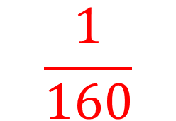
5) Find the ratio of the volumes, in its simples terms.
6) How much bigger, by volume, is the cuboid compared to the triangular prism?
20 x 40 x 30 = 24000 cm³
160 times bigger
½ x 5 x 5 x 12 = 150 cm³
24000 : 150
160 : 1
7) A metal cuboid is melted and made into triangular prisms.
How many prisms can be made?
8) How many times bigger is the volume of the triangular prism compared to the volume of the cuboid?
$$\frac{1}{160}$$
160

