Slide 1
Sequences and Series
Sum of Geometric Series
Chapter 3
(Part 4 of 8)

Slide 2
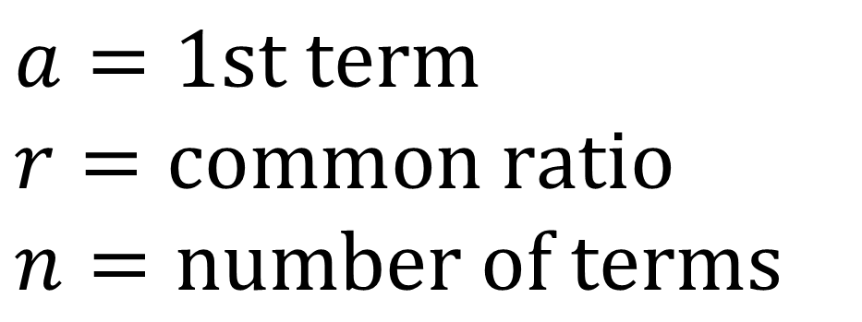
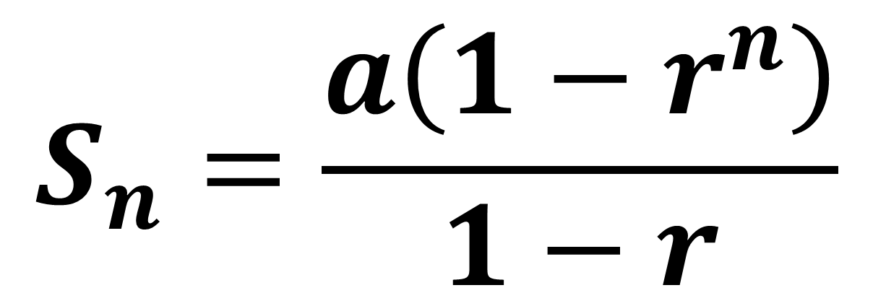
Geometric Series
$$S_{n}=\frac{a\left(1−r^{n}\right)}{1−r}$$
$$a=1st term$$
$$r=common ratio$$
$$n=number of terms$$

Slide 3
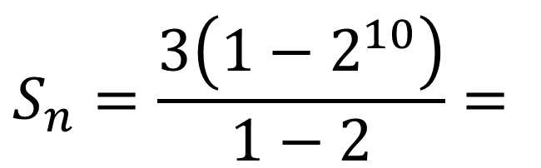
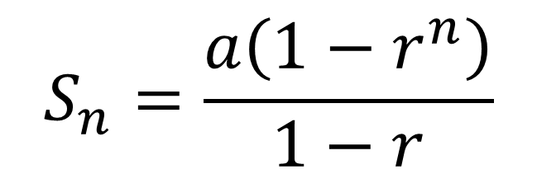
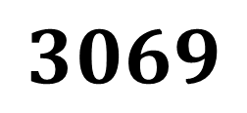

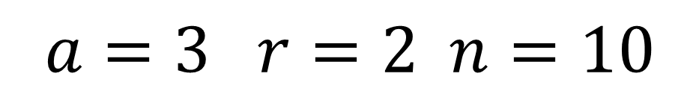
Find the sum of the first 10 terms.
$$3, 6, 12, 24, 48, …$$
$$a=3 r=2 n=10$$
$$S_{n}=\frac{a\left(1−r^{n}\right)}{1−r}$$
$$S_{n}=\frac{3\left(1−2^{10}\right)}{1−2}=$$
$$3069$$

Slide 4
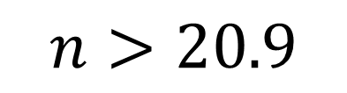
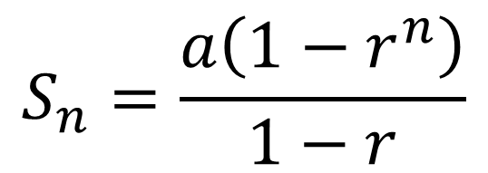
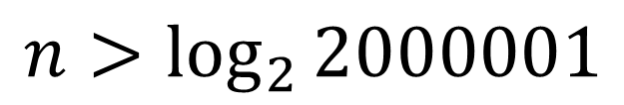
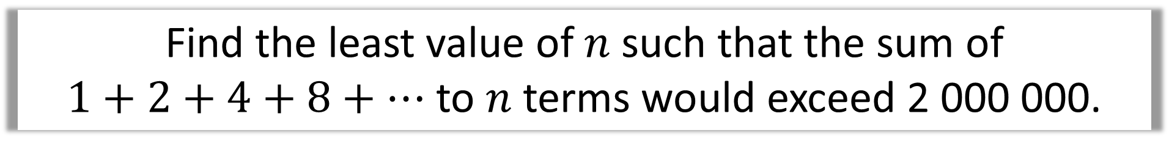
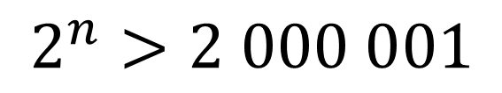
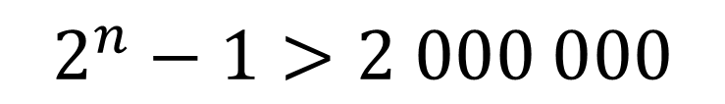
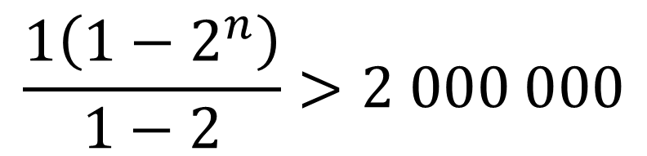
Find the least value of $n$ such that the sum of
$1+2+4+8+…$ to $n$ terms would exceed 2 000 000.
$$S_{n}=\frac{a\left(1−r^{n}\right)}{1−r}$$
$$2^{n}>2 000 001$$
$$n>\log_{2}{2000001}$$
$$\frac{1\left(1−2^{n}\right)}{1−2}>2 000 000$$
$$n>20.9$$
21 terms needed.
$$2^{n}−1>2 000 000$$

Slide 5
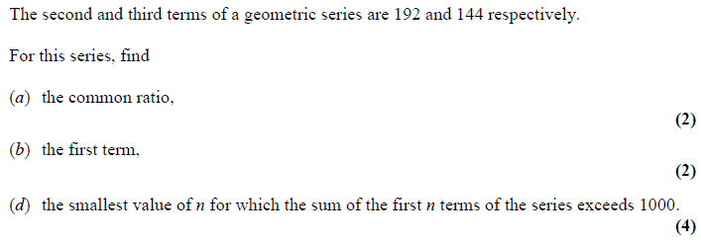

Slide 6
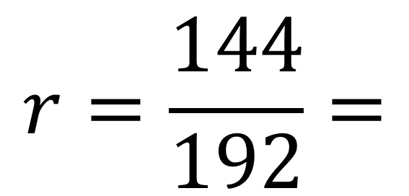
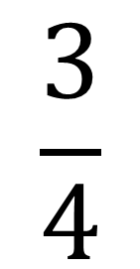
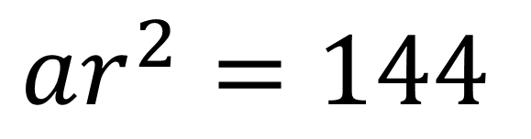
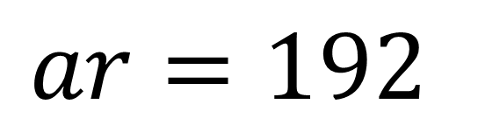
$$ar^{2}=144$$
$$ar=192$$
$$r=\frac{144}{192}=$$
$$\frac{3}{4}$$

Slide 7
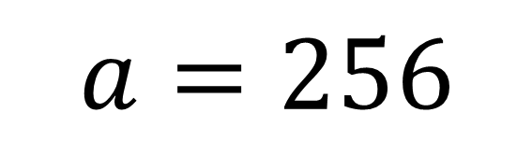
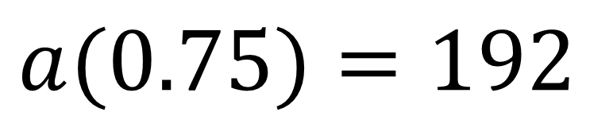
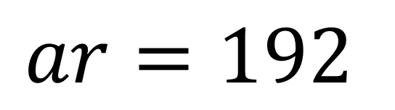
$$ar=192$$
$$a(0.75)=192$$
$$a=256$$

Slide 8
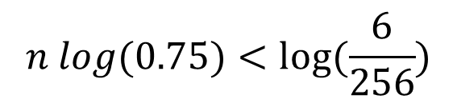
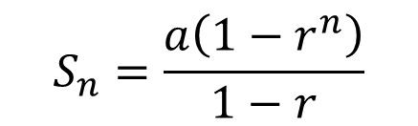
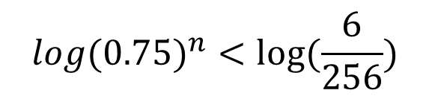

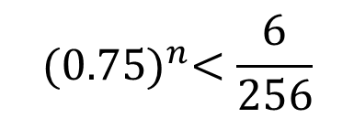
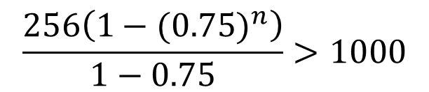

$${(0.75)}^{n}<\frac{6}{256}$$
$$S_{n}=\frac{a\left(1−r^{n}\right)}{1−r}$$
$$n>13$$
$${log(0.75)}^{n}<log⁡(\frac{6}{256})$$
$$n=14$$
$$\frac{256\left(1−{(0.75)}^{n}\right)}{1−0.75}>1000$$
$$n log(0.75)<log⁡(\frac{6}{256})$$

Slide 9
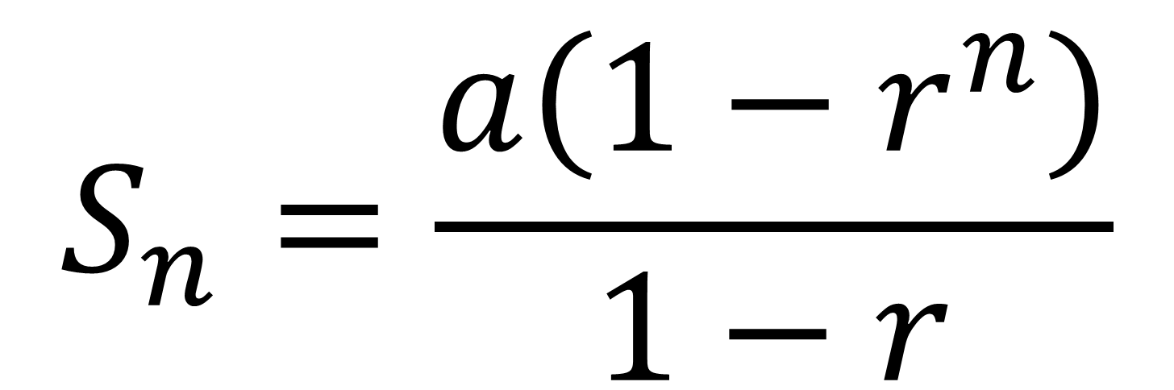
Geometric Series - Proof
$$S_{n}=\frac{a\left(1−r^{n}\right)}{1−r}$$

Slide 10

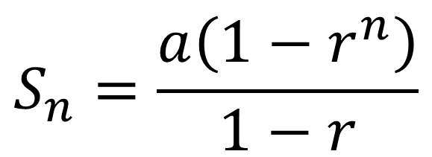
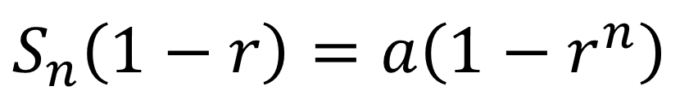
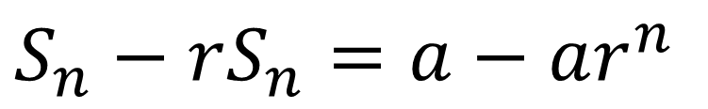
$$S_{n} =a+ar+ar^{2}+…+ar^{n−2}+ar^{n−1}$$
Multiplying by $r$
$$rS_{n}= ar+ar^{2}+… + ar^{n−2}+ar^{n−1}+ar^{n}$$
Subtracting
$$S_{n}−rS_{n}=a−ar^{n}$$
$$S_{n}\left(1−r\right)=a\left(1−r^{n}\right)$$
$$S_{n}=\frac{a\left(1−r^{n}\right)}{1−r}$$

