Slide 1
Sketching Graphs
Points of Intersection
Chapter 4
(Part 4 of 5)

Slide 2
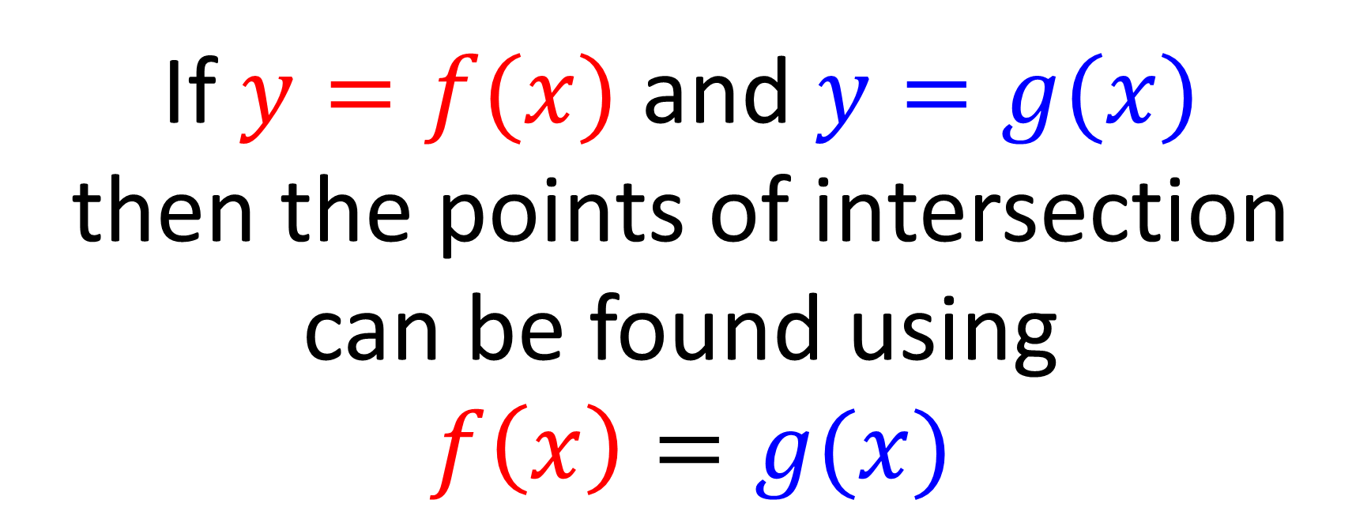
Points of Intersection
If $y=f(x)$ and $y=g(x)$
then the points of intersection
can be found using
$f\left(x\right)=g(x)$

Slide 3

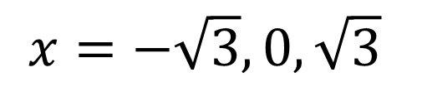


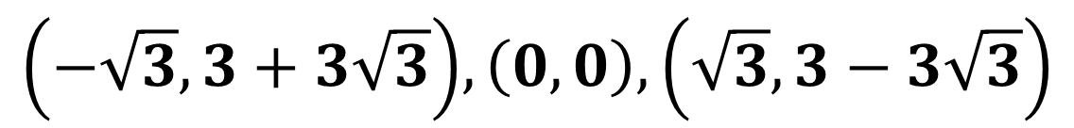




$y=x(x−3)$ and $y=x^{2}\left(1−x\right)$.
Find the coordinates of their points of intersection.
$$y$$
$$x\left(x−3\right)=x^{2}\left(1−x\right)$$
$$x^{2}−3x=x^{2}−x^{3}$$
$$x^{3}−3x=0$$
$${x(x}^{2} − 3)=0$$
1
3
$$x$$
$$x=−\sqrt{3}, 0, \sqrt{3}$$
$$\left(−\sqrt{3}, 3+3\sqrt{3}\right), \left(0,0\right), \left(\sqrt{3}, 3−3\sqrt{3}\right)$$

Slide 4

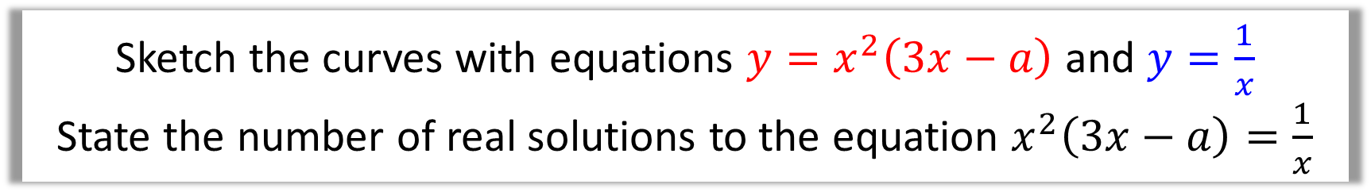

Sketch the curves with equations $y=x^{2}\left(3x−a\right)$ and $y=\frac{1}{x}$
State the number of real solutions to the equation $x^{2}\left(3x−a\right)=\frac{1}{x}$
$$y$$
$$x$$
There are 2 points of intersection, thus 2 solutions to this equation.

Slide 5


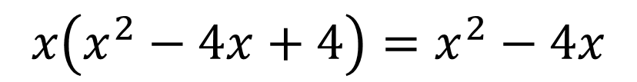
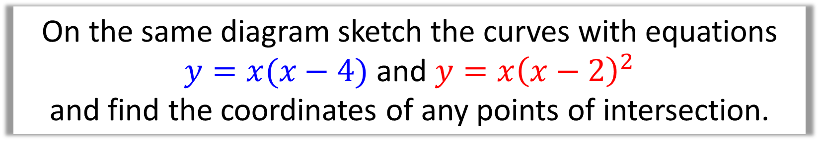

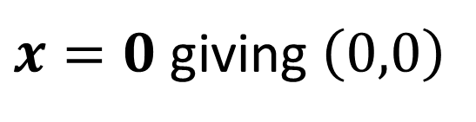
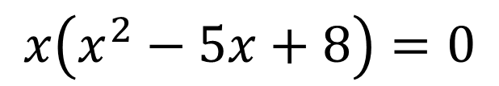


On the same diagram sketch the curves with equations
$y=x(x−4)$ and $y=x{\left(x−2\right)}^{2}$
and find the coordinates of any points of intersection.
$$y$$
$$x{\left(x−2\right)}^{2}=x\left(x−4\right)$$
$$x\left(x^{2}−4x+4\right)=x^{2}−4x$$
$$x^{3}−4x^{2}+4x=x^{2}−4x$$
$$x^{3}−5x^{2}+8x=0$$
2
4
$$x$$
$$x\left(x^{2}−5x+8\right)=0$$
$x=0$ giving $\left(0,0\right)$
The discriminant of $x^{2}−5x+8$ is $−7$, thus no further solutions.

