Slide 1
FM: Differentiation

Slide 2
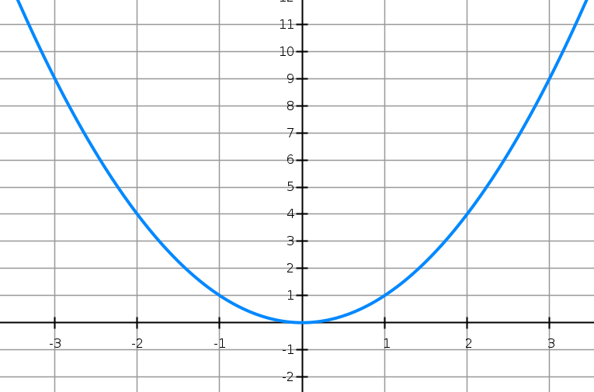
What is the gradient of the curve?
It is different at any given point.

Slide 3
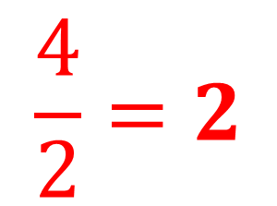
The gradient at any given point is given by
the tangent at that point
$$\frac{4}{2}=2$$
What is the gradient of the tangent when x = 1?

Slide 4







What things do you notice about the gradients?
$$m=−6$$
$$m=6$$
$$m=−4$$
$$m=4$$
$$m=−2$$
$$m=2$$
$$m=0$$

Slide 5





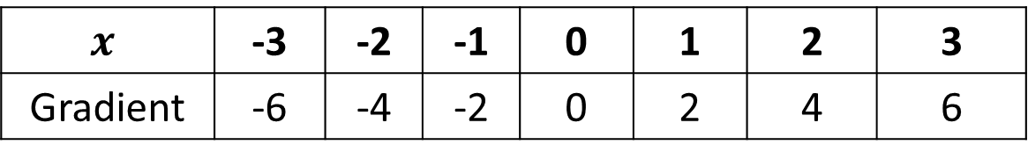

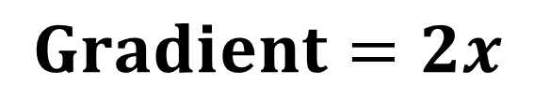

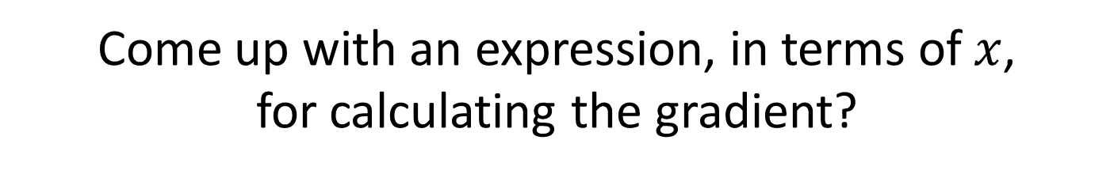

$$y=x^{2}$$
$$m=−6$$
$$m=6$$
$$m=−4$$
$$m=4$$
$$m=−2$$
$$m=2$$
$$m=0$$
$$x$$ | -3 | -2 | -1 | 0 | 1 | 2 | 3
Gradient | -6 | -4 | -2 | 0 | 2 | 4 | 6
Come up with an expression, in terms of $x$,
for calculating the gradient?
$$Gradient=2x$$

Slide 6
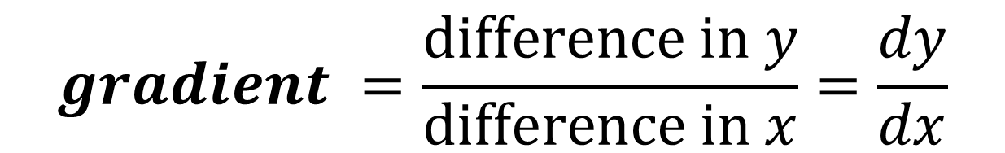





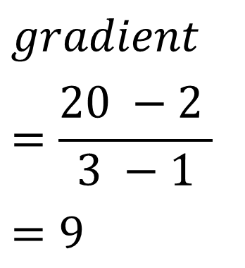
Gradient of the Tangent.
$$\left(3,20\right)$$
$$gradient$$
$$=\frac{20 −2 }{3 −1}$$
$$=9$$
$$18$$
$$y=x^{2}$$
$$\left(1,2 \right)$$
$$2$$
$$gradient =\frac{difference in y}{difference in x}=\frac{dy}{dx}$$

Slide 7
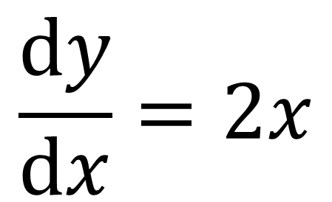
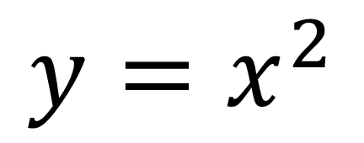
Differentiating is the process of taking
the equation of the curve and coming up with a formula
that calculates the gradient of the curve, at any given point.
$$y=x^{2}$$
$$\frac{dy}{dx}=2x$$

Slide 8
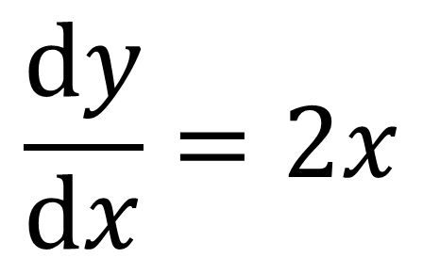
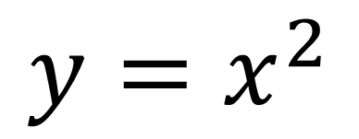
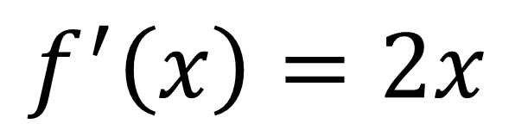
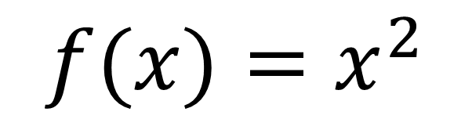
Possible notation.
$$y=x^{2}$$
$$f(x)=x^{2}$$
$$\frac{dy}{dx}=2x$$
$$f^{′}\left(x\right)=2x$$

Slide 9
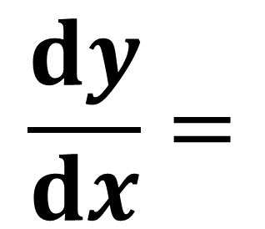
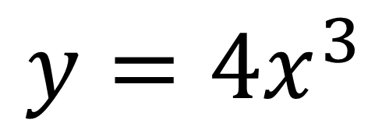
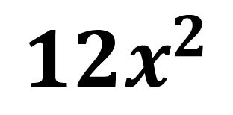
Step 1: Multiply the term by the original power
Step 2: Subtract 1 from the power
$$y={4x}^{3}$$
$$\frac{dy}{dx}=$$
$${12x}^{2}$$

Slide 10
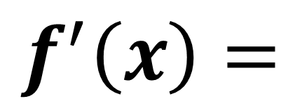
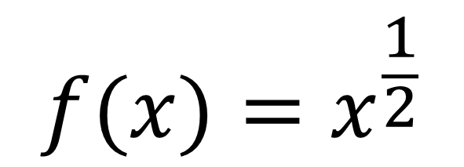
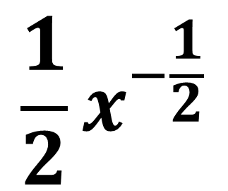
Step 1: Multiply the term by the original power
Step 2: Subtract 1 from the power
$$f(x)=x^{\frac{1}{2}}$$
$$\frac{1}{2}x^{−\frac{1}{2}}$$
$$f^{′}\left(x\right)=$$

Slide 11
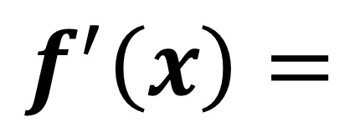
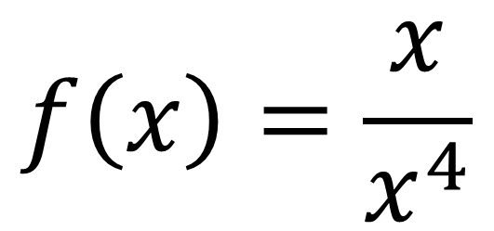
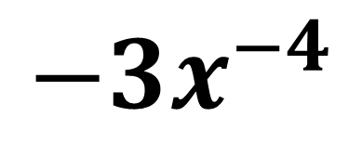
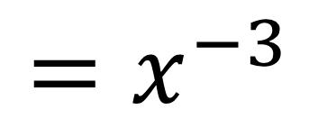
Sometimes you need to rewrite the equation before you can differentiate.
$$f\left(x\right)=\frac{x}{x^{4}}$$
$$=x^{−3}$$
$$f^{′}\left(x\right)=$$
$$−3x^{−4}$$

Slide 12
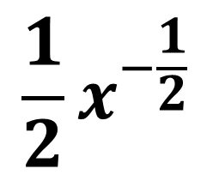
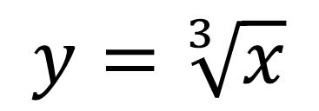
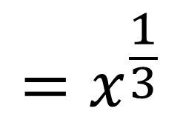
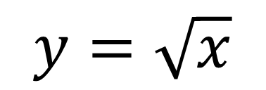
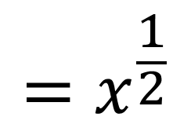
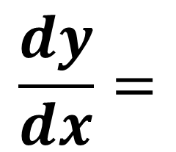
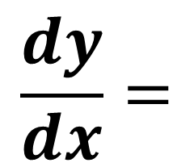
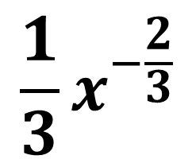
Turn roots into powers.
$$=x^{\frac{1}{2}}$$
$$=x^{\frac{1}{3}}$$
$$y=\sqrt{x}$$
$$y=\sqrt[3]{x}$$
$$\frac{dy}{dx}=$$
$$\frac{1}{2}x^{−\frac{1}{2}}$$
$$\frac{dy}{dx}=$$
$$\frac{1}{3}x^{−\frac{2}{3}}$$

Slide 13
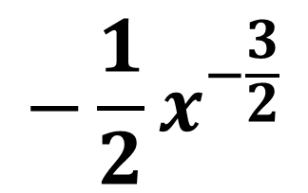
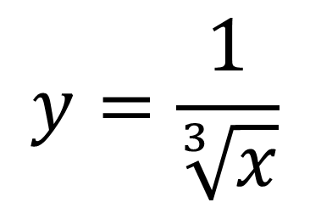
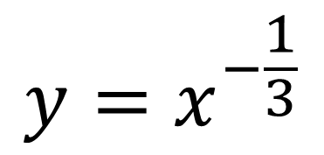
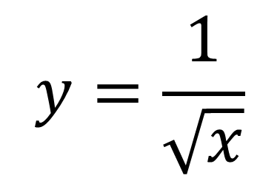
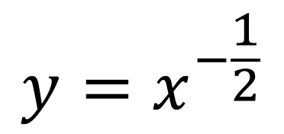
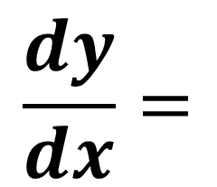
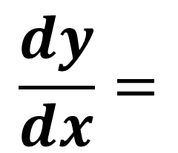
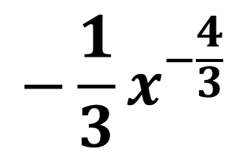
$$y=\frac{1}{\sqrt[3]{x}}$$
$$y=\frac{1}{\sqrt{x}}$$
$$y=x^{−\frac{1}{2}}$$
$$y=x^{−\frac{1}{3}}$$
$$\frac{dy}{dx}=$$
$$−\frac{1}{2}x^{−\frac{3}{2}}$$
$$\frac{dy}{dx}=$$
$$−\frac{1}{3}x^{−\frac{4}{3}}$$

Slide 14
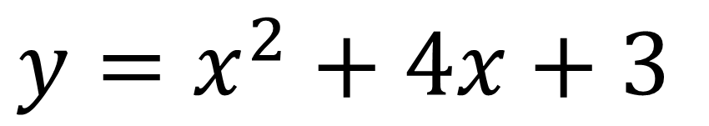
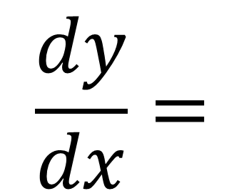
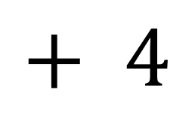

Dealing with multiple terms.
$$y=x^{2}+4x+3$$
differentiate each term
individually
$$\frac{dy}{dx}=$$
$$2x$$
$$+ 4$$

Slide 15
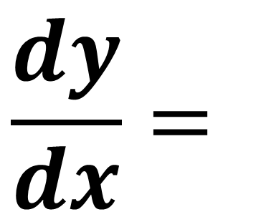
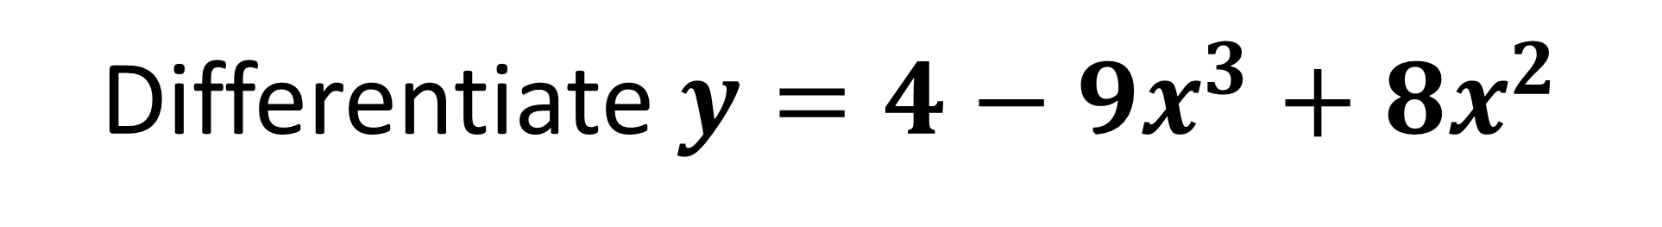
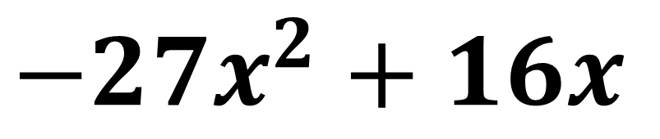
Differentiate $y=4−9x^{3}{+ 8x}^{2}$
$$\frac{dy}{dx}=$$
$$−27x^{2}+16x$$

Slide 16
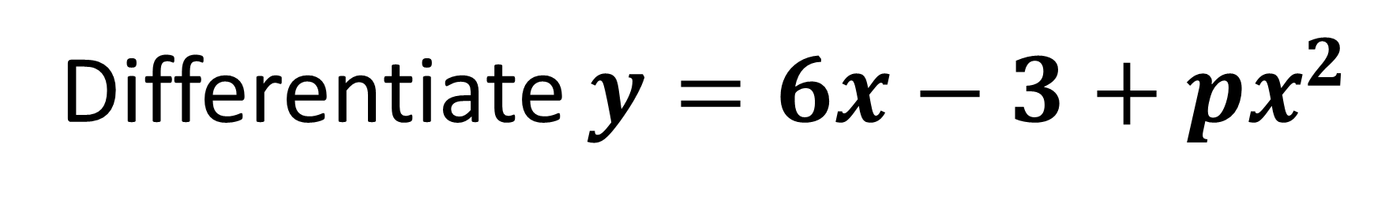
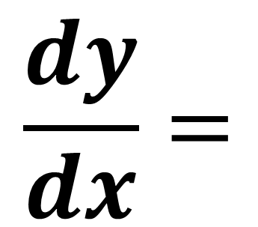
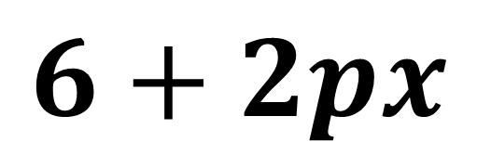
Differentiate $y=6x−3+px^{2}$
$$\frac{dy}{dx}=$$
$$6+2px$$

Slide 17
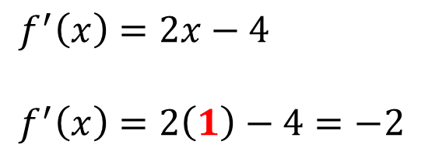



Let $f\left(x\right)=x^{2}−4x+2$
Find the gradient of $y=f\left(x\right)$ at the point $\left(1,−1\right)$
Find the coordinates of the point on the graph of $y=f\left(x\right)$ where the gradient is 5.
Find the gradient of $y=f\left(x\right)$ at the points where the curve meets the line $y=2−x$
a
$$f^{′}\left(x\right)=2x−4$$
$$f^{′}\left(x\right)=2\left(1\right)−4=−2$$
$$x^{2}−4x+2=2−x$$
Solving: $x=0$ or $x=3$
When $x=0, f^{′}\left(0\right)=−4$
When $x=3, f^{′}\left(3\right)=2$
c
b
$$5=2x−4$$
$$x=\frac{9}{2}$$
$$y={\left(\frac{9}{2}\right)}^{2}−4\left(\frac{9}{2}\right)+2=\frac{17}{4}$$
Point is $\left(\frac{9}{2},\frac{17}{4}\right)$

Slide 18


Beware of fractions and the denominators!
$$y=\frac{3}{x}$$
$$y=\frac{1}{3x}$$

Slide 19


Are they equivalent?
$$y=\frac{3}{x}$$
$$y=3 \text{x}\frac{1}{x}$$
YES

Slide 20


Are they equivalent?
$$y=\frac{3}{x}$$
$$y=\frac{1}{3}\text{x}\frac{1}{x}$$
NO

Slide 21


Are they equivalent?
$$y=\frac{3}{x}$$
$$y=\frac{3}{1}\text{x}\frac{1}{x}$$
YES

Slide 22


Are they equivalent?
$$y=\frac{1}{5x}$$
$$y=\frac{1}{5}\text{x}\frac{1}{x}$$
YES

Slide 23


Are they equivalent?
$$y=\frac{1}{5x}$$
$$y=5 \text{x}\frac{1}{x}$$
NO

Slide 24





Given $y=\frac{3}{x}$ find $\frac{dy}{dx}$
$y=3 \text{x} \frac{1}{x}$
$$y=3 x^{−1}$$
$$\frac{dy}{dx}=$$
$$−3x^{−2}$$

Slide 25





Given $y=\frac{1}{3x}$ find $\frac{dy}{dx}$
$y=\frac{1}{3} \text{x} \frac{1}{x}$
$$y=\frac{1}{3}{ x}^{−1}$$
$$\frac{dy}{dx}=$$
$$−\frac{1}{3}x^{−2}$$

Slide 26




Differentiate $y=\frac{1}{3x^{2}}$
$$y=\frac{1}{3}x^{−2}$$
$$\frac{dy}{dx}=$$
$$−\frac{2}{3}x^{−3}$$

Slide 27






Differentiate $y=\frac{x^{3} + 3}{x}$
Split up fractions into multiple terms.
$$y=x^{2}+3x^{−1}$$
$$y=\frac{x^{3}}{x}+\frac{3}{x}$$
$$\frac{dy}{dx}=$$
$$2x−3x^{−2}$$
$$y=x^{2}+ \frac{3}{x}$$

Slide 28





Differentiate $y=\frac{2 + x^{3}}{x^{2}}$
$$y=\frac{2}{x^{2}}+\frac{x^{3}}{x^{2}}$$
$$y={2x}^{−2}+x$$
$$\frac{dy}{dx}=$$
$$−4x^{−3}+1$$

Slide 29





Differentiate $y=\frac{x^{2} + 3}{\sqrt{x}}$
$$y=\frac{x^{2}}{x^{\frac{1}{2}}}+\frac{3}{x^{\frac{1}{2}}}$$
$$y=x^{\frac{3}{2}}+3x^{−\frac{1}{2}}$$
$$\frac{dy}{dx}=$$
$$\frac{3}{2}x^{\frac{1}{2}} − \frac{3}{2}x^{−\frac{3}{2}}$$

Slide 30




Differentiate $y=x^{2}\left(x−3\right)$
$$y=x^{3}−3x^{2}$$
$$\frac{dy}{dx}=$$
$$3x^{2}−6x$$

