Slide 1

The Gym Problem

Slide 2
A local gym has three payment options
Option A: £6 a session.
Option B: Pay a one off fee of £100 and then pay £4 per sessions.
Option C: £500 for a life membership and unlimited use of the gym.
Investigate which option is best and when.

Slide 3
Complete the table below.
Visits to the Gym | Option A | Option B | Option C
0
10
20
30
40
50
60
70
80
90
100

Slide 4
Write an equation for each option.
Option A:
Option B:
Option C:

Slide 5
Total Money Spent
Total Visits

Slide 6
ANSWERS

Slide 7
Complete the table below.
Visits to the Gym | Option A | Option B | Option C
0
10
20
30
40
50
60
70
80
90
100
0
60
120
180
240
300
360
420
480
540
600
100
140
180
220
260
300
340
380
420
460
500
500
500
500
500
500
500
500
500
500
500
500

Slide 8
Write an equation for each option.
Option A:
y = 6x
Option B:
y = 4x + 100
Option C:
y = 500

Slide 9
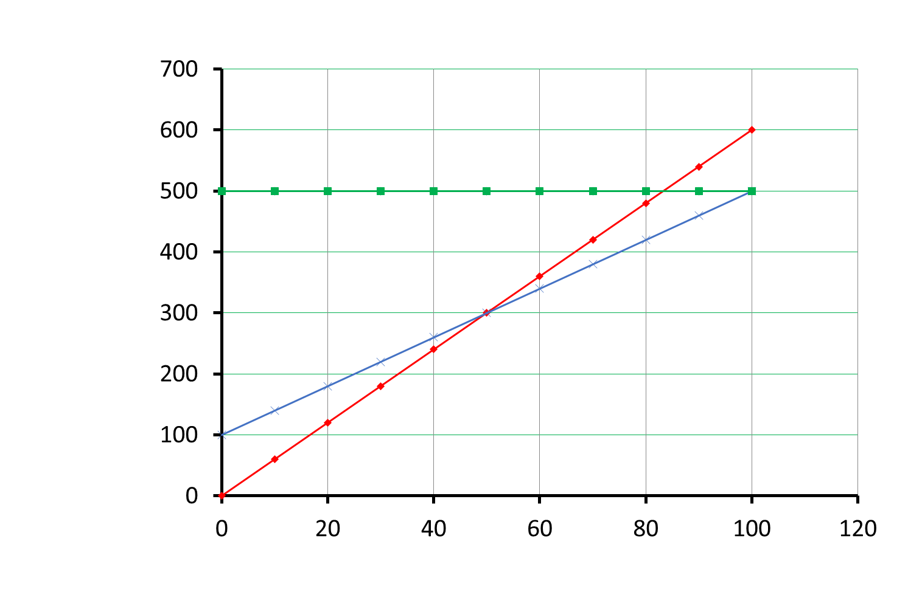
Total Money Spent
Total Money Spent

