Slide 1
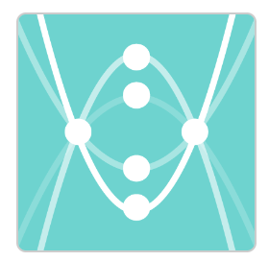
Match My Parabola
Activity: Click on the icon
Students work though the 15 slides draw various graphs to pass through the given co-ordiantes.

