Slide 1
Trigonometry and Modelling
a sin x + b cos x
Chapter 7
(Part 4 of 6)

Slide 2
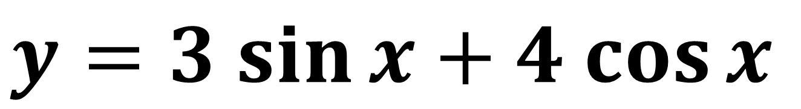
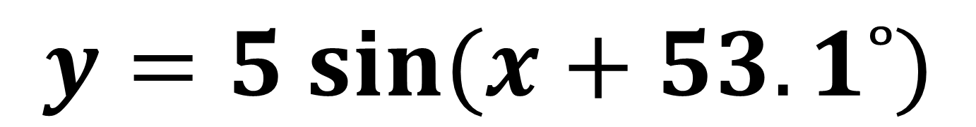
Plot the following graphs.
demos
$y=5 sin⁡(x+53.1˚)$
$$y=3 sin{x}+4 cos{x}$$
What do you notice?

Slide 3
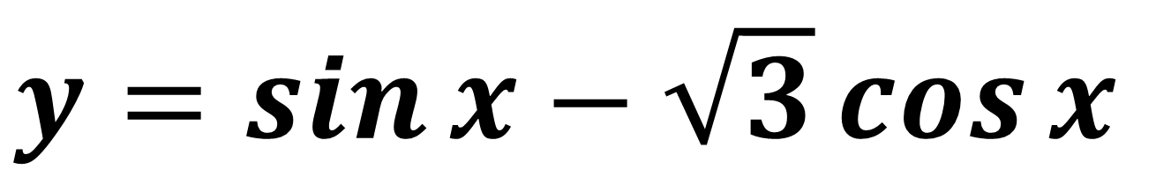
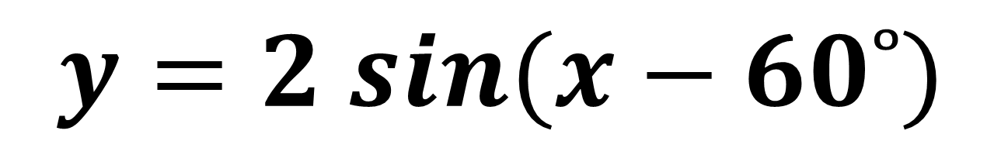
Plot the following graphs.
demos
$y=2 sin⁡(x−60˚)$
$$y=\sin{x}−\sqrt{3}\cos{x}$$
What do you notice?

Slide 4
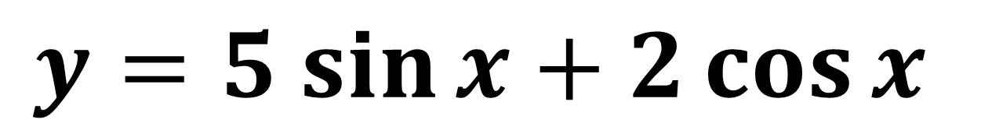
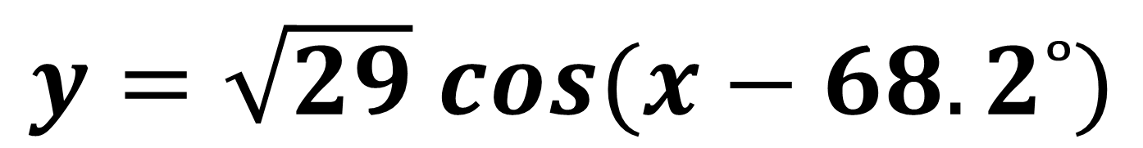
Plot the following graphs.
demos
$y=\sqrt{29} cos⁡(x−68.2˚)$
$$y=5 sin{x}+2\cos{x}$$
What do you notice?

Slide 5
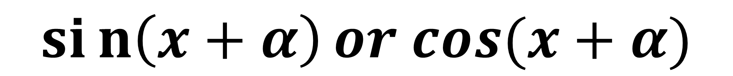
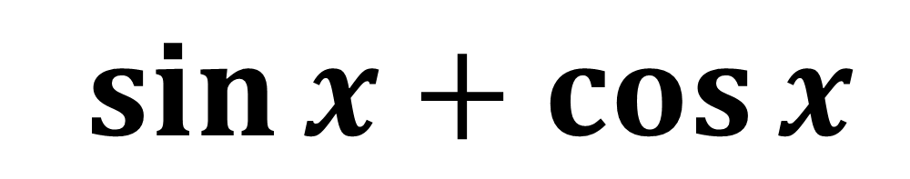
Adding or Subtracting
a sine wave with a cosine wave
will produce a translated
single sine wave or single cosine wave.
$$\sin{x}+\cos{x}$$
$sin\left(x+α\right)or cos(x+α)$

Slide 6
Additional Formula
$$\sin\left(x+α\right)=\sin{x}\cos{α}+\cos{x}\sin{α}$$
$$\sin\left(x−α\right)=\sin{x}\cos{α}−\cos{x}\sin{α}$$
$$\cos\left(x+α\right)=\cos{x}\cos{α}−\sin{x}\sin{α}$$
$$\cos\left(x−α\right)=\cos{x}\cos{α}+\sin{x}\sin{α}$$

Slide 7
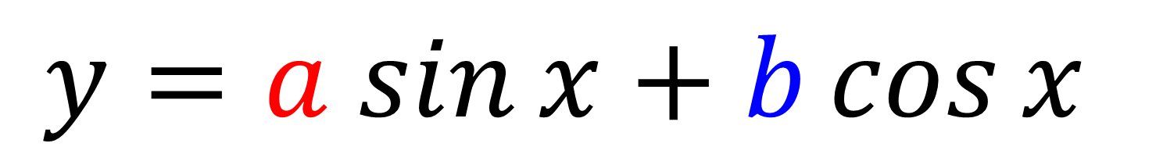
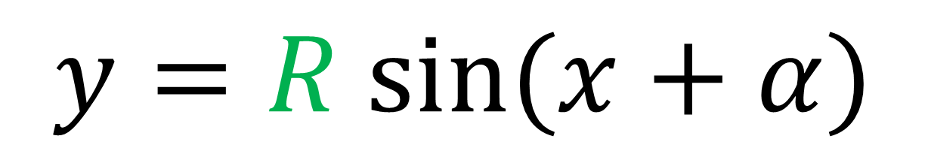
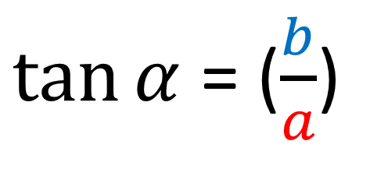
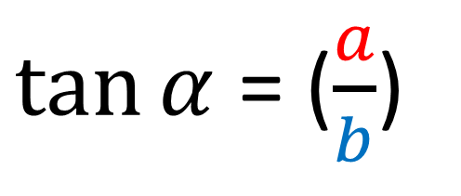
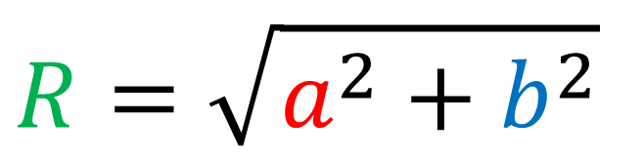
$$y=a sin{x}+b\cos{x}$$
$y=R sin⁡(x+α)$
$\tan{α}$ = ($\frac{a}{b}$)
$$R=\sqrt{a^{2}+b^{2}}$$
or
$\tan{α}$ = ($\frac{b}{a}$)

Slide 8

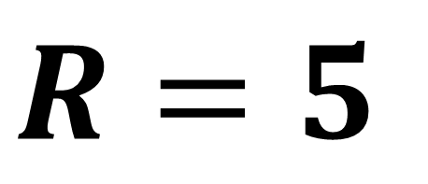
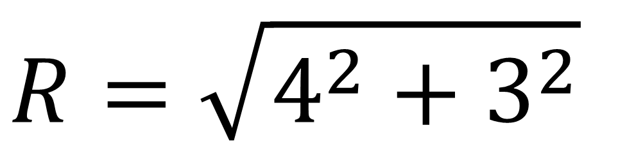
Finding $R$
$\sin\left(x+α\right)= 4\sin{x}+3\cos{x}$
$$R=\sqrt{4^{2}+3^{2}}$$
$$R=5$$

Slide 9
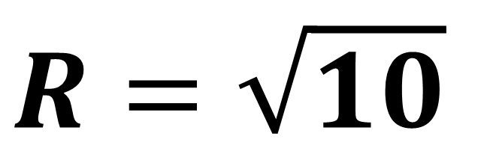
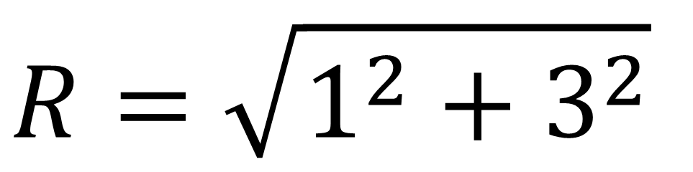
Finding $R$
$\sin\left(x−α\right)= \sin{x}−3\cos{x}$
$$R=\sqrt{1^{2}+3^{2}}$$
$$R=\sqrt{10}$$

Slide 10
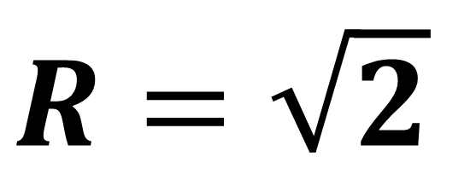
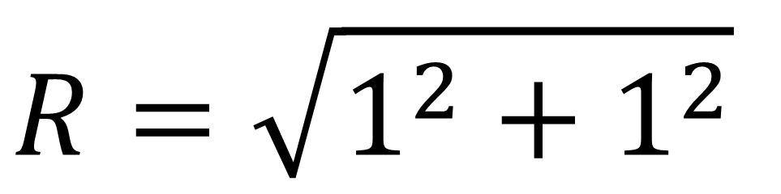
Finding $R$
$\cos\left(x+α\right)=\cos{x}+\sin{x}$
$$R=\sqrt{1^{2}+1^{2}}$$
$$R=\sqrt{2}$$

Slide 11
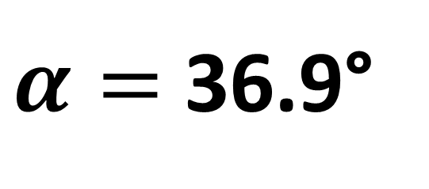
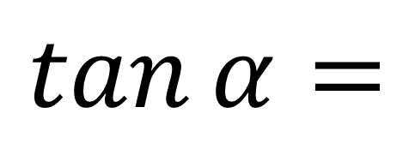


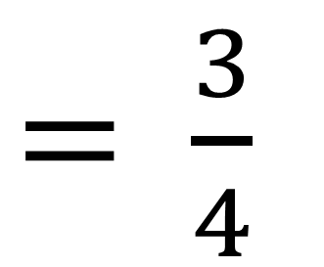
Finding $α$
$\sin\left(x+α\right)= 4\sin{x}+3\cos{x}$
$\sin\left(x+α\right)=\sin{x}cos{α}+\cos{x}$ $\sin{α}$
$$\frac{\sin{α}}{\cos{α}}$$
$=$ $\frac{3}{4}$
$$\tan{α}=$$
$α=$ 36.9°

Slide 12
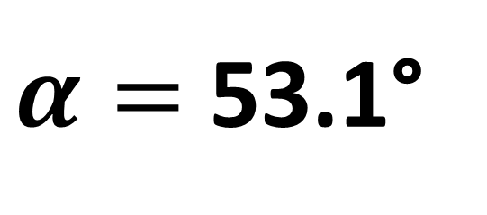
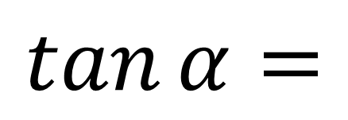

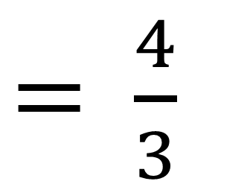
Finding $α$
$\sin\left(x−α\right)=4\cos{x}−3\sin{x}$
$\sin\left(x−α\right)=\sin{α}cos{x}−\cos{α}$ $\sin{x}$
$$\frac{\sin{α}}{\cos{α}}$$
$=$ $\frac{4}{3}$
$$\tan{α}=$$
$α=$ 53.1°

Slide 13

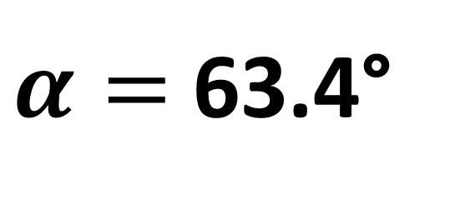
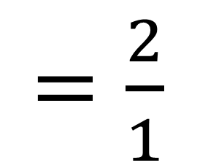
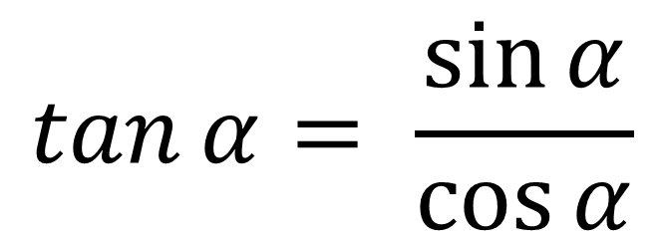
Finding $α$
$$\cos\left(x+α\right)=1\cos{x}−2\sin{x}$$
$cos⁡(x+α)$ $=\cos{x}cos{α}−\sin{x}$ $\sin{α}$
$$\tan{α}= \frac{\sin{α}}{\cos{α}}$$
$=\frac{2}{1}$
$α=$63.4°

Slide 14
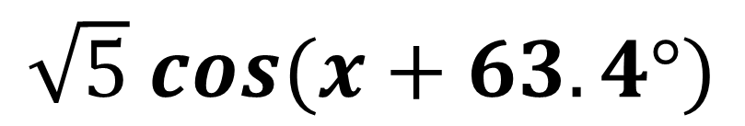
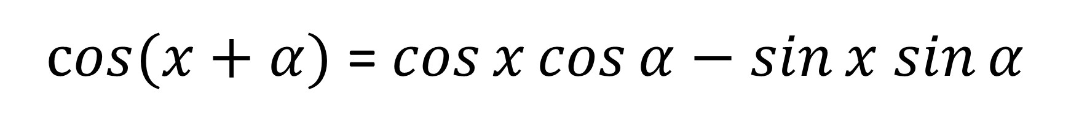
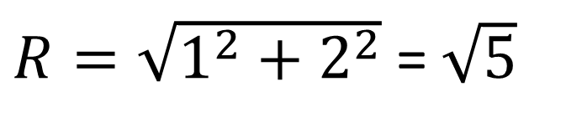
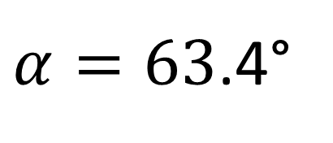
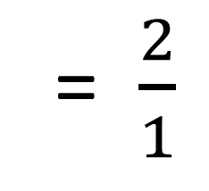
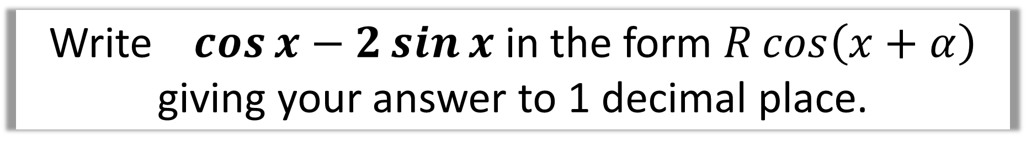
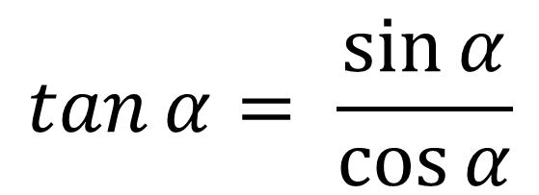
Write $\cos{x}−2\sin{x}$ in the form $R\cos\left(x+α\right)$ giving your answer to 1 decimal place.
1
$cos⁡(x+α)$ = $\cos{x}cos{α}−\sin{x}$ $\sin{α}$
$$\tan{α}= \frac{\sin{α}}{\cos{α}}$$
= $\frac{2}{1}$
$R=\sqrt{1^{2}+2^{2}}$ = $\sqrt{5}$
$\sqrt{5} cos⁡(x+63.4°)$
$α=63$.4°

Slide 15
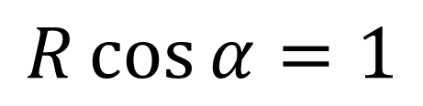
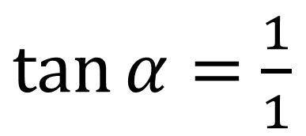
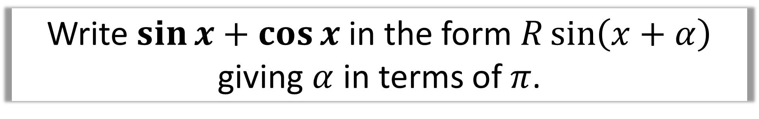
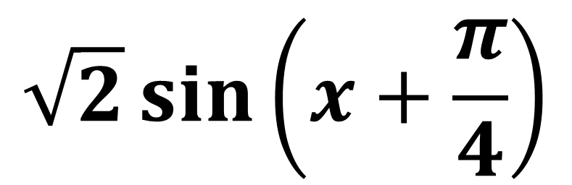
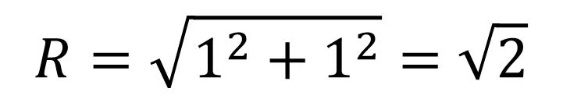
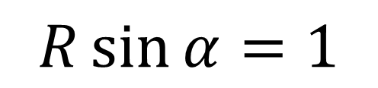
Write $\sin{x}+\cos{x}$ in the form $R\sin\left(x+α\right)$ giving $α$ in terms of $π$.
$$R\sin\left(x+α\right)≡R\sin{x}\cos{α}+R\cos{x}\sin{α}$$
$$R=\sqrt{1^{2}+1^{2}}=\sqrt{2}$$
$$R\sin{α}=1$$
$\tan{α}=$ $\frac{1}{1}$
$$R\cos{α}=1$$
$$\sqrt{2}\sin\left(x+\frac{π}{4}\right)$$

Slide 16
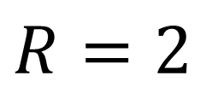
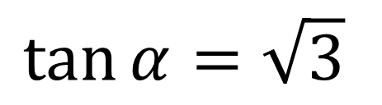
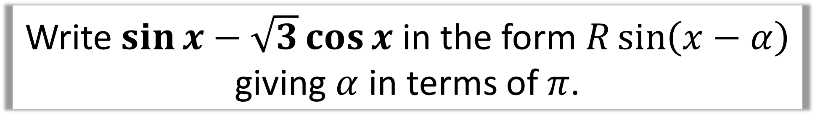
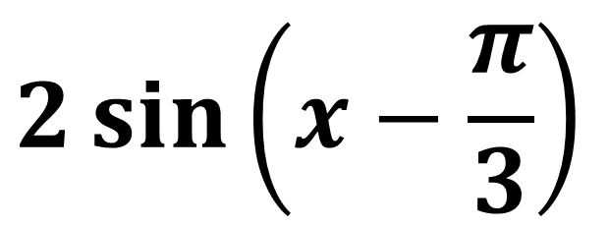
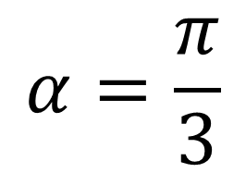
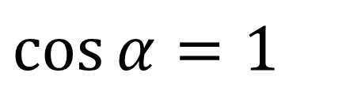
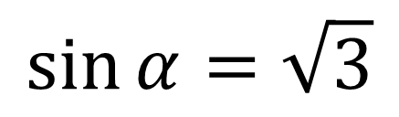
Write $\sin{x}−\sqrt{3}\cos{x}$ in the form $R\sin\left(x−α\right)$ giving $α$ in terms of $π$.
$$R\sin\left(x−α\right)≡R\sin{x}\cos{α}−R\cos{x}\sin{α}$$
$$\tan{α}=\sqrt{3}$$
$$R=2$$
$$\cos{α}=1$$
$$\sin{α}=\sqrt{3}$$
$$α=\frac{π}{3}$$
$$2\sin\left(x−\frac{π}{3}\right)$$

Slide 17




Solve the equation $2\cos{θ}+5\sin{θ}=3$
for $0<θ<360$
$$2\cos{θ}+5\sin{θ}≡\sqrt{29}\cos\left(θ−68.2°\right)$$
$$\sqrt{29}\cos\left(θ−68.2°\right)=3$$
$$\cos\left(θ−68.2°\right)=\frac{3}{\sqrt{29}}$$
$$θ−68.2°=−56.1…°, 56.1…°$$
$$θ=12.1°, 124.3°$$

Slide 18



