Slide 1
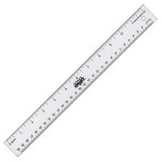
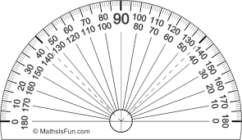
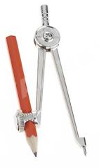
Challenge A
Draw an angle of 30º
only using a ruler, pencil and a compass?
Challenge B
Draw an angle of 22.5º
only using a ruler, pencil and a compass?

