Slide 1
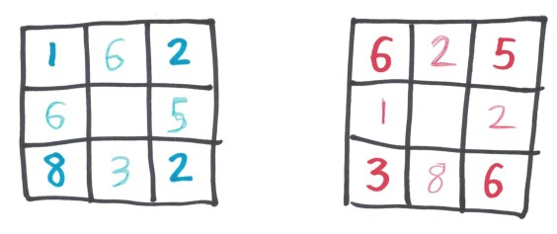
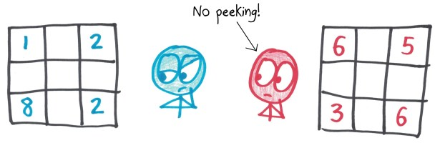
Magical Squares
Then, you reveal your squares to each other. Now, whatever numbers your opponent put in her corners, you must put in your edges (in whatever order you like).
Each player begins with a blank square, then secretly places numbers in the four corners. You may use whatever numbers you like (including repeats).

Slide 2
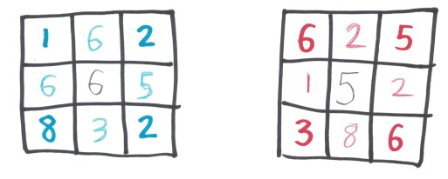
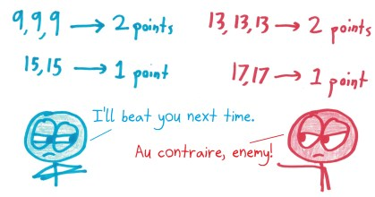
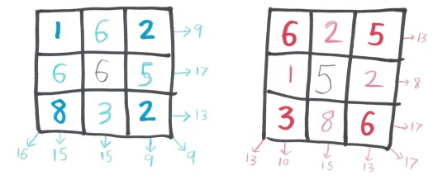
Finally, you can choose whatever number you like for the center.
A pair with the same sum scores 1 point; a trio scores 2 points; a quartet scores 3 points; and so on.
(This sample game ended in a 3-3 tie.)
The goal: have as many rows, columns, and diagonals as possible sharing the same sum.

