Slide 1
FM: Inverse Functions

Slide 2
You need to know the inverse operations:
÷
x
–
+

Slide 3
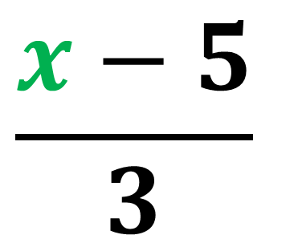
Function
x
x 3
+ 5
3x + 5
Inverse Function
$$\frac{x−5}{3}$$
x
÷ 3
- 5

Slide 4
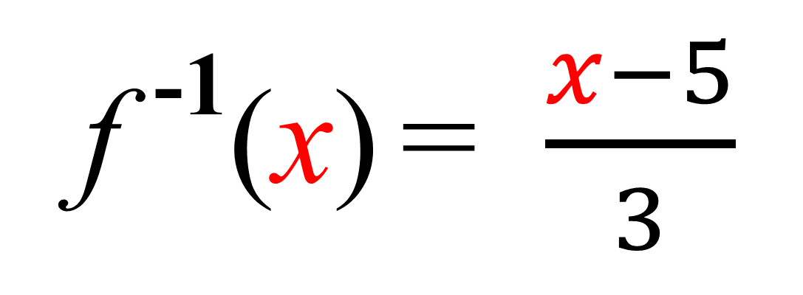
Inverse Function Notation
f (x) = 3x + 5
f ⁻¹(x) = $\frac{x−5}{3}$

Slide 5
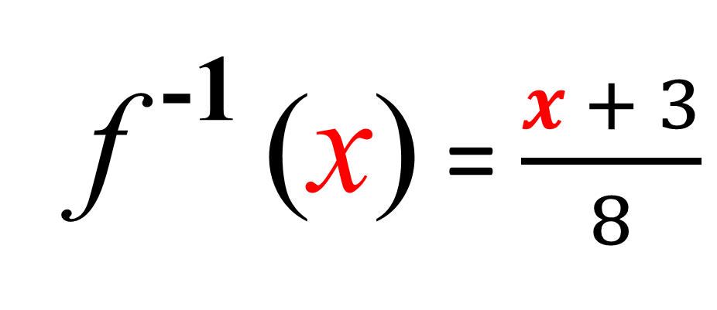
Finding the inverse of f(x)
f (x) = 8x – 3
f ⁻¹ (x) = $\frac{x + 3}{8}$

Slide 6
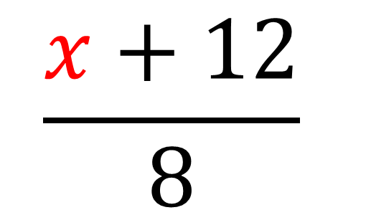
Finding the inverse of f (x)
f (x) = 4(2x – 3)
f (x) = 8x – 12
$$\frac{x+12}{8}$$
f ⁻¹(x) =

Slide 7
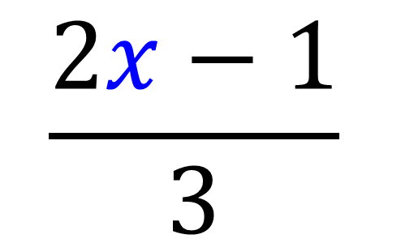
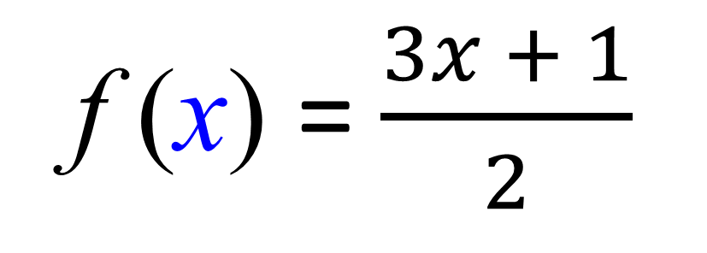
Finding the inverse of f (x)
f (x) = $\frac{3x + 1}{2}$
$$\frac{2x−1}{3}$$
f ⁻¹(x) =

Slide 8







Inverse Functions - Graphing
To get an inverse graph,
you reflect the f(x) in the reflection line y = x
$$y$$
$$y=f^{−1}(x)$$
$$y=f(x)$$
$$2$$
$$x$$
$$2$$
$$y=x$$

