Slide 1
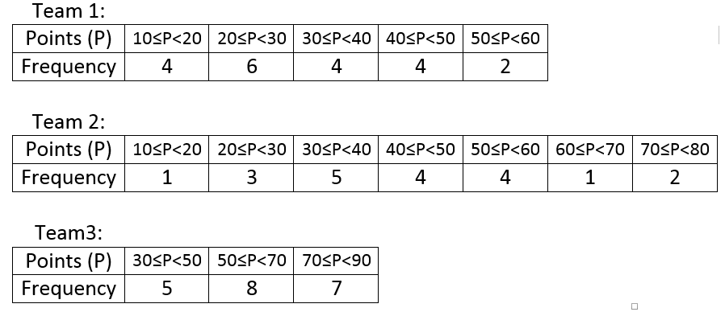

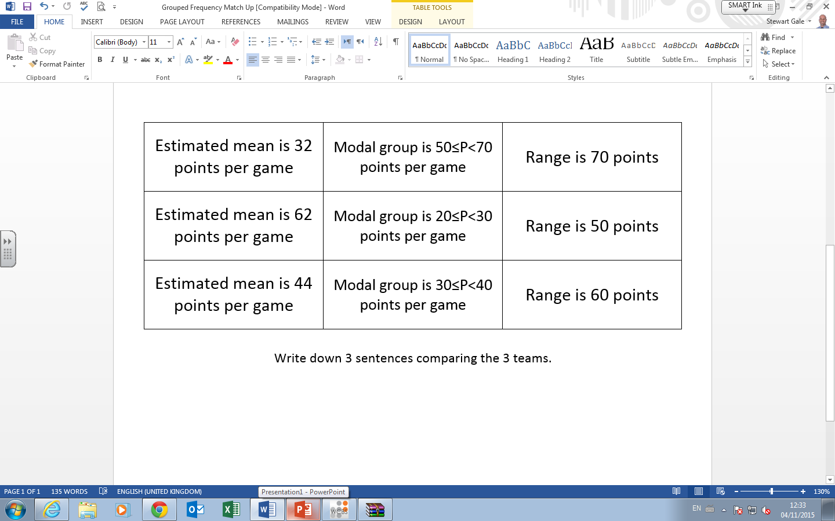
The 3 tables contain the data for 3 basketball teams and how many points they scored in each game of the season
Match up the statements with the teams.
Compare the teams and make a comment.

Slide 2
ANSWERS

Slide 3
The 3 tables contain the data for 3 basketball teams and how many points they scored in each game of the season
Match up the statements with the teams.
Compare the teams and make a comment.
1
3
2
3
1
1
2
2
3

