Slide 1
Application of Forces
Inextensible Strings
Chapter 7
(Part 1 of 6)

Slide 2
Inextensible Strings
An inextensible string means
no matter how much you pull on it,
it won't extend.

Slide 3
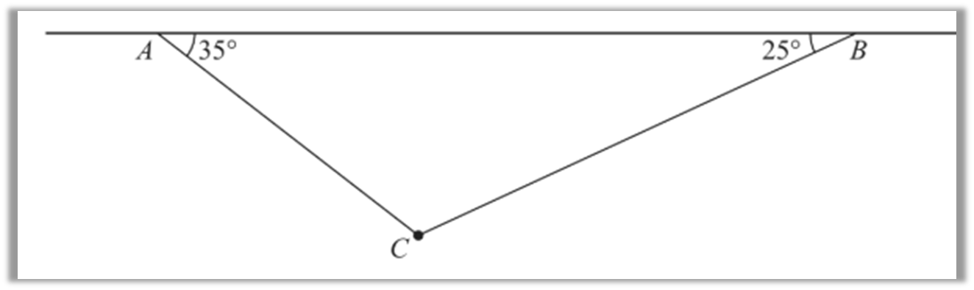
Always ask yourself if it is
one string or two separate strings.

Slide 4
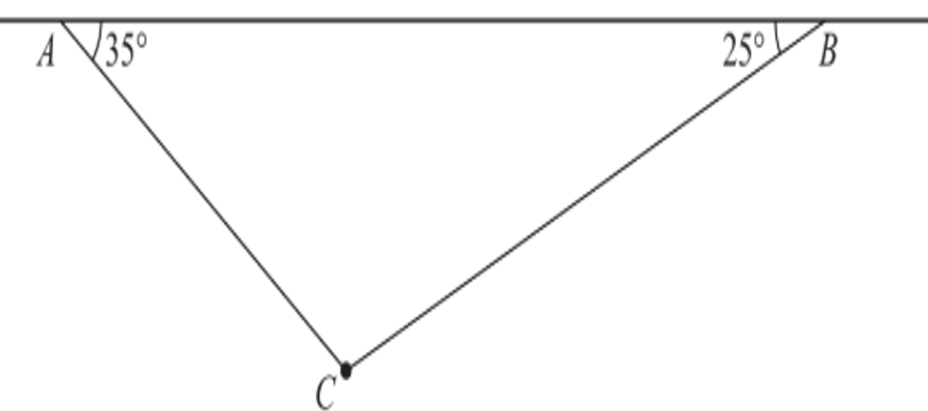
One continuous piece of string.
T
T

Slide 5


Two separate pieces of string.
$$T_{A}$$
$$T_{B}$$

Slide 6
For every question,
write two equations.
One for vertical forces
One for horizontal forces.
Then solve the two equations simultaneous.

Slide 7
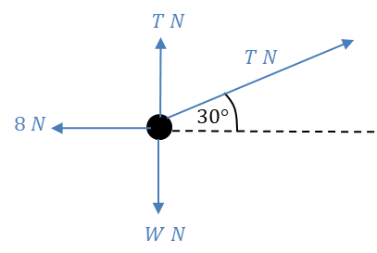



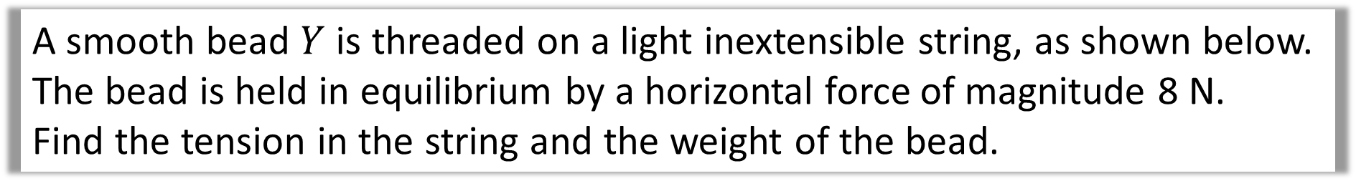






A smooth bead $Y$ is threaded on a light inextensible string, as shown below.
The bead is held in equilibrium by a horizontal force of magnitude 8 N.
Find the tension in the string and the weight of the bead.
Resolve Horizontally
8N
$$T\cos{30°}=8$$
30˚
$$T$$
$$T=9.24 (3sf)$$
Identify Forces
$$T\sin{30°}$$
Resolve Vertically
$$8$$
$$W=T+T\sin{30°}$$
$$T\cos{30°}$$
$$W=13.9 (3sf)$$
$$W$$

Slide 8
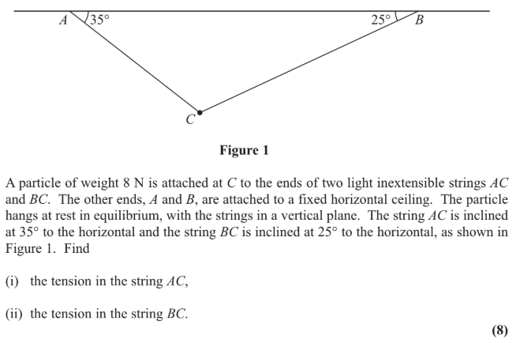

Slide 9
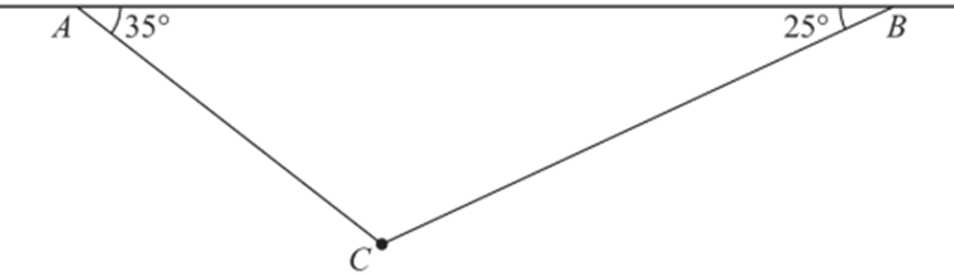








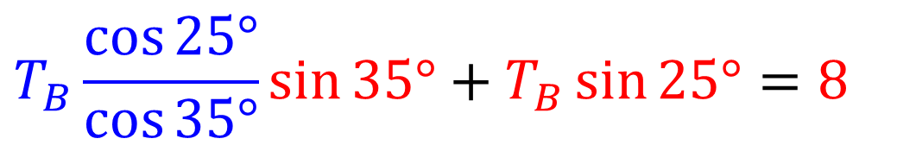
Resolve Horizontally
$$T_{A}\cos{35°}=T_{B}\cos{25°}$$
T_{A}
T_{B}
$$T_{A}\cos{35°}$$
$$T_{B}\cos{25°}$$
Resolve Vertically
$$T_{A}\sin{35°}$$
$$T_{B}\sin{25°}$$
$$T_{A}\sin{35°}+T_{B}\sin{25°}=8$$
T_{A}
T_{B}
Solve Simultaneous
8
$$T_{B}\frac{\cos{25°}}{\cos{35°}}\sin{35°}+T_{B}\sin{25°}=8$$
$$T_{A}=8.37N$$
$$T_{B}=7.57N$$

