Slide 1
Circles
Intersecting Lines
Chapter 6
(Part 3 of 4)

Slide 2
How many times can a straight intersect a circle?
2 intersections
1 intersections
0 intersections

Slide 3
How can you show that
a quadratic equation
has no solutions?
Show that the discriminate has a negative value.

Slide 4
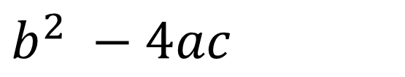
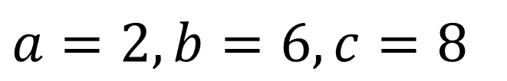
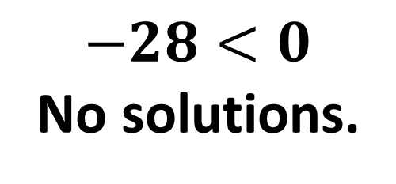
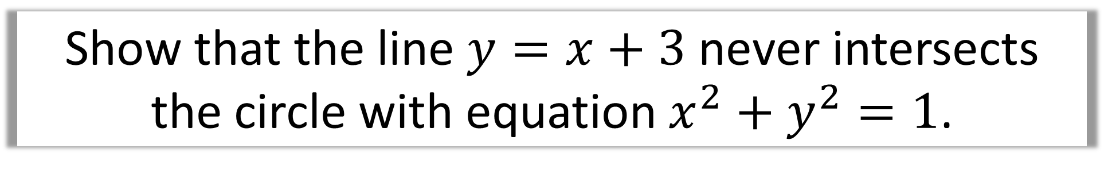
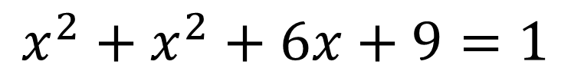
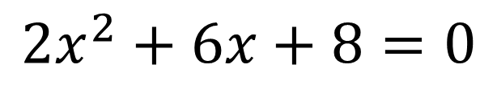
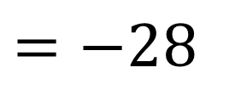
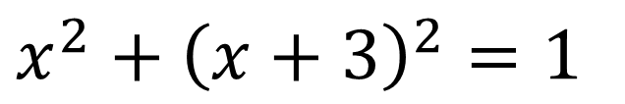
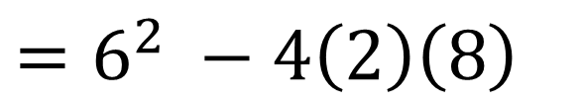
Show that the line $y=x+3$ never intersects
the circle with equation $x^{2}+y^{2}=1$.
Using substitution
Discriminant
$$a=2, b=6, c=8$$
$$x^{2}+{\left(x+3\right)}^{2}=1$$
$b^{2} −4ac$
$$x^{2}+x^{2}+6x+9=1$$
$$=6^{2} −4\left(2\right)\left(8\right)$$
$$=−28$$
$$2x^{2}+6x+8=0$$
$−28<0$
No solutions.

Slide 5
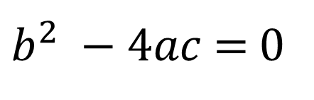
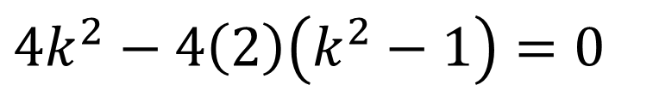

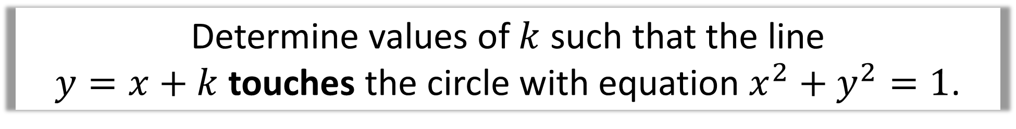

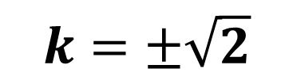




Determine values of $k$ such that the line
$y=x+k$ touches the circle with equation $x^{2}+y^{2}=1$.
Using substitution
$b^{2} −4ac$ = 0
$$x^{2}+{\left(x+k\right)}^{2}=1$$
$$4k^{2}−4\left(2\right)\left(k^{2}−1\right)=0$$
$$x^{2}+x^{2}+2kx+k^{2}=1$$
$$4k^{2}−8k^{2}+8=0$$
$$2x^{2}+2kx+k^{2}−1=0$$
$$4k^{2}−8=0$$
Discriminant
$$a=2, b=2k, c=k^{2}−1$$
$$k=±\sqrt{2}$$

Slide 6
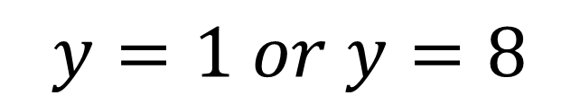
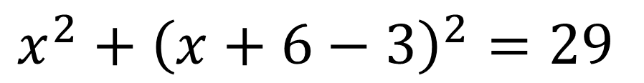
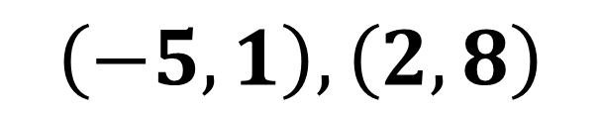
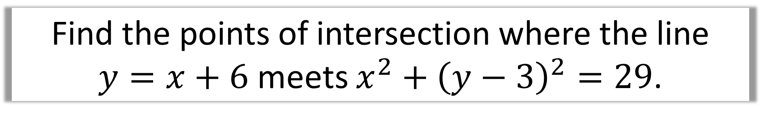
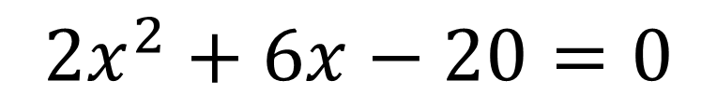
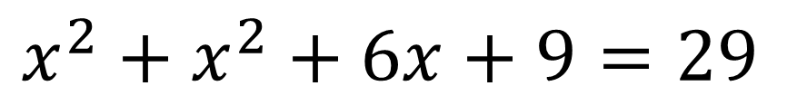
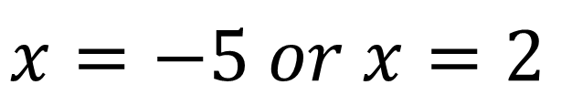
Find the points of intersection where the line
$y=x+6$ meets $x^{2}+{\left(y−3\right)}^{2}=29$.
$$x^{2}+{\left(x+6−3\right)}^{2}=29$$
$$x=−5 or x=2$$
$$x^{2}+x^{2}+6x+9=29$$
$$y=1 or y=8$$
$$2x^{2}+6x−20=0$$
$$\left(−5, 1\right), \left(2,8\right)$$

Slide 7
What is the relationship between the tangent and the radius?
radius
tangent
The tangent is perpendicular to the radius
(at the point of intersection).

Slide 8
What will the perpendicular bisector
of a chord always pass through?
perpendicular bisector
chord
The perpendicular bisector of any chord passes through the centre of the circle.

Slide 9

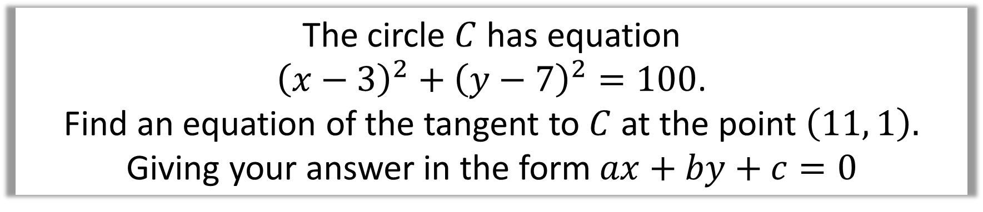
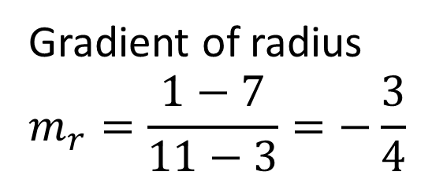
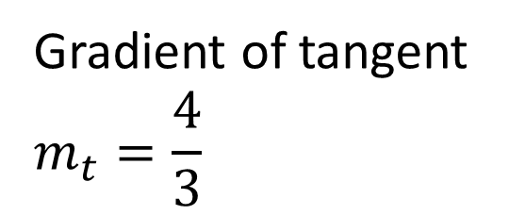
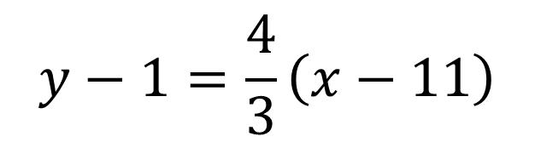



The circle $C$ has equation
${\left(x−3\right)}^{2}+{\left(y−7\right)}^{2}=100$.
Find an equation of the tangent to $C$ at the point $\left(11, 1\right).$
Giving your answer in the form $ax+by+c=0$
Circle centre $\left(3,7\right)$
$$y−1=\frac{4}{3}\left(x−11\right)$$
Gradient of radius
$$m_{r}=\frac{1−7}{11−3}=−\frac{3}{4}$$
$$3y−3=4\left(x−11\right)$$
$$3y−3=4x−44$$
Gradient of tangent
$$m_{t}=\frac{4}{3}$$
$$4x−3y−41=0$$

Slide 10
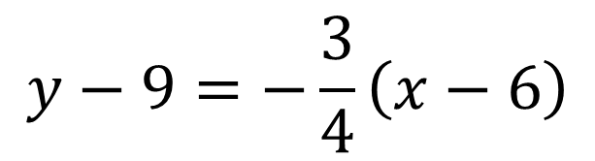

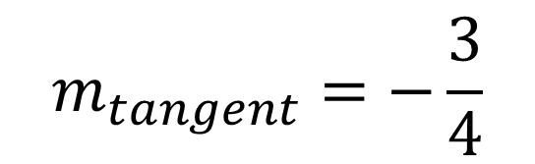
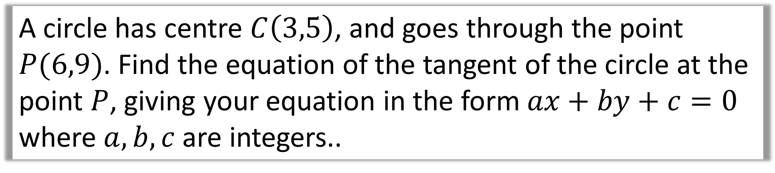
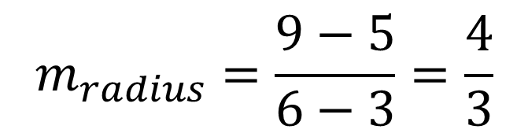




A circle has centre $C\left(3,5\right)$, and goes through the point $P(6,9)$. Find the equation of the tangent of the circle at the point $P$, giving your equation in the form $ax+by+c=0$ where $a,b,c$ are integers..
$$m_{radius}=\frac{9−5}{6−3}=\frac{4}{3}$$
$$m_{tangent}=−\frac{3}{4}$$
$$\left(6,9\right)$$
$$y−9=−\frac{3}{4}\left(x−6\right)$$
$$\left(3,5\right)$$
$$4y−36=−3\left(x−6\right)$$
$$4y−36=−3x+18$$
$$3x+4y−54=0$$

Slide 11
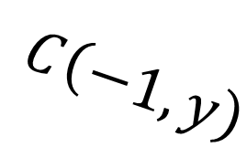


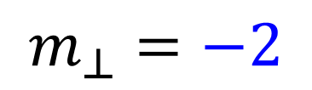
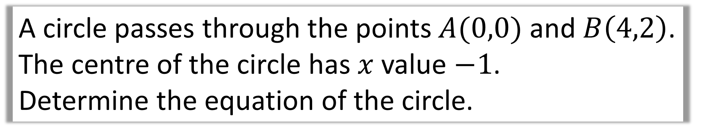

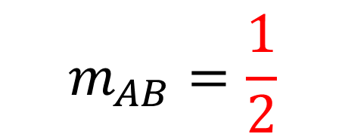
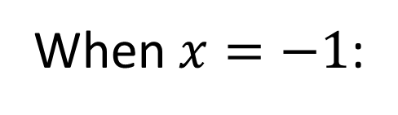



A circle passes through the points $A(0,0)$ and $B\left(4,2\right)$.
The centre of the circle has $x$ value $−1$.
Determine the equation of the circle.
$$m_{AB}=\frac{1}{2}$$
Equation of perpendicular bisector
$$y−1=−2\left(x−2\right)$$
$$m_{⊥}=−2$$
When $x=−1$:
$$B\left(4,2\right)$$
$$y−1=−2\left(−1−2\right)$$
$$C\left(−1,y\right)$$
$$y−1=6$$
$$y=7$$
$$A\left(0,0\right)$$

Slide 12

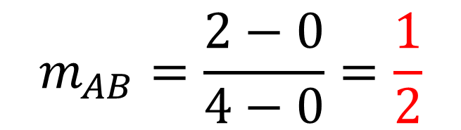
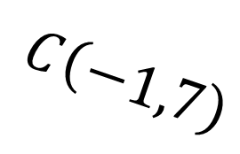


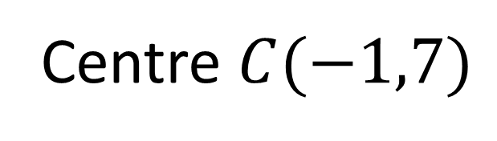
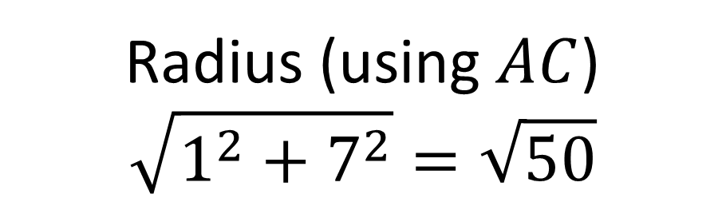
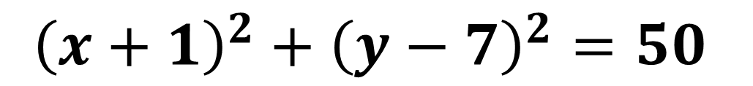

A circle passes through the points $A(0,0)$ and $B\left(4,2\right)$.
The centre of the circle has $x$ value $−1$.
Determine the equation of the circle.
$$m_{AB}=\frac{2−0}{4−0}=\frac{1}{2}$$
$$m_{⊥}=−2$$
Centre $C(−1,7)$
Radius (using $AC$)
$$\sqrt{1^{2}+7^{2}}=\sqrt{50}$$
$$B\left(4,2\right)$$
$$C\left(−1,7\right)$$
$${\left(x+1\right)}^{2}+{\left(y−7\right)}^{2}=50$$
$$A\left(0,0\right)$$

