Slide 1
Straight Line Graphs
Equations of a Line
Chapter 5
(Part 1 of 4)

Slide 2
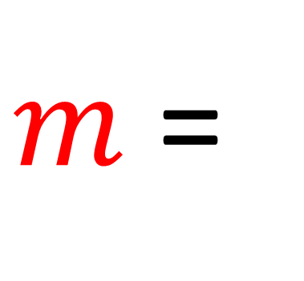
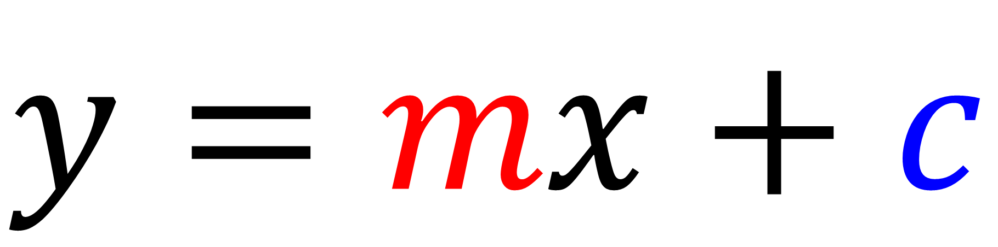

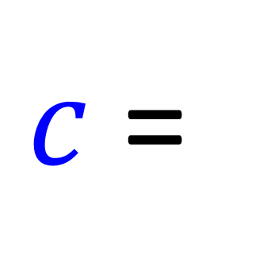
$$\text{Straight} \text{Line} \text{Graphs}$$
$$y=mx+c$$
$m$ =
gradient
$c$ =
y intercept

Slide 3
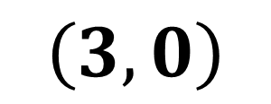
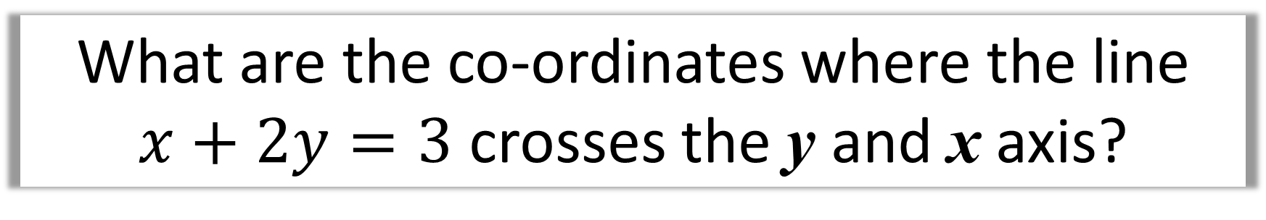
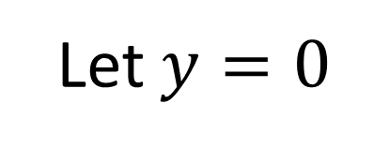
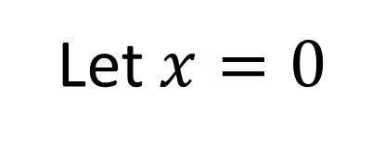
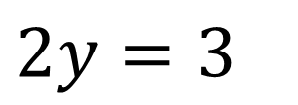
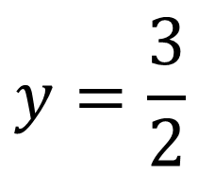
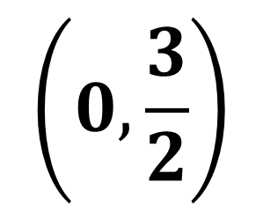
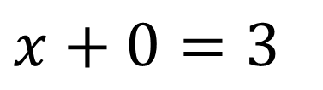
What are the co-ordinates where the line
$x+2y=3$ crosses the y and x axis?
Let $x=0$
Let $y=0$
$$2y=3$$
$$x+0=3$$
$$y=\frac{3}{2}$$
$$\left(3,0\right)$$
$$\left(0,\frac{3}{2}\right)$$

Slide 4
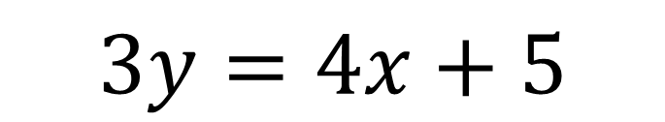
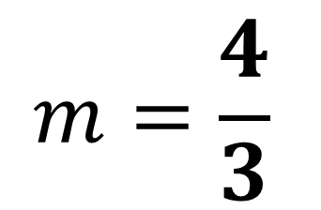
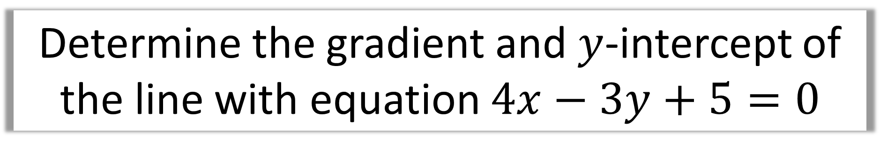
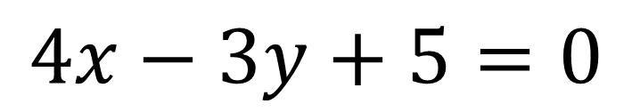
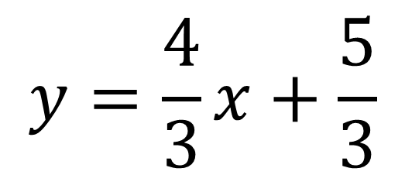
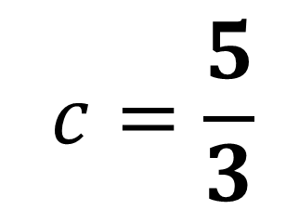
Determine the gradient and $y$-intercept of
the line with equation $4x−3y+5=0$
$$4x−3y+5=0$$
$$3y=4x+5$$
$$y=\frac{4}{3}x+\frac{5}{3}$$
$$m=\frac{4}{3}$$
$$c=\frac{5}{3}$$

Slide 5

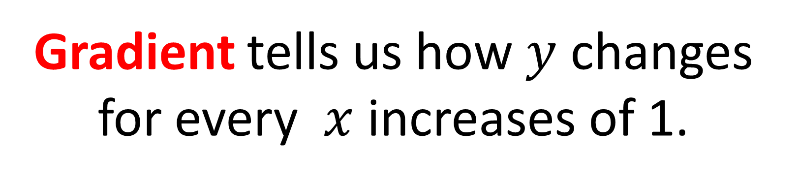



Gradient
Gradient tells us how $y$ changes
for every $x$ increases of 1.
$$\left(3,5\right)$$
$$2$$
$\left(2,3\right)$
$$1$$

Slide 6
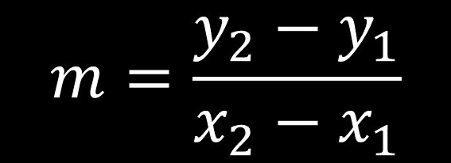

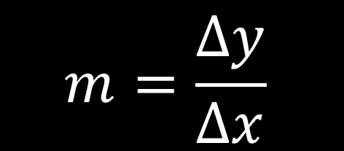

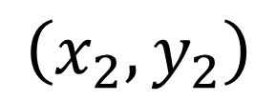
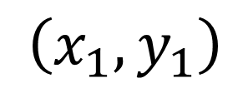
Gradient
$$y$$
$$\left(x_{2},y_{2}\right)$$
$$x$$
$\left(x_{1},y_{1}\right)$
$$m=\frac{Δy}{Δx}$$
$$m=\frac{y_{2}−y_{1}}{x_{2}−x_{1}}$$

Slide 7
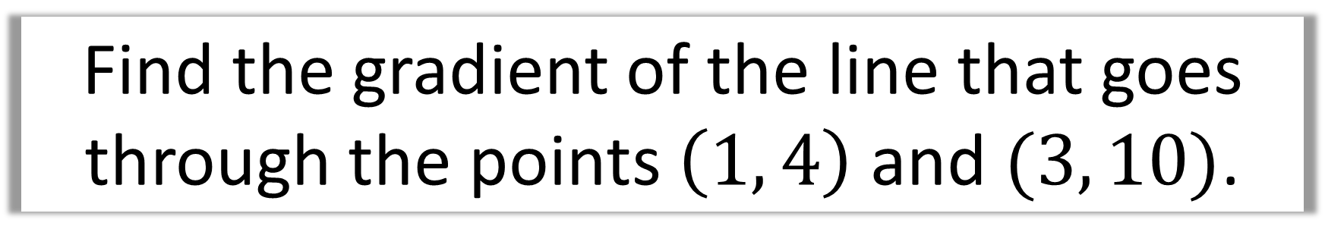
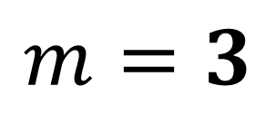
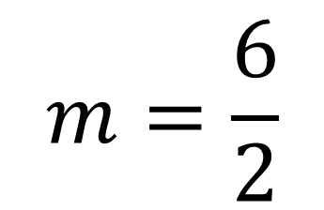
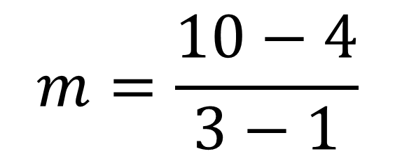
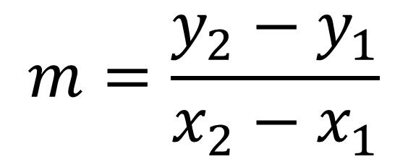
Find the gradient of the line that goes through the points $\left(1, 4\right) \text{and} (3, 10)$.
$$m=\frac{y_{2}−y_{1}}{x_{2}−x_{1}}$$
$$m=\frac{10−4}{3−1}$$
$$m=\frac{6}{2}$$
$$m=3$$

Slide 8
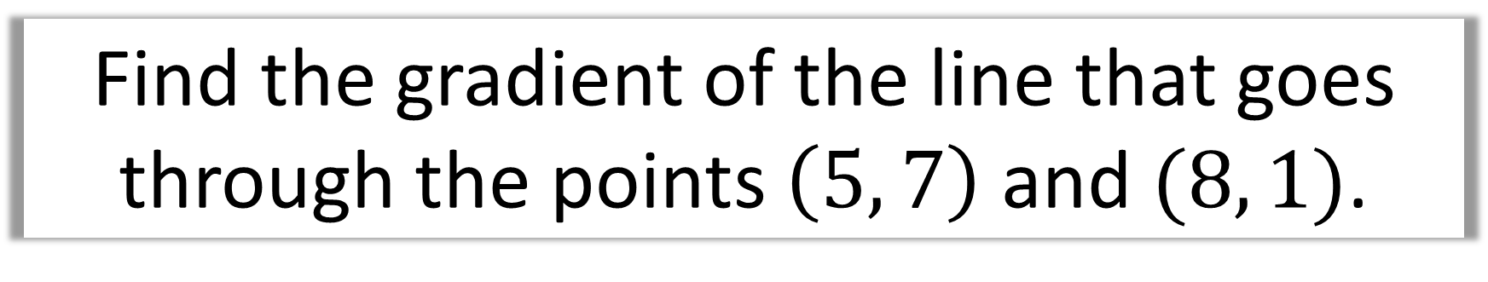
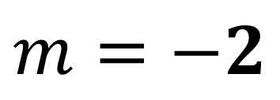
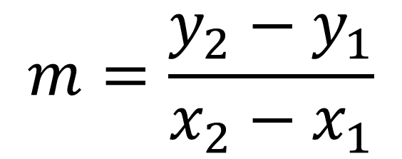
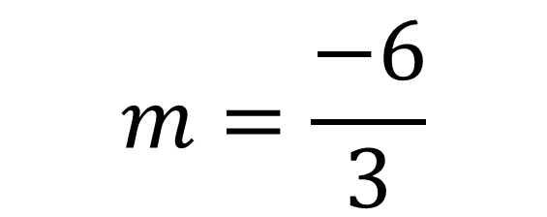
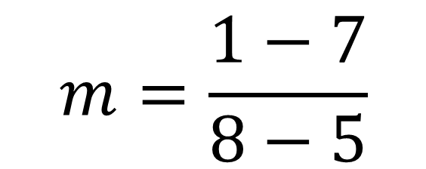
Find the gradient of the line that goes through the points $\left(5, 7\right) \text{and} (8, 1)$.
$$m=\frac{y_{2}−y_{1}}{x_{2}−x_{1}}$$
$$m=\frac{1−7}{8−5}$$
$$m=\frac{−6}{3}$$
$$m=−2$$

Slide 9
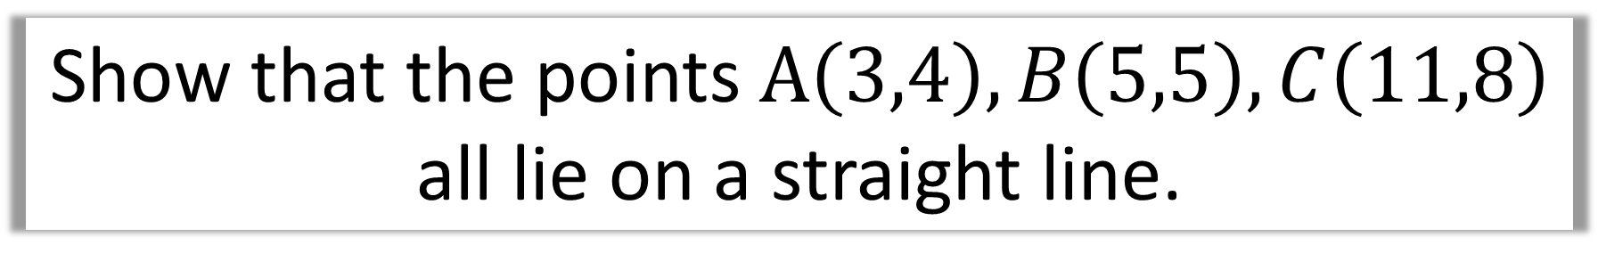
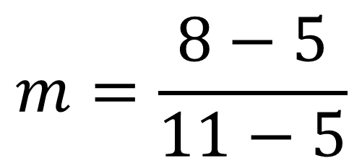

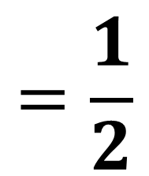
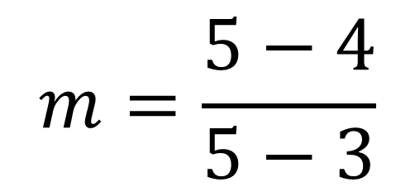
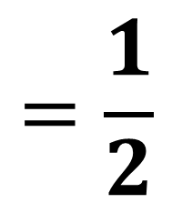
Show that the points $A\left(3,4\right),B\left(5,5\right),C\left(11,8\right)$
all lie on a straight line.
Gradient A to B
$$m=\frac{5−4}{5−3}$$
$$=\frac{1}{2}$$
Gradient B to C
$$m=\frac{8−5}{11−5}$$
$$=\frac{1}{2}$$
Gradients the same $∴$ ‘collinear’

Slide 10
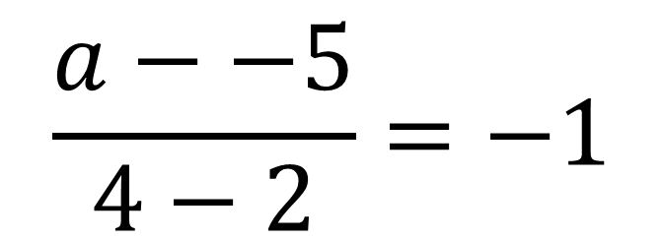
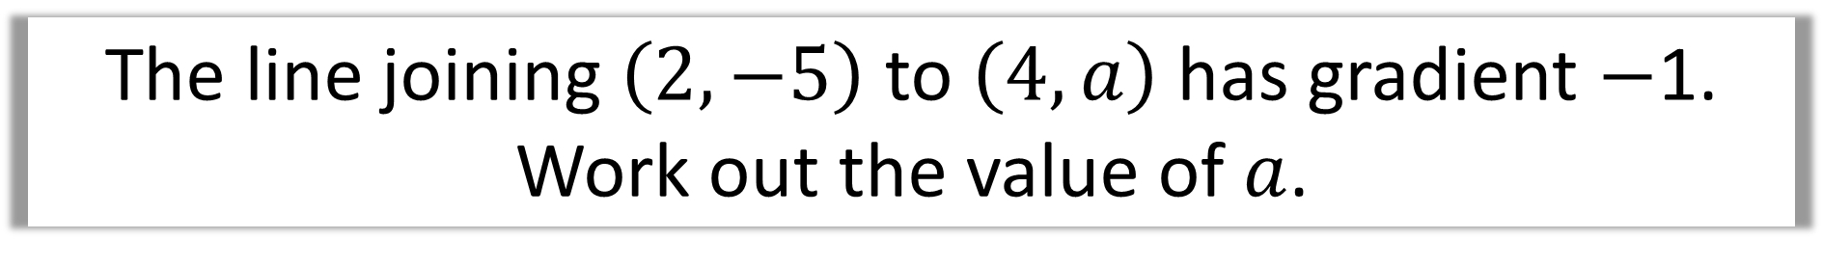

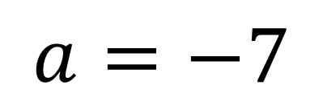
The line joining $\left(2,−5\right)$ to $\left(4,a\right)$ has gradient $−$1.
Work out the value of $a$.
$$\frac{a−−5}{4−2}=−1$$
$$\frac{a+5}{2}=−1$$
$$a=−7$$

Slide 11

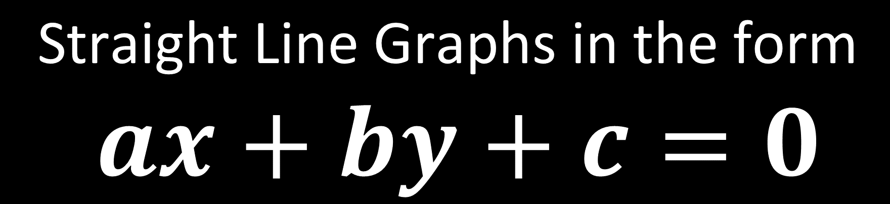
$$\text{Straight} \text{Line} \text{Graphs} \text{in} \text{the} \text{form}$$
$$ax+by+c=0$$
where $a,b,c$ are integers.
This is known as the ‘standard’ form.

Slide 12
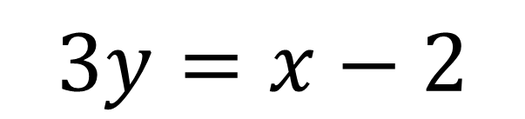
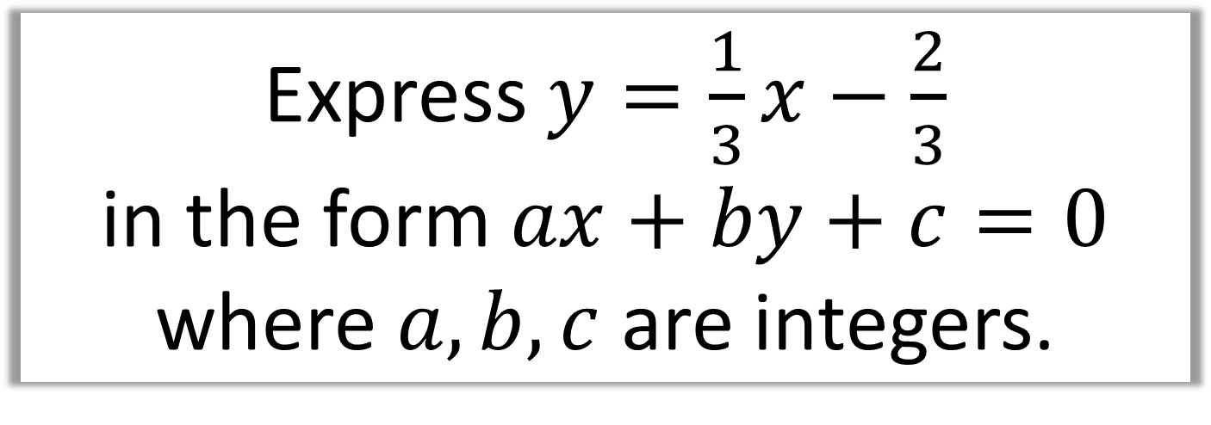
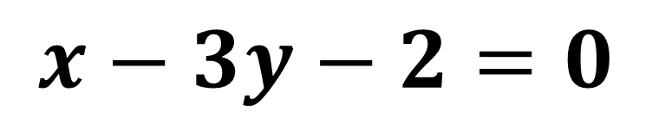
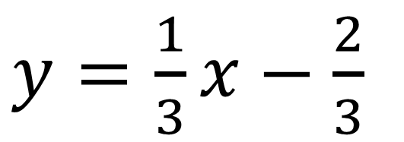
Express $y=\frac{1}{3}x−\frac{2}{3}$
in the form $ax+by+c=0$
where $a,b,c$ are integers.
$y=\frac{1}{3}x−\frac{2}{3}$
$$3y=x−2$$
$$x−3y−2=0$$

Slide 13

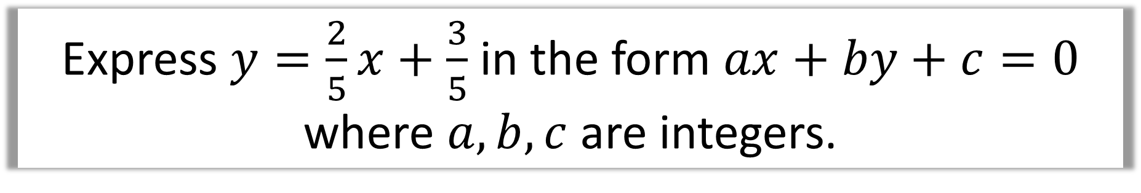
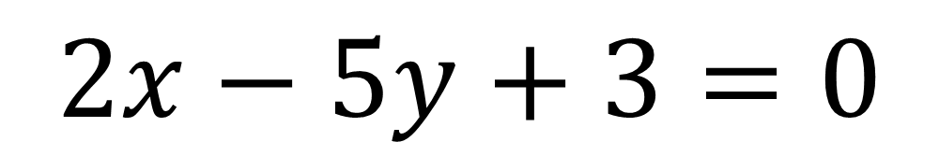
Express $y=\frac{2}{5}x+\frac{3}{5}$ in the form $ax+by+c=0$ where $a,b,c$ are integers.
Multiply through by 5
$$5y=2x+3$$
$$2x−5y+3=0$$

Slide 14
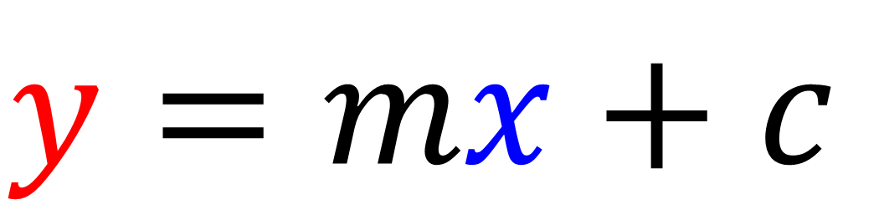

$$\text{Straight} \text{Line} \text{Graphs}$$
Writing Equations
$$y=mx+c$$
(x, y)
Identifying a co-ordinate that a line passes through can be very useful for finding m or c.

Slide 15
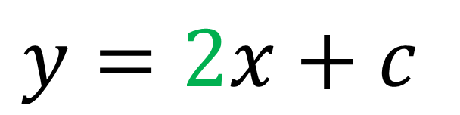

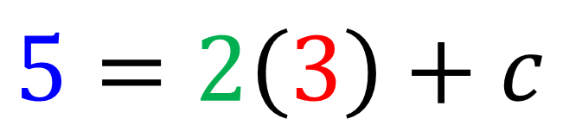


Find the equation of the line that goes
through $\left(3,5\right)$ and has gradient 2.
$$y=2x+c$$
$$5=2\left(3\right)+c$$
$$c=−1$$
$$y=2x−1$$

Slide 16

Another method for finding the equation of a line is to use……..
$$y−y_{1}=m\left(x−x_{1}\right)$$

Slide 17





Find the equation of the line that goes
through $\left(3,5\right)$ and has gradient 2.
$$y−y_{1}=m\left(x−x_{1}\right)$$
$$y−5=2\left(x−3\right)$$
$$y−5=2x −6$$
$$y=2x−1$$

Slide 18




Find the equation of the line that goes
through $\left(3,0\right)$ and has gradient $5$.
$$y−y_{1}=m\left(x−x_{1}\right)$$
$$y−0=5\left(x−3\right)$$
$$y=5x−15$$

Slide 19







Find the equation of the line that goes
through $\left(1,−5\right)$ and has gradient $\frac{1}{2}$.
in the form $ax+by+c=0$ where $a,b,c$ are integers.
$$y−y_{1}=m\left(x−x_{1}\right)$$
$$2y+10=x−1$$
$$y−−5=\frac{1}{2}\left(x−1\right)$$
$$2y=x−11$$
$$y+5=\frac{1}{2}x−\frac{1}{2}$$
$$2y−x+11=0$$

Slide 20







Find the equation of the line that goes through $\left(4,5\right)$ and $\left(6,2\right)$, giving your equation in the form $ax+by+c=0$
where $a,b,c$ are integers.
$$m=\frac{2−5}{6−4}=\frac{−3}{2}$$
$$2y−10=−3\left(x−4\right)$$
$$2y−10=−3x+12$$
$$y−y_{1}=m\left(x−x_{1}\right)$$
$$3x+2y−22=0$$
$$y−5=\frac{−3}{2}\left(x−4\right)$$

