Slide 1
Straight Line Graphs
Points of Intersection
Chapter 5
(Part 2 of 4)

Slide 2



Intersection of lines
To find the point of intersection,
solve the two equations simultaneously.
$$y$$
Point of Intersection
$$x$$
$$O$$

Slide 3




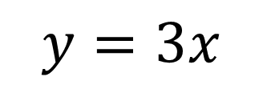
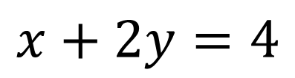
$$y$$
$$y=3x$$
$$P$$
$$x+2y=4$$
$$x$$
$$O$$
You can solve the simultaneous equations by elimination or substitution.

Slide 4




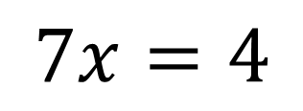
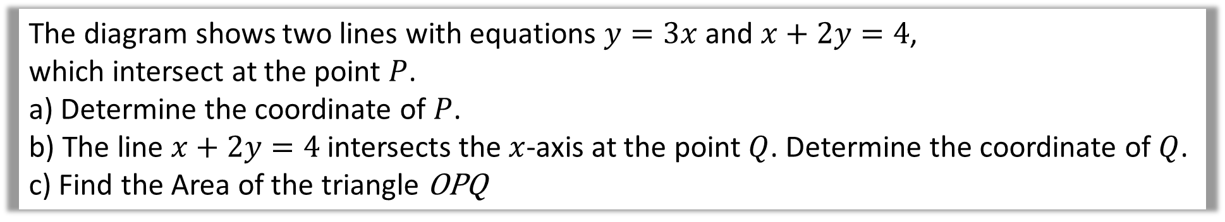

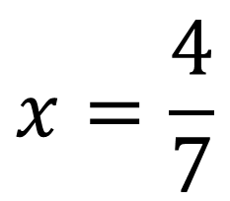

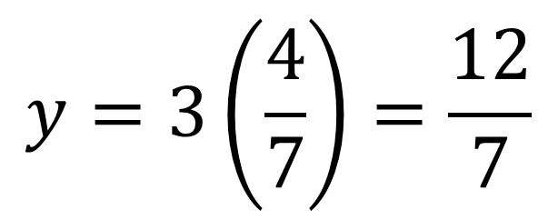

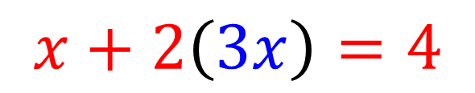
The diagram shows two lines with equations $y=3x$ and $x+2y=4$,
which intersect at the point $P$.
a) Determine the coordinate of $P$.
b) The line $x+2y=4$ intersects the $x$-axis at the point $Q$. Determine the coordinate of $Q$.
c) Find the Area of the triangle OPQ
a)
$$x+2\left(3x\right)=4$$
$$y$$
$$y=3x$$
$$7x=4$$
$$P$$
$$x=\frac{4}{7}$$
$$y=3\left(\frac{4}{7}\right)=\frac{12}{7}$$
$$x+2y=4$$
$P(\frac{4}{7}$, $\frac{12}{7})$
$$x$$
$$O$$

Slide 5

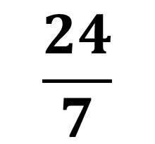
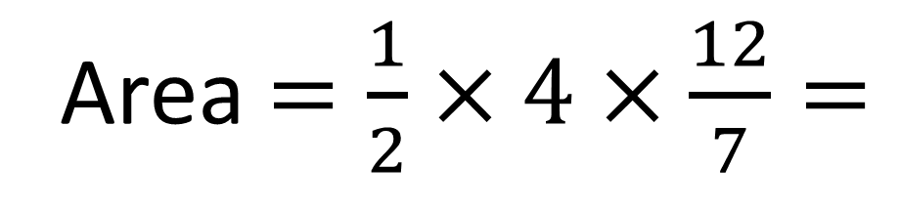


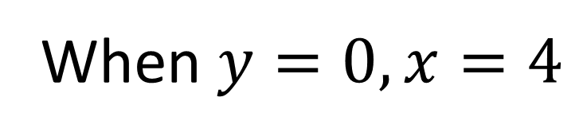


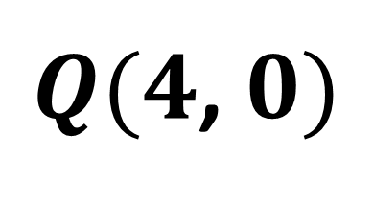



The diagram shows two lines with equations $y=3x$ and $x+2y=4$,
which intersect at the point $P$.
a) Determine the coordinates of $P$.
b) The line $x+2y=4$ intersects the $x$-axis at the point $Q$. Determine the coordinate of $Q$.
c) Find the Area of the triangle OPQ
b)
When $y=0, x=4$
$Q(4$, $0)$
$$y$$
$$y=3x$$
c)
$$\frac{12}{7}$$
$$P$$
Area $=\frac{1}{2}×4×\frac{12}{7}=$
$$\frac{24}{7}$$
$$x$$
$$0$$
$$4$$

Slide 6
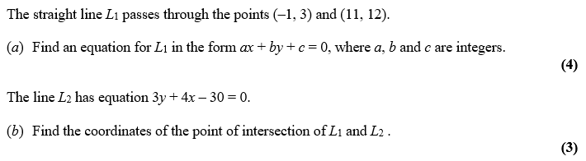
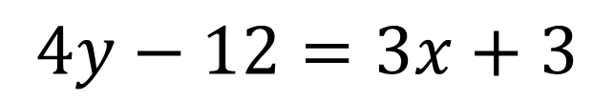
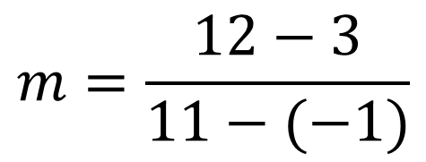
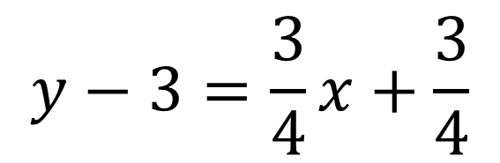
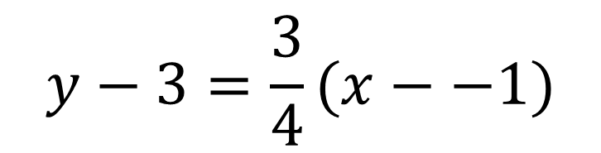
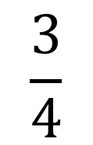
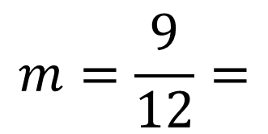
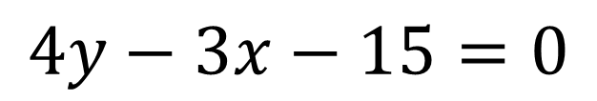
a)
$$y−3=\frac{3}{4}(x−−1)$$
$$m=\frac{12−3}{11−(−1)}$$
$$4y−12=3x+3$$
$$y−3=\frac{3}{4}x+\frac{3}{4}$$
$$4y−3x−15=0$$
$$m=\frac{9}{12}=$$
$$\frac{3}{4}$$

Slide 7
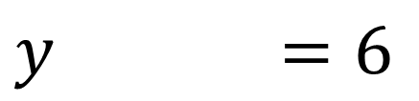
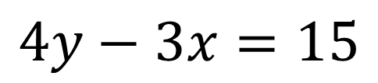
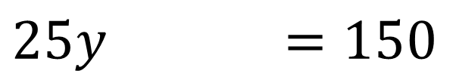
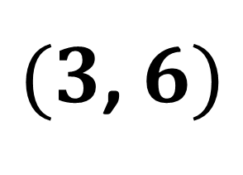
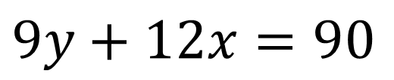
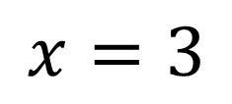
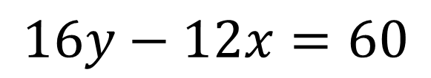
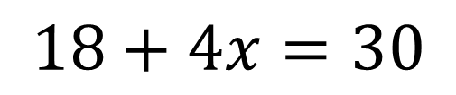
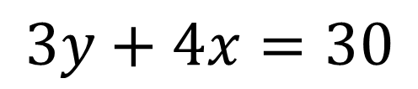
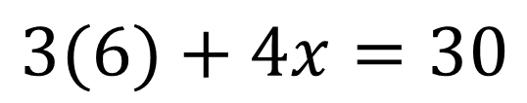
b)
$$4y−3x=15$$
$$16y−12x=60$$
$$3(6)+4x=30$$
$$3y+4x=30$$
$$9y+12x=90$$
$$18+4x=30$$
$$25y =150$$
$$x=3$$
$$y =6$$
$(3$, $6)$

