Slide 1
Numerical Solutions
Newton Raphson Process
Chapter 10
(Part 3 of 3)

Slide 2
The Newton-Raphson Process
Newton–Raphson method,
named after Isaac Newton
and Joseph Raphson,
is a method for finding
approximations to the
roots of a function.

Slide 3

$$x_{n+1}=x_{n}−\frac{f\left(x_{n}\right)}{f^{′}\left(x_{n}\right)}$$
It is in the formulae booklet.

Slide 4


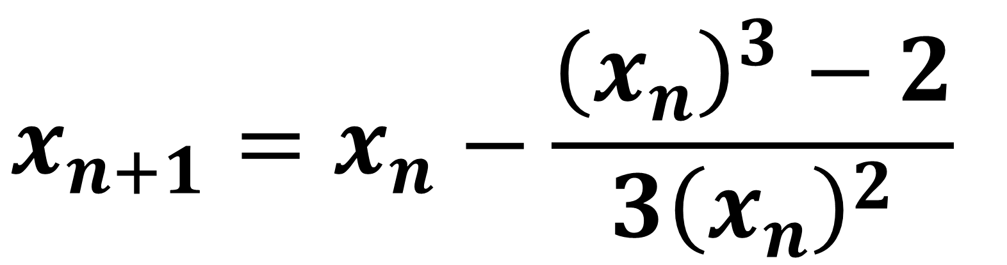
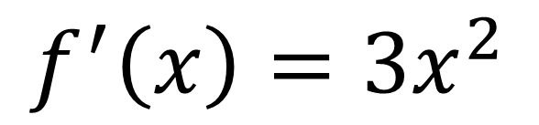
$$x_{n+1}=x_{n}−\frac{f\left(x_{n}\right)}{f^{′}\left(x_{n}\right)}$$
$$f\left(x\right)=x^{3}−2$$
$$f^{′}\left(x\right)={3x}^{2}$$
$$x_{n+1}=x_{n}−\frac{{\left(x_{n}\right)}^{3}−2}{3{\left(x_{n}\right)}^{2}}$$

Slide 5

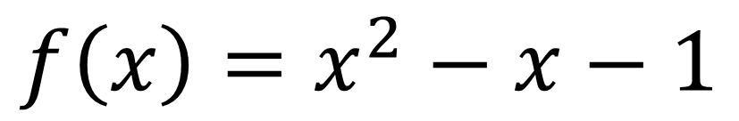
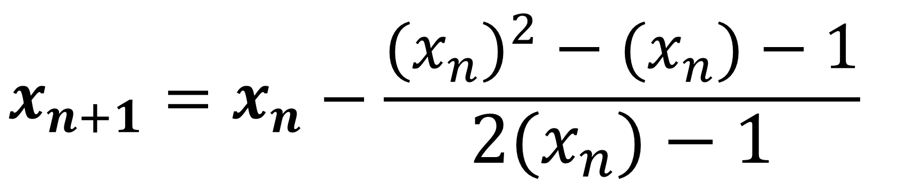
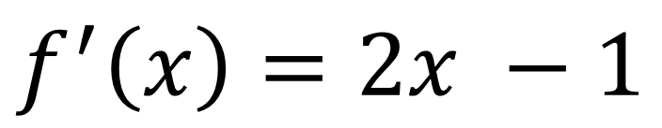
$$x_{n+1}=x_{n}−\frac{f\left(x_{n}\right)}{f^{′}\left(x_{n}\right)}$$
$$f\left(x\right)=x^{2}−x−1$$
$$f^{′}\left(x\right)=2x −1$$
$$x_{n+1}=x_{n}−\frac{{{(x}_{n})}^{2}−{(x}_{n})−1}{{2(x}_{n})−1}$$

Slide 6

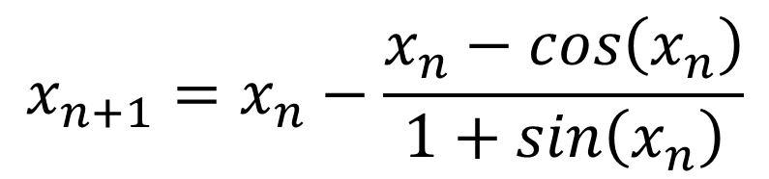

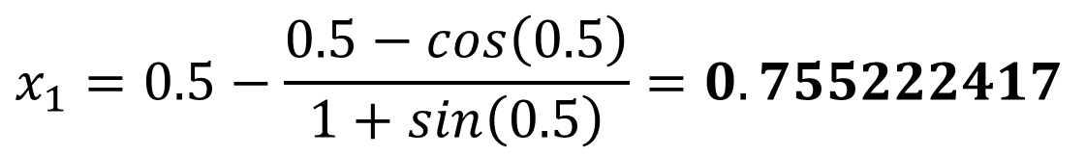


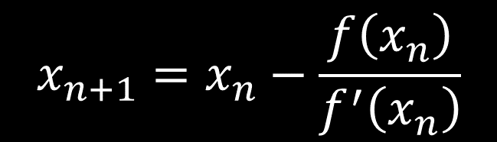
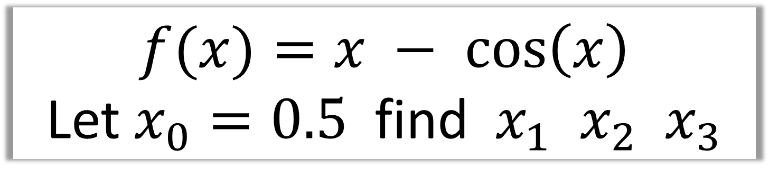
$f(x)=x − cos\left(x\right)$
Let $x_{0}=0.5$ find${ x}_{1}$ $x_{2} x_{3}$
Use radians
$$x_{n+1}=x_{n}−\frac{f\left(x_{n}\right)}{f^{′}\left(x_{n}\right)}$$
$$x_{n+1}=x_{n}−\frac{x_{n}−cos\left(x_{n}\right)}{1+sin\left(x_{n}\right)}$$
$$f\left(x\right)=x−cos$$
$$x_{1}=0.5−\frac{0.5−cos\left(0.5\right)}{1+sin\left(0.5\right)}=0.755222417$$
$$f^{′}\left(x\right)=1+\sin{x}$$
$$x_{2}=0.739141$$
$$x_{3}=0.739085$$

Slide 7
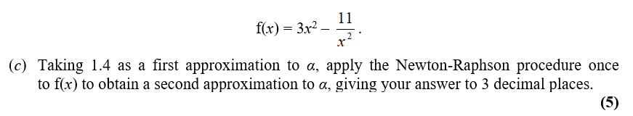
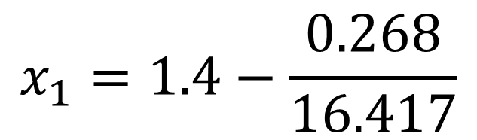
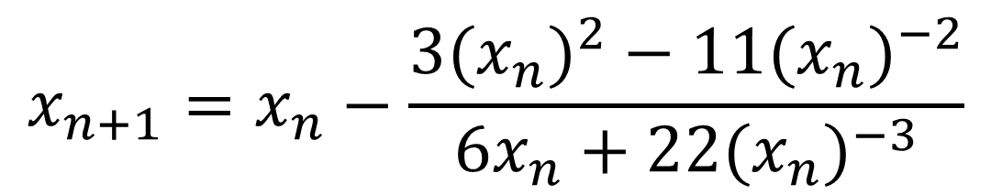
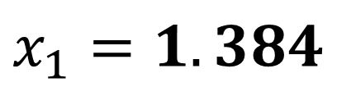


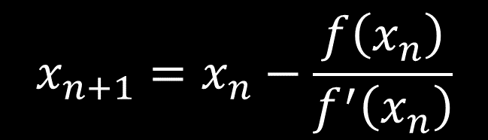
$$x_{n+1}=x_{n}−\frac{f\left(x_{n}\right)}{f^{′}\left(x_{n}\right)}$$
$$x_{n+1}=x_{n}−\frac{{3(x_{n})}^{2}−11{{(x}_{n})}^{−2}}{6x_{n}+22{(x_{n})}^{−3}}$$
$$f\left(x\right)={3x}^{2}−11x^{−2}$$
$$x_{1}=1.4−\frac{0.268}{16.417}$$
$$f^{′}\left(x\right)=6x+22x^{−3}$$
$$x_{1}=1.384$$

Slide 8
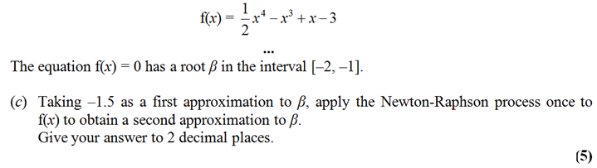

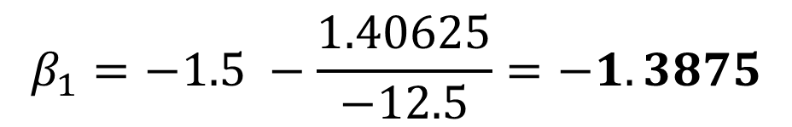

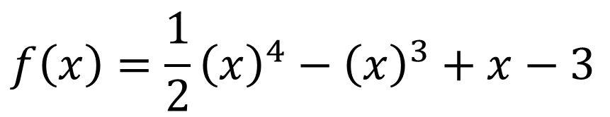
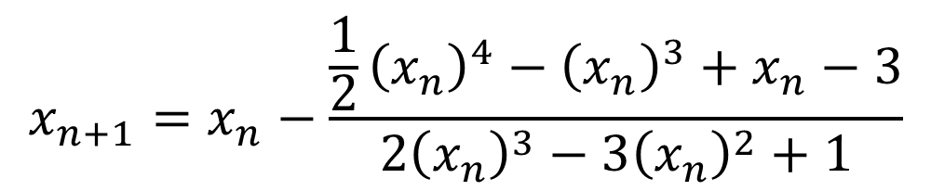
$$x_{n+1}=x_{n}−\frac{f\left(x_{n}\right)}{f^{′}\left(x_{n}\right)}$$
$$x_{n+1}=x_{n}−\frac{\frac{1}{2}{\left(x_{n}\right)}^{4}−{\left(x_{n}\right)}^{3}+x_{n}−3}{2{\left(x_{n}\right)}^{3}−3{\left(x_{n}\right)}^{2}+1}$$
$$f\left(x\right)=\frac{1}{2}{\left(x\right)}^{4}−{\left(x\right)}^{3}+x−3$$
$$β_{1}=−1.5 −\frac{1.40625}{−12.5}=−1.3875$$
$$f^{′}\left(x\right)=2{\left(x_{n}\right)}^{3}−3{\left(x_{n}\right)}^{2}+1$$

Slide 9
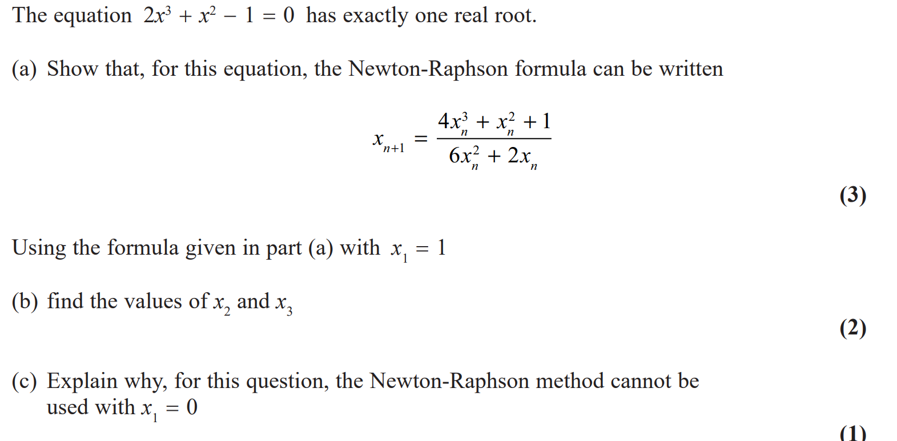

Slide 10
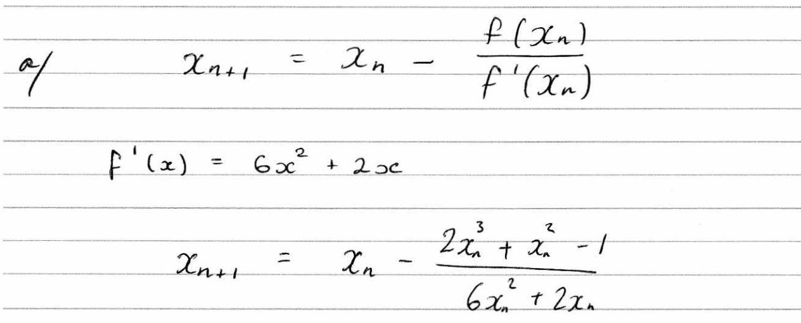
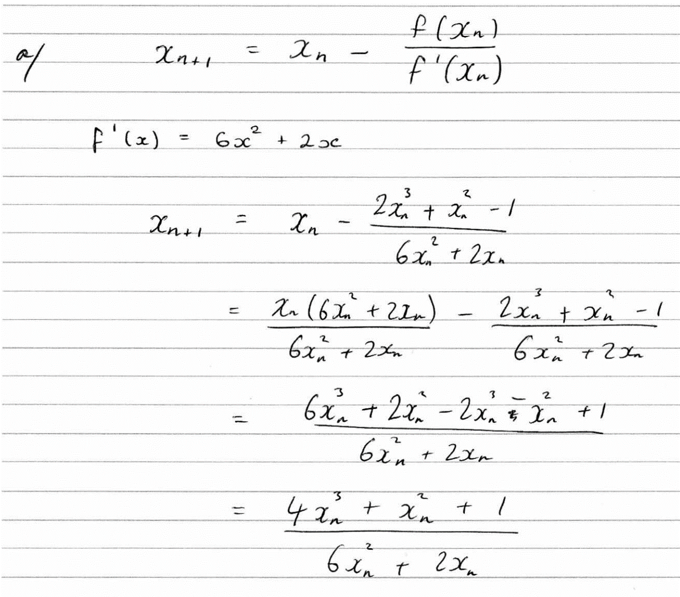

Slide 11
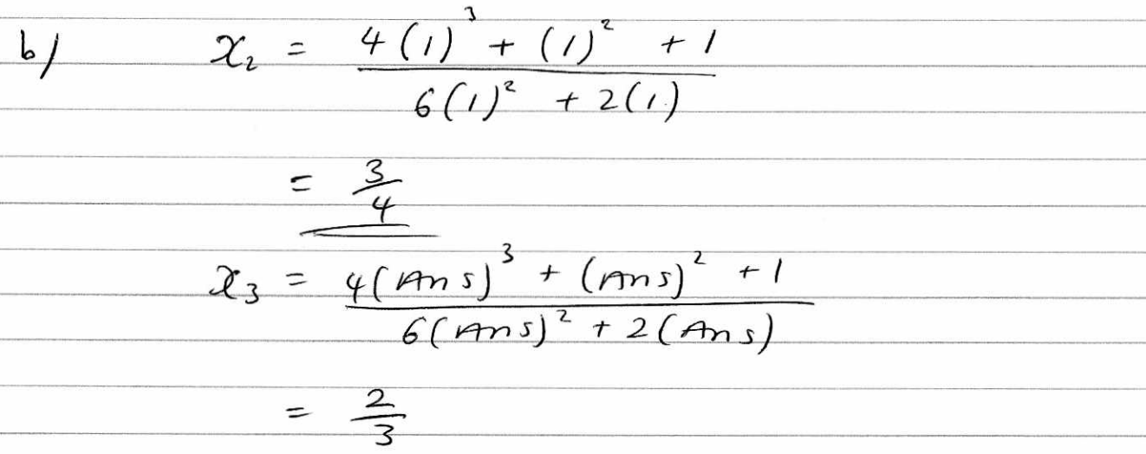
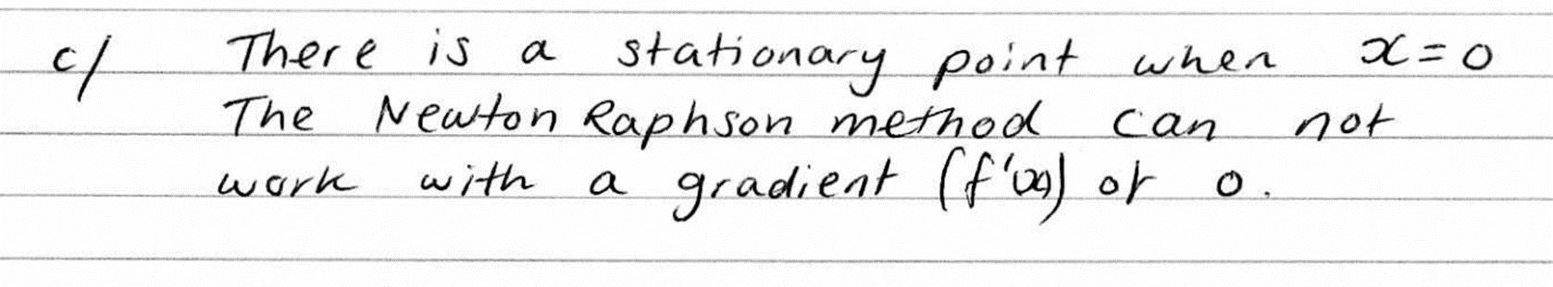

Slide 12
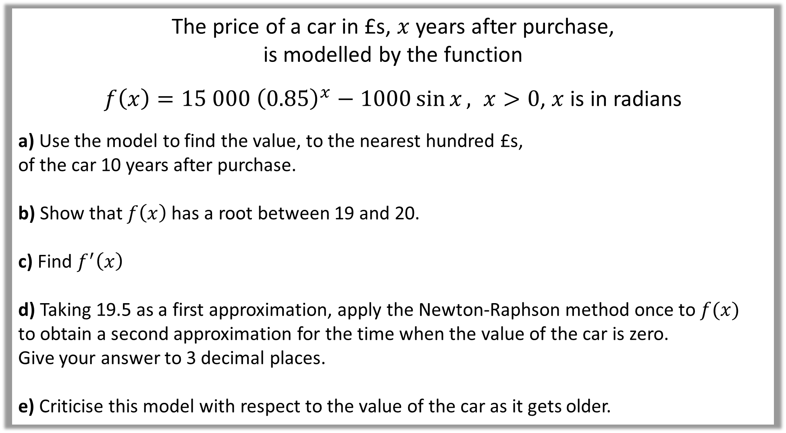
The price of a car in £s, $x$ years after purchase,
is modelled by the function
$f\left(x\right)=15 000 {\left(0.85\right)}^{x}−1000\sin{x}, x>0$, $x$ is in radians
a) Use the model to find the value, to the nearest hundred £s,
of the car 10 years after purchase.
b) Show that $f\left(x\right)$ has a root between 19 and 20.
c) Find $f^{′}\left(x\right)$
d) Taking 19.5 as a first approximation, apply the Newton-Raphson method once to $f(x)$
to obtain a second approximation for the time when the value of the car is zero.
Give your answer to 3 decimal places.
e) Criticise this model with respect to the value of the car as it gets older.

Slide 13
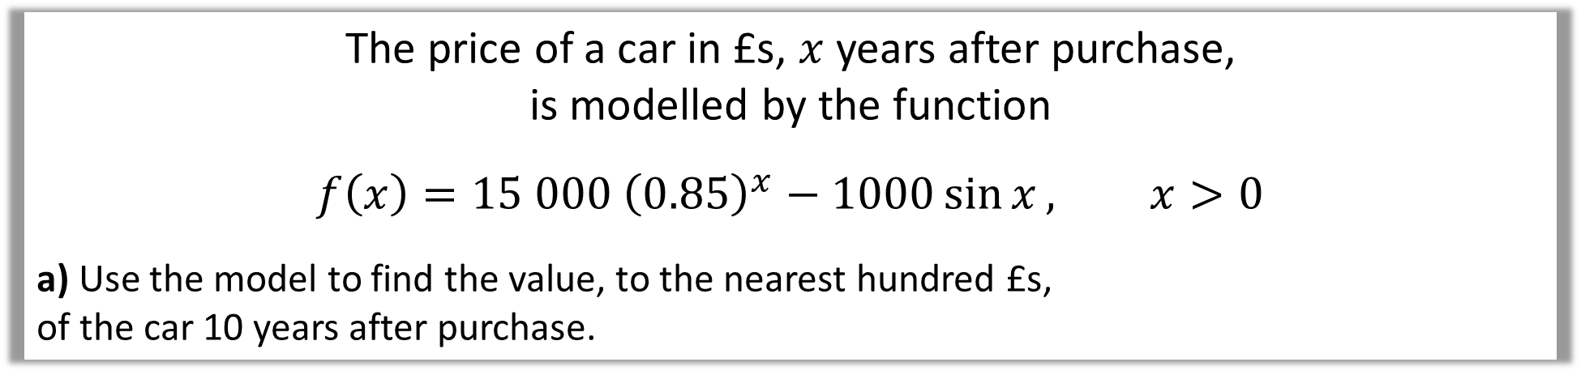
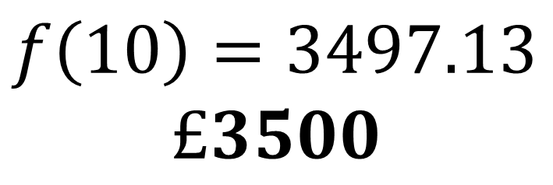
The price of a car in £s, $x$ years after purchase,
is modelled by the function
$$f\left(x\right)=15 000 {\left(0.85\right)}^{x}−1000\sin{x}, x>0$$
a) Use the model to find the value, to the nearest hundred £s,
of the car 10 years after purchase.
a)
$$f\left(10\right)=3497.13$$
$$£3500$$

Slide 14
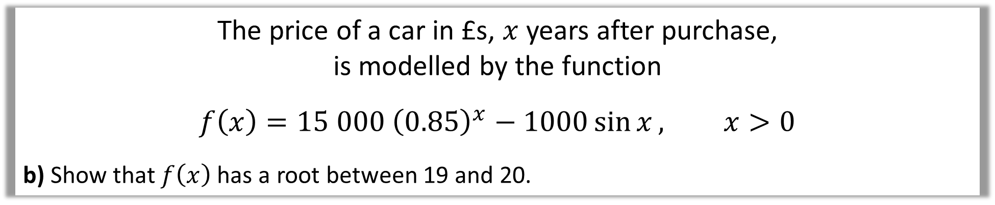
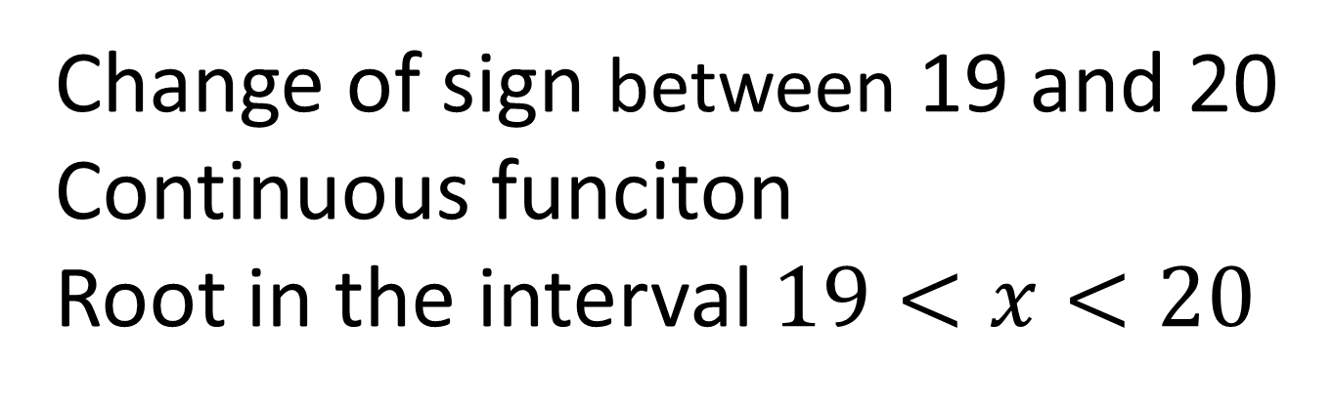
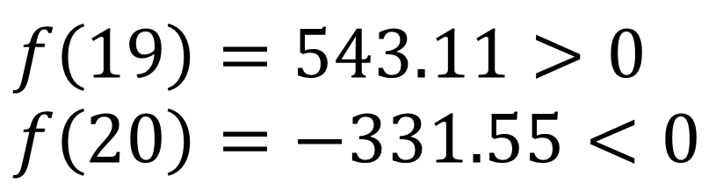
The price of a car in £s, $x$ years after purchase,
is modelled by the function
$$f\left(x\right)=15 000 {\left(0.85\right)}^{x}−1000\sin{x}, x>0$$
b) Show that $f\left(x\right)$ has a root between 19 and 20.
$$f\left(19\right)=543.11>0 \\ f\left(20\right)=−331.55<0$$
b)
Change of sign between 19 and 20
Continuous funciton
Root in the interval $19<x<20$

Slide 15
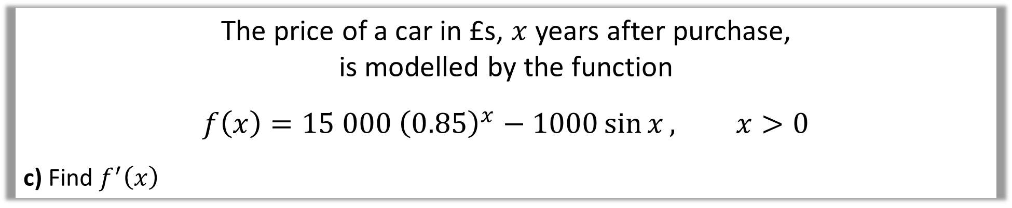
The price of a car in £s, $x$ years after purchase,
is modelled by the function
$$f\left(x\right)=15 000 {\left(0.85\right)}^{x}−1000\sin{x}, x>0$$
c) Find $f^{′}\left(x\right)$
c)
$$f^{′}\left(x\right)=\left(15 000\right){\left(0.85\right)}^{x}\left(\ln{0.85}\right)−1000\cos{x}$$

Slide 16
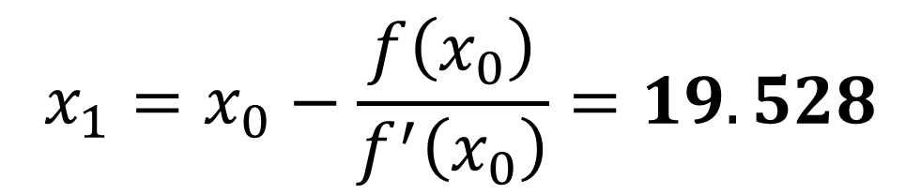
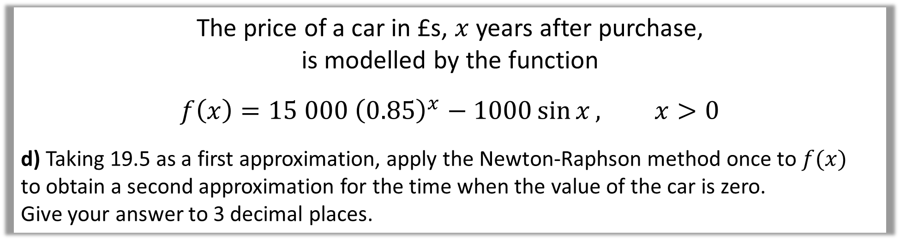

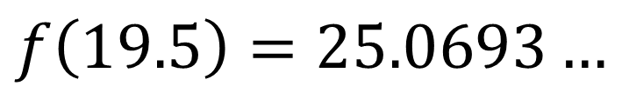
The price of a car in £s, $x$ years after purchase,
is modelled by the function
$$f\left(x\right)=15 000 {\left(0.85\right)}^{x}−1000\sin{x}, x>0$$
d) Taking 19.5 as a first approximation, apply the Newton-Raphson method once to $f(x)$
to obtain a second approximation for the time when the value of the car is zero.
Give your answer to 3 decimal places.
d)
$$f^{′}\left(x\right)=\left(15 000\right){\left(0.85\right)}^{x}\left(\ln{0.85}\right)−1000\cos{x}$$
$$f\left(19.5\right)=25.0693…$$
$$f^{′}\left(19.5\right)=−898.3009…$$
$$x_{1}=x_{0}−\frac{f\left(x_{0}\right)}{f^{′}\left(x_{0}\right)}=19.528$$

Slide 17

The price of a car in £s, $x$ years after purchase,
is modelled by the function
$$f\left(x\right)=15 000 {\left(0.85\right)}^{x}−1000\sin{x}, x>0$$
e) Criticise this model with respect to the value of the car as it gets older.
e)
In reality, the car can never have a negative value
so this model is not reasonable for cars that are approximately 20 or more years old.

