Slide 1
LO: Fractional and
Negative Indices

Slide 2
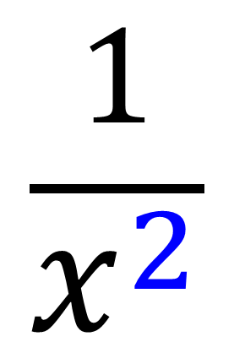
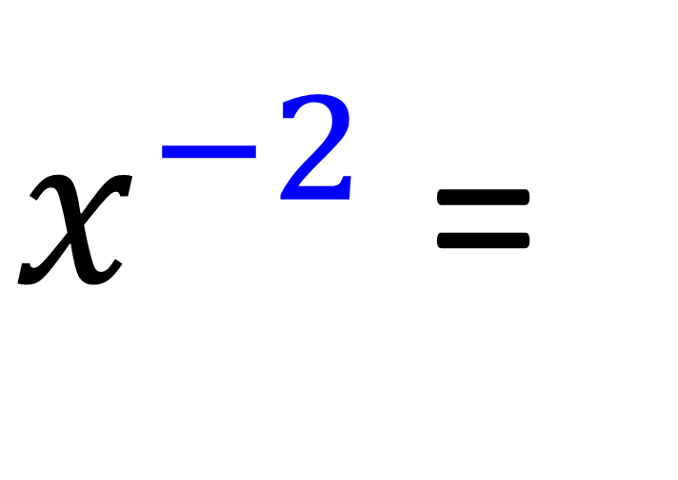
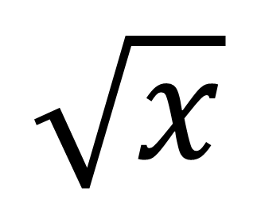
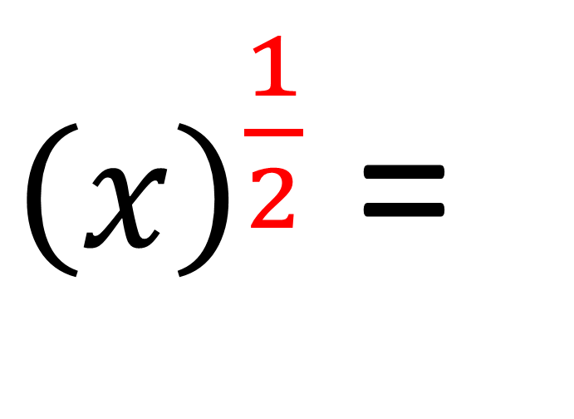
$$\frac{1}{x^{2}}$$
$x^{−2}$ =
${\left(x\right)}^{\frac{1}{2}}$ =
$$\sqrt{x}$$

Slide 3
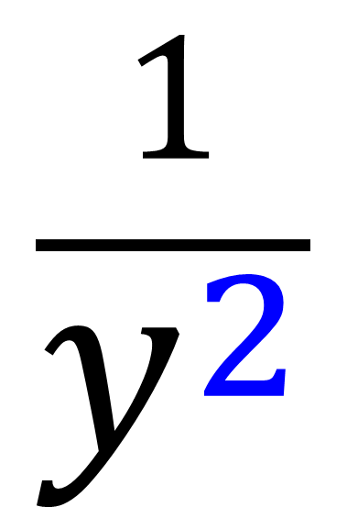

Write as a fraction
$$\frac{1}{y^{2}}$$
$y^{−2}$ =

Slide 4
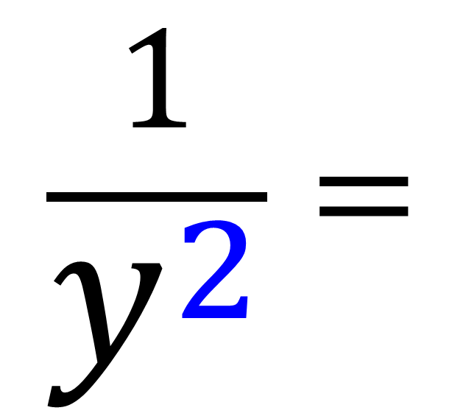
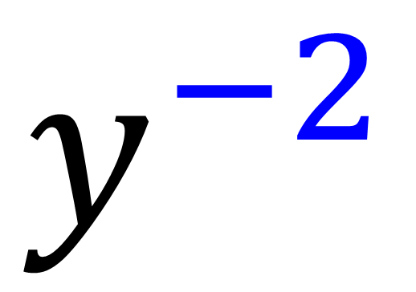
Write as a negative index
$$\frac{1}{y^{2}}=$$
$$y^{−2}$$

Slide 5
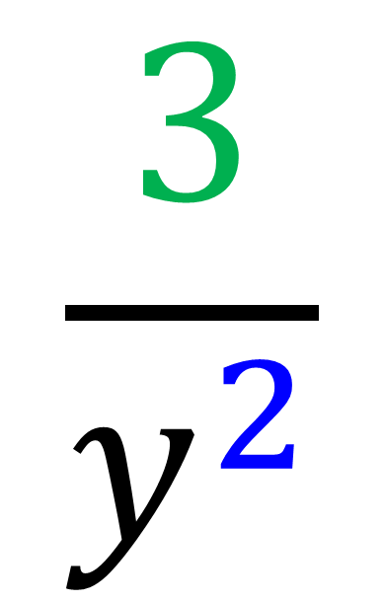
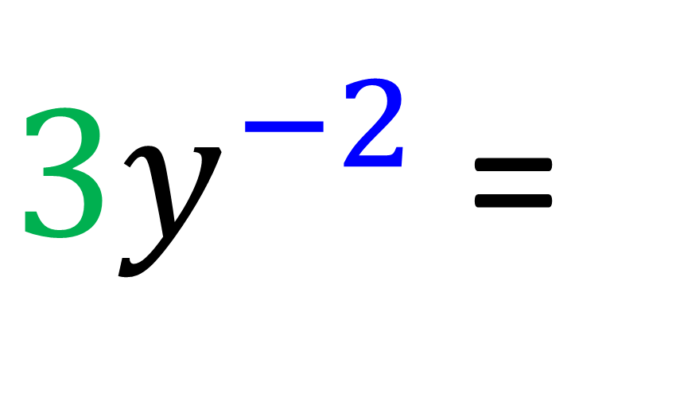
Write as a fraction
$$\frac{3}{y^{2}}$$
${3y}^{−2}$ =

Slide 6
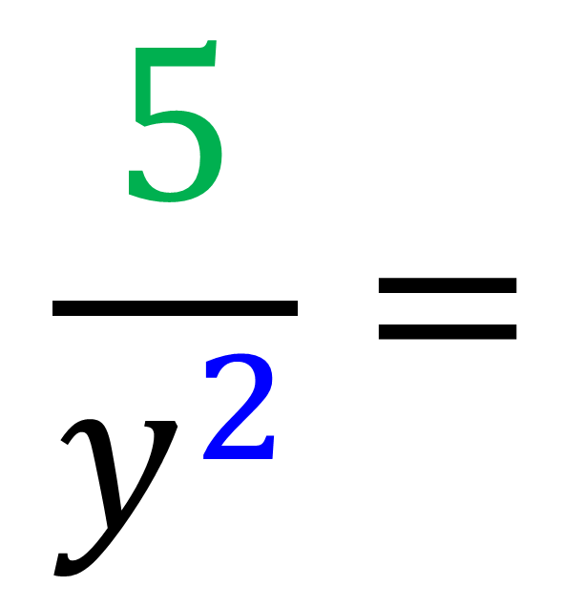
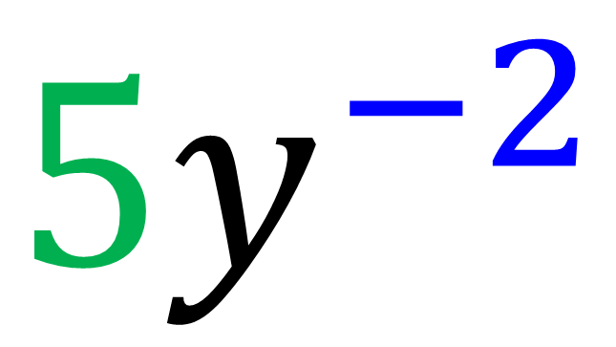
Write as a negative index
$$\frac{5}{y^{2}}=$$
${5y}^{−2}$

Slide 7
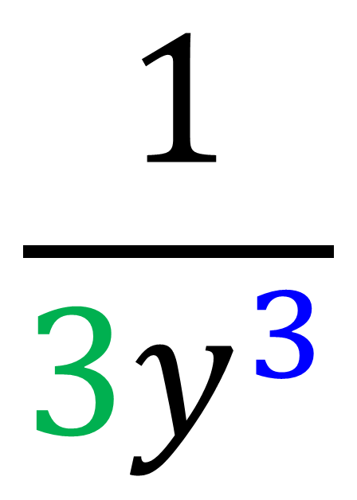
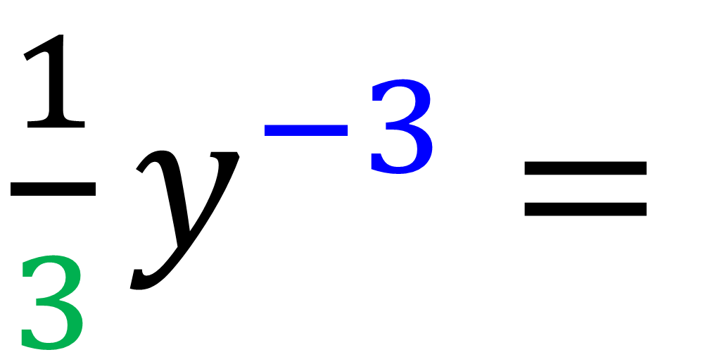
Write as a fraction
$$\frac{1}{{3y}^{3}}$$
$\frac{1}{3}y^{−3}=$

Slide 8
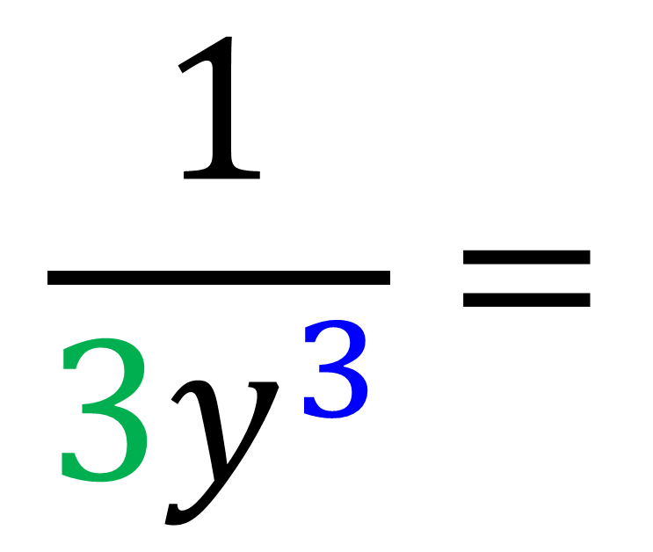
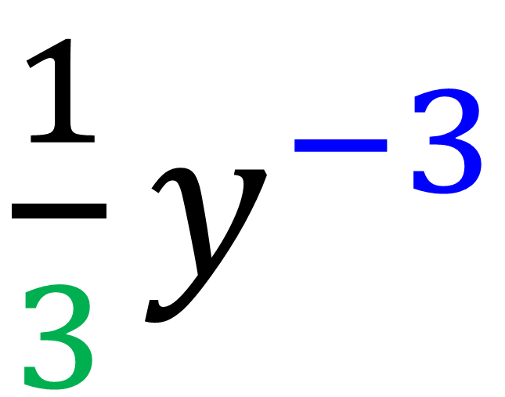
Write as a negative index
$$\frac{1}{{3y}^{3}}=$$
$\frac{1}{3}y^{−3}$

Slide 9
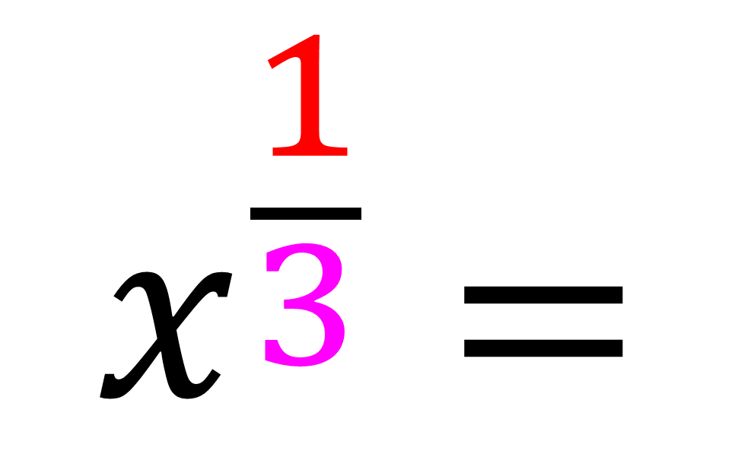
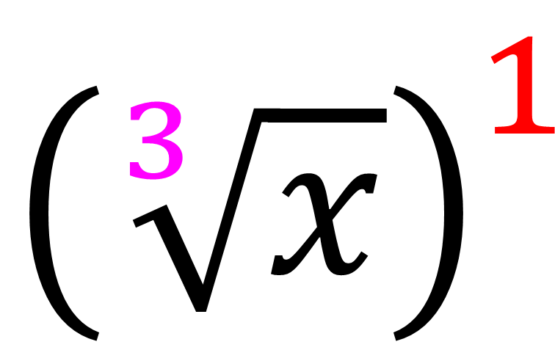
Write as a root
$$x^{\frac{1}{3}}=$$
$${\left(\sqrt[3]{x}\right)}^{1}$$

Slide 10
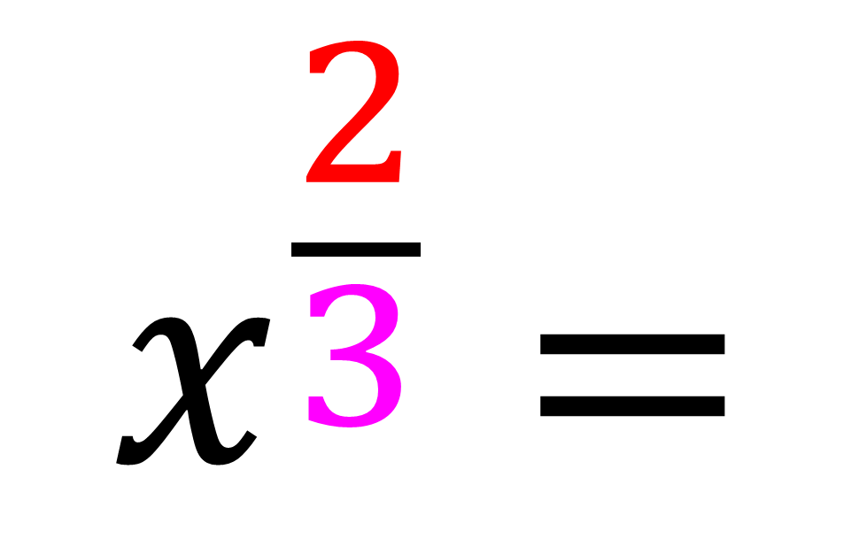
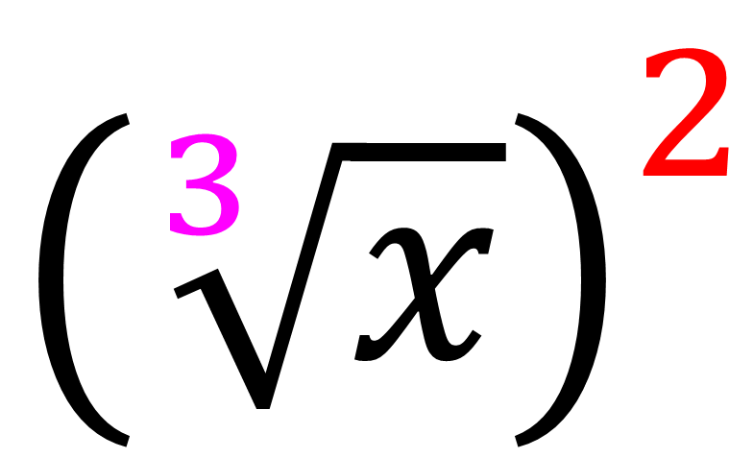
Write as a root
$$x^{\frac{2}{3}}=$$
$${\left(\sqrt[3]{x}\right)}^{2}$$

Slide 11
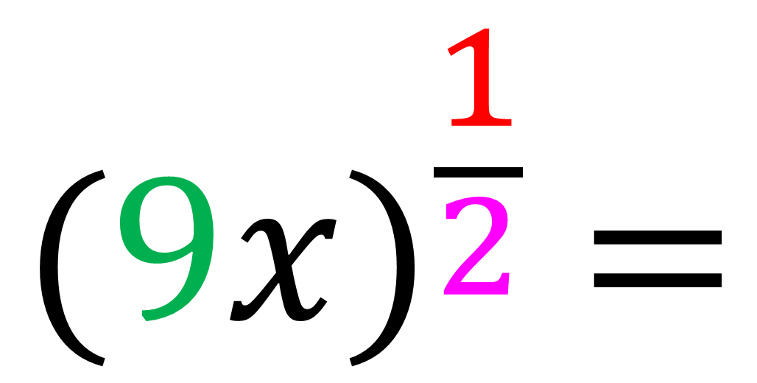
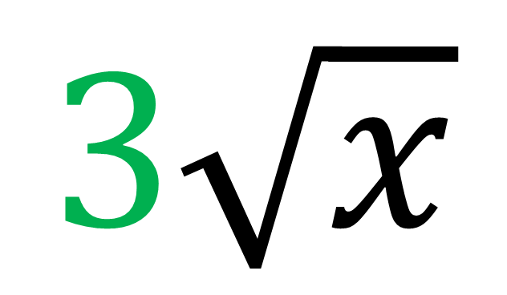
Write as a root
$${(9x)}^{\frac{1}{2}} =$$
$$3\sqrt{x}$$

