Slide 1
Differentiation
Introduction
Chapter 12
(Part 1 of 8)

Slide 2
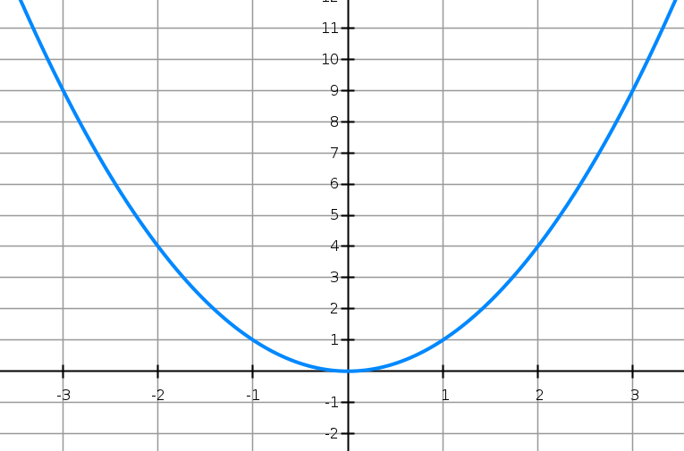
What is the gradient of the curve?
It is different at any given point.

Slide 3
How can you find the gradient at any given point?
Find the gradient of the tangent at the given point.

Slide 4
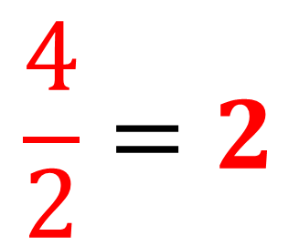
What is the gradient of the tangent when x = 1?
$$\frac{4}{2}=2$$

Slide 5
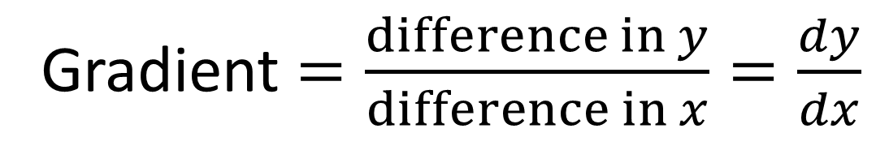





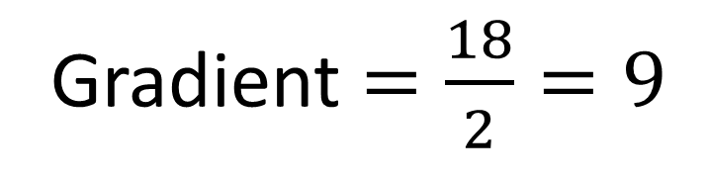
Gradient of the Tangent
$$\left(3,20\right)$$
$$18$$
Gradient $=\frac{18}{2}=9$
$$2$$
$$y=x^{2}$$
$$\left(1,2\right)$$
Gradient $=\frac{difference in y}{difference in x}=\frac{dy}{dx}$

Slide 6







What things do you notice about the gradients?
$$m=−6$$
$$m=6$$
$$m=−4$$
$$m=4$$
$$m=−2$$
$$m=2$$
$$m=0$$

Slide 7


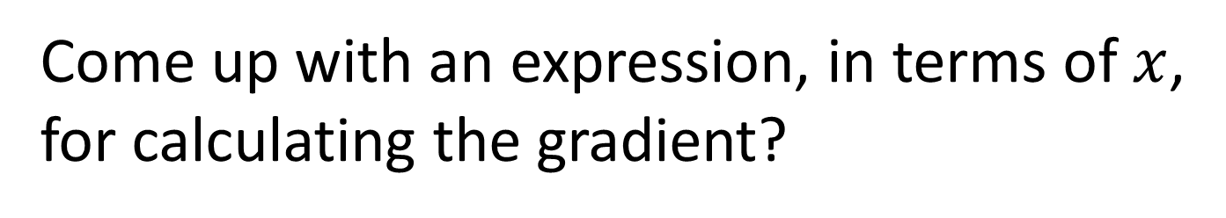


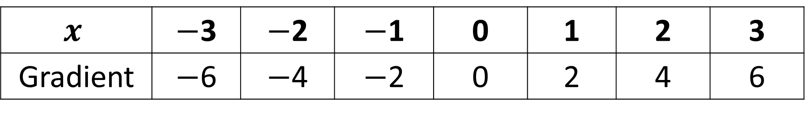

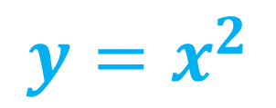

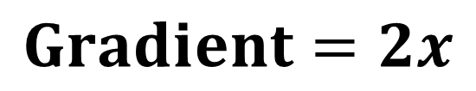

$$y=x^{2}$$
$$m=−6$$
$$m=6$$
$$m=−4$$
$$m=4$$
$$m=−2$$
$$m=2$$
$$m=0$$
$$x$$ | $−$3 | $−$2 | $−$1 | 0 | 1 | 2 | 3
Gradient | $−$6 | $−$4 | $−$2 | 0 | 2 | 4 | 6
Come up with an expression, in terms of $x$,
for calculating the gradient?
$$Gradient=2x$$

Slide 8
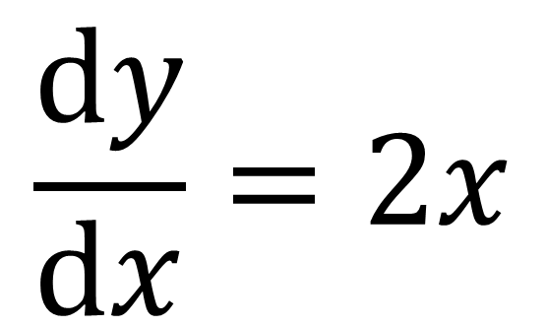
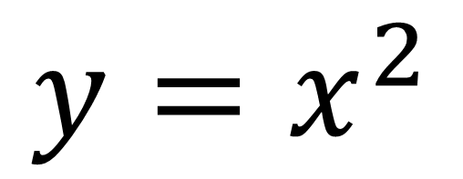
Differentiation
Differentiating is the process of
taking the equation of the curve
and coming up with a formula that
calculates the gradient of the curve.
$$\frac{dy}{dx}=2x$$
$$y=x^{2}$$

Slide 9
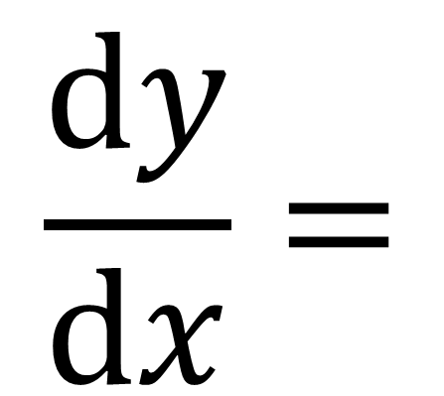
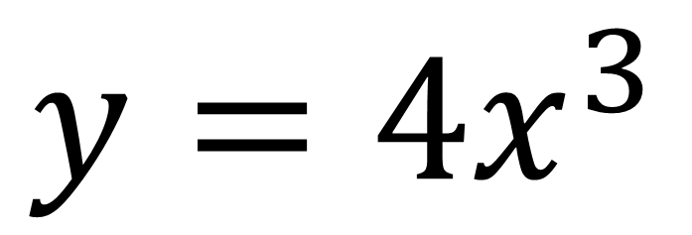
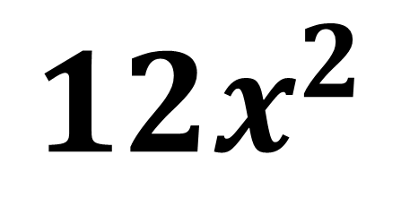
Differentiation Process
Step 1: Multiply the term by the original power
Step 2: Subtract 1 from the power
$$\frac{dy}{dx}=$$
$$y={4x}^{3}$$
$${12x}^{2}$$

Slide 10
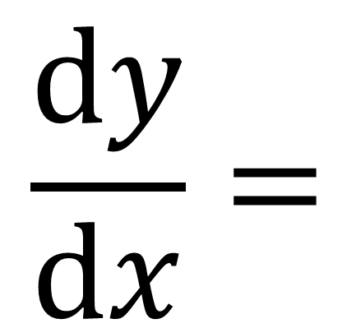
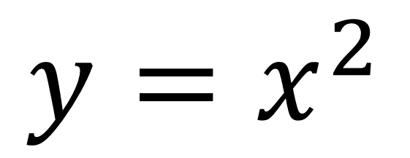
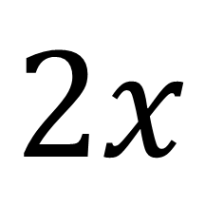
Differentiation
$$y=x^{2}$$
$$\frac{dy}{dx}=$$
$$2x$$

Slide 11
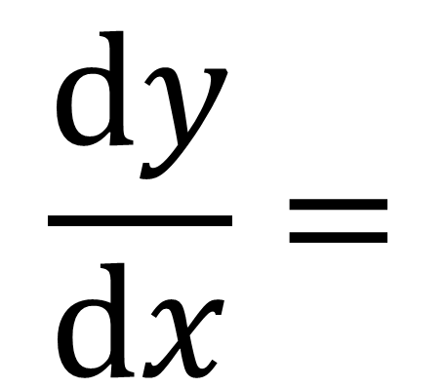
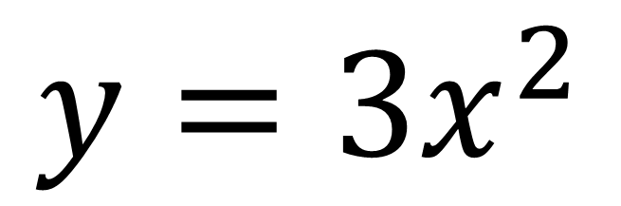
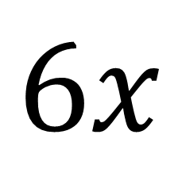
Differentiation
$$y={3x}^{2}$$
$$\frac{dy}{dx}=$$
$$6x$$

Slide 12
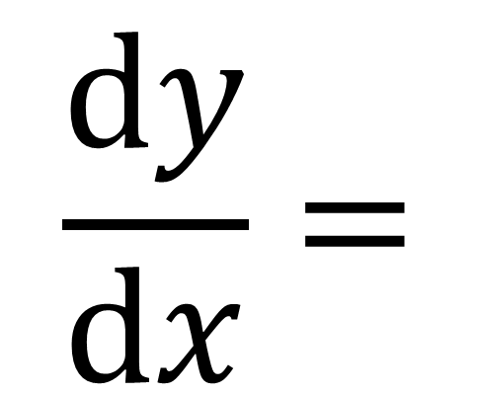
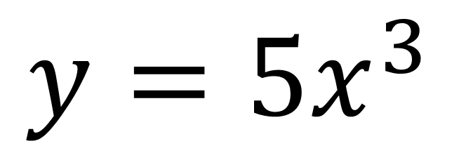
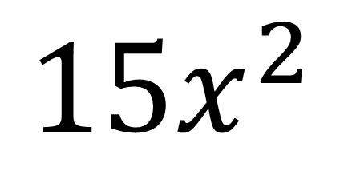
Differentiation
$$y={5x}^{3}$$
$$\frac{dy}{dx}=$$
$${15x}^{2}$$

Slide 13
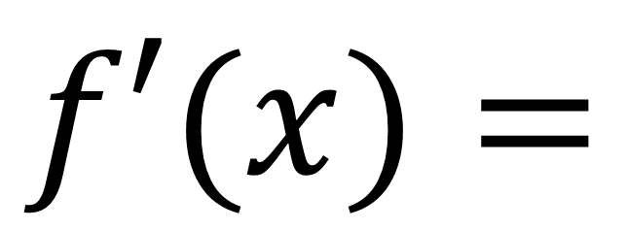
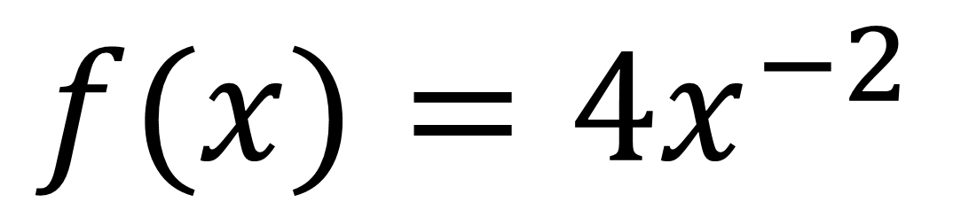
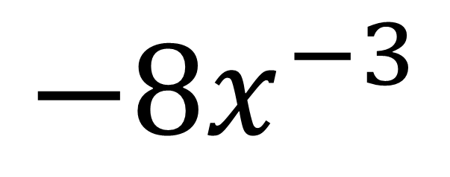
Differentiation
$$f(x)={4x}^{−2}$$
$$f′(x)=$$
$${−8x}^{−3}$$

Slide 14
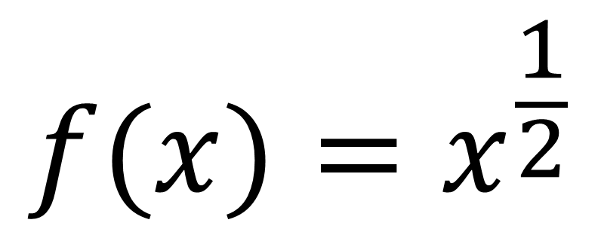
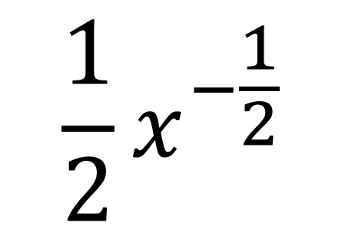
Differentiation
$$f(x)=x^{\frac{1}{2}}$$
$$\frac{1}{2}x^{−\frac{1}{2}}$$
$$f′(x)=$$

Slide 15
Differentiation - Rewrite
Sometimes you need to rewrite the equation before you can differentiate.

Slide 16
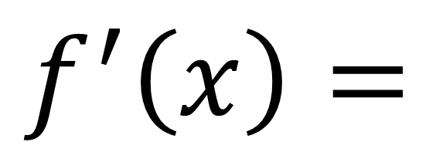
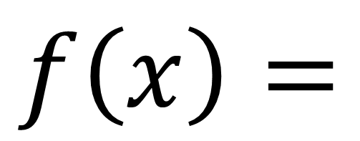
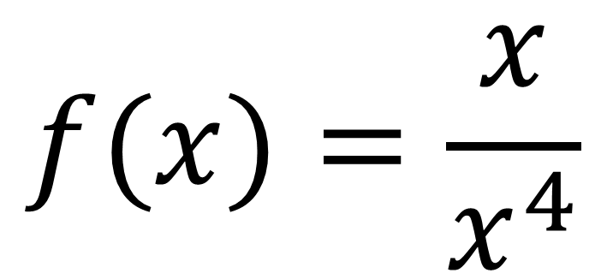
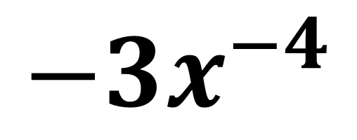
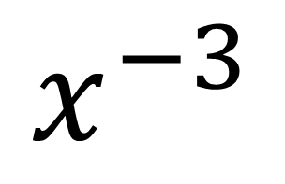
Differentiation
$$f(x)=\frac{x}{x^{4}}$$
$$f\left(x\right)=$$
$$x^{−3}$$
$$f^{′}\left(x\right)=$$
$$−3x^{−4}$$

Slide 17
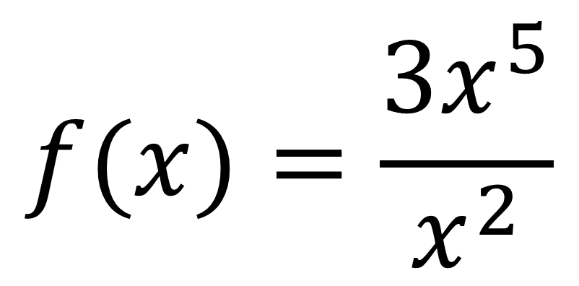
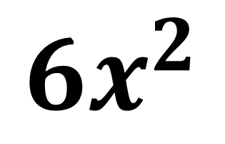
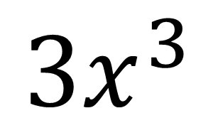
Differentiation
$$f(x)=\frac{3x^{5}}{x^{2}}$$
$$f\left(x\right)=$$
$${3x}^{3}$$
$$f^{′}\left(x\right)=$$
$$6x^{2}$$

Slide 18
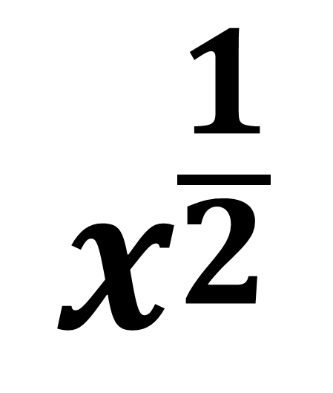
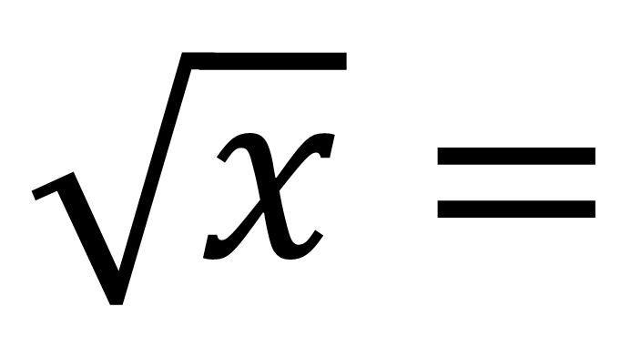
Differentiation – Roots
Turn roots into powers.
$$x^{\frac{1}{2}}$$
$$\sqrt{x}=$$

Slide 19
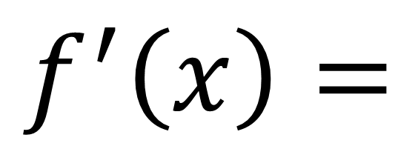
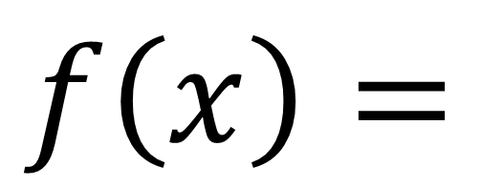
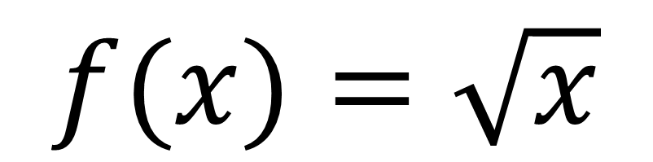
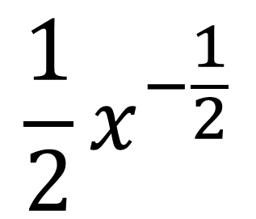
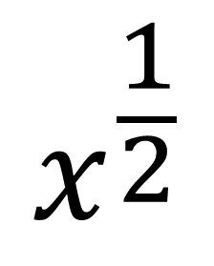
Differentiation
$$f(x)=\sqrt{x}$$
$$x^{\frac{1}{2}}$$
$$f\left(x\right)=$$
$$\frac{1}{2}x^{−\frac{1}{2}}$$
$$f^{′}\left(x\right)=$$

Slide 20
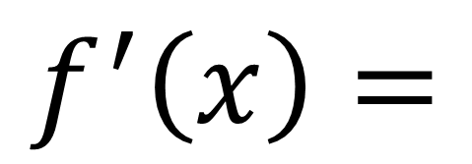
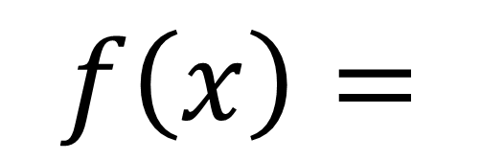
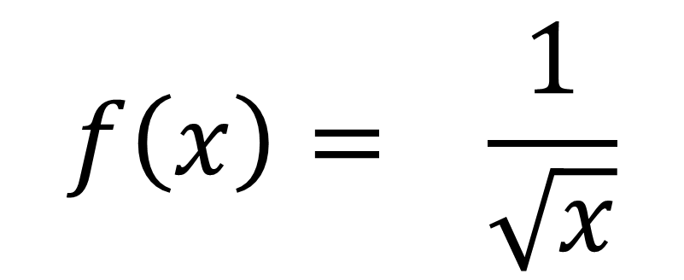
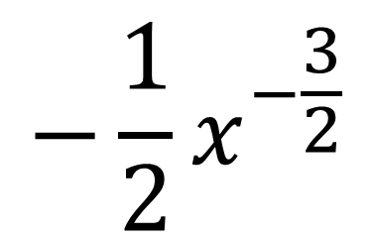
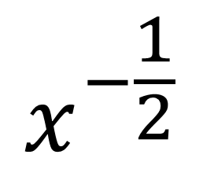
Differentiation
$$f\left(x\right)= \frac{1}{\sqrt{x}}$$
$$x^{−\frac{1}{2}}$$
$$f\left(x\right)=$$
$$−\frac{1}{2}x^{−\frac{3}{2}}$$
$$f^{′}\left(x\right)=$$

Slide 21
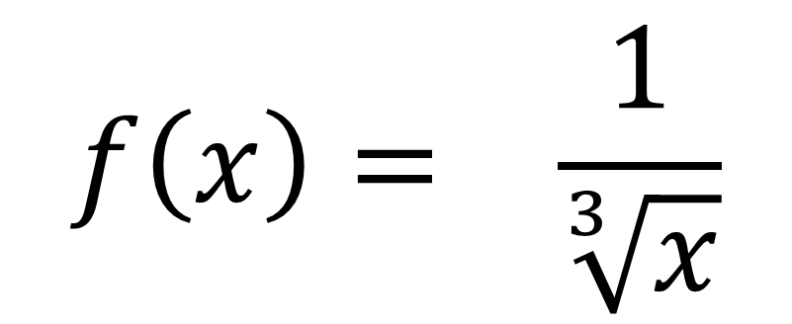
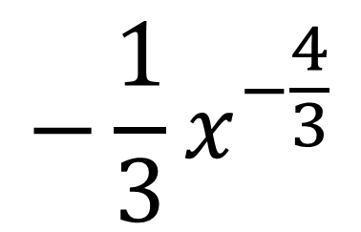

Differentiation
$$f\left(x\right)= \frac{1}{\sqrt[3]{x}}$$
$$x^{−\frac{1}{3}}$$
$$f\left(x\right)=$$
$$−\frac{1}{3}x^{−\frac{4}{3}}$$
$$f^{′}\left(x\right)=$$

Slide 22




Dealing with Multiple Terms
Differentiate each term individually
$$y=x^{2}+4x+3$$
$$\frac{dy}{dx}=$$
$$2x$$
$$+ 4$$

Slide 23



Differentiate $y=4−9x^{3}{+ 8x}^{2}$
$$\frac{dy}{dx}=$$
$$−27x^{2}+16x$$

Slide 24



Differentiate $y=6x−3+px^{2}$
$$\frac{dy}{dx}=$$
$$6+2px$$

Slide 25








Let $f\left(x\right)=x^{2}−4x+2$
Find the gradient of $y=f\left(x\right)$ at the point $\left(1,−1\right)$
Find the coordinates of the point on the graph of $y=f\left(x\right)$ where the gradient is 5.
Find the gradient of $y=f\left(x\right)$ at the points where the curve meets the line $y=2−x$.
$$f^{′}\left(x\right)=2x−4$$
b)
$$5=2x−4$$
a)
$$x=\frac{9}{2}$$
$$f^{′}\left(x\right)=2\left(1\right)−4=$$
$$−2$$
$$y={\left(\frac{9}{2}\right)}^{2}−4\left(\frac{9}{2}\right)+2=\frac{17}{4}$$
Point is $\left(\frac{9}{2},\frac{17}{4}\right)$

Slide 26





Let $f\left(x\right)=x^{2}−4x+2$
Find the gradient of $y=f\left(x\right)$ at the point $\left(1,−1\right)$
Find the coordinates of the point on the graph of $y=f\left(x\right)$ where the gradient is 5.
Find the gradient of $y=f\left(x\right)$ at the points where the curve meets the line $y=2−x$.
$$x^{2}−4x+2=2−x$$
c)
$$x^{2}−3x=0$$
$x=0$ or $x=3$
When $x=0, f^{′}\left(0\right)=−4$
When $x=3, f^{′}\left(3\right)=2$

Slide 27





Let $f\left(x\right)=4x^{2}−8x+3$
Find the gradient of $y=f\left(x\right)$ at the point $\left(\frac{1}{2},0\right)$
Find the coordinates of the point on the graph of $y=f\left(x\right)$ where the gradient is 8.
Find the gradient of $y=f\left(x\right)$ at the points where the curve meets the line $y=4x−5$.
a)
$$f^{′}\left(x\right)=8x−8$$
$$8\left(\frac{1}{2}\right)−8=$$
When $f^{′}\left(\frac{1}{2}\right)=$
$$−4$$

Slide 28





Let $f\left(x\right)=4x^{2}−8x+3$
Find the gradient of $y=f\left(x\right)$ at the point $\left(\frac{1}{2},0\right)$
Find the coordinates of the point on the graph of $y=f\left(x\right)$ where the gradient is 8.
Find the gradient of $y=f\left(x\right)$ at the points where the curve meets the line $y=4x−5$.
$$8=8x−8$$
b)
$$x=2$$
$$y=4{\left(2\right)}^{2}−8\left(2\right)+3=$$
$$3$$
Point is $\left(2,3\right)$

Slide 29





Let $f\left(x\right)=4x^{2}−8x+3$
Find the gradient of $y=f\left(x\right)$ at the point $\left(\frac{1}{2},0\right)$
Find the coordinates of the point on the graph of $y=f\left(x\right)$ where the gradient is 8.
Find the gradient of $y=f\left(x\right)$ at the points where the curve meets the line $y=4x−5$.
c)
First find point of intersection:
$$4x^{2}−8x+3=4x−5$$
$$4x^{2}−12x+8=0$$
Solving, we obtain: $x=1$ or $x=2$
When $x=1, f^{′}\left(1\right)=0$
When $x=2, f^{′}\left(2\right)=8$

