Slide 1
FM: Solving Quadratics
by using the
Quadratic Formula

Slide 2
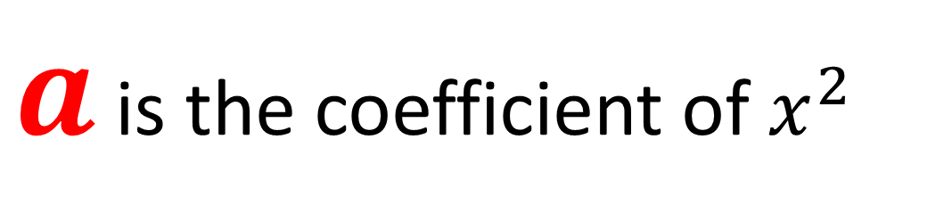
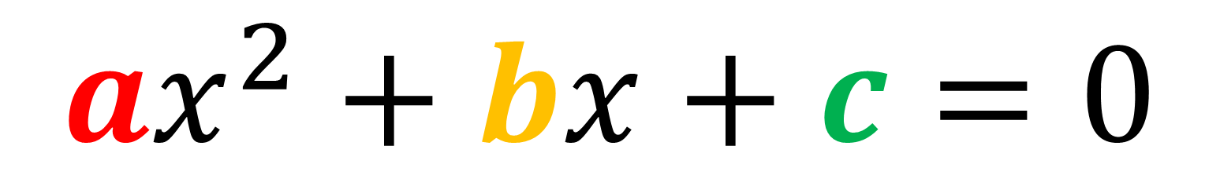

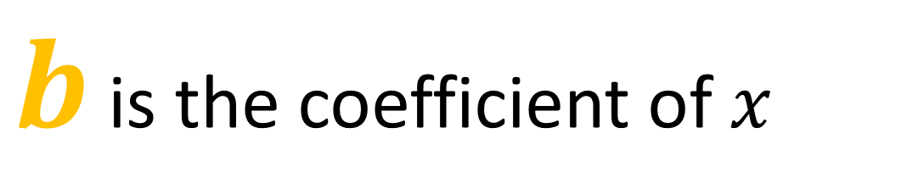
$ax^{2}+bx+c=0$
$a$ is the coefficient of $x^{2}$
$b$ is the coefficient of $x$
$c$ is the constant

Slide 3
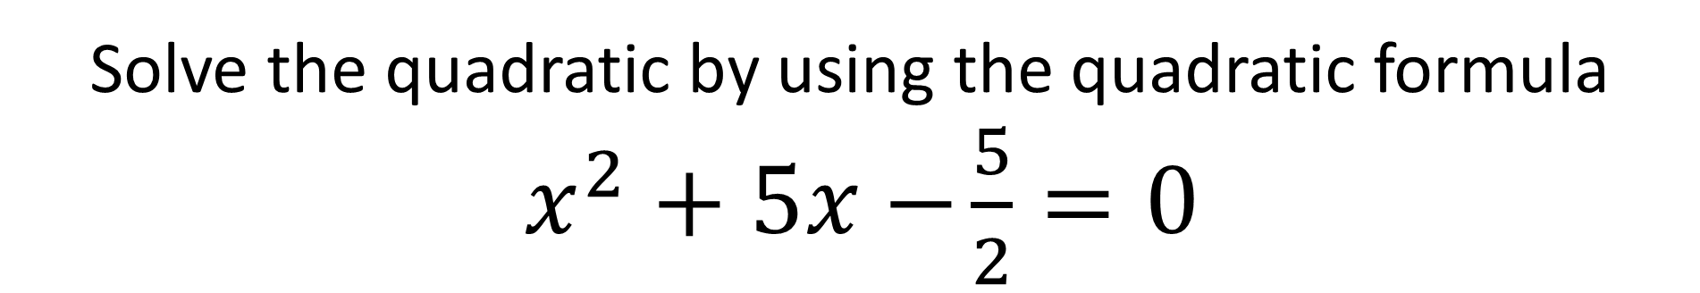
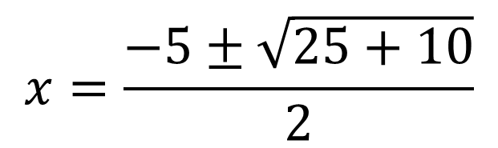
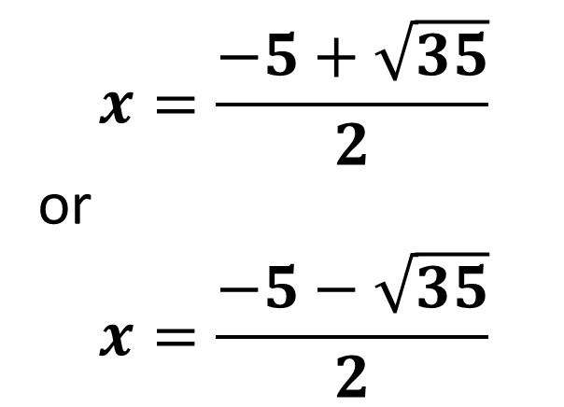
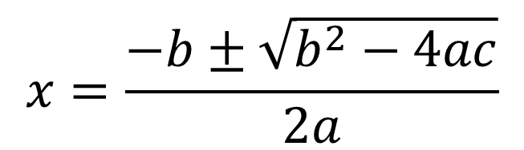
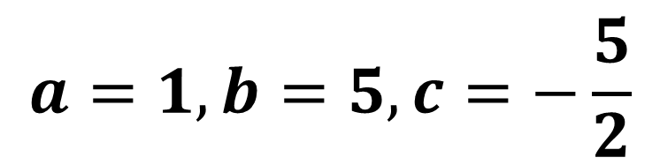
Solve the quadratic by using the quadratic formula
$x^{2}+5x−$ $\frac{5}{2}=0$
$$a=1, b=5, c=−\frac{5}{2}$$
$$x=\frac{−5+\sqrt{35}}{2}$$
or
$$x=\frac{−5−\sqrt{35}}{2}$$
$$x=\frac{−b±\sqrt{b^{2}−4ac}}{2a}$$
$$x=\frac{−5±\sqrt{25+10}}{2}$$

Slide 4
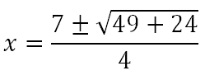

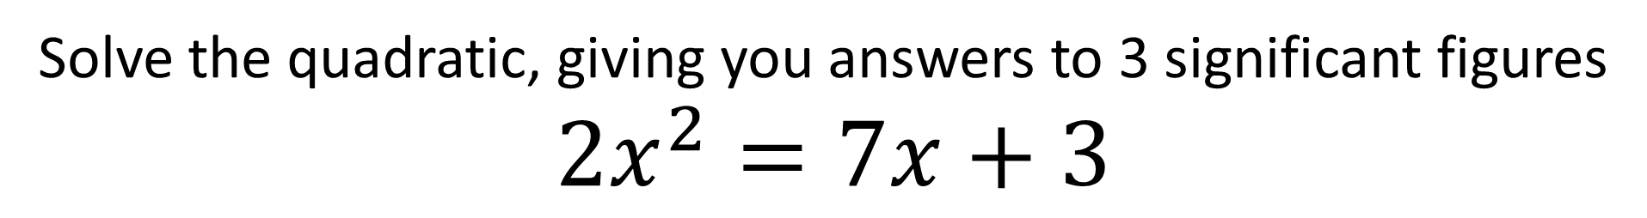
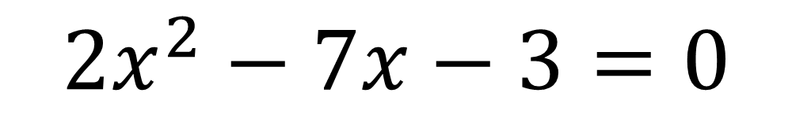
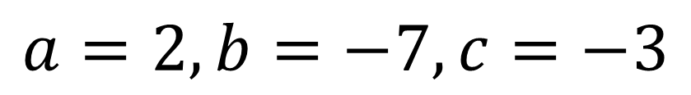
Solve the quadratic, giving you answers to 3 significant figures
$2x^{2}=7x+3$
$$2x^{2}−7x−3=0$$
$$a=2, b=−7, c=−3$$

