Slide 1
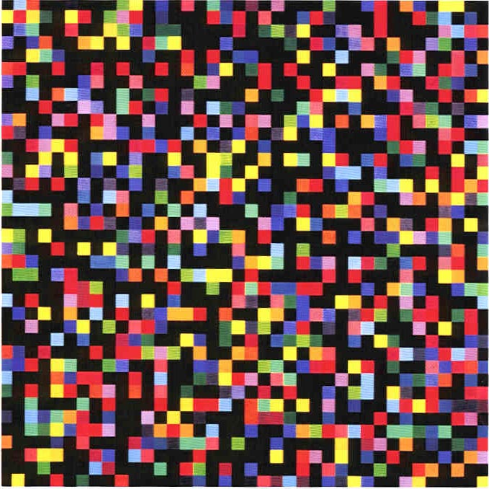
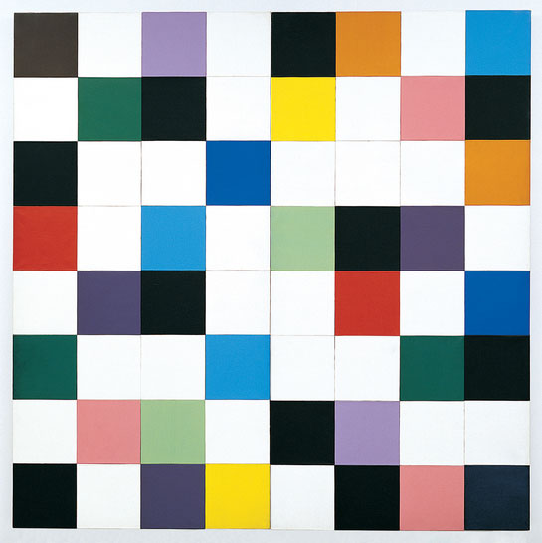
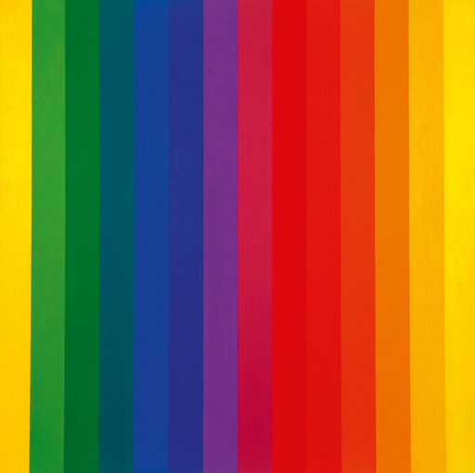
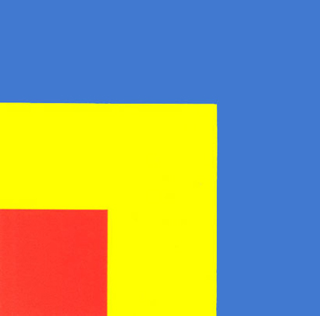
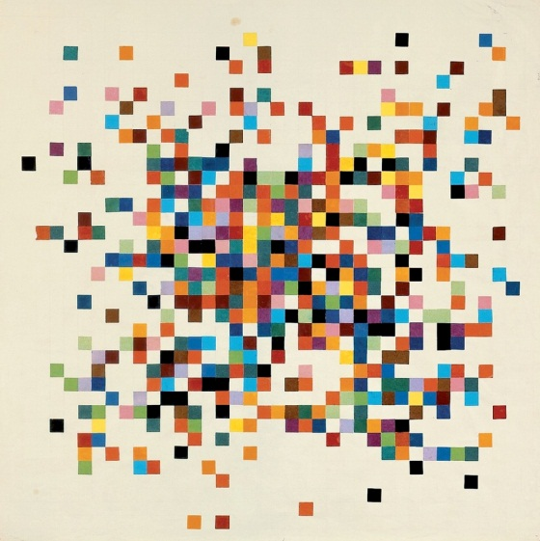
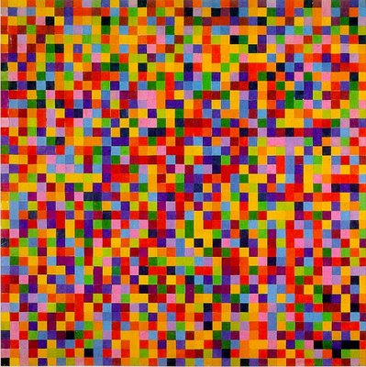
Modern Art Maths
Paintings by Ellsworth Kelly

Slide 2
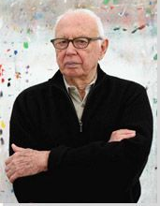
Ellsworth Kelly
AMERICAN PAINTER AND SCULPTOR
Born: May 31, 1923 - Newburgh, New York
Died: December 27, 2015 - Spencertown, New York
Movements and Styles: Minimalism, Hard-edge Painting, Post-Painterly Abstraction.

Slide 3
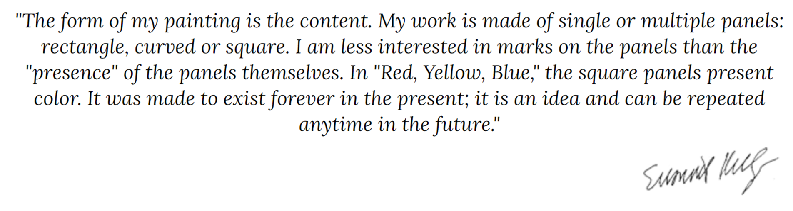

Slide 4
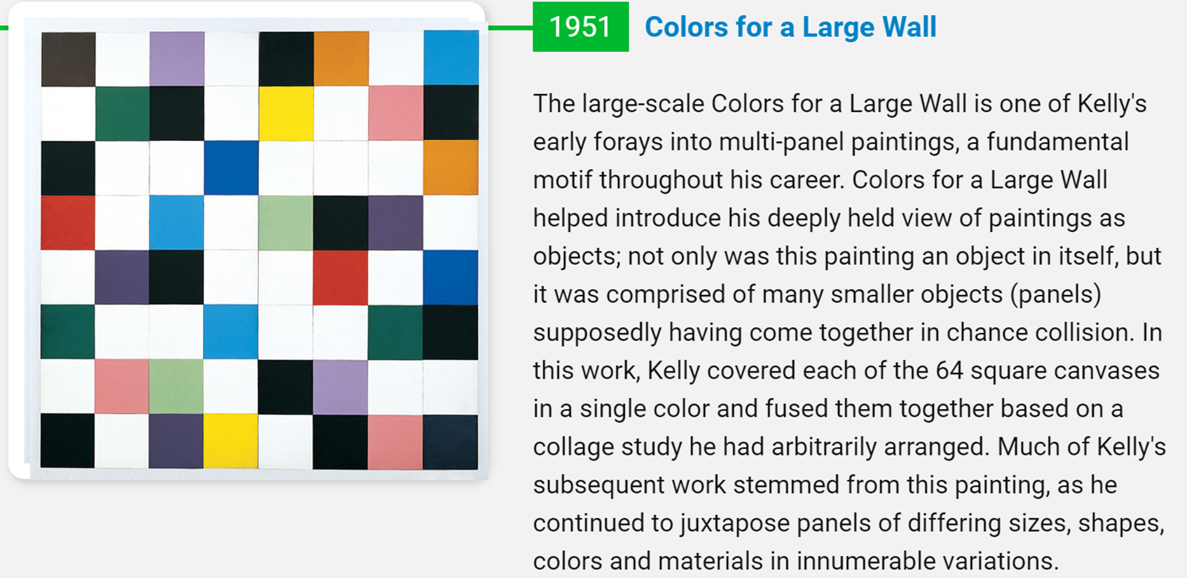

Slide 5
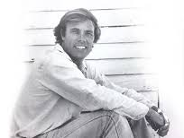
Inspiring Mosaic Portraits Using A Grid Pattern
David Armstrong has created some inspiring mosaic portraits, and he did it using whole tiles arranged in a grid
instead of irregular pieces.

Slide 6
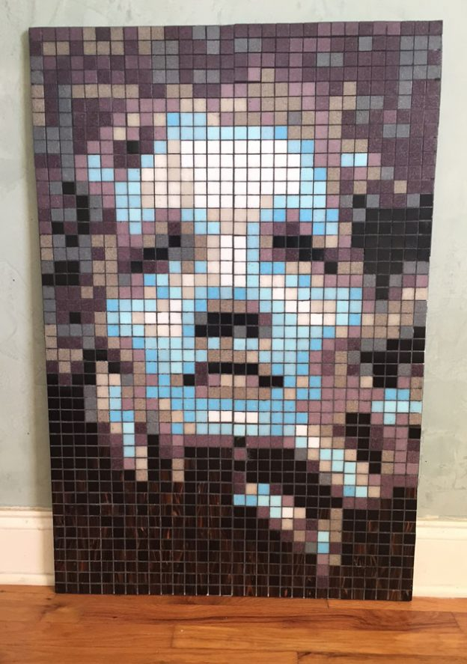

Slide 7
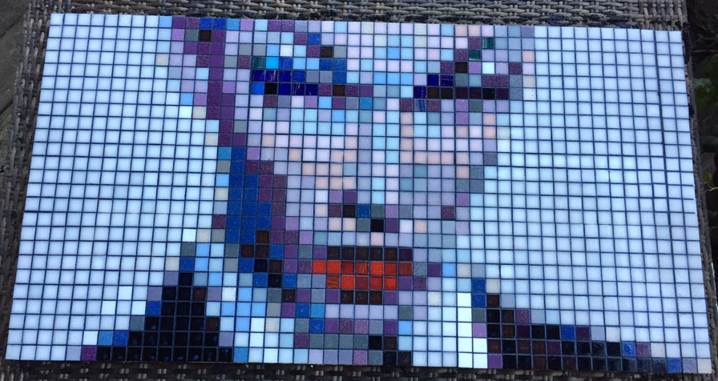

Slide 8
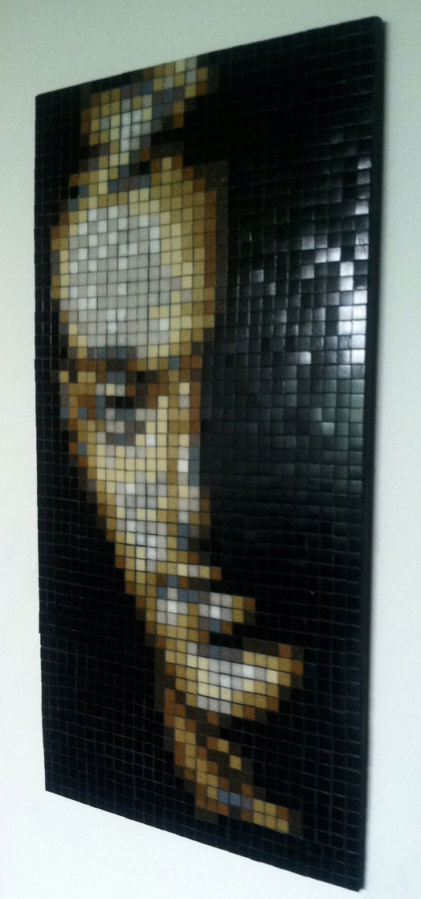

Slide 9
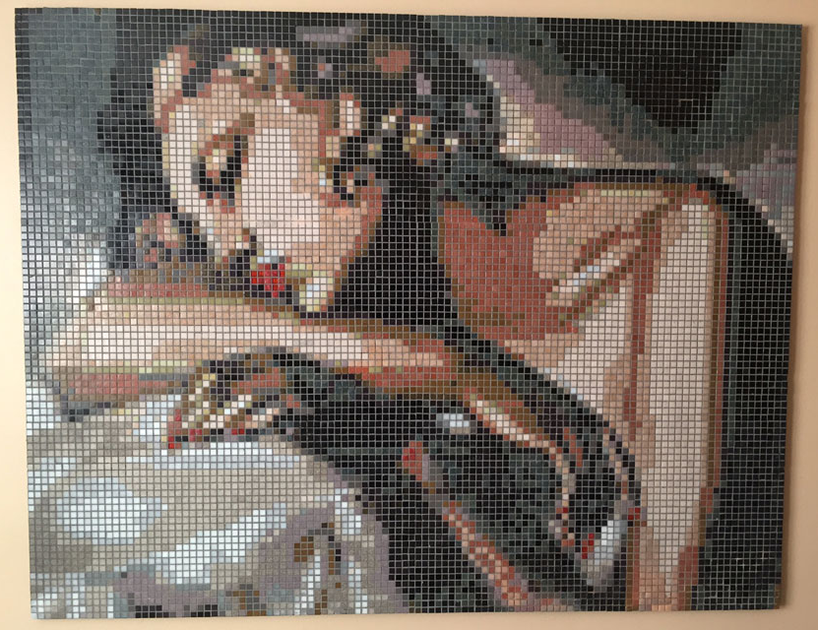

Slide 10
Think about your design and then colour fill the individual squares to create your modern art piece.

Slide 11
10 by 10

Slide 12
8 by 8

Slide 13
14 by 12

