Slide 1
Trig Functions
cot cosec sec
Chapter 6
(Part 1 of 4)

Slide 2
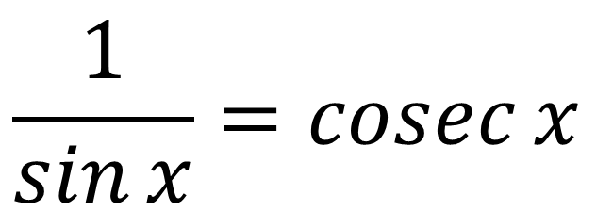
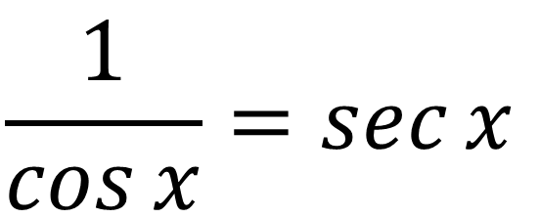
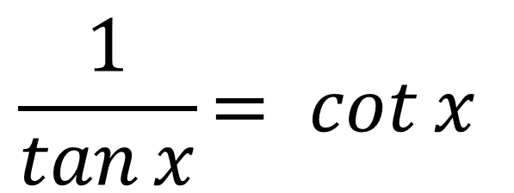
$$\frac{1}{\cos{x}}=\sec{x}$$
$$\frac{1}{\sin{x}}=\operatorname{cosec}{x}$$
$$\frac{1}{\tan{x}}= cot{x}$$
Learn: You need to know them

Slide 3
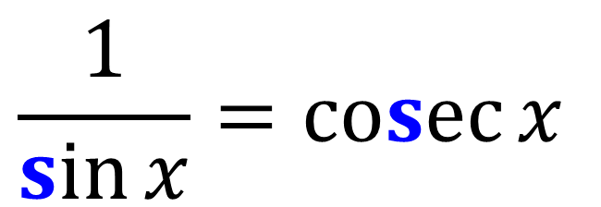
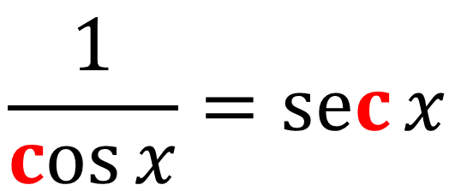
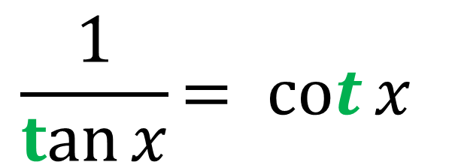
$$\frac{1}{\cos{x}}=\sec{x}$$
$$\frac{1}{\sin{x}}=\operatorname{cosec}{x}$$
$$\frac{1}{\tan{x}}= cot{x}$$
Tip: Look at the 3rd letter

Slide 4

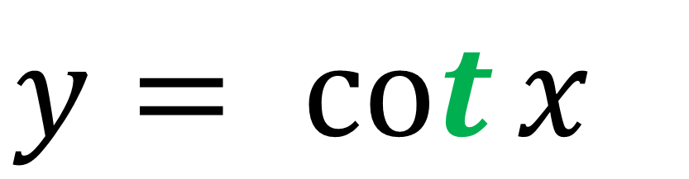
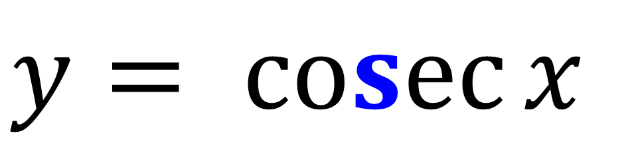
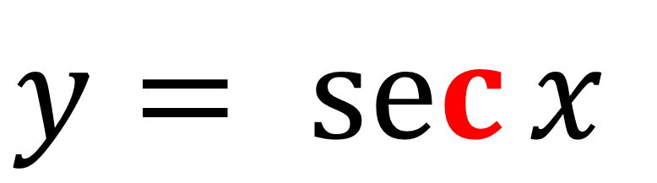
$$y= sec{x}$$
Graphing
$$y= \operatorname{cosec}{x}$$
$$y= cot{x}$$

Slide 5






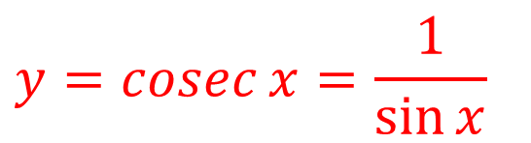




Sketch $y=cosec x$
$$y$$
Asymptote
$$1$$
$$x$$
$$\frac{1}{2}π$$
$$π$$
$$\frac{3}{2}π$$
$$2π$$
$$y=\sin{x}$$
$$−1$$
$$y=\operatorname{cosec}{x}=\frac{1}{\sin{x}}$$

Slide 6


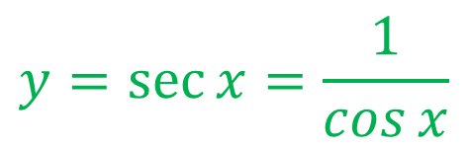
Sketch $y=sec x$
$$y$$
$$1$$
$$y=\cos{x}$$
$$x$$
$$\frac{1}{2}π$$
$$π$$
$$\frac{3}{2}π$$
$$2π$$
$$−1$$
$$y=\sec{x=\frac{1}{\cos{x}}}$$

Slide 7


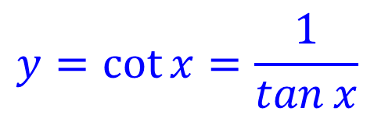
Sketch $y=cot x$
$$y=\tan{x}$$
$$y$$
$$x$$
$$\frac{1}{2}π$$
$$π$$
$$\frac{3}{2}π$$
$$2π$$
$$y=\cot{x=\frac{1}{\tan{x}}}$$

Slide 8






















Sketch $y=−1+\sec{2x}$ in the interval $0≤x<360°$
$$y=\sec{x}$$
$$y=\sec{2x}$$
$$y=−1+\sec{2x}$$
$$y$$
$$y$$
$$y$$
$$1$$
$$1$$
$$x$$
$$x$$
$$x$$
$$90°$$
$$180°$$
$$270°$$
$$360°$$
$$90°$$
$$180°$$
$$270°$$
$$360°$$
$$90°$$
$$180°$$
$$270°$$
$$360°$$
$$−1$$
$$−1$$
$$−2$$

