Slide 1
Quadratics
Discriminate
Chapter 2
(Part 4 of 4)

Slide 2
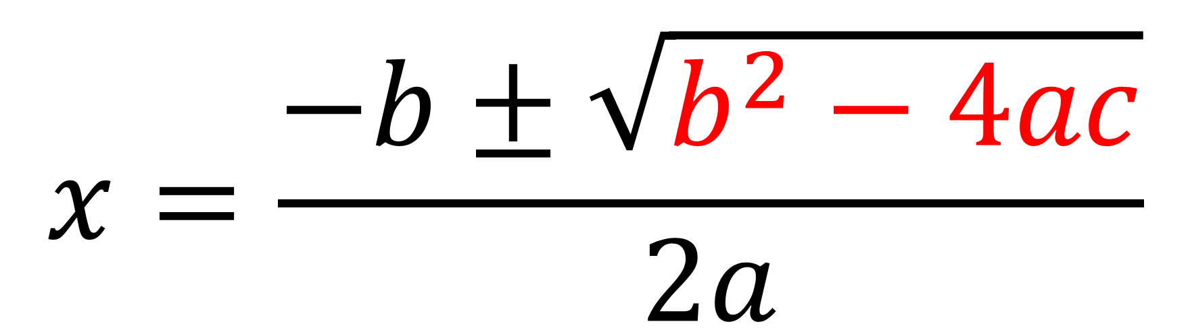
Quadratic Formula
$$x=\frac{−b±\sqrt{b^{2}−4ac}}{2a}$$

Slide 3
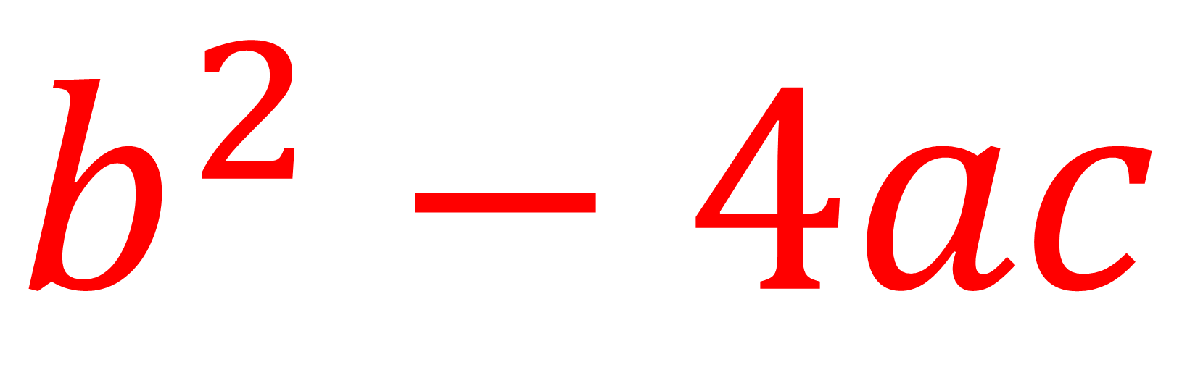
Discriminate
$$b^{2}−4ac$$

Slide 4
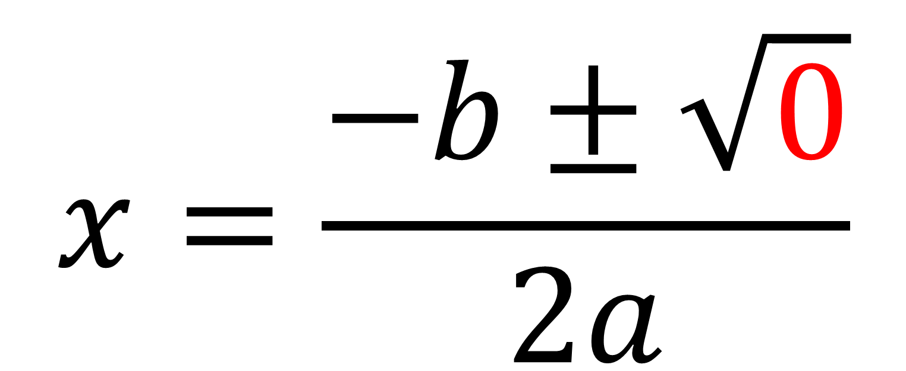
How many solutions?
$$x=\frac{−b±\sqrt{0}}{2a}$$
One

Slide 5
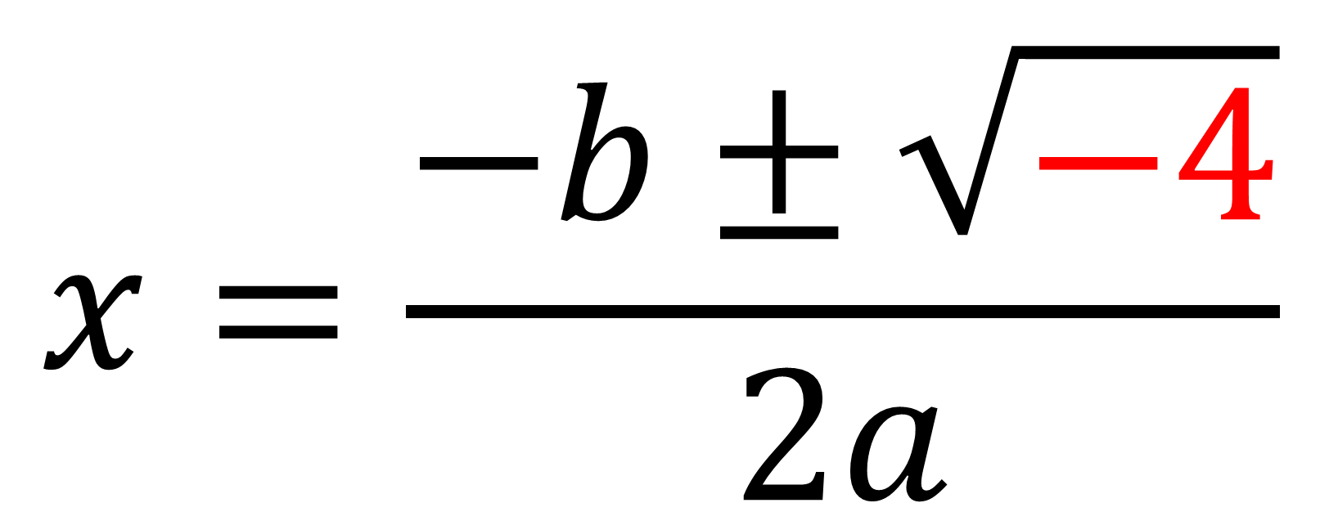
How many solutions?
$$x=\frac{−b±\sqrt{−4}}{2a}$$
None

Slide 6
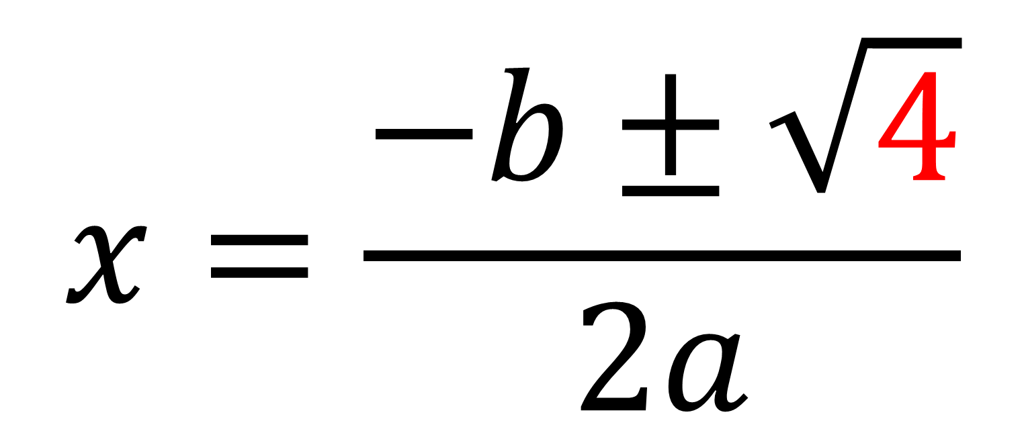
How many solutions?
$$x=\frac{−b±\sqrt{4}}{2a}$$
Two

Slide 7
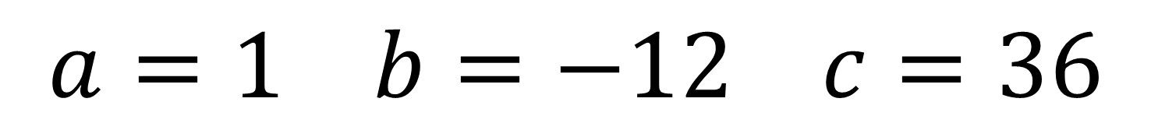
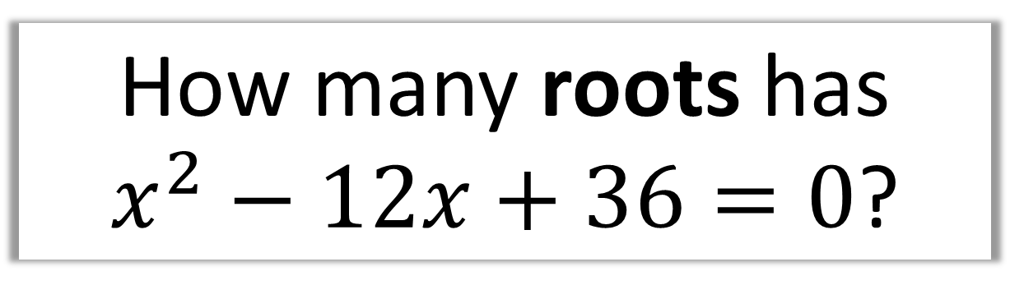
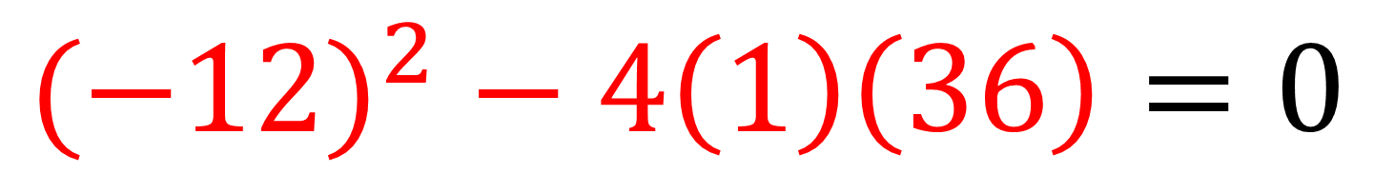
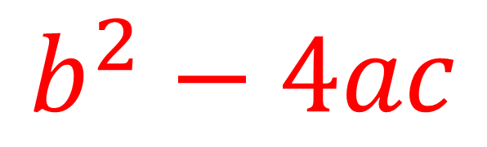
How many roots has
$x^{2}−12x+36=0$?
$$a=1 b=−12 c=36$$
$$b^{2}−4ac$$
$${(−12)}^{2} − 4\left(1\right)\left(36\right)=0$$
1 root

Slide 8
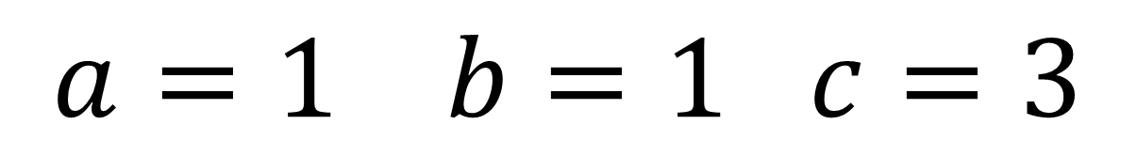
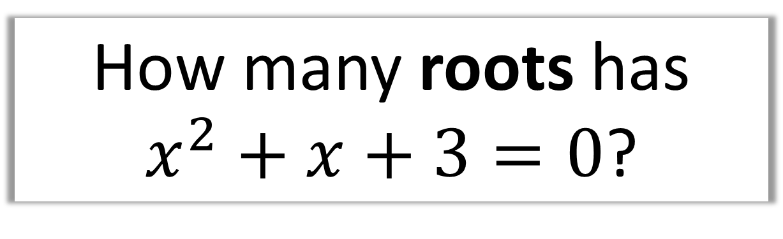
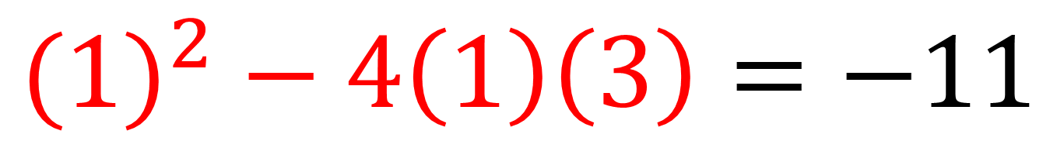
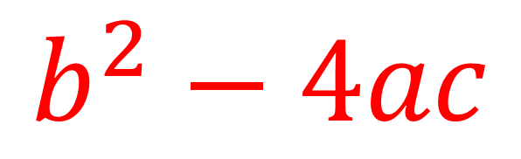
How many roots has
$x^{2}+x+3=0$?
$$a=1 b=1 c=3$$
$$b^{2}−4ac$$
$${(1)}^{2} − 4\left(1\right)\left(3\right)=−11$$
0 roots

Slide 9
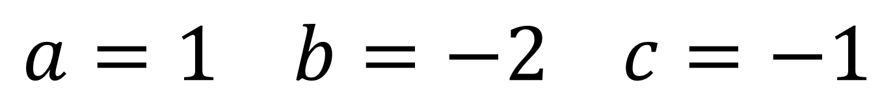
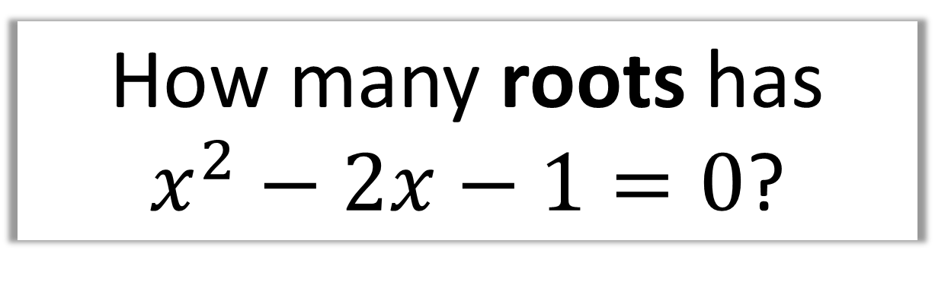
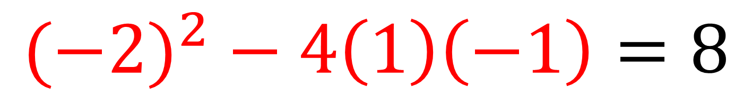
How many roots has
$x^{2}−2x−1=0$?
$$a=1 b=−2 c=−1$$
$$b^{2}−4ac$$
$${(−2)}^{2} − 4\left(1\right)\left(−1\right)=8$$
2 roots

Slide 10
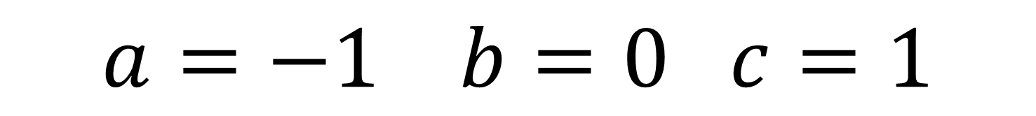
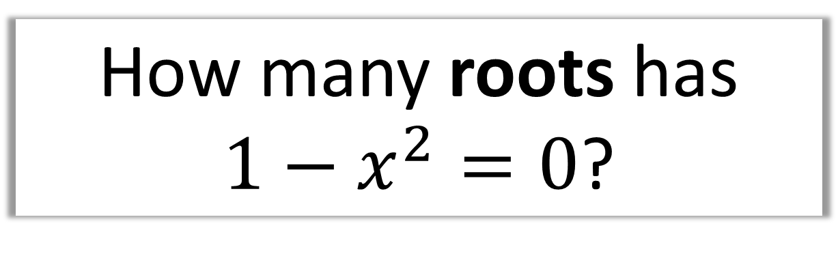
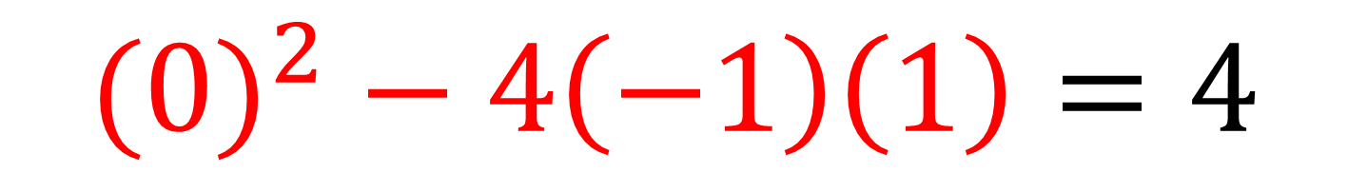
How many roots has
$1−x^{2}=0$?
$$a=−1 b=0 c=1$$
$$b^{2}−4ac$$
$${(0)}^{2} − 4\left(−1\right)\left(1\right)=4$$
2 roots

Slide 11
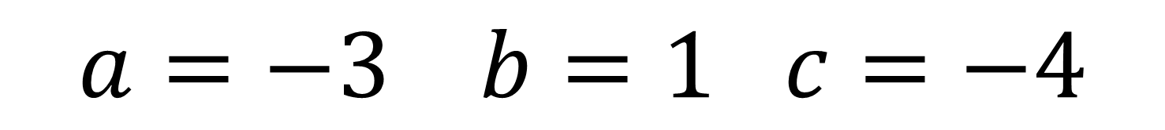
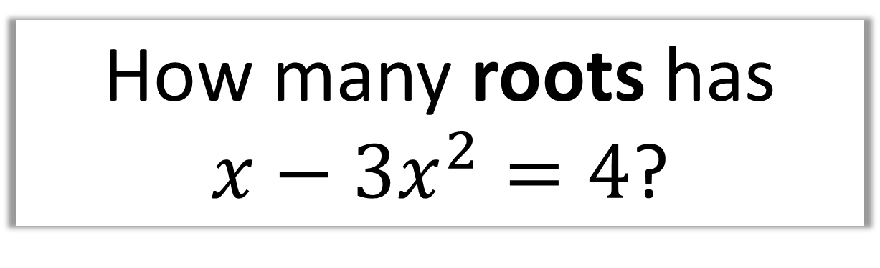
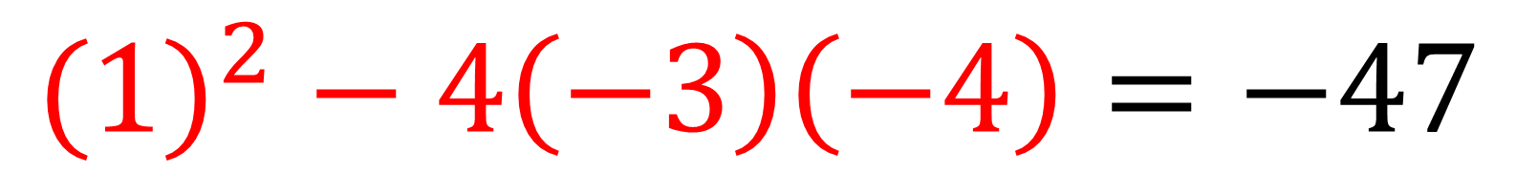
How many roots has
$x−3x^{2}=4$?
$$a=−3 b=1 c=−4$$
$$b^{2}−4ac$$
$${(1)}^{2} − 4\left(−3\right)\left(−4\right)=−47$$
0 roots

Slide 12
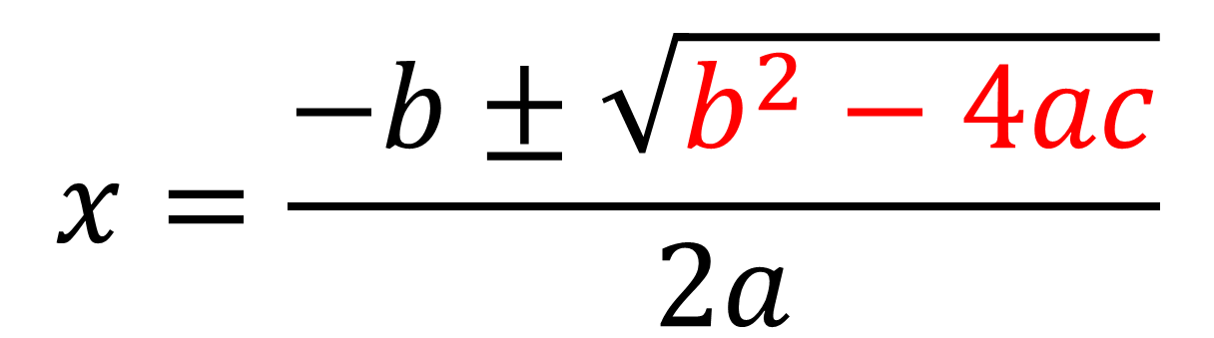
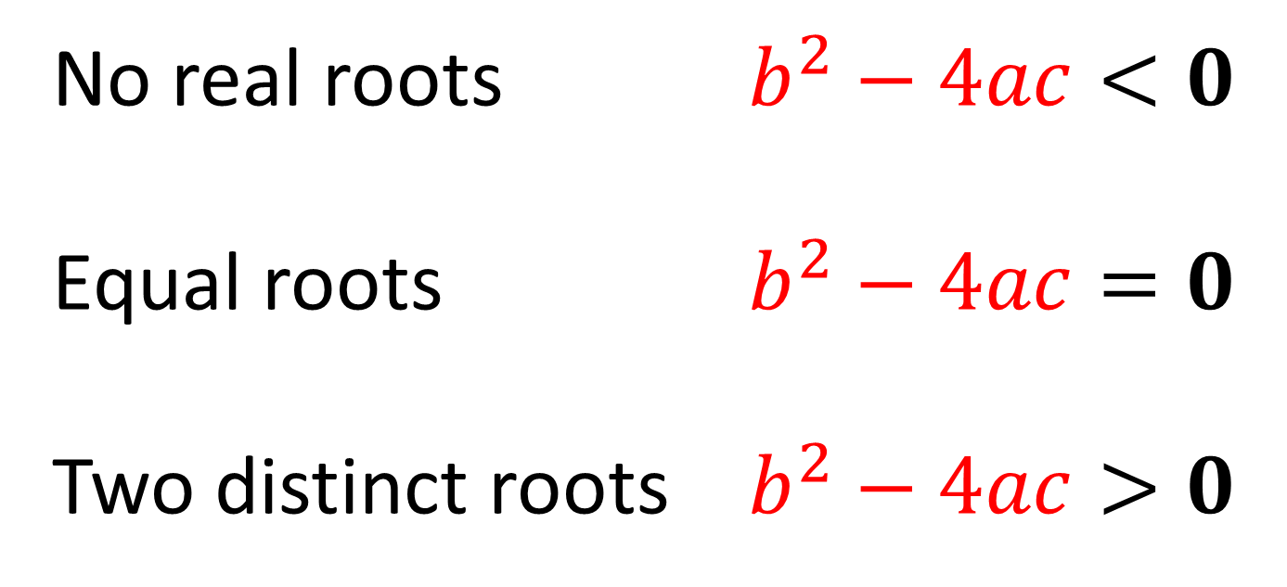
$$x=\frac{−b±\sqrt{b^{2}−4ac}}{2a}$$
No real roots $b^{2}−4ac<0$
Equal roots $b^{2}−4ac=0$
Two distinct roots $b^{2}−4ac>0$

Slide 13
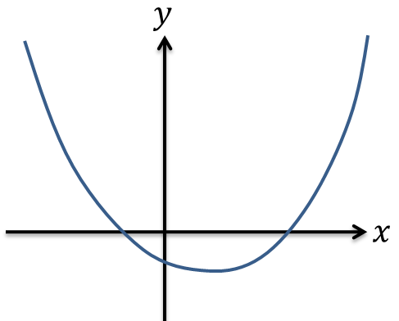

Sketch a graphs with two distinct roots $b^{2}−4ac>0$

Slide 14
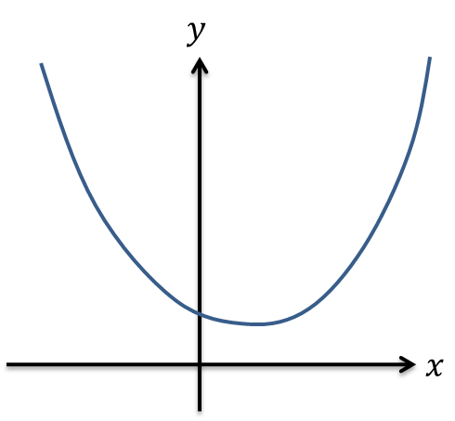

Sketch a graph with no real roots
$$b^{2}−4ac<0$$

Slide 15
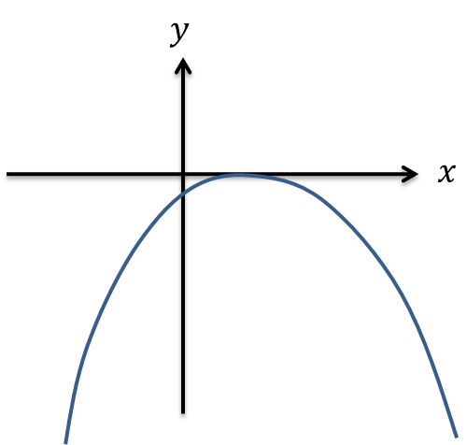

Sketch a graph with one real root
$$b^{2}−4ac=0$$

Slide 16


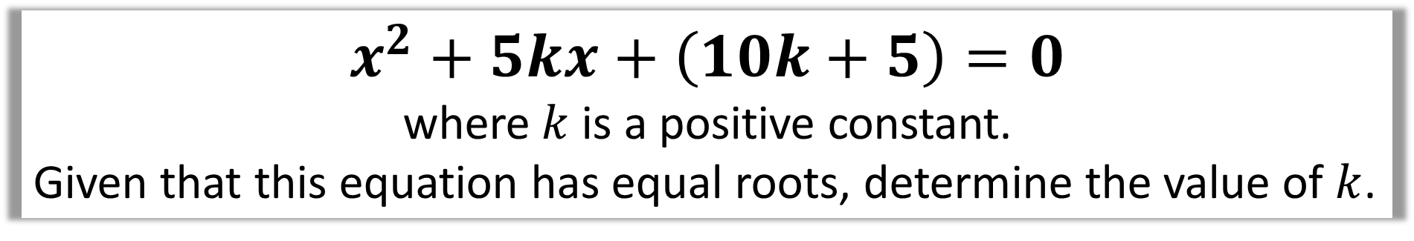
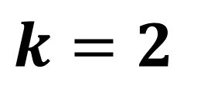

$$x^{2}+5kx+\left(10k+5\right)=0$$
where $k$ is a positive constant.
Given that this equation has equal roots, determine the value of $k$.
$$a=1, b=5k, c=10k+5$$
$$b^{2}−4ac=0$$
$${\left(5k\right)}^{2}−4\left(1\right)\left(10k+5\right)=0$$
$$25k^{2}−40k−20=0$$
$$k=2$$

Slide 17
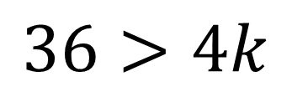
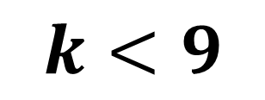
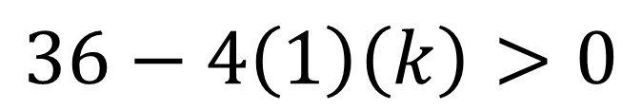
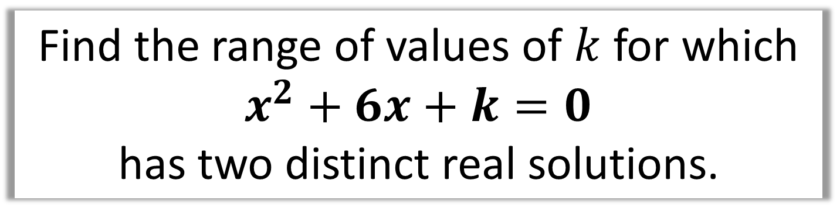
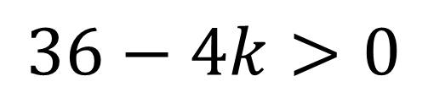
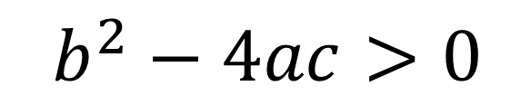
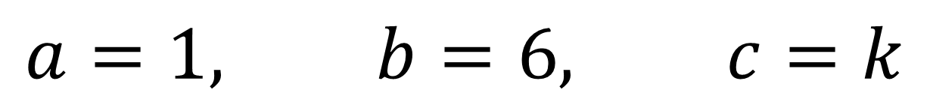
Find the range of values of $k$ for which
$x^{2}+6x+k=0$
has two distinct real solutions.
$$a=1, b=6, c=k$$
$$b^{2}−4ac>0$$
$$36>4k$$
$$36−4\left(1\right)\left(k\right)>0$$
$$k<9$$
$$36−4k>0$$

Slide 18
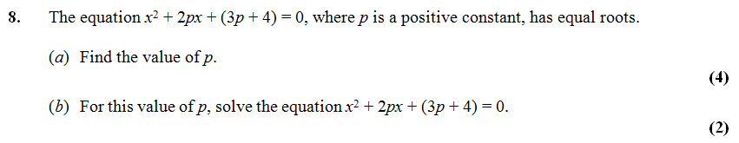
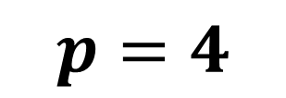


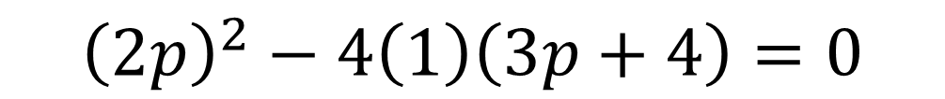
a)
$$a=1, b=2p, c=3p+4$$
$${\left(2p\right)}^{2}−4\left(1\right)\left(3p+4\right)=0$$
$$4p^{2}−12p−16=0$$
$$p^{2}−3p−4=0$$
$$p=4$$

Slide 19
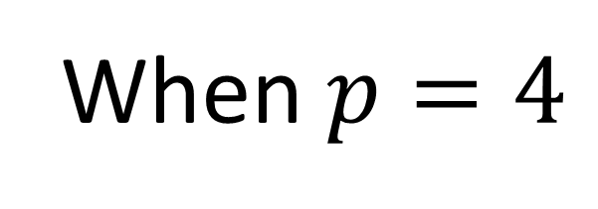
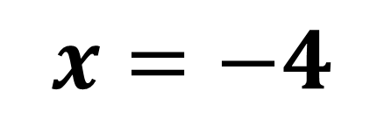
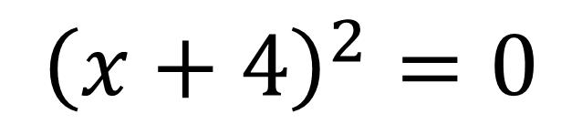

When $p=4$
b)
$$x^{2}+8x+16=0$$
$${\left(x+4\right)}^{2}=0$$
$$x=−4$$

