Slide 1
LO: Simplifying and Equivalent Ratios

Slide 2

What is a ratio?
Ratio is the comparison between
two or more numbers.

Slide 3
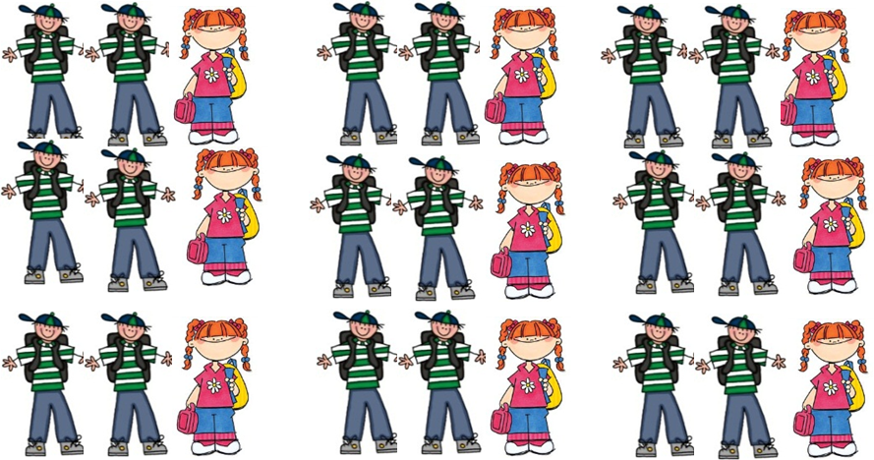
What is the ratio of
boys to girls in the class?
18 |  |  |  | : | 9
2 |  |  |  | : | 1

Slide 4
What is the ratio of
girls to boys in the class?
9 |  |  |  | : | 18
1 |  |  |  | : | 2

Slide 5
To simplify ratios,
divide the numbers in the ratio
by the HCF.
 | 12 | : | 4 |  |  | 24 | : | 16 |  | 9 | : | 12 | : | 21
3 | : | 1
3 | : | 2
3 | : | 4 | : | 7

Slide 6
Simplify 75p : £1.25
Convert to the same units.
75p : 125p
3 : 5

Slide 7
Simplify £6 : 30p
600p : 30p
20 : 1

Slide 8
Simplify 40mm : 2cm
4 : 2
2 : 1

Slide 9
Simplify 300m : 12km
300 : 12000
1 : 40

Slide 10
Simplify 2 litres : 80 ml
2000 : 80
25 : 1

Slide 11

Simplify $\frac{1}{2} : \frac{1}{4} :3$
Multiply by 4
2 : 1 : 12

Slide 12
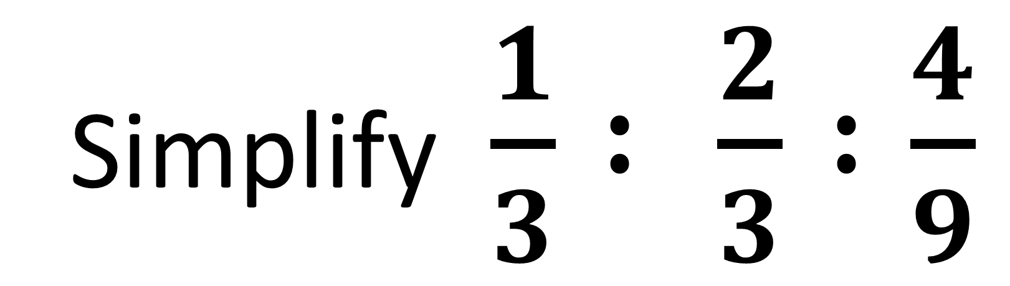
Simplify $\frac{1}{3} : \frac{2}{3} :\frac{4}{9}$
3 : 6 : 4

Slide 13
Simplify 0.1 : 2 : 0.36
Multiply by 100
10 : 200 : 36
5 : 100 : 18

Slide 14
Simplify 0.01 : 0.2 : 0.36
1 : 20 : 36

Slide 15


Which trip is better supervised?

Slide 16
School A
School B
Teachers : Students
Teachers : Students
2 : 7
5 : 11
1 : 3.5
1 : 2.2
School B is better supervised as
1 teacher only has to look after 2.2 students.

Slide 17
Write the following ratio in the form 1:n
2 : 18
1 : 9

Slide 18
Write the following ratio in the form 1:n
4 : 5
1 : 1.25

Slide 19
Write the following ratio in the form n:1
4 : 5
0.8 : 1

Slide 20
Write the following ratio in the form n:1
10 : 8
1.25 : 1

Slide 21
Equivalent Ratios
What is the missing number?
5 : 2
30 :
12
?

Slide 22
Equivalent Ratios
What is the missing number?
5 : 2
75
: 30
?

Slide 23
Anju and Kieran share some money in the ratio 5:2
Anju receives £30.
How much does Kieran receive?
5 : 2
£30 : ?
2 x 6 = £12

Slide 24
Anju and Kieran share some money in the ratio 5:2.
Kieran receives £30.
How much does Anju receive?
5 : 2
? : £30
5 x 15 = £75

