Slide 1
Projectiles
Formulae
Chapter 6
(Part 3 of 3)

Slide 2
Projectile Formulae
There’s nothing new here,
but you may be asked to prove more general results
regarding projectile motion.

Slide 3



$$\text{Show} \text{that} t=\frac{2U\sin{α}}{g}$$
$$\text{Show} \text{that} R=\frac{U^{2}\sin{2α}}{g}$$
Show that $y=x\tan{α −\frac{gx^{2}}{2u^{2}}\left(1+\tan^{2}{α}\right)}$

Slide 4
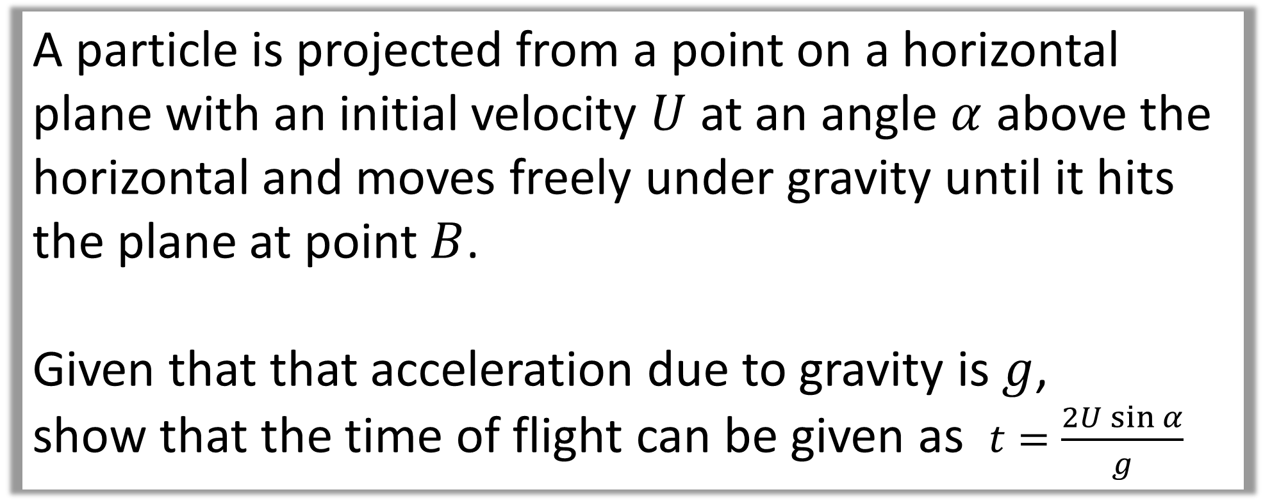
Question A
A particle is projected from a point on a horizontal plane with an initial velocity $U$ at an angle $α$ above the horizontal and moves freely under gravity until it hits the plane at point $B$.
Given that that acceleration due to gravity is $g$,
show that the time of flight can be given as $t=\frac{2U\sin{α}}{g}$

Slide 5
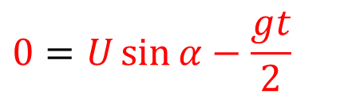

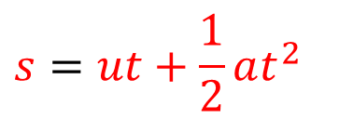
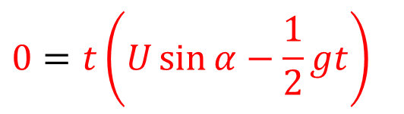


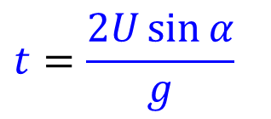
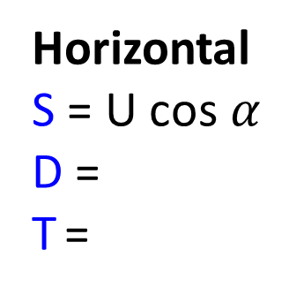
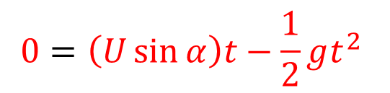

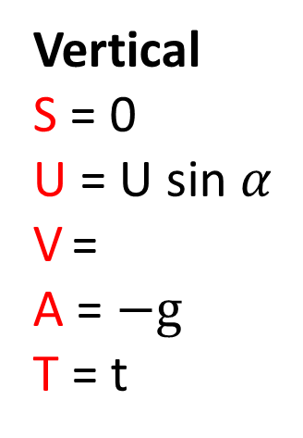

A particle is projected from a point on a horizontal plane with an initial velocity $U$ at an angle $α$ above the horizontal and moves freely under gravity until it hits the plane at point $B$.
Given that that acceleration due to gravity is $g$, find expressions for the time of flight
Vertical
S = 0
U = U sin $α$
V =
A = $−g$
T = t
$$Resolve Vertically$$
$$Resolve Horizontially$$
$$s=ut+\frac{1}{2}at^{2}$$
$$0=2U\sin{α}−gt$$
$$0=\left(U\sin{α}\right)t−\frac{1}{2}gt^{2}$$
$$gt=2U\sin{α}$$
Horizontal
S = U cos $α$ D =
T =
$$0=t\left(U\sin{α}−\frac{1}{2}gt\right)$$
$$t=\frac{2U\sin{α}}{g}$$
$$0=U\sin{α}−\frac{gt}{2}$$

Slide 6
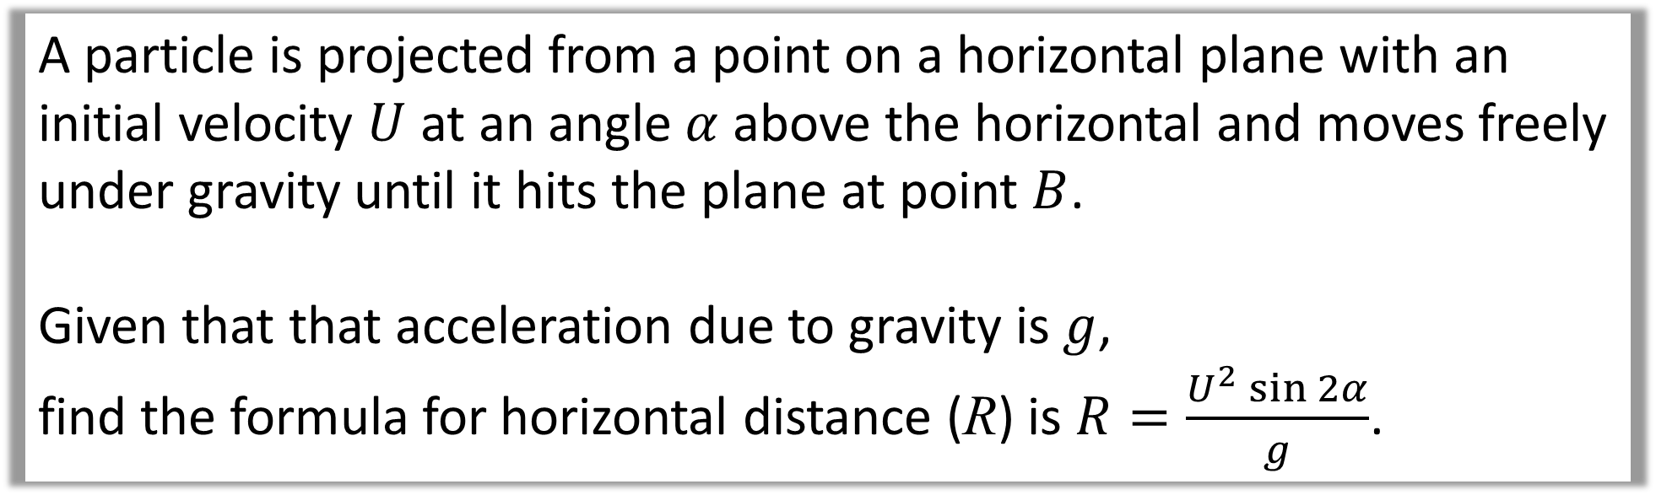
Question B
A particle is projected from a point on a horizontal plane with an initial velocity $U$ at an angle $α$ above the horizontal and moves freely under gravity until it hits the plane at point $B$.
Given that that acceleration due to gravity is $g$,
find the formula for horizontal distance (R) is $R=\frac{U^{2}\sin{2α}}{g}$.

Slide 7
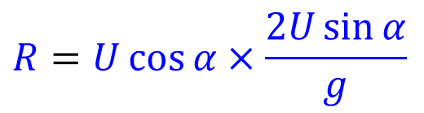

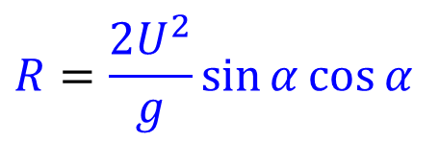
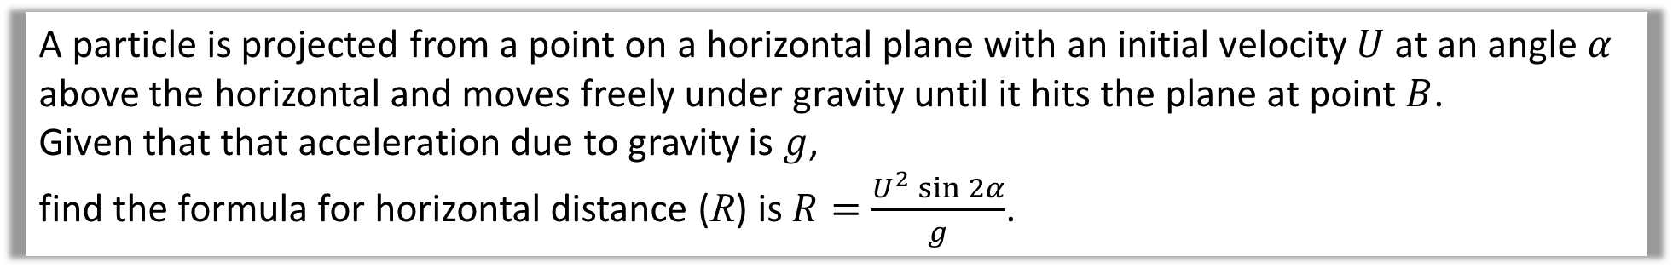
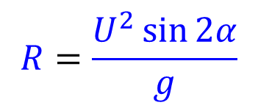
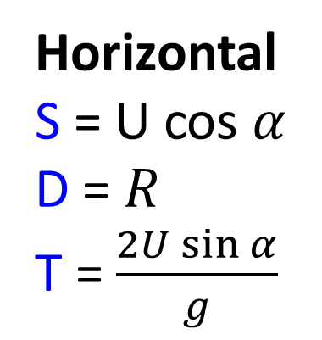


A particle is projected from a point on a horizontal plane with an initial velocity $U$ at an angle $α$ above the horizontal and moves freely under gravity until it hits the plane at point $B$.
Given that that acceleration due to gravity is $g$,
find the formula for horizontal distance (R) is $R=\frac{U^{2}\sin{2α}}{g}$.
Horizontal
S = U cos $α$
D = $R$
T = $\frac{2U\sin{α}}{g}$
$$Resolve Horizontially$$
Distance $=$Speed x Time
$$R=U\cos{α}×\frac{2U\sin{α}}{g}$$
$$R=\frac{2U^{2}}{g}\sin{α}cos{α}$$
Using double-angle formula to get $sin$ $2α$
$$R=\frac{U^{2}\sin{2α}}{g}$$

Slide 8
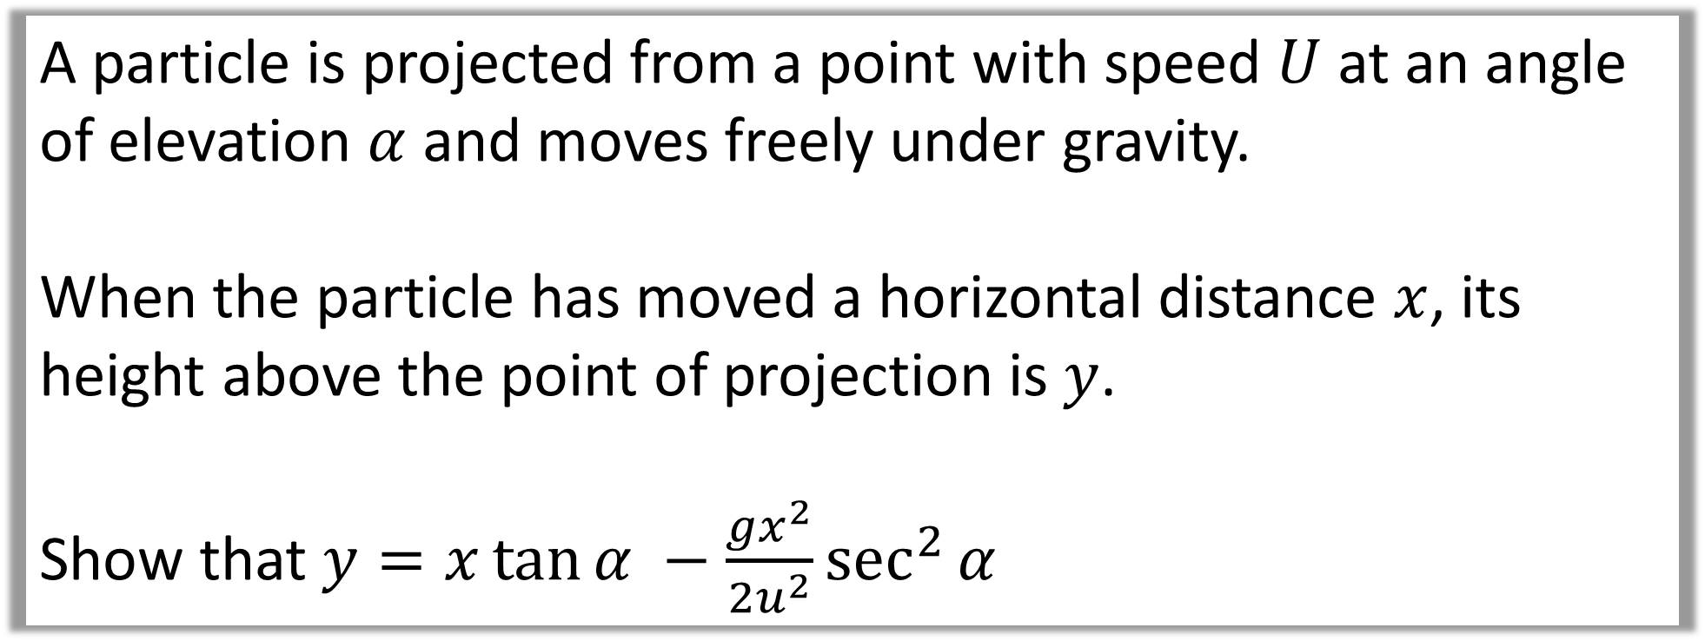
Question C
A particle is projected from a point with speed $U$ at an angle of elevation $α$ and moves freely under gravity.
When the particle has moved a horizontal distance $x$, its height above the point of projection is $y$.
Show that $y=x\tan{α −\frac{gx^{2}}{2u^{2}}\sec^{2}{α}}$

Slide 9

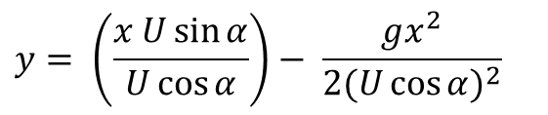
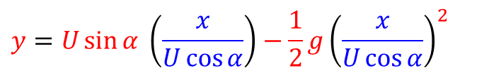
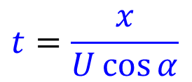
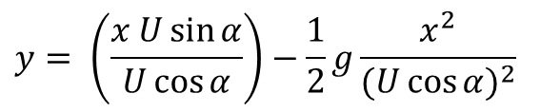

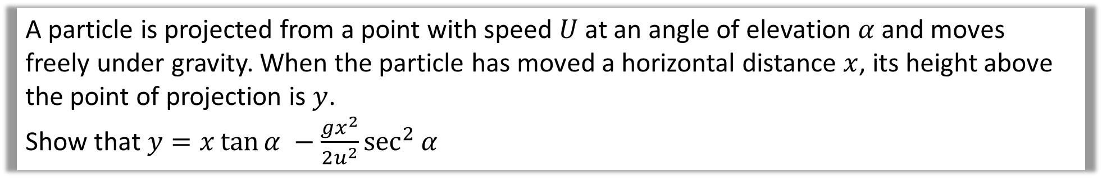

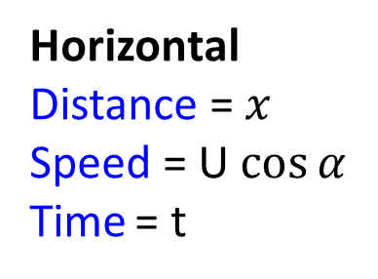
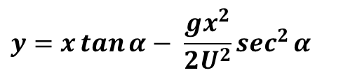
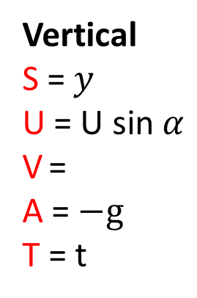

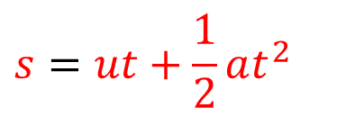

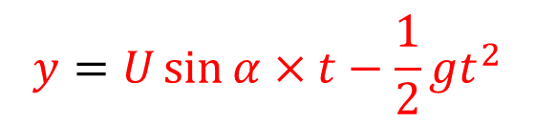

A particle is projected from a point with speed $U$ at an angle of elevation $α$ and moves freely under gravity. When the particle has moved a horizontal distance $x$, its height above the point of projection is $y$.
Show that $y=x\tan{α −\frac{gx^{2}}{2u^{2}}\sec^{2}{α}}$
$$y=U\sin{α} \left(\frac{x}{U\cos{α}}\right)−\frac{1}{2}g{\left(\frac{x}{U\cos{α}}\right)}^{2}$$
$$Resolve Vertically$$
Vertical
S = $y$
U = U sin $α$
V =
A = $−g$
T = t
$$s=ut+\frac{1}{2}at^{2}$$
$$y= \left(\frac{x U\sin{α}}{U\cos{α}}\right)−\frac{1}{2}g\frac{x^{2}}{{(U\cos{α})}^{2}}$$
$$y=U\sin{α}×t−\frac{1}{2}gt^{2}$$
$$y= \left(\frac{x U\sin{α}}{U\cos{α}}\right)− \frac{gx^{2}}{{2(U\cos{α})}^{2}}$$
$$Resolve Vertically$$
$$y= \left(\frac{x U\sin{α}}{U\cos{α}}\right)− \frac{gx^{2}}{{{2U}^{2}(cos{α})}^{2}}$$
Horizontal
Distance = $x$
Speed = U $\cos{α}$
Time = t
Distance $=$ Speed x Time
$$x=U\cos{α}×t$$
$y= \left(\frac{x U\sin{α}}{U\cos{α}}\right)− \frac{gx^{2}}{{2U}^{2}}$ $\frac{1}{{(cos{α})}^{2}}$
$$t=\frac{x}{U\cos{α}}$$
$$y=x\tan{α}− \frac{gx^{2}}{2U^{2}}\sec^{2}{α}$$

Slide 10
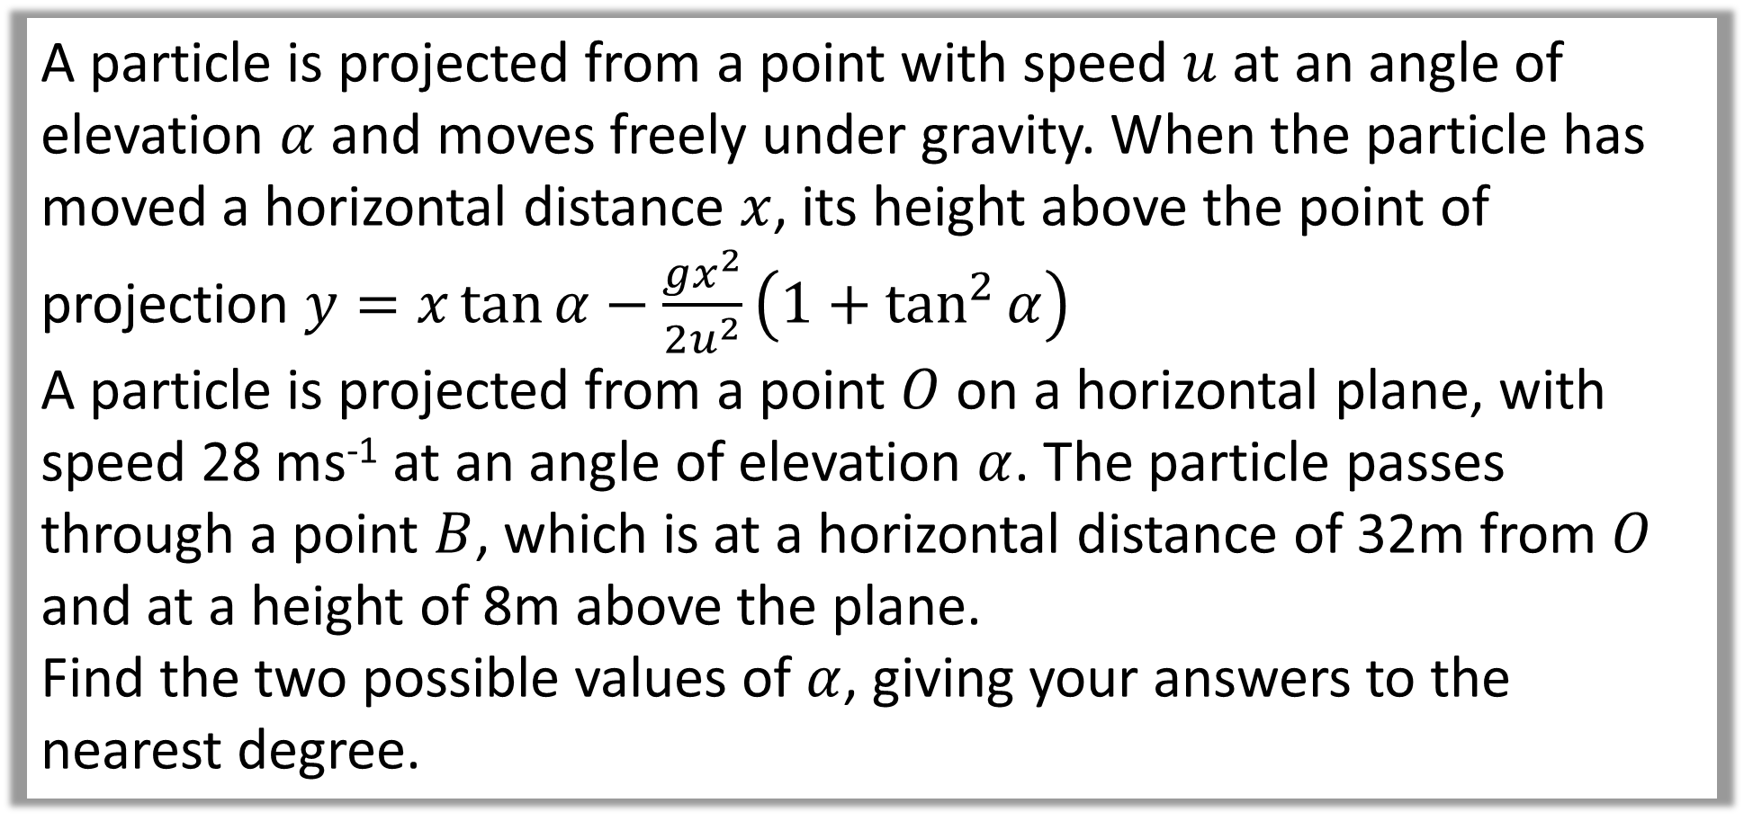
Question C
A particle is projected from a point with speed $u$ at an angle of elevation $α$ and moves freely under gravity. When the particle has moved a horizontal distance $x$, its height above the point of projection $y=x\tan{α−\frac{gx^{2}}{2u^{2}}\left(1+\tan^{2}{α}\right)}$
A particle is projected from a point $O$ on a horizontal plane, with speed 28 ms⁻¹ at an angle of elevation $α$. The particle passes through a point $B$, which is at a horizontal distance of 32m from $O$ and at a height of 8m above the plane.
Find the two possible values of $α$, giving your answers to the nearest degree.

Slide 11
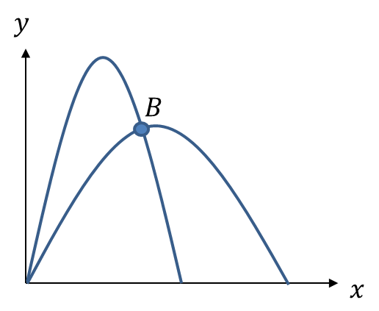


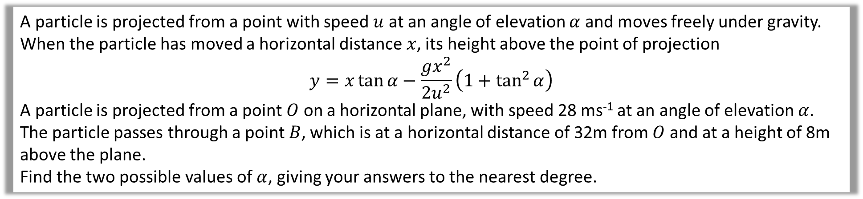

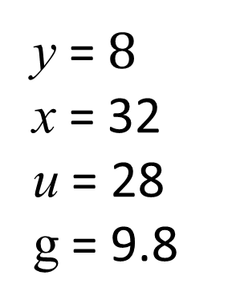
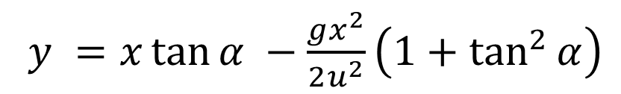


A particle is projected from a point with speed $u$ at an angle of elevation $α$ and moves freely under gravity. When the particle has moved a horizontal distance $x$, its height above the point of projection
$$y=x\tan{α−\frac{gx^{2}}{2u^{2}}\left(1+\tan^{2}{α}\right)}$$
A particle is projected from a point $O$ on a horizontal plane, with speed 28 ms⁻¹ at an angle of elevation $α$. The particle passes through a point $B$, which is at a horizontal distance of 32m from $O$ and at a height of 8m above the plane.
Find the two possible values of $α$, giving your answers to the nearest degree.
y = $8$
x = 32
u = 28
g = 9.8
$y =x\tan{α −\frac{gx^{2}}{2u^{2}}\left(1+\tan^{2}{α}\right)}$
$$8=32\tan{α}−6.4\left(1+\tan^{2}{α}\right)$$
$$6.4\tan^{2}{α}−32\tan{α+14.4=0}$$
$$\tan{α=\frac{1}{2}}$$
$$\tan{α=\frac{9}{2}}$$
$$α=27°$$
$$α=77°$$

