Slide 1
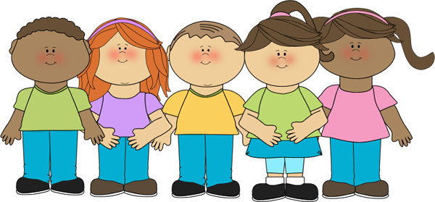
You must say BUZZ if you number is one of the given properties for the game.
4
2
buzz
5
1
If you get your number/buzz wrong then you are out of the game.
Then the next student starts from 1 again until the last person standing wins.
Possible rules could be prime numbers,
multiples of 3 and numbers containing 3 (such as 13), even numbers….etc

