Slide 1
Elastic, Strings and Springs
Hooke’s Law – At an Angle
Chapter 3
(Part 3 of 5)

Slide 2
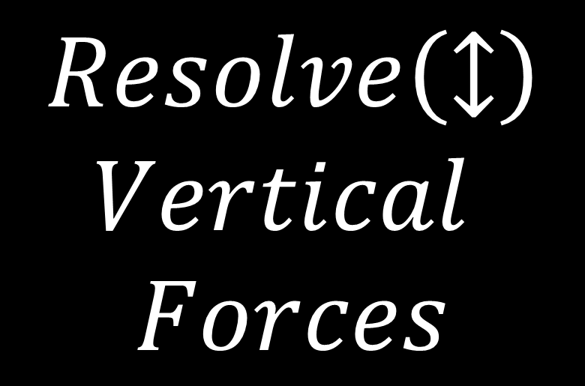
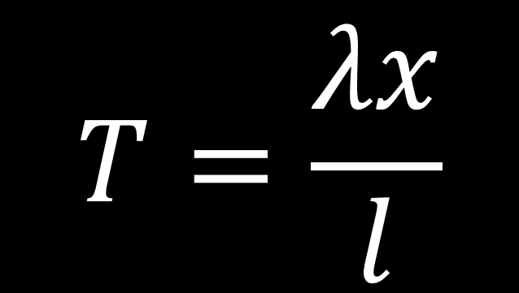
Game Plan:
$$T=\frac{λx}{l}$$
$$Resolve\left(↕\right)$$
$$Vertical$$
$$Forces$$

Slide 3
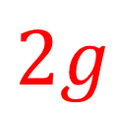







Forces applied from the horizontal
Before F is applied
After F is applied
$$θ$$
$$T$$
$$T$$
$$2$$
$$F$$
$$2$$
$$2g$$
$$2g$$

Slide 4



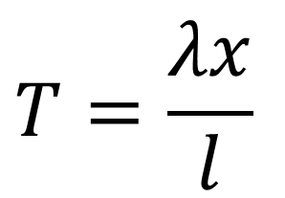
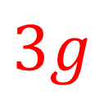
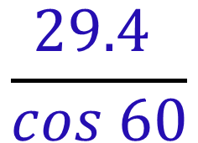

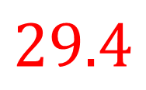


Find T
$$\frac{29.4 }{cos 60}$$
$$T$$
= 58.8
$$60˚$$
$$60˚$$
$$T$$
$$29.4$$
$$F$$
$$3g$$
or if you have the right information, you could use
$$T=\frac{λx}{l}$$

Slide 5



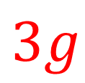

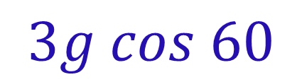


Find T
$$T$$
$$F$$
$$60˚$$
$$30˚$$
$$3g cos 60$$
$$60˚$$
= 14.7
$$3g$$

Slide 6

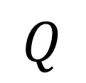
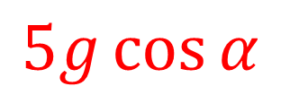
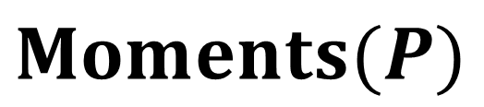
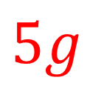
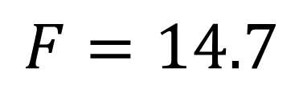
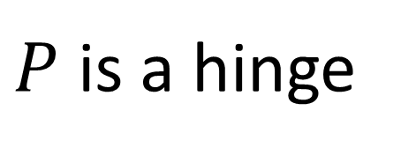

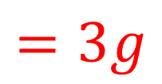

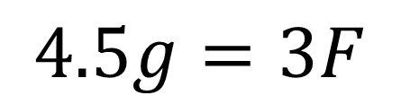
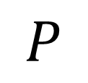
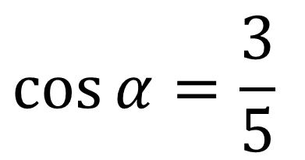
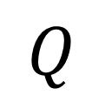
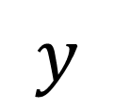
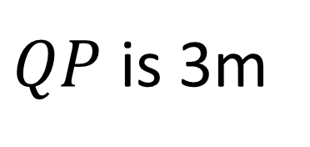
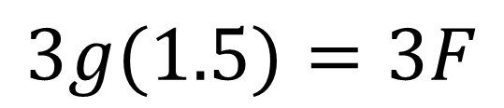

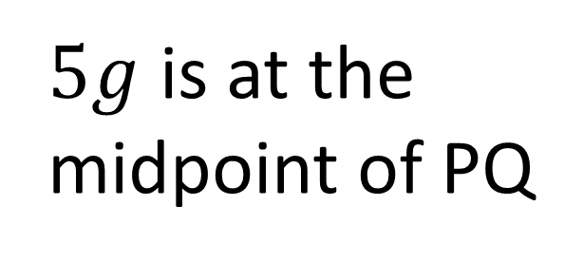


$$y$$
Find F
$$P$$
$$x$$
$$α$$
$$F$$
$P$ is a hinge
$5g$ is at the midpoint of PQ
$$5g$$
$$Q$$
$$Moments(P)$$
$$α$$
$$3g(1.5)=3F$$
$QP$ is 3m
$$F$$
$$4.5g=3F$$
$$\cos{α}=\frac{3}{5}$$
$$5g\cos{α}$$
$$Q$$
$$F=14.7$$
$$=3g$$

Slide 7
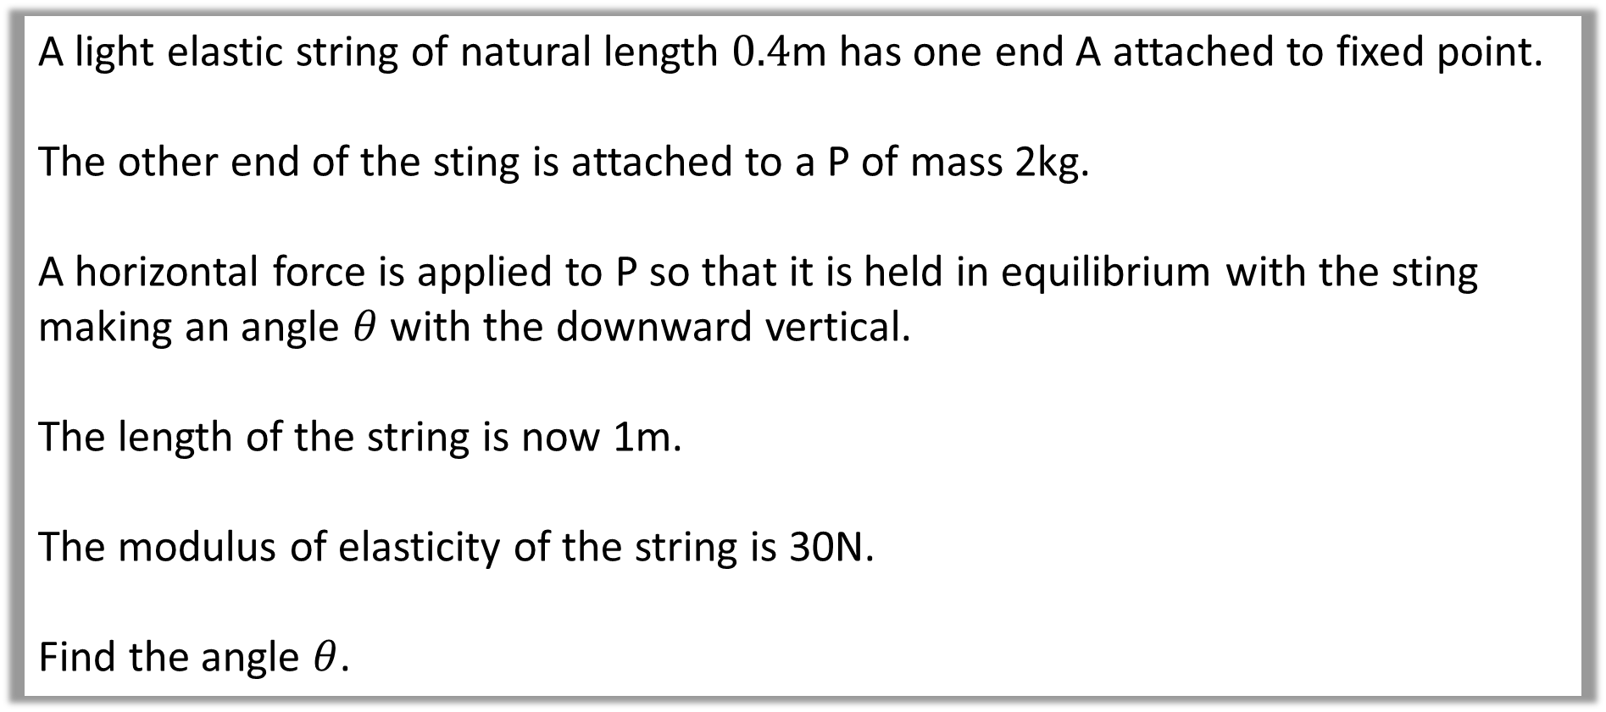
Example A: Horizontal Force
A light elastic string of natural length $0.4$m has one end A attached to fixed point.
The other end of the sting is attached to a P of mass 2kg.
A horizontal force is applied to P so that it is held in equilibrium with the sting making an angle $θ$ with the downward vertical.
The length of the string is now 1m.
The modulus of elasticity of the string is 30N.
Find the angle $θ$.

Slide 8
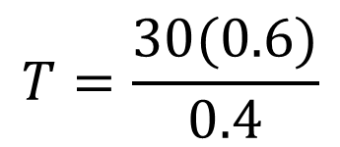
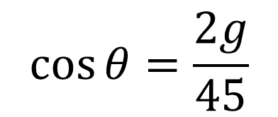

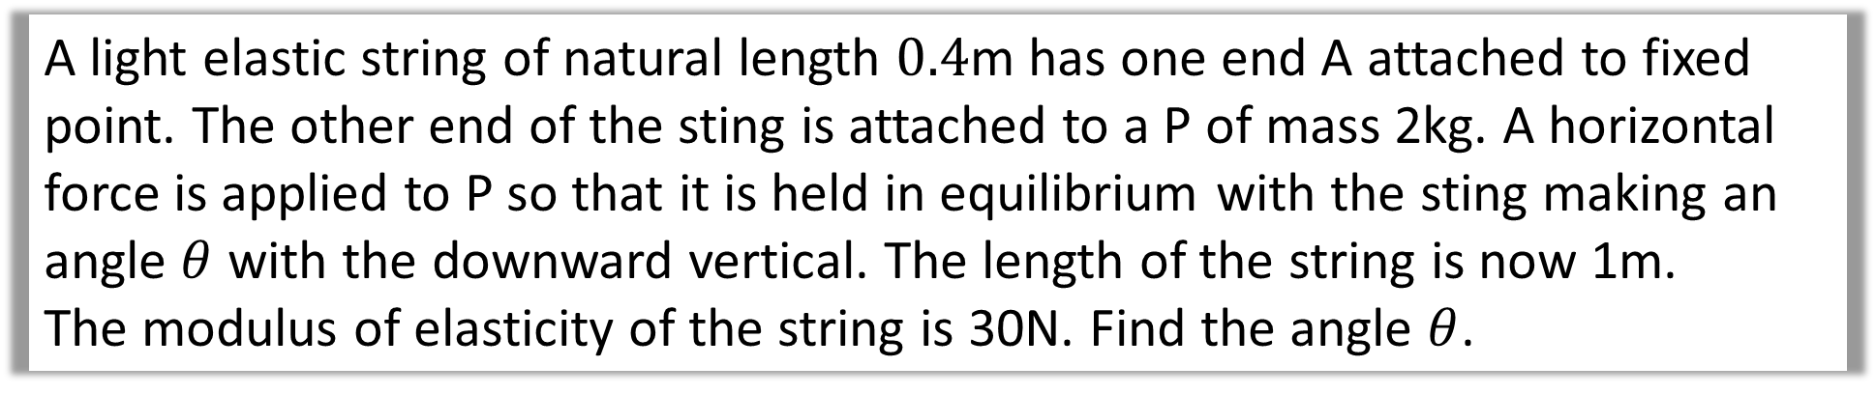
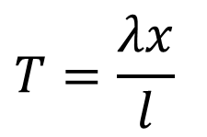



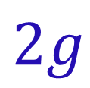









A light elastic string of natural length $0.4$m has one end A attached to fixed point. The other end of the sting is attached to a P of mass 2kg. A horizontal force is applied to P so that it is held in equilibrium with the sting making an angle $θ$ with the downward vertical. The length of the string is now 1m.
The modulus of elasticity of the string is 30N. Find the angle $θ$.
$$T=$$
$$T=\frac{λx}{l}$$
$$θ$$
$$45$$
$$θ$$
$$T$$
$$λ=30$$
$$2g$$
$$x=0.6$$
$$T=\frac{30(0.6)}{0.4}$$
$$F$$
$$l=0.4$$
$$\cos{θ}=\frac{2g}{45}$$
$$T=45 N$$
$$2g$$
$$θ=64°$$

Slide 9
Forces applied
at the mid-point

Slide 10



Forces applied at the mid-point
$$2$$
Before P is added:
A
B
After P is added
at the midpoint:
A
B
$$30°$$
$$30°$$
P

Slide 11




When a particle is attached to the midpoint of a string
the two halves of the string act like two independent strings.
A
B
$$30°$$
$$30°$$
$$T$$
$$T$$
Mg
By symmetry the tension in both strings is the same.

Slide 12
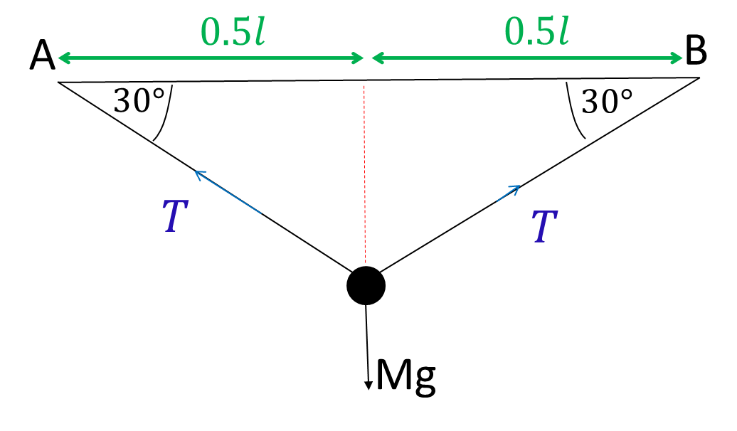
The modulus of elasticity of each half is
THE SAME as the original string.

Slide 13



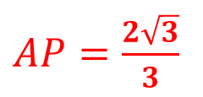





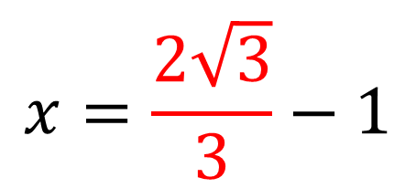

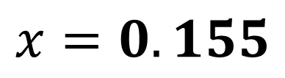
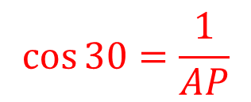

Before P is added:
After P is added:
$$2$$
$$2$$
A
B
A
B
$$30°$$
$$30°$$
Find the length of the extension.
P
$$1$$
$$x=\frac{2\sqrt{3}}{3}−1$$
$$30°$$
$$T=$$
$$\cos{30}=\frac{1}{AP}$$
$$λ=$$
$$x=$$
$$x=0.155$$
$AP=\frac{2\sqrt{3}}{3}$
$$l=1$$

Slide 14
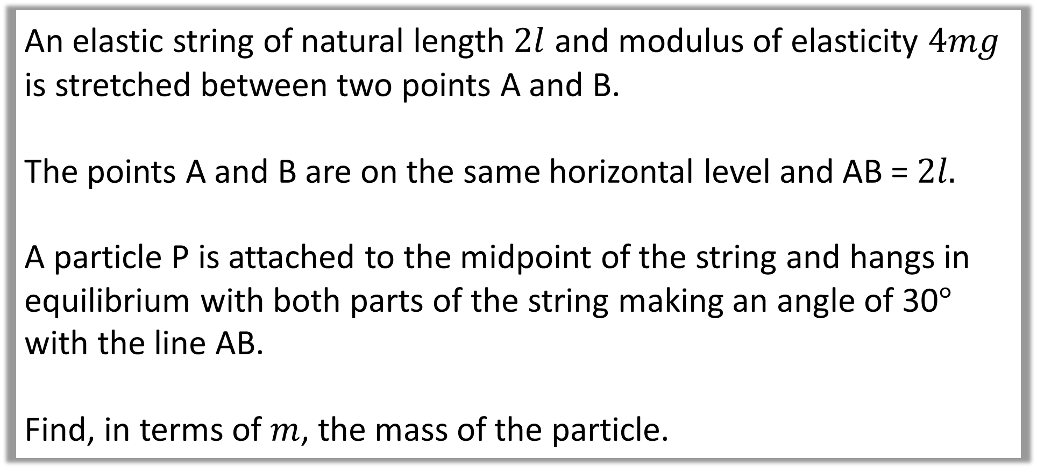
Example B: Mid Point
An elastic string of natural length $2l$ and modulus of elasticity $4mg$ is stretched between two points A and B.
The points A and B are on the same horizontal level and AB =$2l.$
A particle P is attached to the midpoint of the string and hangs in equilibrium with both parts of the string making an angle of 30$°$ with the line AB.
Find, in terms of $m$, the mass of the particle.

Slide 15
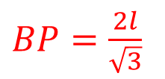
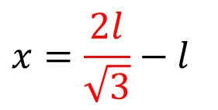
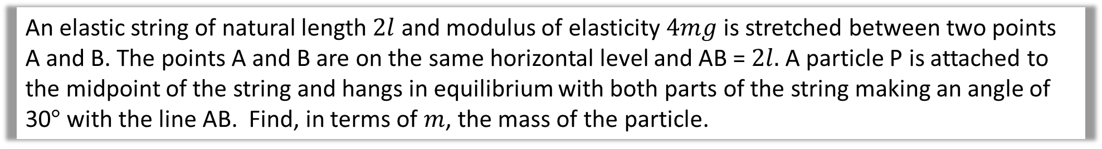



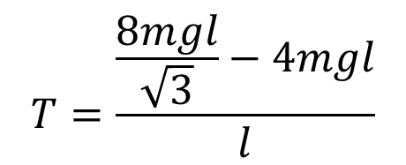

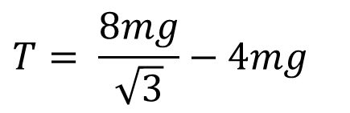

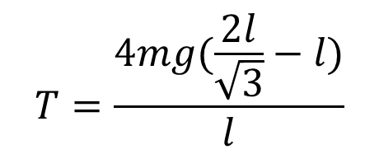
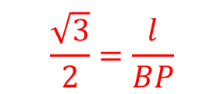


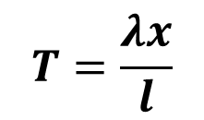
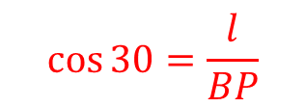

An elastic string of natural length $2l$ and modulus of elasticity $4mg$ is stretched between two points A and B. The points A and B are on the same horizontal level and AB =$2l.$A particle P is attached to the midpoint of the string and hangs in equilibrium with both parts of the string making an angle of 30$°$ with the line AB. Find, in terms of $m$, the mass of the particle.
$$2l$$
$$T=\frac{λx}{l}$$
A
B
$$T=$$
$$30°$$
$$30°$$
$$λ=4mg$$
$$T=\frac{4mg(\frac{2l}{\sqrt{3}}−l)}{l}$$
$$x=\frac{2l}{\sqrt{3}}−l$$
P
$$l$$
$$l=l$$
$$T=\frac{\frac{8mgl}{\sqrt{3}}−4mgl}{l}$$
$$30°$$
$$\cos{30}=\frac{l}{BP}$$
$$\frac{\sqrt{3}}{2}=\frac{l}{BP}$$
$$T= \frac{8mg}{\sqrt{3}}−4mg$$
$BP=\frac{2l}{\sqrt{3}}$

Slide 16
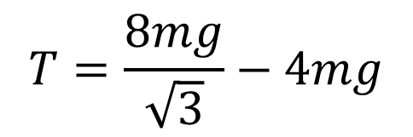

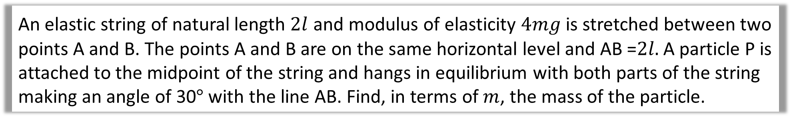
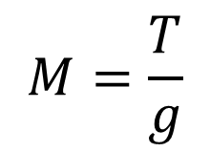

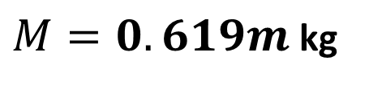


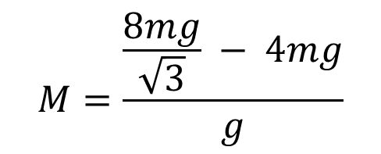





An elastic string of natural length $2l$ and modulus of elasticity $4mg$ is stretched between two points A and B. The points A and B are on the same horizontal level and AB =$2l.$A particle P is attached to the midpoint of the string and hangs in equilibrium with both parts of the string making an angle of 30$°$ with the line AB. Find, in terms of $m$, the mass of the particle.
A
B
Resolve $\left(↕\right)$
$$2Tsin30=Mg$$
$$30°$$
$$30°$$
$$T=Mg$$
$$T$$
$$T$$
$$M=\frac{T}{g}$$
$$Tsin30$$
P
$$Tsin30$$
$$M=\frac{\frac{8mg}{\sqrt{3}} − 4mg}{g}$$
Mg
$$T=\frac{8mg}{\sqrt{3}}−4mg$$
$M=0.619m$ kg

