Slide 1
LO: Histograms

Slide 2
Histograms look a lot like
Bar Charts.
However there are some
big differences.

Slide 3
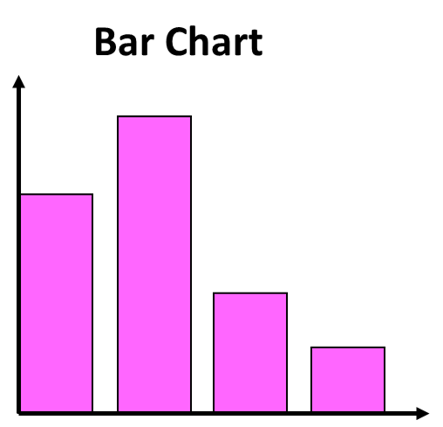
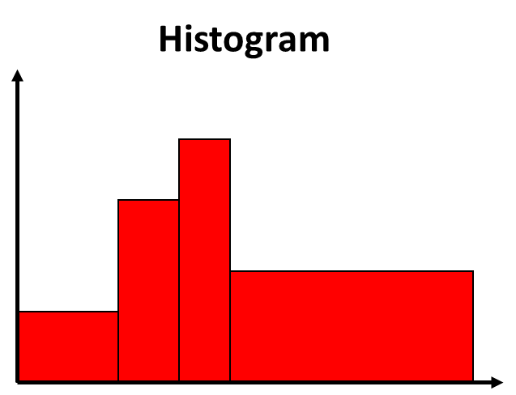
What differences can you notice?
Frequency
Frequency Density

Slide 4
 | Bar Chart | Histogram
Discrete
(Gaps)
Continuous
(No Gaps)
Data Type
Bar Width
Equal Width
Unequal Width
Frequency
Density
y-axis
Frequency
Frequency
Height
Area

Slide 5
Why use a histogram?
Histograms are good for
looking at the
distribution of data.

Slide 7
Histograms
are for continuous data only.
Length | Frequency
0 < t < 40 | 4
40 < t < 80 | 2
80 < t < 100 | 6
100 < t < 120 | 8
120 < t < 180 | 2

Slide 8

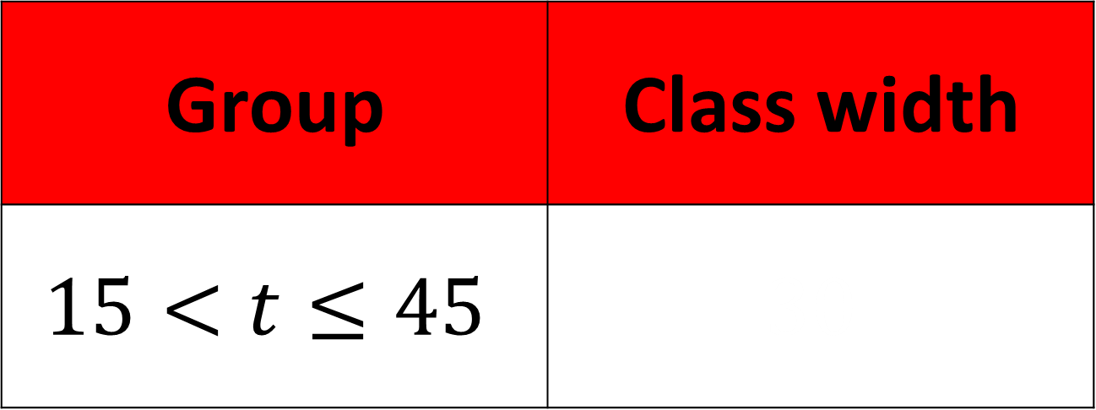
Group | Class width
$$15<t≤45$$ | $$30$$
$$30$$

Slide 9

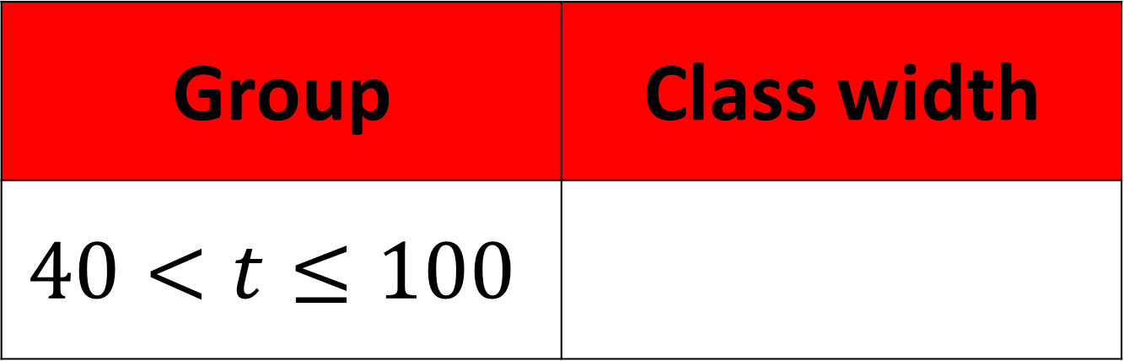
Group | Class width
$$40<t≤100$$ | $$30$$
$$60$$

Slide 10

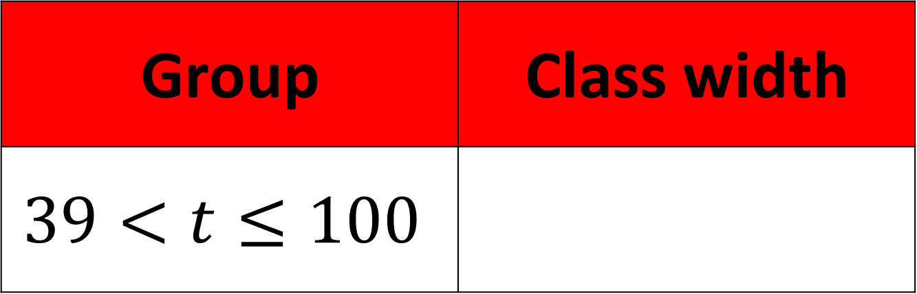
Group | Class width
$$39<t≤100$$ | $$30$$
$$61$$

Slide 11

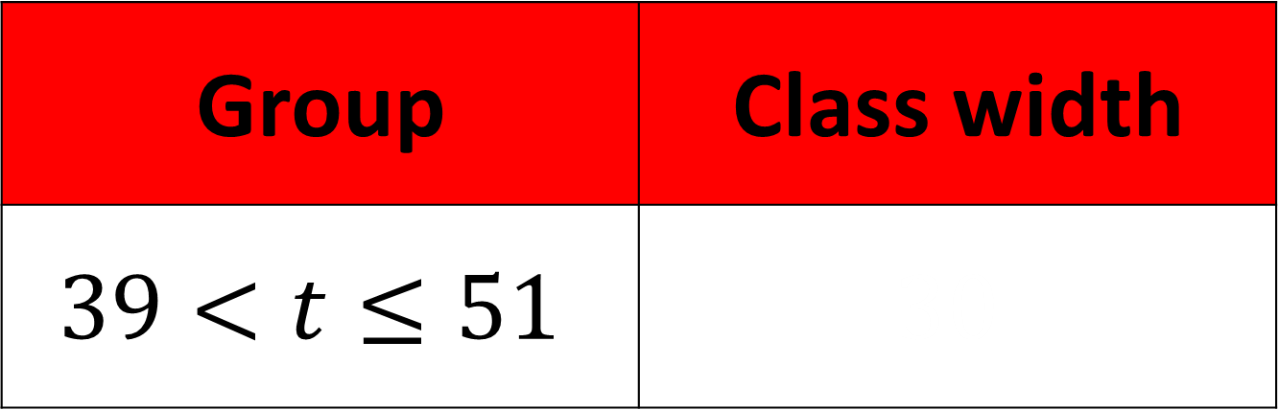
Group | Class width
$$39<t≤51$$ | $$30$$
$$12$$

Slide 12
Frequency
Frequency
Density
Class Interval
Frequency = Frequency Density x Class Intervals

Slide 13
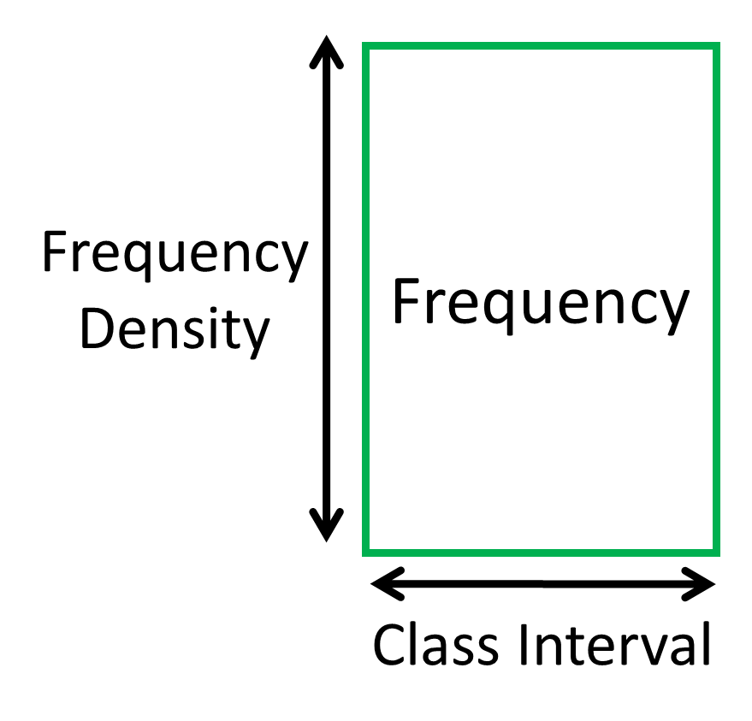

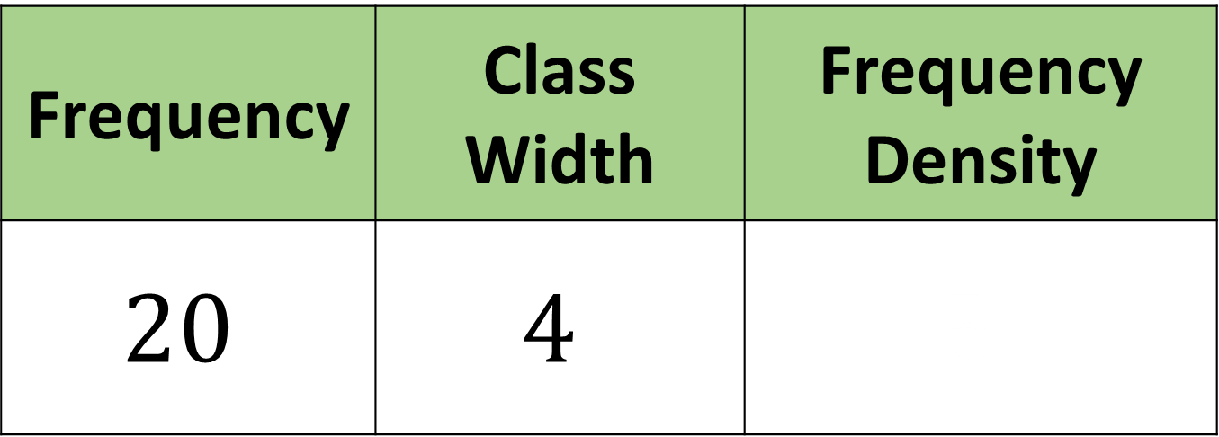
Frequency | Class Width | Frequency Density
$$20$$ | $$4$$ | $$5$$
$$5$$

Slide 14

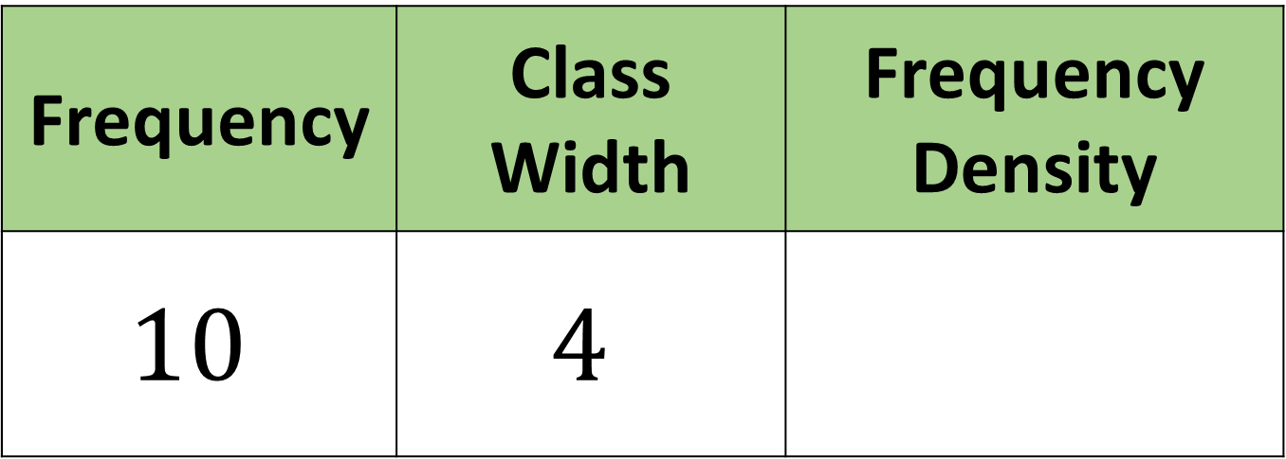
Frequency | Class Width | Frequency Density
$$10$$ | $$4$$
$$2.5$$

Slide 15
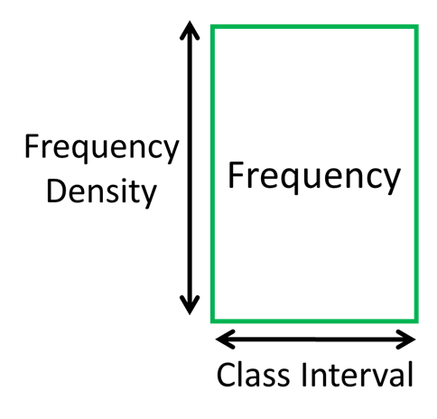

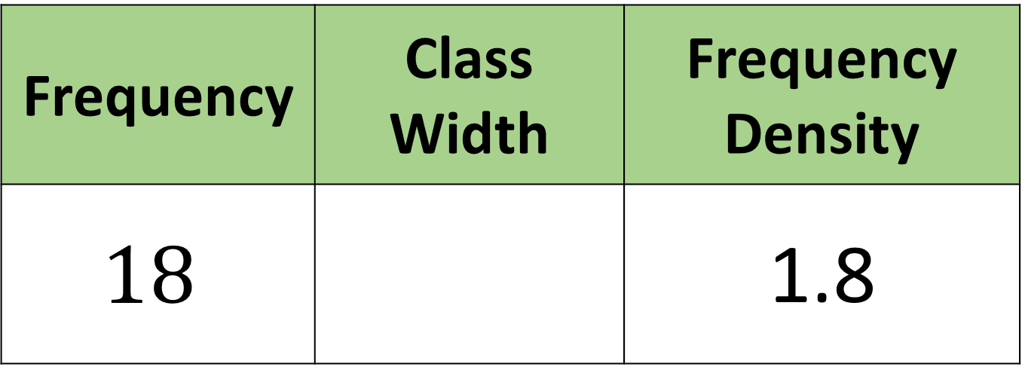
Frequency | Class Width | Frequency Density
$$18$$ |  | 1.8
$$10$$

Slide 16

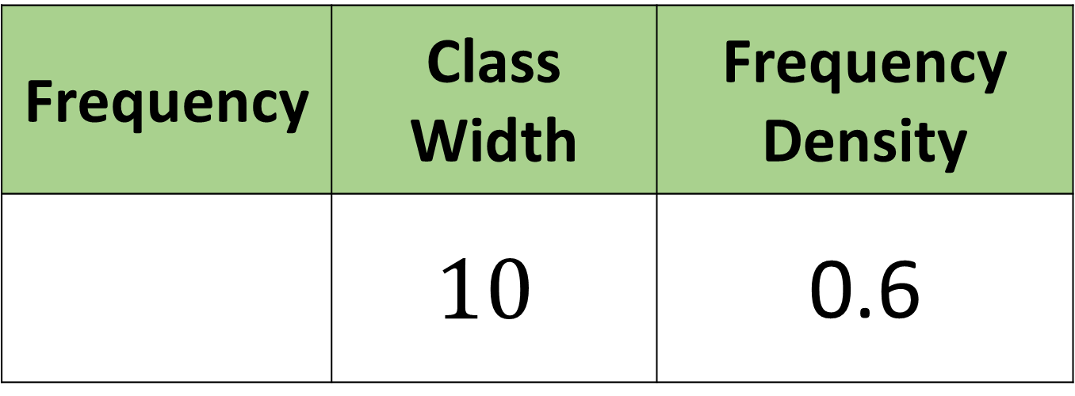
Frequency | Class Width | Frequency Density
 | $$10$$ | 0.6
$$6$$

Slide 17
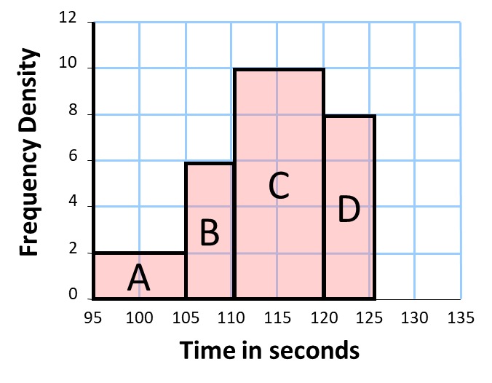
What is the frequency of Bar A?
A
2
10
Frequency
= 2 x 10
= 20

Slide 18
What is the frequency of Bar B?
B
6
5
Frequency
= 6 x 5
= 30

Slide 19
What is the frequency of Bar C?
C
10
10
Frequency
= 10 x 10
= 100

Slide 20
What is the frequency of Bar D?
D
8
5
Frequency
= 8 x 5
= 40

Slide 21
How many people were timed?
A = 10 x 2 = 20
B = 5 x 6 = 30
C = 10 x 10 = 100
D = 5 x 8 = 40
Total = 190

Slide 22
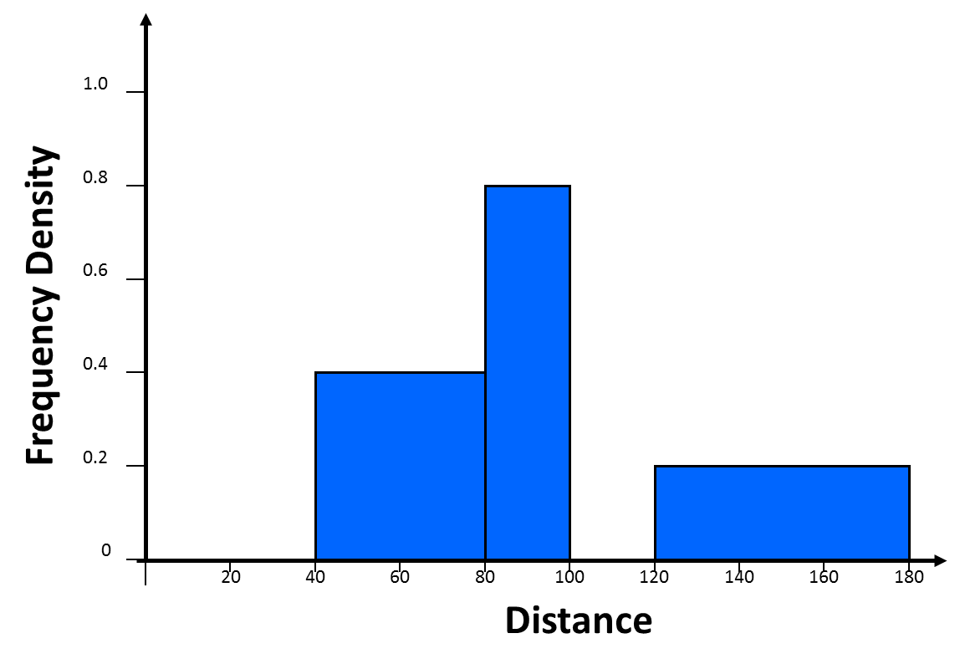
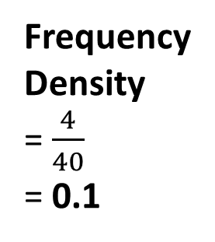
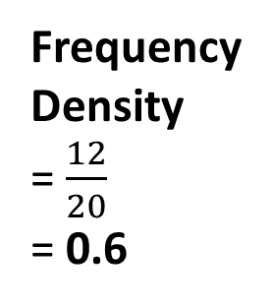
 | Complete the table
 | Length | Frequency
A | 0 < t < 40 | 4
B | 40 < t < 80
C | 80 < t < 100
D | 100 < t < 120 | 12
E | 120 < t < 180
C
B
0.4
Frequency
= 0.8 x 20
= 16
40
0.8
Frequency
= 0.4 x 40
= 16
20
Frequency
= 0.2 x 60
= 12
0.2
E
60
A
D
Frequency
Density
= $\frac{4}{40}$
= 0.1
Frequency
Density
= $\frac{12}{20}$
= 0.6
4
12
?
?
40
20

Slide 23
How many people took
over 115 seconds?
C = 10 x 10 = 100
D = 5 x 8 = 40
Half C + D = 50 + 40 = 90

Slide 24
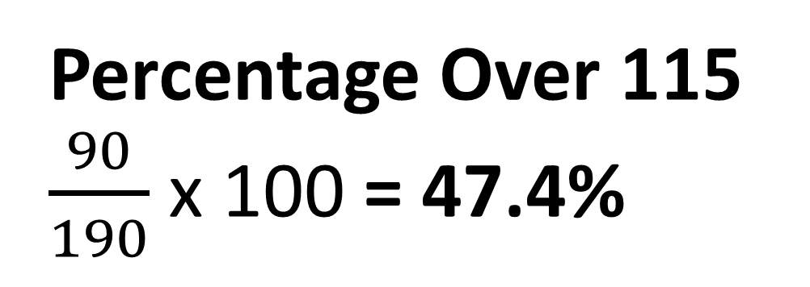
What percentage of people took
over 115 seconds?
Total = 190
Total Over 115 = 90
Percentage Over 115
$\frac{90}{190}$ x 100 = 47.4%

