Slide 1
Equations and Inequalities
Simultaneous Equations
Chapter 3
(Part 1 of 3)

Slide 2
Simultaneous Equations
Always substitute the
linear equation into
the quadratic equation.

Slide 3
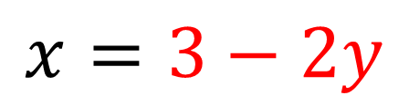
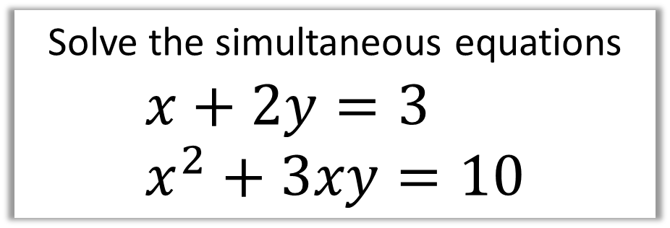
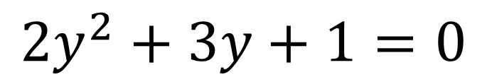
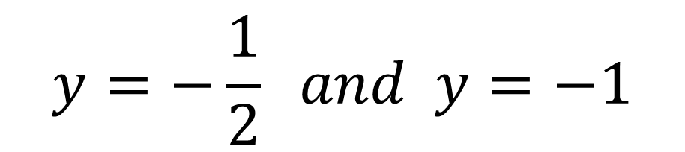
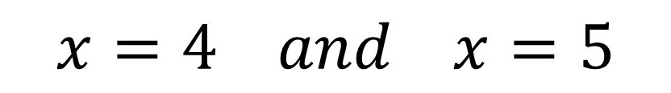
Solve the simultaneous equations
$$x+2y=3 \\ x^{2}+3xy=10$$
$$x=3−2y$$
$${\left(3−2y\right)}^{2}+3y\left(3−2y\right)=10$$
$$2y^{2}+3y+1=0$$
$$y=−\frac{1}{2} and y=−1$$
$$x=4 and x=5$$

Slide 4
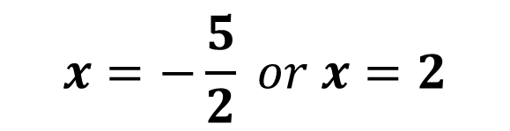
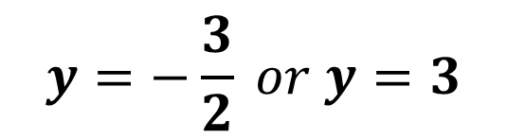
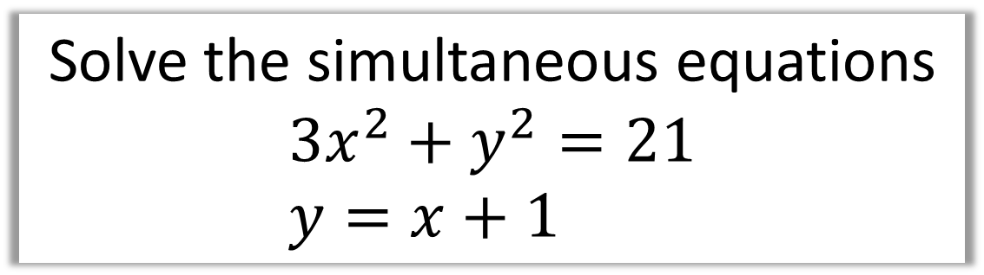



Solve the simultaneous equations
$$3x^{2}+y^{2}=21 \\ y=x+1$$
$$3x^{2}+{\left(x+1\right)}^{2}=21$$
$$3x^{2}+x^{2}+2x+1=21$$
$$4x^{2}+2x−20=0$$
$$x=−\frac{5}{2} or x=2$$
$$y=−\frac{3}{2} or y=3$$

Slide 5
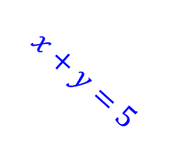
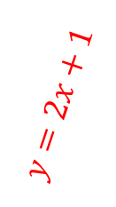
Simultaneous Equations and Graphs
When you are solving a simultaneous equation,
what you really are doing is
finding the
POINT OF INTERSECTION.
The point of intersection!
$$x+y=5$$
$$y=2x+1$$

Slide 6
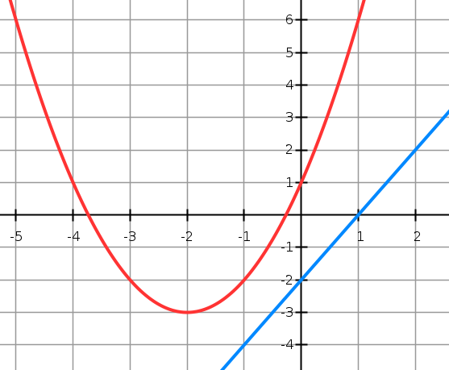
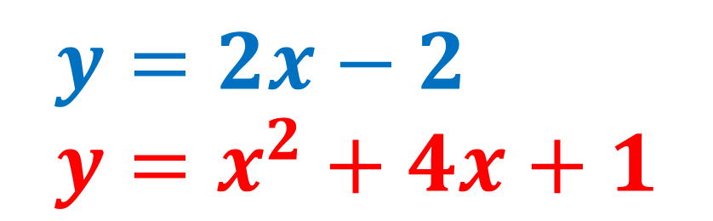
$$y=2x−2 \\ y=x^{2}+4x+1$$
No points of intersection
means
no solutions.

Slide 7
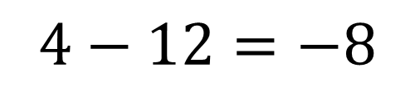
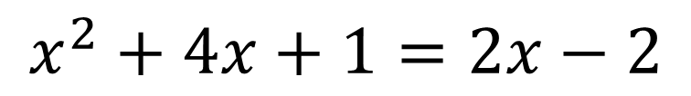
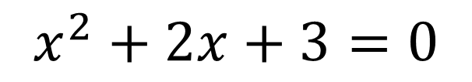
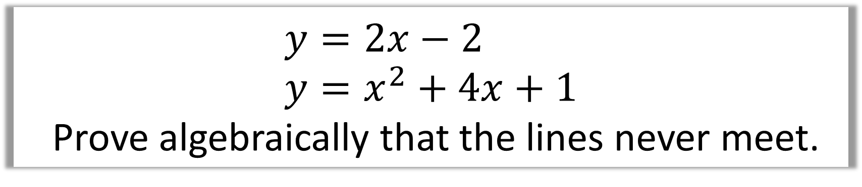
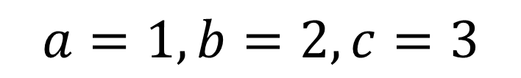
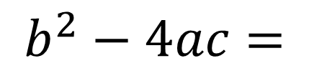
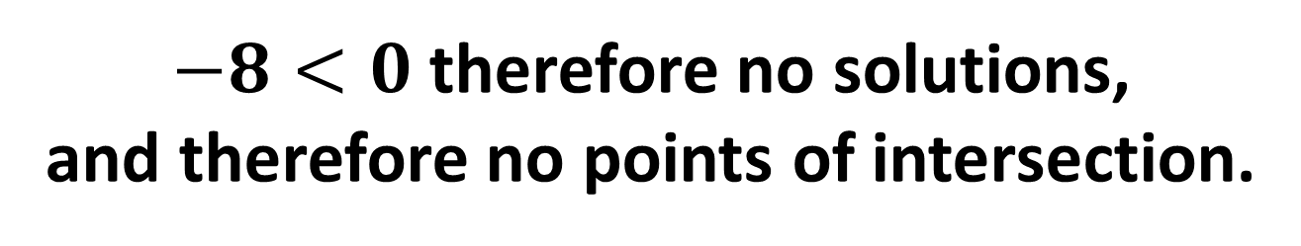
$$y=2x−2 \\ y=x^{2}+4x+1$$
Prove algebraically that the lines never meet.
$$x^{2}+4x+1=2x−2$$
$$x^{2}+2x+3=0$$
$$a=1, b=2, c=3$$
$$b^{2}−4ac=$$
$$4−12=−8$$
$−8<0$ therefore no solutions,
and therefore no points of intersection.

Slide 8

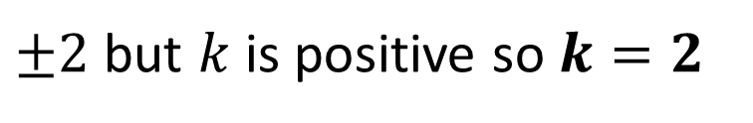

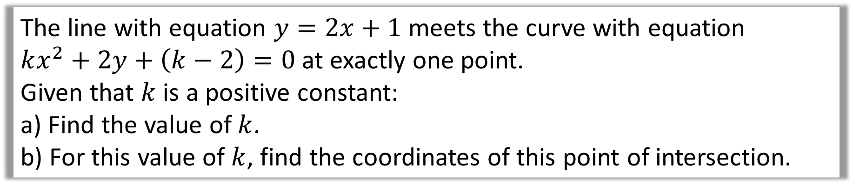

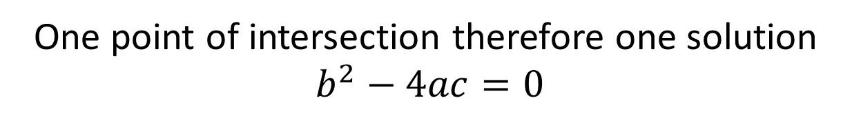

The line with equation $y=2x+1$ meets the curve with equation
$kx^{2}+2y+\left(k−2\right)=0$ at exactly one point.
Given that $k$ is a positive constant:
a) Find the value of $k$.
b) For this value of $k$, find the coordinates of this point of intersection.
a)
Substituting:
$$kx^{2}+2\left(2x+1\right)+k−2=0$$
$$kx^{2}+4x+2+k−2=0$$
$$kx^{2}+4x+k=0$$
One point of intersection therefore one solution
$b^{2}−4ac=0$
$$a=k, b=4, c=k$$
$$16−4k^{2}=0$$
$±2$ but $k$ is positive so $k=2$

Slide 9

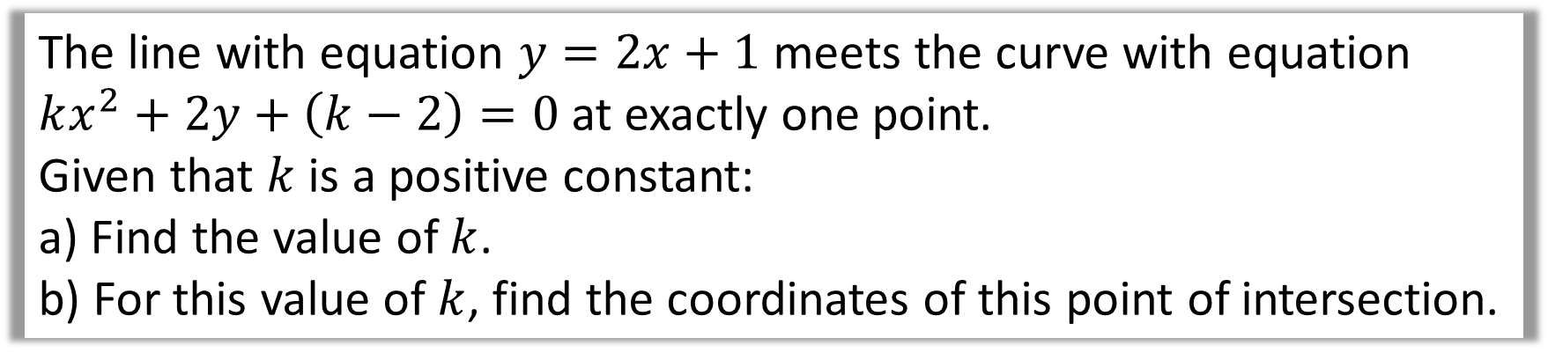

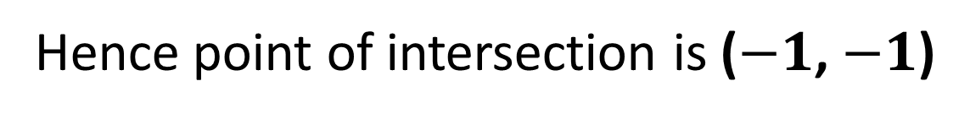

The line with equation $y=2x+1$ meets the curve with equation
$kx^{2}+2y+\left(k−2\right)=0$ at exactly one point.
Given that $k$ is a positive constant:
a) Find the value of $k$.
b) For this value of $k$, find the coordinates of this point of intersection.
When $k=2$, $2x^{2}+4x+2=0$
b)
$$x=−1 and x=−1$$
$$y=−1 and y=−1$$
Hence point of intersection is ($−1$, $−1$)

