Slide 1
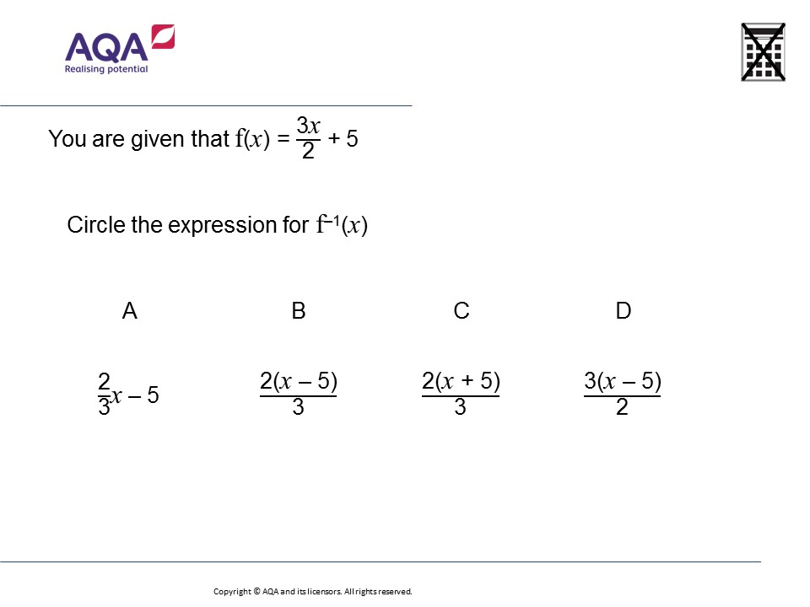
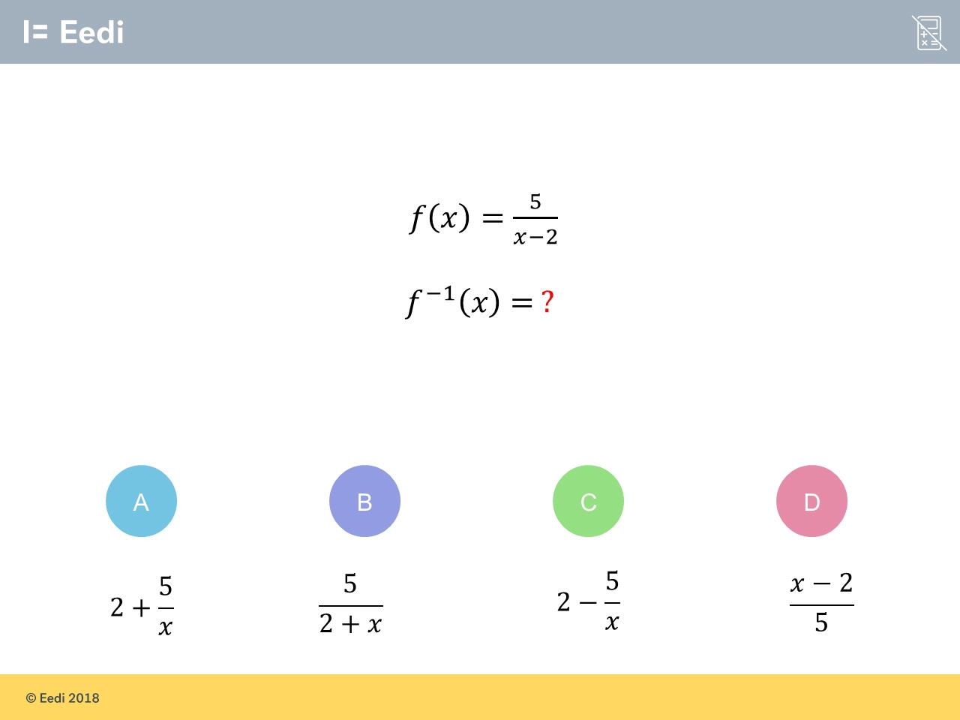
Worst answered question?
Most common wrong answer?

Slide 2
ANSWERS

Slide 3
Worst answered question?

Slide 4
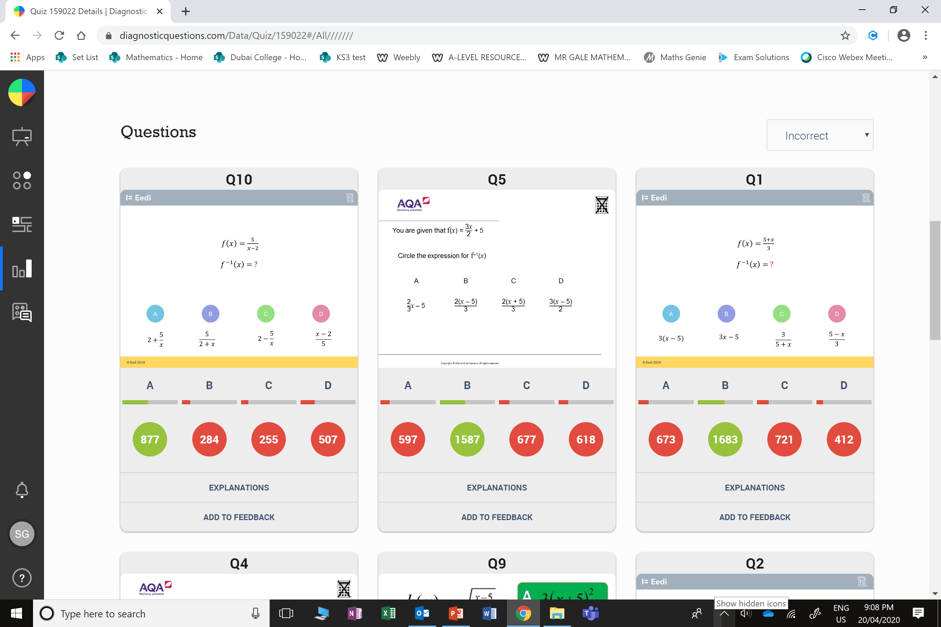
D
The student has found the reciprocal of f(x). They may be confused by the power.

Slide 5
C
The student has added 5, rather than subtracting.

