Slide 1
Representation of Data
Cumulative Graphs
Chapter 3
(Part 2 of 3)

Slide 2
Cumulative Frequency Diagrams
Time (s) | Frequency
9.6 < t ≤ 9.7 | 1
9.7 < t ≤ 9.9 | 4
9.9 < t ≤ 10.05 | 10
10.05 < t ≤ 10.2 | 17
Time (s) | Cum Freq
9.6 < t ≤ 9.7
9.6 < t ≤ 9.9
9.6 < t ≤ 10.05
9.6 < t ≤ 10.2
1
5
15
32

Slide 3
What are the coordinates of
each point you need to plot?
Time (s) | Cumulative Frequencies
9.6 < t ≤ 9.7 | 1
9.6 < t ≤ 9.9 | 5
9.6 < t ≤ 10.05 | 15
9.6 < t ≤ 10.2 | 32
(9.7, 1)
(9.9, 5)
(10.05, 15)
(10.2, 32)

Slide 4
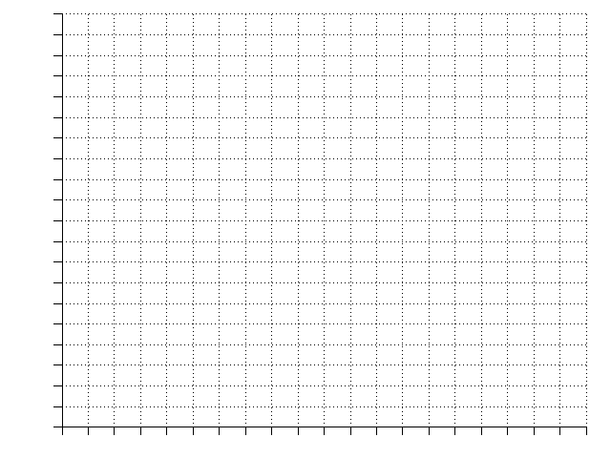
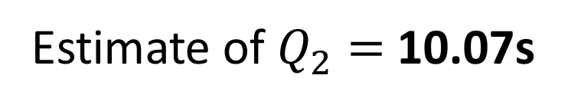
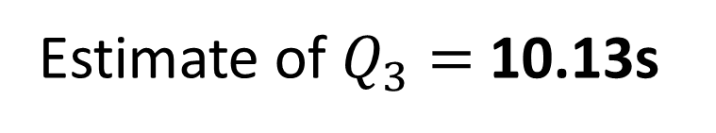

Time (s) | Frequency | Cum Freq
9.6 < t ≤ 9.7 | 1 | 1
9.7 < t ≤ 9.9 | 4 | 5
9.9 < t ≤ 10.05 | 10 | 15
10.05 < t ≤ 10.2 | 17 | 32
32
28
24
20
16
12
8
4
0
Cumulative Frequency
Estimate of $Q_{2}=$ 10.07s
Estimate of $Q_{1}=$ 9.95s
Estimate of $Q_{3}=$ 10.13s
IQR = 0.18s
9.5 9.6 9.7 9.8 9.9 10.0 10.1 10.2 10.3
Time (s)

Slide 5
Estimate how many runners had a time less than 10.15s.
32
28
24
20
16
12
8
4
0
26 Runners
Estimate how many runners
had a time between
9.8s and 10s.
Cumulative Frequency
11 – 3 = 8 Runners
Estimate how many runners had a time more than 9.95
32 – 8 = 24 Runners
9.5 9.6 9.7 9.8 9.9 10.0 10.1 10.2
Time (s)

