Slide 1
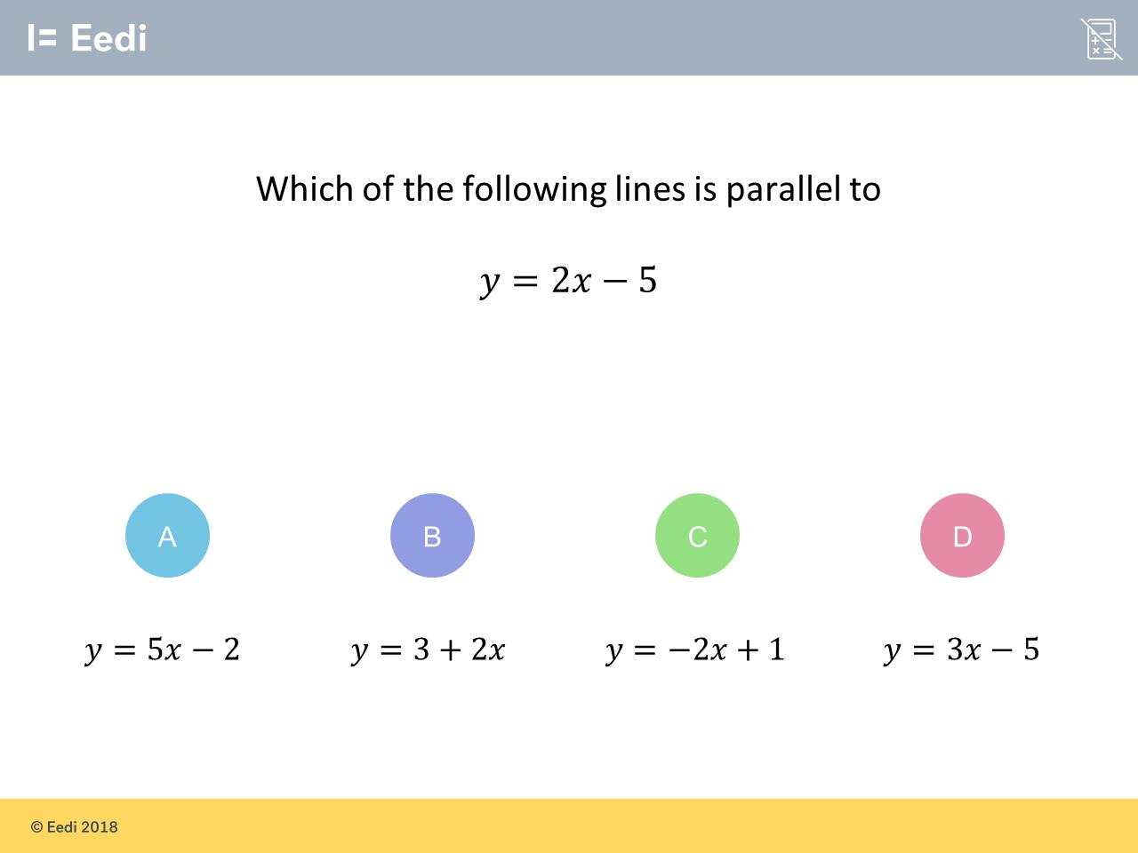
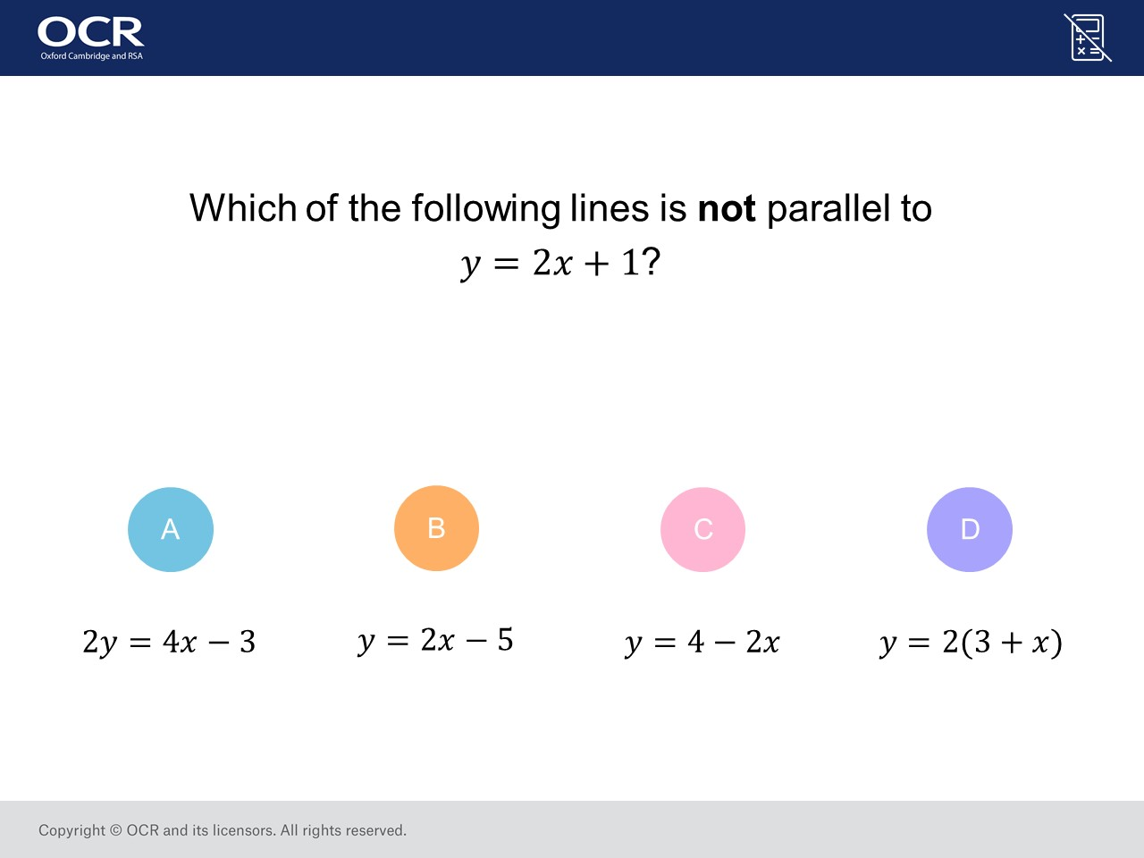
Worst answered question?
Most common wrong answer?

Slide 2
ANSWERS

Slide 3
Worst answered question?

Slide 4
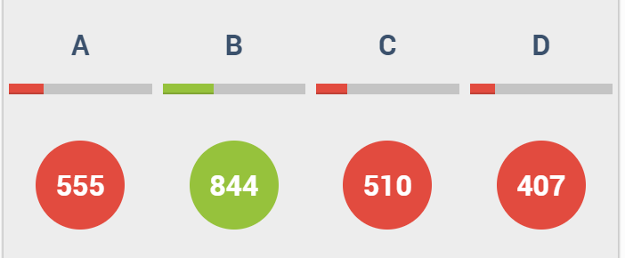
A
The student thought the 5
was the gradient.

Slide 5
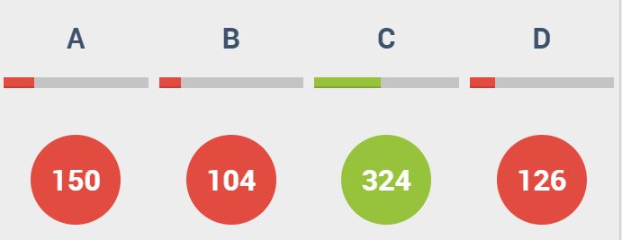
A
They didn’t
divide the 4x
by 2.

