Slide 1
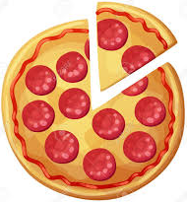
1) What is the area of a 12 inch diameter pizza? (1 d.p)
2) A pizza shop has 2 deals.
Option A: One 12inch pizza for 50dhs
Option B: Two 8inch pizzas for 50dhs
Which deal gives you more pizza for you money?
3) A pizzeria sells 14inch diameter pizzas and slices each pizza into 6 equal slices.
What is the area of one slice of pizza? (1 d.p.)
4) A pizzeria sells 10inch diameter pizzas
and slices each pizza into 6 equal slices.
It cost the pizzeria 10dhs to make the pizza.
They sell each slice for 5dhs.
How much profit do they make per pizza?
5) What is the circumference of a 12 inch diameter pizza? (1 d.p.)
6) A pizzeria want to sell a pizza that is twice the area of a 10inch diameter pizza.
What should the radius of this new pizza be? (1 d.p.)

Slide 2
7) A farmers field is the shape of semicircle with a diameter of 50m.
He want to cover it with grass seed.
Grass seed bags cover an area of 35m².
How many bags does the farmer need to buy?
8) The farmer wants to fence the perimeter of his field.
How much fencing will he need (in metres)? (1. d.p.)
9) The farmer has a second field which has a diameter double the size of this one.
The farmer thinks this means the area will be double. Are they correct. Give you reasons.
10) To plant all the grass seed it take 3 workers 4 days
to cover the whole field. How long will it take 2 workers?
50metres

Slide 3
ANSWERS

Slide 4

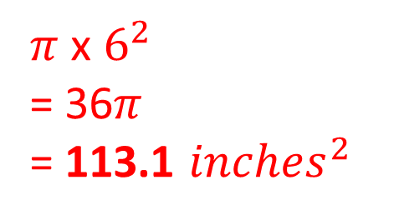
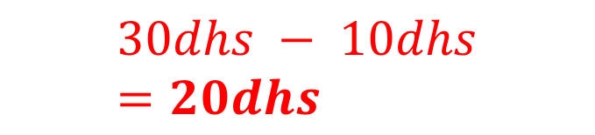
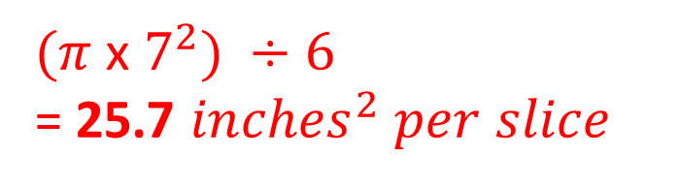
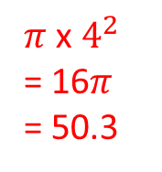
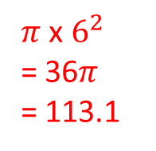
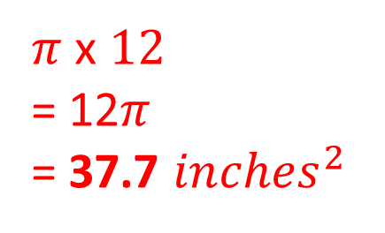
1) What is the area of a 12 inch diameter pizza? (1 d.p)
2) A pizza shop has 2 deals.
Option A: One 12inch pizza for 50dhs
Option B: Two 8inch pizzas for 50dhs
Which deal gives you more pizza for you money?
$π$ x $6^{2}$
= 36$π$
= 113.1 ${inches}^{2}$
$π$ x $6^{2}$
= 36$π$
= 113.1
$π$ x $4^{2}$
= 16$π$
= 50.3
113.1 > 100.6
Option A
3) A pizzeria sells 14inch diameter pizzas and slices each pizza into 6 equal slices.
What is the area of one slice of pizza? (1 d.p.)
4) A pizzeria sells 10inch diameter pizzas
and slices each pizza into 6 equal slices.
It cost the pizzeria 10dhs to make the pizza.
They sell each slice for 5dhs.
How much profit do they make per pizza?
$(π$ x $7^{2}) ÷6$
= 25.7 ${inches}^{2} per slice$
$$30dhs − 10dhs=20dhs$$
5) What is the circumference of a 12 inch diameter pizza? (1 d.p.)
6) A pizzeria want to sell a pizza that is twice the area of a 10inch diameter pizza.
What should the radius of this new pizza be? (1 d.p.)
$π$ x $12$
= 12$π$
= 37.7 ${inches}^{2}$
Area = 78.5 x 2 = 157
Radius = $\sqrt{\frac{157}{π}}=7.1 inch$

Slide 5
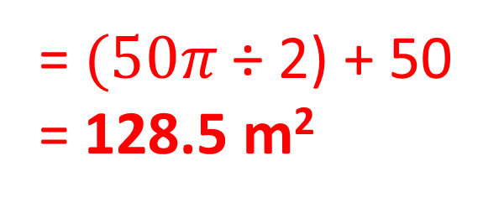


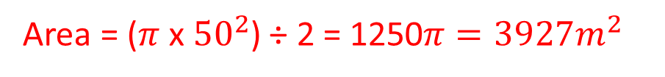
7) A farmers field is the shape of semicircle with a diameter of 50m.
He want to cover it with grass seed.
Grass seed bags cover an area of 35m².
How many bags does the farmer need to buy?
8) The farmer wants to fence the perimeter of his field.
How much fencing will he need (in metres)? (1. d.p.)
= $(50π$ ÷ 2) + 50
= 128.5 m²
Area = ($π$ x ${25}^{2}$) ÷ 2 = 981.7 $m^{2}$
Bag needed = 981.7 ÷ 35 = 28.04
Bags needed = 29
9) The farmer has a second field which has a diameter double the size of this one.
The farmer thinks this means the area will be double. Are they correct. Give you reasons.
10) To plant all the grass seed it take 3 workers 4 days
to cover the whole field. How long will it take 2 workers?
50metres
1 worker = 12 days
2 workers = 6 days
Area = ($π$ x ${50}^{2}$) ÷ 2 = 1250$π$ $=3927m^{2}$
Area = ($π$ x ${25}^{2}$) ÷ 2 = 981.7 $m^{2}$
No because
981.7 x 2 ≠ 3927

