Slide 1
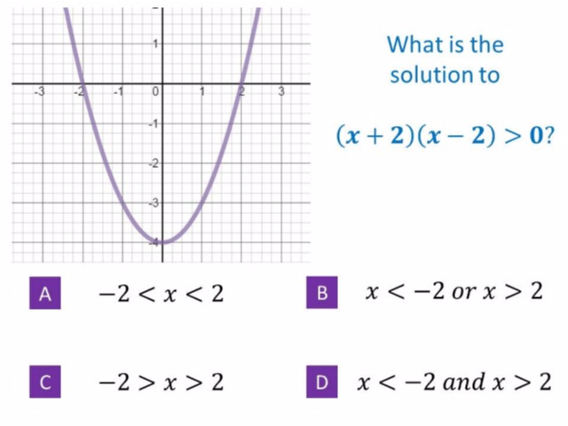
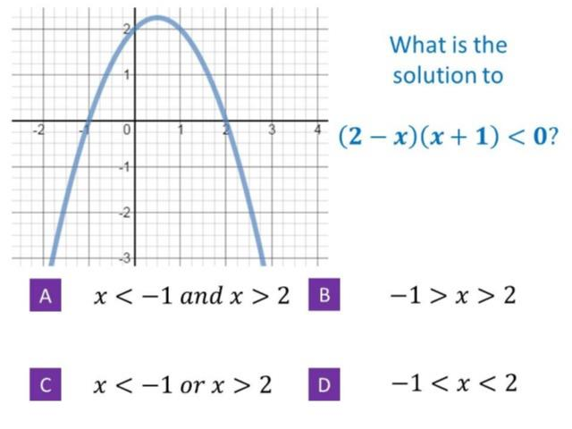
Worst answered question?
Most common wrong answer?

Slide 2
ANSWERS

Slide 3
Worst answered question?

Slide 4
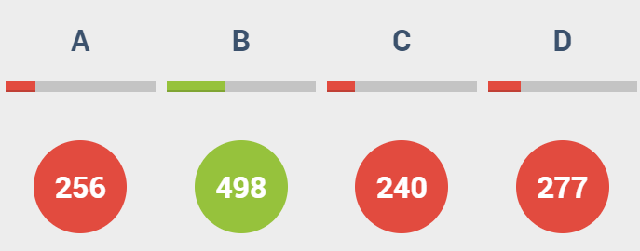
D
Option D states AND instead of OR.

Slide 5

D
The have describe the graph that is above the axis.

