Slide 1
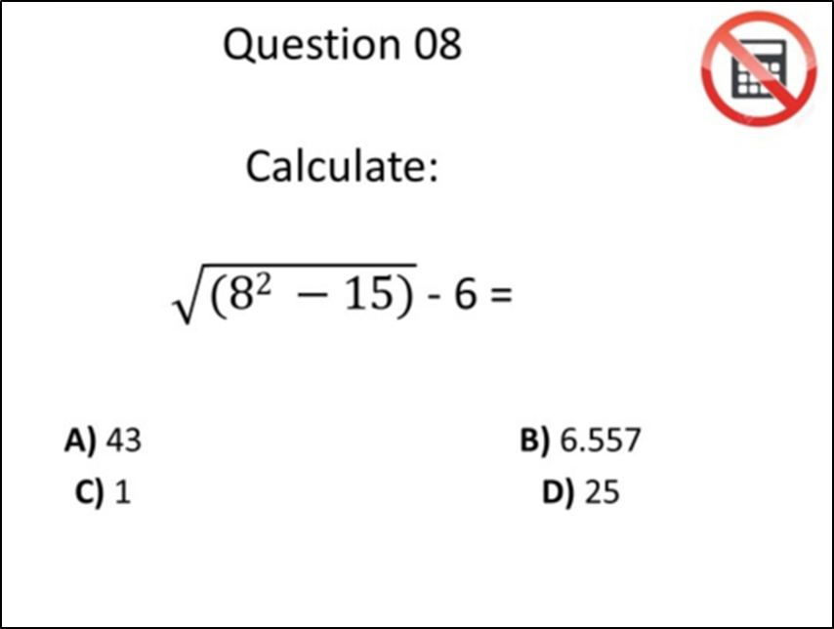
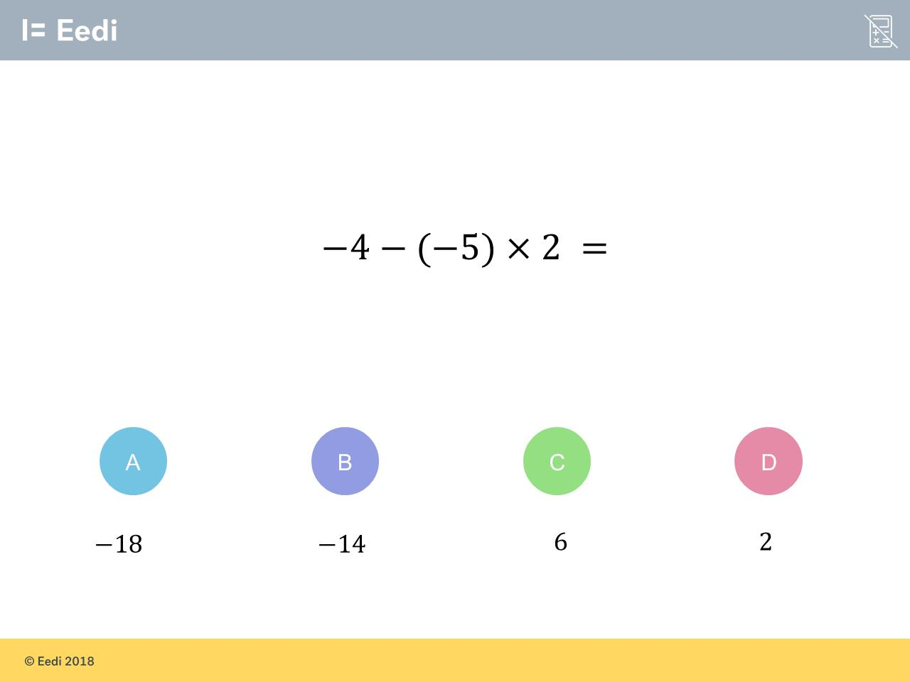
Worst answered question?
Most common wrong answer?

Slide 2
ANSWERS

Slide 3
Worst answered question?

Slide 4
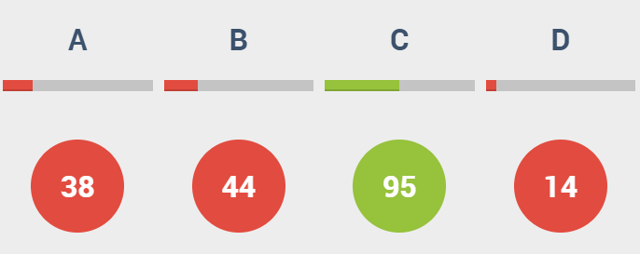
A
The ignored the square root.

Slide 5
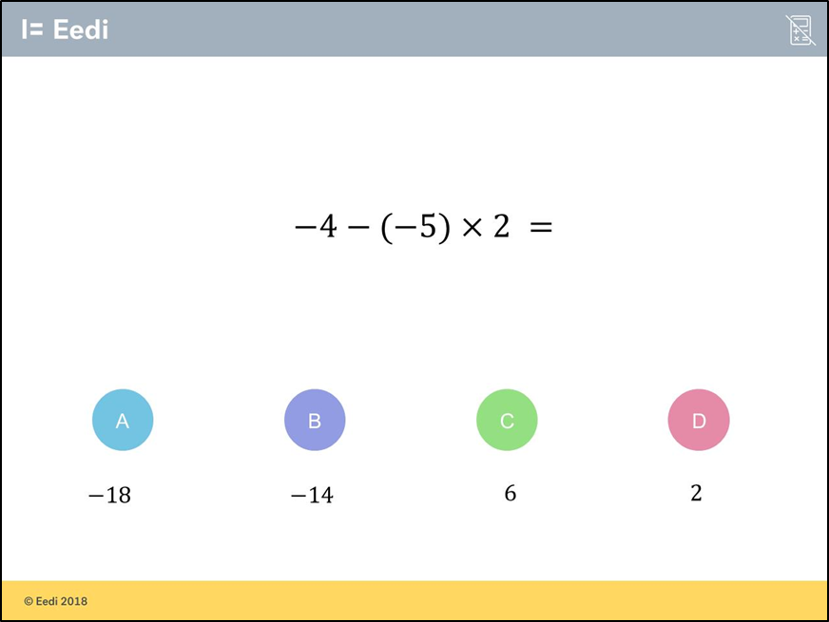
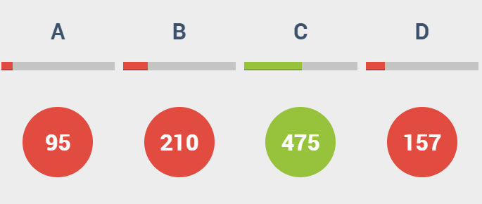
B
They did –4 – 10 instead of –4 + 10.

