Slide 1
Projectiles
Introduction
Chapter 6
(Part 1 of 4)

Slide 2
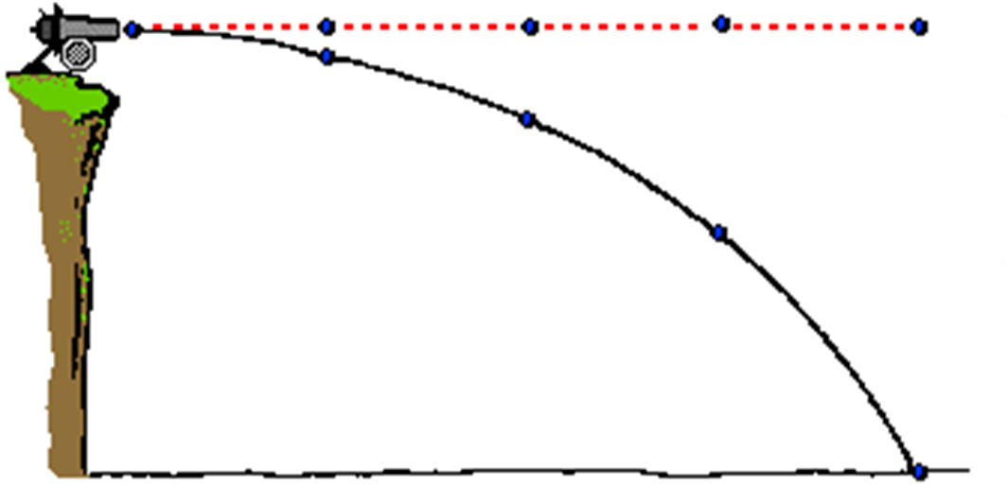
What is strange about the path?
Path if not effected by gravity

Slide 3





Does the horizontal speed change?
$${30ms}^{−1}$$
$${30ms}^{−1}$$
$${30ms}^{−1}$$
$${30ms}^{−1}$$
$${30ms}^{−1}$$
Horizontal speed will remain constant.

Slide 4
Projectiles
Split every question into
vertical motion calculations
and
horizontal motion calculations.

Slide 5
Vertical Motion Calculations
Use SUVAT equations
Acceleration is always –9.8 ms⁻²

Slide 6

Horizontal Motion Calculations
Constant Speed
Acceleration is always 0 ms⁻²
Use $speed=\frac{distance}{time}$

Slide 7
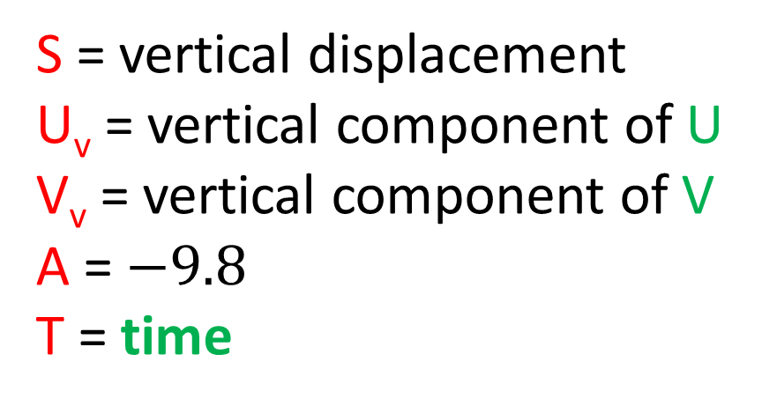
The only value that can be transferred
between vertical and horizontal calculations
is time.
Vertical Motion
Horizontal Motion
S = vertical displacement
U_{v} = vertical component of U
V_{v} = vertical component of V
A = $−9.8$
T = time
Distance = horizontal displacement
Speed = horizontal component
Time = time

Slide 8
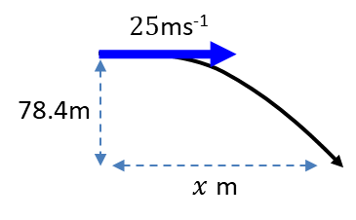
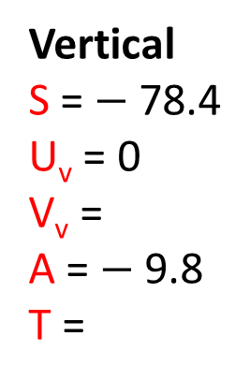


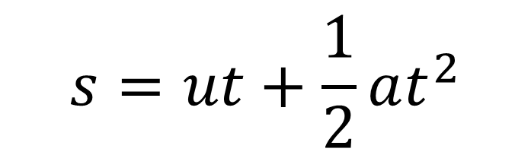

A particle is project horizontally at 25 ms⁻¹ from a point 78.4 metres above a horizontal surface. Find:
a) the time taken by the particle to reach the surface
b) the horizontal distance travelled in that time.
a)
$$Vertical Motion$$
$$s=ut+\frac{1}{2}at^{2}$$
Vertical
S = $−$78.4
U_{v} = 0
V_{v} =
A = $−$9.8
T =
Horizontal
Distance = x
Speed = 25
Time =
$$−78.4=−4.9t^{2}$$
$$t=4$$

Slide 9

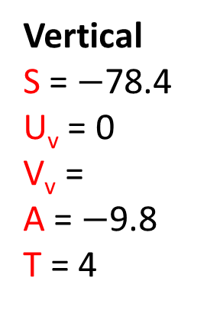


A particle is project horizontally at 25 ms⁻¹ from a point 78.4 metres above a horizontal surface. Find:
a) the time taken by the particle to reach the surface
b) the horizontal distance travelled in that time.
b)
$$Horizontal Motion$$
Vertical
S = $−$78.4
U_{v} = 0
V_{v} =
A = $−$9.8
T = 4
Horizontal
Distance = x
Speed = 25 Time = 4
$$x=25×4=100m$$

Slide 10
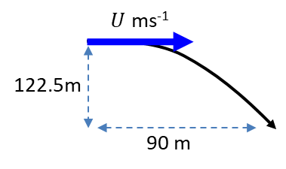

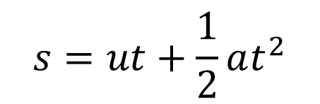

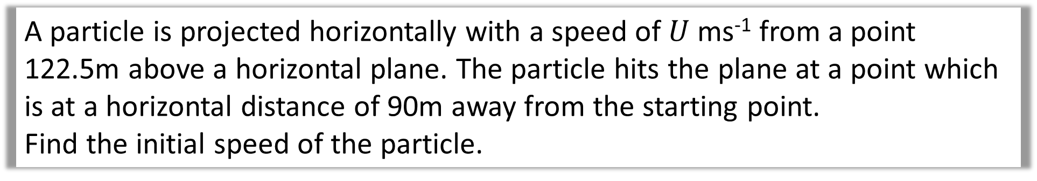
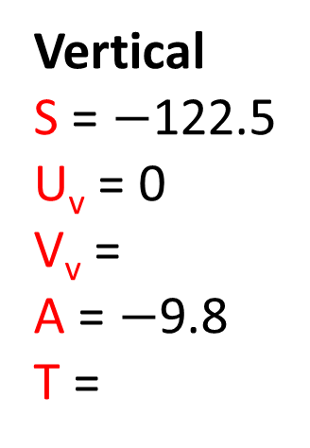




A particle is projected horizontally with a speed of $U$ ms⁻¹ from a point 122.5m above a horizontal plane. The particle hits the plane at a point which is at a horizontal distance of 90m away from the starting point.
Find the initial speed of the particle.
$$s=ut+\frac{1}{2}at^{2}$$
$$Vertical Motion$$
$$−122.5=−4.9t^{2}$$
$$t=5 sec$$
Vertical
S = $−$122.5
U_{v} = 0
V_{v} =
A = $−$9.8
T =
Horizontal
Distance = 90
Speed = U
Time =
$$Horizontal Motion$$
$$90=U×5$$
$$U=18 ms^{−1}$$

Slide 11
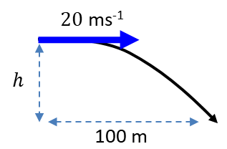

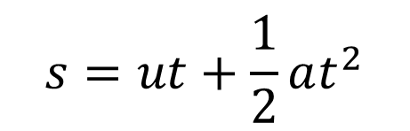

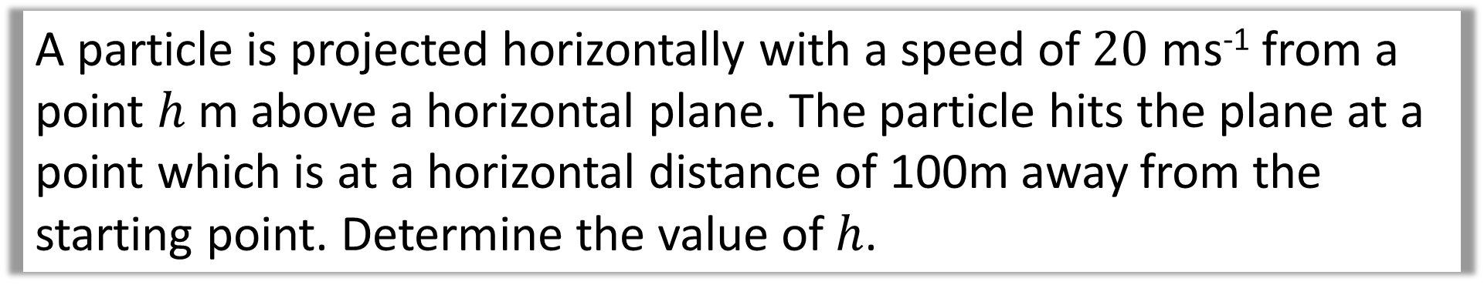
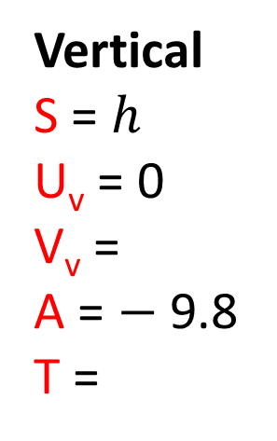

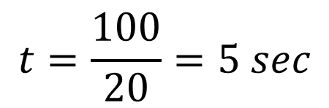

A particle is projected horizontally with a speed of $20$ ms⁻¹ from a point $h$ m above a horizontal plane. The particle hits the plane at a point which is at a horizontal distance of 100m away from the starting point. Determine the value of $h$.
$$Horizontal Motion$$
$$t=\frac{100}{20}=5 sec$$
Vertical
S = $h$
U_{v} = 0
V_{v} =
A = $−$9.8
T =
Horizontal
Dis = 100
Speed = 20
Time =
$$s=ut+\frac{1}{2}at^{2}$$
$$Vertical Motion$$
$$s=4.9×5^{2}$$
$$s=122.5 m$$

