Slide 1
Constant Acceleration
SUVAT Horizontal
Chapter 9
(Part 3 of 4)

Slide 2
Constant Acceleration
SUVAT Equations
The equations only work if
you have constant acceleration.

Slide 3
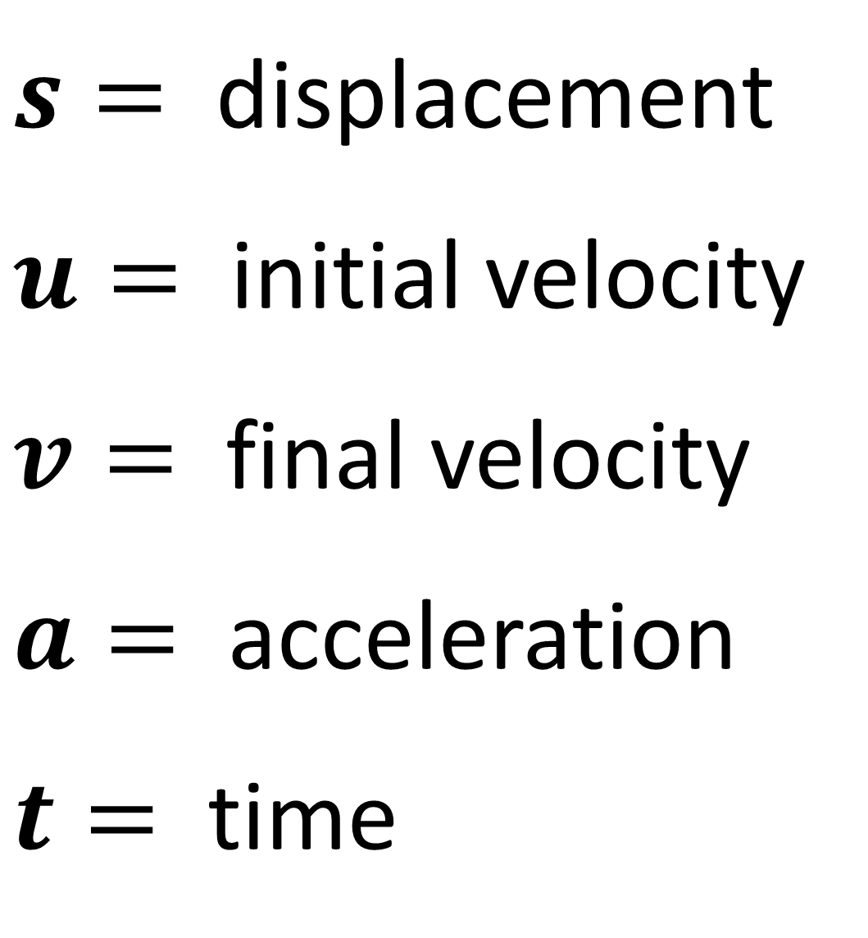
$s=$ displacement
$u=$ initial velocity
$v=$ final velocity
$a=$ acceleration
$t=$ time

Slide 4
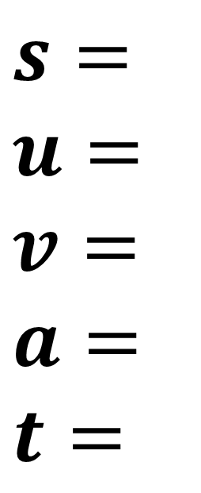
For each question write out SUVAT
and identify the information you know.
$s=$
$$u=$$
$$v=$$
$$a=$$
$$t=$$
Then identify which SUVAT equation
you can use that only gives you one unknown.

Slide 5
Horizontal Movement
When using SUVAT you need to identify
a forward and backward direction.
-
+

Slide 6

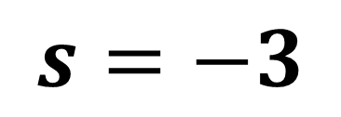

Displacement is the distance from your starting point to your current position.
$$S$$
5m
Start
8m
Finish
What is the displacement of the particle?
$s=−3$

Slide 7
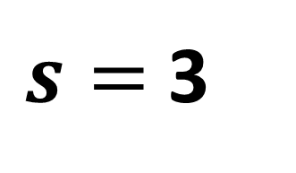
Displacement is the distance from your starting point to your current position.
$$S$$
5m
Start
2m
Finish
What is the displacement of the particle?
$s=$ 3

Slide 8
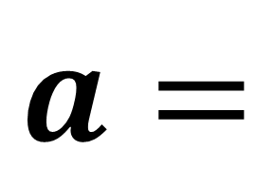


$$a$$
a is the acceleration/deceleration.
6 ms⁻²
$$a=$$
$$6$$

Slide 9
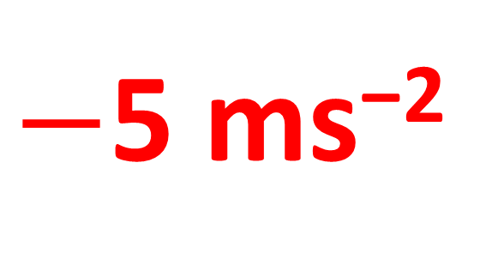
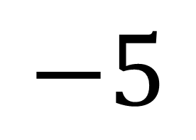
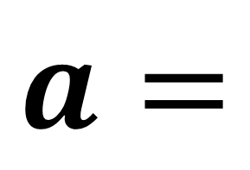
$$a$$
a is the acceleration/deceleration.
$−$5 ms⁻²
$$a=$$
$$−5$$

Slide 10

$$t$$
t time take to travel from one point to another.
A
B
C
t = 5
t = 3
What is the time that it takes to go from A to C?
t = 8

Slide 11

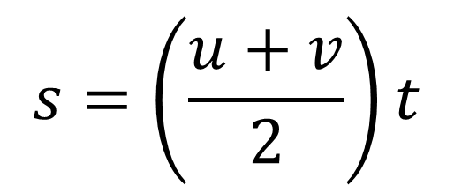
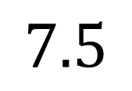
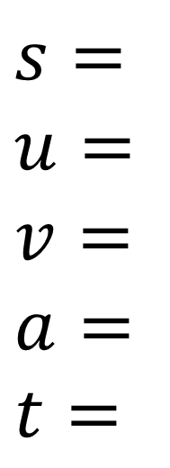

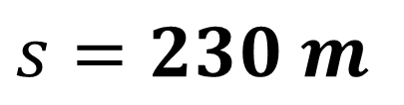

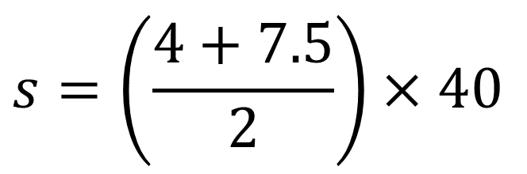

A cyclist is travelling along a straight road. She accelerates at a constant rate from a velocity of 4 ms⁻¹ to a velocity of 7.5 ms⁻¹ in 40 seconds. Find:
the distance she travels in these 40 seconds
her acceleration in these 40 seconds.
$$v=u+at$$
$$s=\left(\frac{u+v}{2}\right)t$$
$$v^{2}=u^{2}+2as$$
$$s=ut+\frac{1}{2}at^{2}$$
a)
Identify Values
Choose Equation
Substitute Values
$$s=$$
$$u=$$
$$v= \\ a=$$
$$t=$$
$$?$$
$$s=\left(\frac{u+v}{2}\right)t$$
$$s=\left(\frac{4+7.5}{2}\right)×40$$
$$4$$
$$7.5$$
$$s=230 m$$
$$40$$

Slide 12
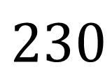
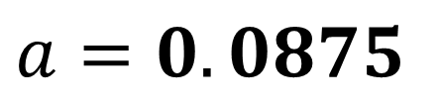
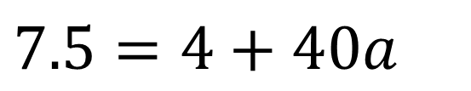
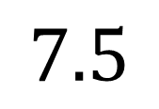
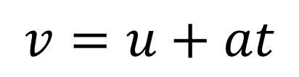
A cyclist is travelling along a straight road. She accelerates at a constant rate from a velocity of 4 ms⁻¹ to a velocity of 7.5 ms⁻¹ in 40 seconds. Find:
the distance she travels in these 40 seconds
her acceleration in these 40 seconds.
$$v=u+at$$
$$s=\left(\frac{u+v}{2}\right)t$$
$$v^{2}=u^{2}+2as$$
$$s=ut+\frac{1}{2}at^{2}$$
b)
Identify Values
Choose Equation
Substitute Values
$$s=$$
$$u=$$
$$v= \\ a=$$
$$t=$$
$$230$$
$$v=u+at$$
$$7.5=4+40a$$
$$4$$
$$a=0.0875$$
$$7.5$$
$$40$$

Slide 13

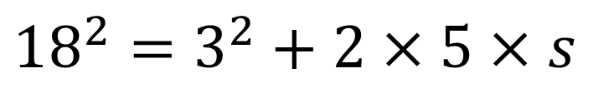


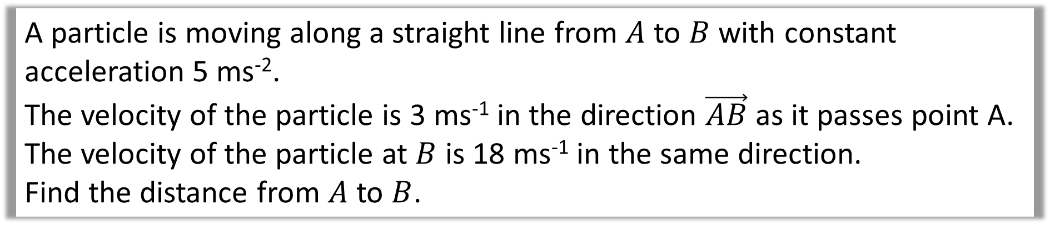


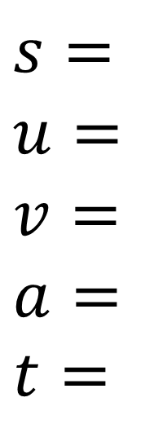
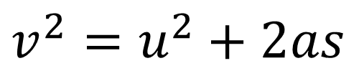
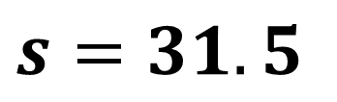

A particle is moving along a straight line from $A$ to $B$ with constant acceleration 5 ms⁻².
The velocity of the particle is 3 ms⁻¹ in the direction $\vec{AB}$ as it passes point A.
The velocity of the particle at $B$ is 18 ms⁻¹ in the same direction.
Find the distance from $A$ to $B$.
$$v=u+at$$
$$s=\left(\frac{u+v}{2}\right)t$$
$$v^{2}=u^{2}+2as$$
$$s=ut+\frac{1}{2}at^{2}$$
Identify Values
Choose Equation
$$s=$$
$$u=$$
$$v= \\ a=$$
$$t=$$
$$?$$
Substitute Values
$$v^{2}=u^{2}+2as$$
$$3$$
$${18}^{2}=3^{2}+2×5×s$$
$$18$$
$$s=31.5$$
$$5$$
$$?$$

Slide 14



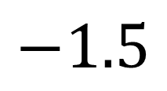
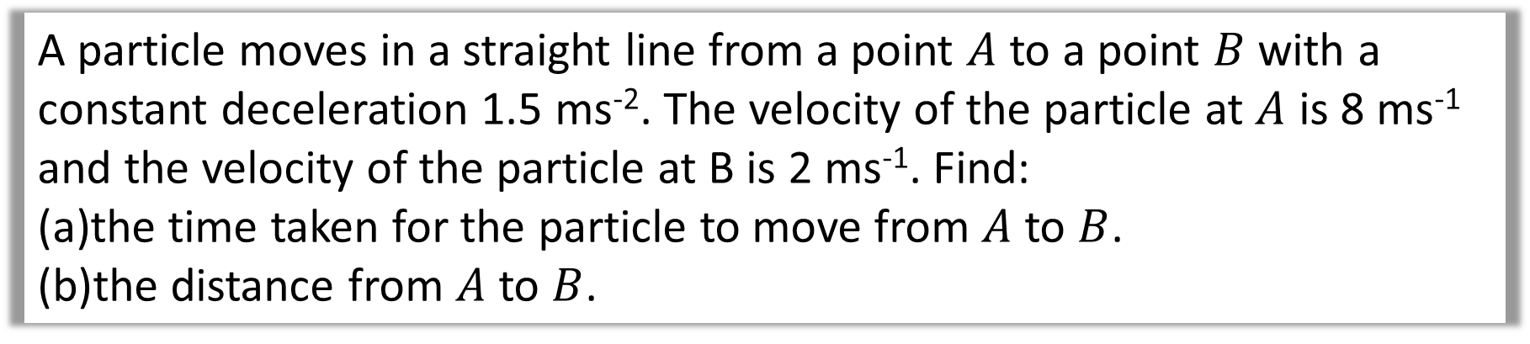
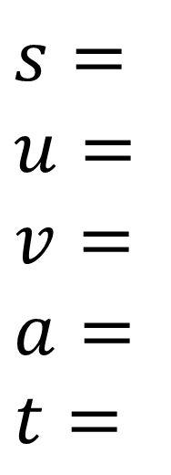
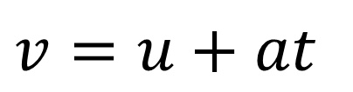


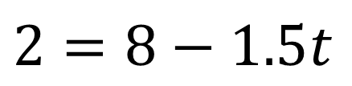

A particle moves in a straight line from a point $A$ to a point $B$ with a constant deceleration 1.5 ms⁻². The velocity of the particle at $A$ is 8 ms⁻¹ and the velocity of the particle at B is 2 ms⁻¹. Find:
the time taken for the particle to move from $A$ to $B$.
the distance from $A$ to $B$.
$$v=u+at$$
$$s=\left(\frac{u+v}{2}\right)t$$
$$v^{2}=u^{2}+2as$$
$$s=ut+\frac{1}{2}at^{2}$$
a
Identify Values
Choose Equation
Substitute Values
$$s=$$
$$u=$$
$$v= \\ a=$$
$$t=$$
$$?$$
$$v=u+at$$
$$2=8−1.5t$$
$$8$$
$$t=4 \text{seconds}$$
$$2$$
$$−1.5$$
$$?$$

Slide 15

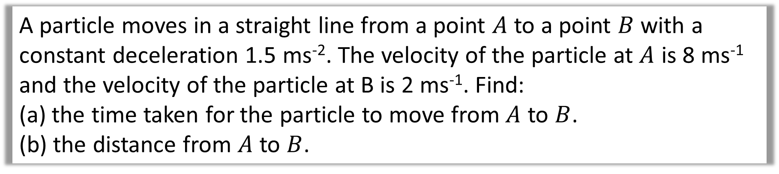
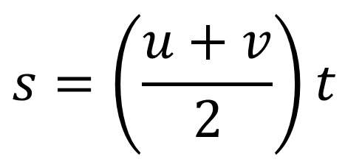
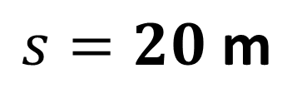
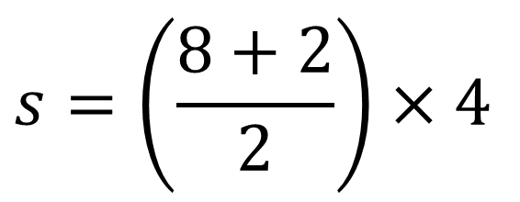
A particle moves in a straight line from a point $A$ to a point $B$ with a constant deceleration 1.5 ms⁻². The velocity of the particle at $A$ is 8 ms⁻¹ and the velocity of the particle at B is 2 ms⁻¹. Find:
the time taken for the particle to move from $A$ to $B$.
the distance from $A$ to $B$.
$$v=u+at$$
$$s=\left(\frac{u+v}{2}\right)t$$
$$v^{2}=u^{2}+2as$$
$$s=ut+\frac{1}{2}at^{2}$$
b)
Identify Values
Choose Equation
Substitute Values
$$s=$$
$$u=$$
$$v= \\ a=$$
$$t=$$
$$?$$
$$s=\left(\frac{u+v}{2}\right)t$$
$$s=\left(\frac{8+2}{2}\right)×4$$
$$8$$
$$2$$
$$−1.5$$
$$s=20 \text{m}$$
$$4$$

Slide 16

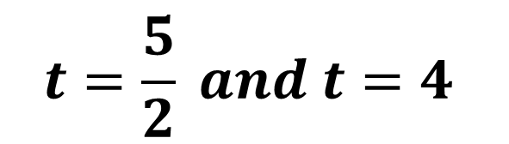
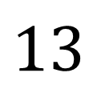
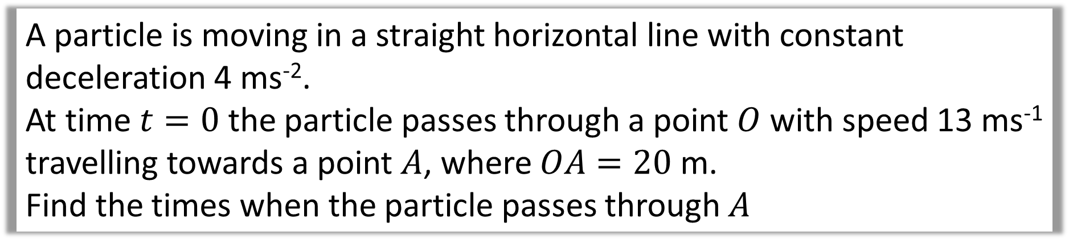

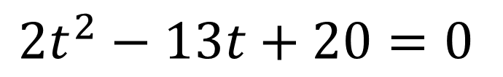
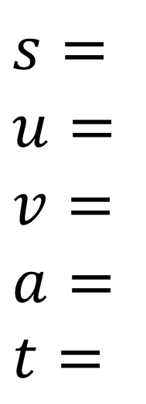
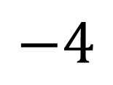
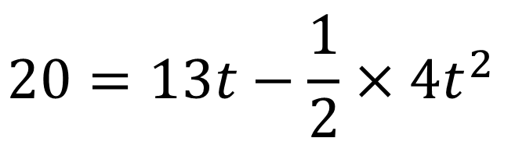
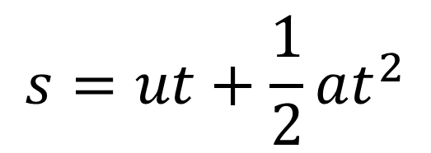
A particle is moving in a straight horizontal line with constant deceleration 4 ms⁻².
At time $t=0$ the particle passes through a point $O$ with speed 13 ms⁻¹ travelling towards a point $A$, where $OA=20$ m.
Find the times when the particle passes through $A$
Identify Values
Choose Equation
Substitute Values
$$s=$$
$$u=$$
$$v= \\ a=$$
$$t=$$
$$20$$
$$20=13t−\frac{1}{2}×4t^{2}$$
$$s=ut+\frac{1}{2}at^{2}$$
$$13$$
$$2t^{2}−13t+20=0$$
$$−4$$
$$t=\frac{5}{2} and t=4$$
$$?$$

Slide 17
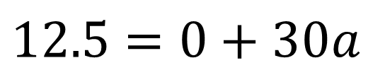
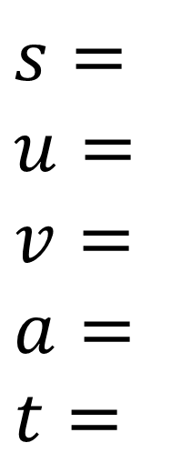

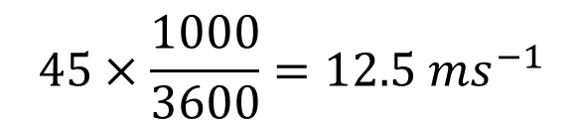


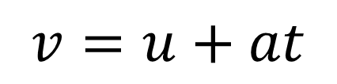


A car moves from traffic lights along a straight road with constant acceleration.
The car starts from rest at the traffic lights and 30 second later the car passes a speed-trap where it is registered as travelling at 45 km h⁻¹. Find:
the acceleration of the car
the distance between the traffic lights and the speed-trap.
$$45×\frac{1000}{3600}=12.5 ms^{−1}$$
a)
Ensure everything is in SI units first.
Identify Values
Choose Equation
Substitute Values
$$s=$$
$$u=$$
$$v= \\ a=$$
$$t=$$
$$v=u+at$$
$$12.5=0+30a$$
$$0$$
$$a=\frac{5}{12} ms^{−2}$$
$$12.5$$
$$?$$
$$30$$

Slide 18








A car moves from traffic lights along a straight road with constant acceleration.
The car starts from rest at the traffic lights and 30 second later the car passes a speed-trap where it is registered as travelling at 45 km h⁻¹. Find:
the acceleration of the car
the distance between the traffic lights and the speed-trap.
b)
Identify Values
Choose Equation
Substitute Values
$$s=$$
$$u=$$
$$v= \\ a=$$
$$t=$$
$$s=\left(\frac{u+v}{2}\right)t$$
$$s=\left(\frac{0+12.5}{2}\right)30$$
$$0$$
$$12.5$$
$$\frac{5}{12}$$
$$s=187.5$$
$$30$$

Slide 19









a)
Identify Values
Choose Equation
Substitute Values
$$s=$$
$$u=$$
$$v= \\ a=$$
$$t=$$
$$240$$
$$240=\left(\frac{u+34}{2}\right)10$$
$$s=\left(\frac{u+v}{2}\right)t$$
$$?$$
$$34$$
$$u=14$$
$$10$$

Slide 20
















b)
Identify Values AB
Choose Equation
Identify Values AM
Choose Equation
$$s=$$
$$u=$$
$$v= \\ a=$$
$$t=$$
$$240$$
$$v=u+at$$
$$s=$$
$$u=$$
$$v= \\ a=$$
$$t=$$
$$120$$
$$s=ut+\frac{1}{2}at^{2}$$
$$14$$
$$14$$
Substitute Values
Substitute Values
$$34$$
$$34=14+10a$$
$$120=14t+\frac{1}{2}2t^{2}$$
$$2$$
$$a=2$$
$$t=6$$
$$10$$
$$?$$

