Slide 1

Senior Challenge 2
GOLD

Slide 2
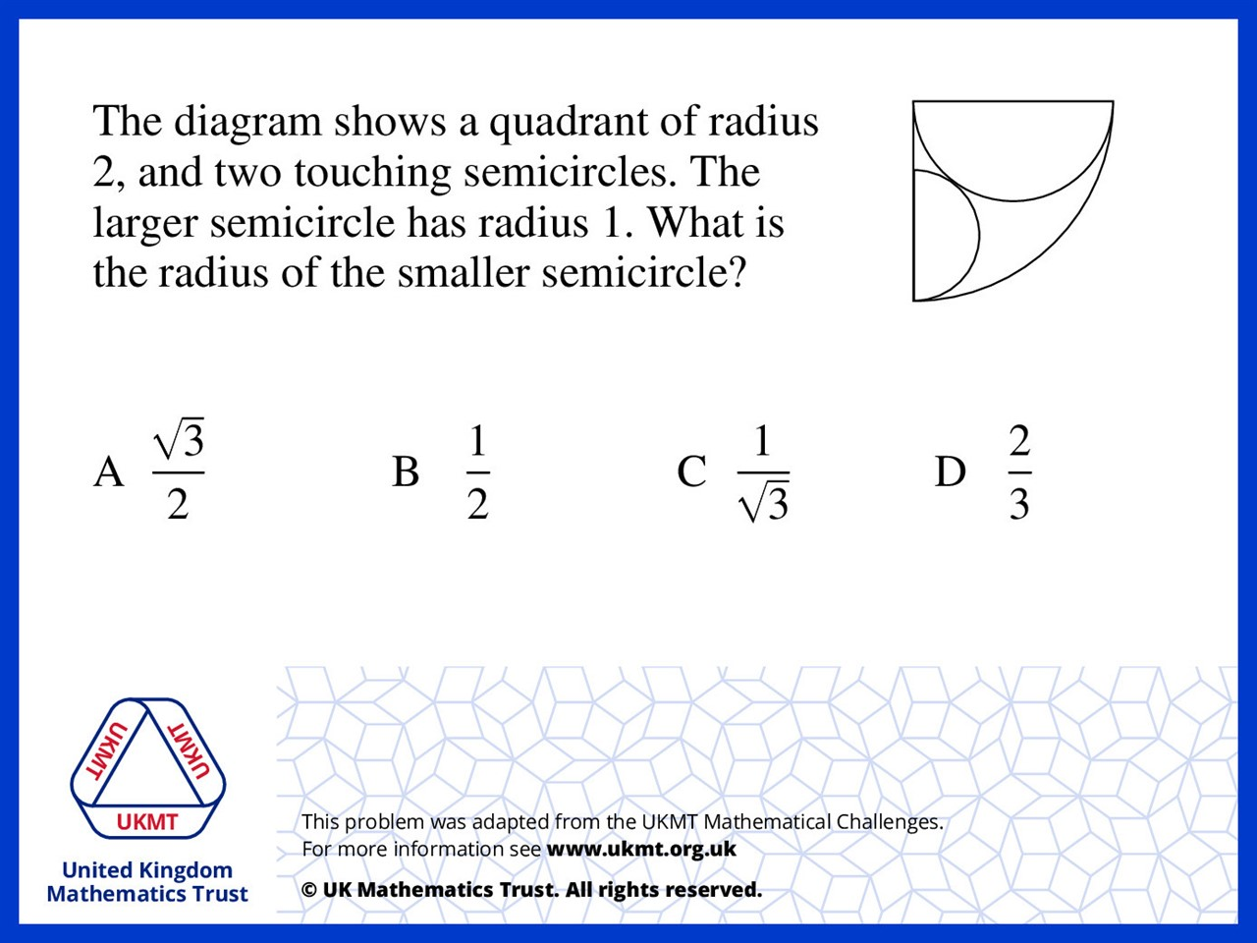
Q1.
Height = 1
Opposite = 2 - r
Hypotenuse is 1 = r
4 = 6r
r = 2/3

Slide 3
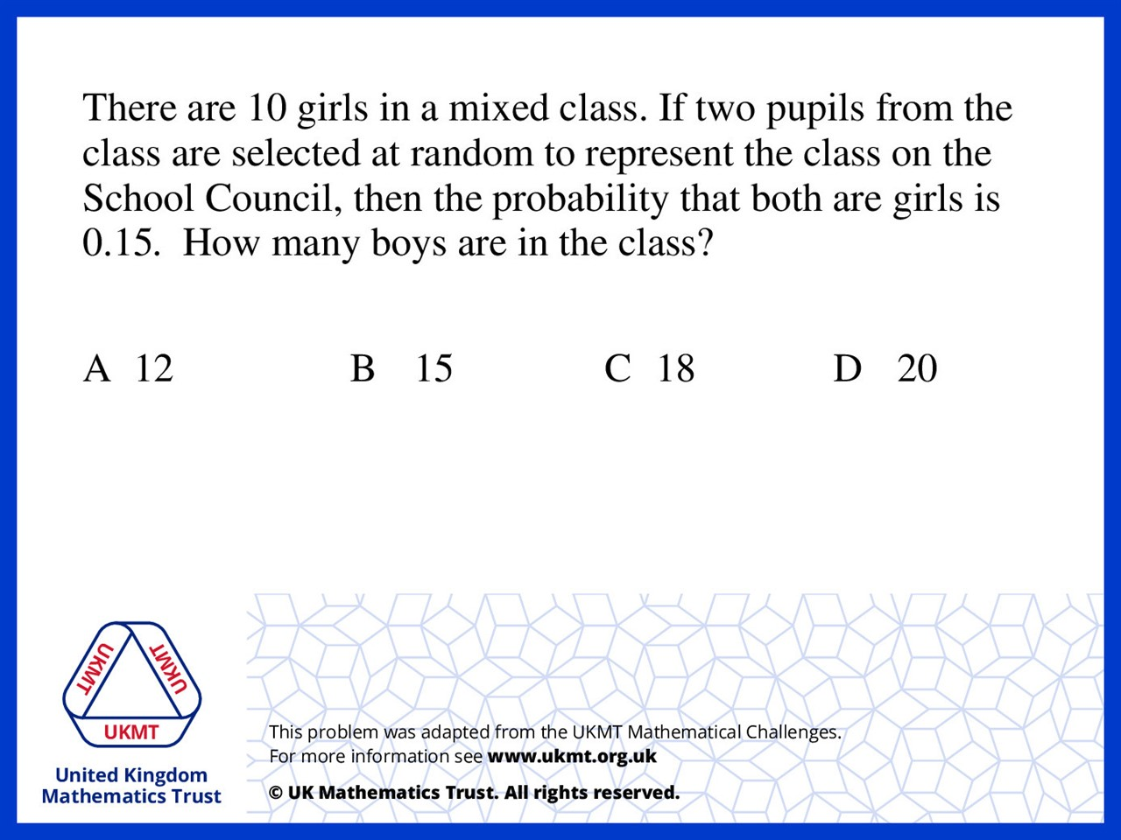
Q2.
10/25 x 9/24 = 0.15

Slide 4
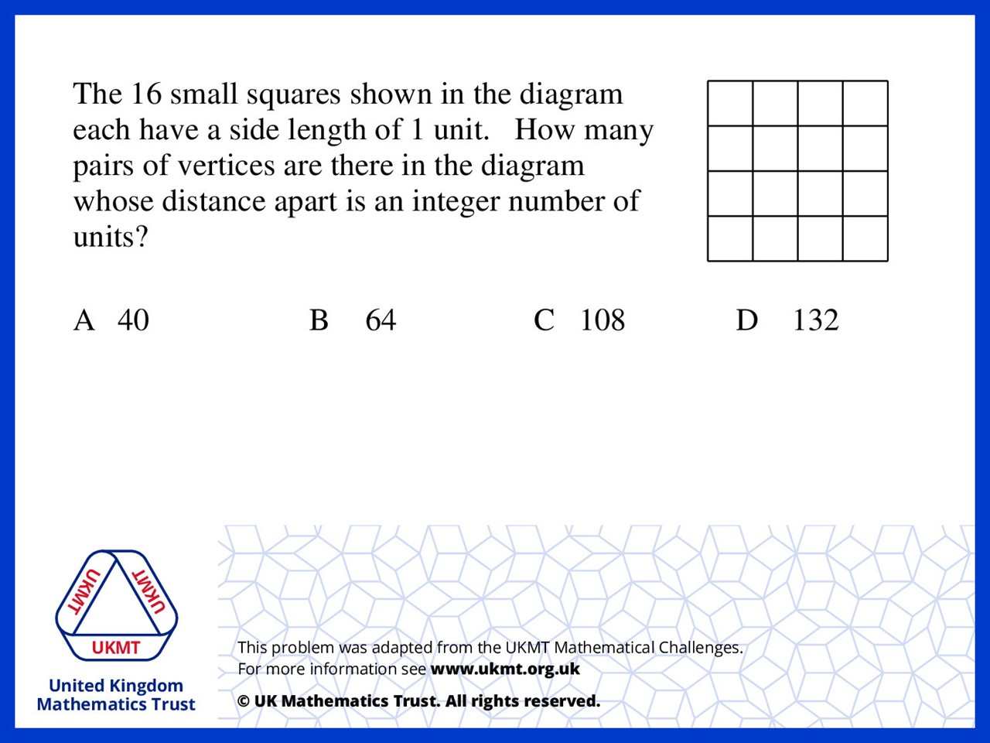
Q3.
There are: 40 with value one
30 with value two
20 with value three
10 with value four
8 with value five formed from three by four triangles

Slide 5
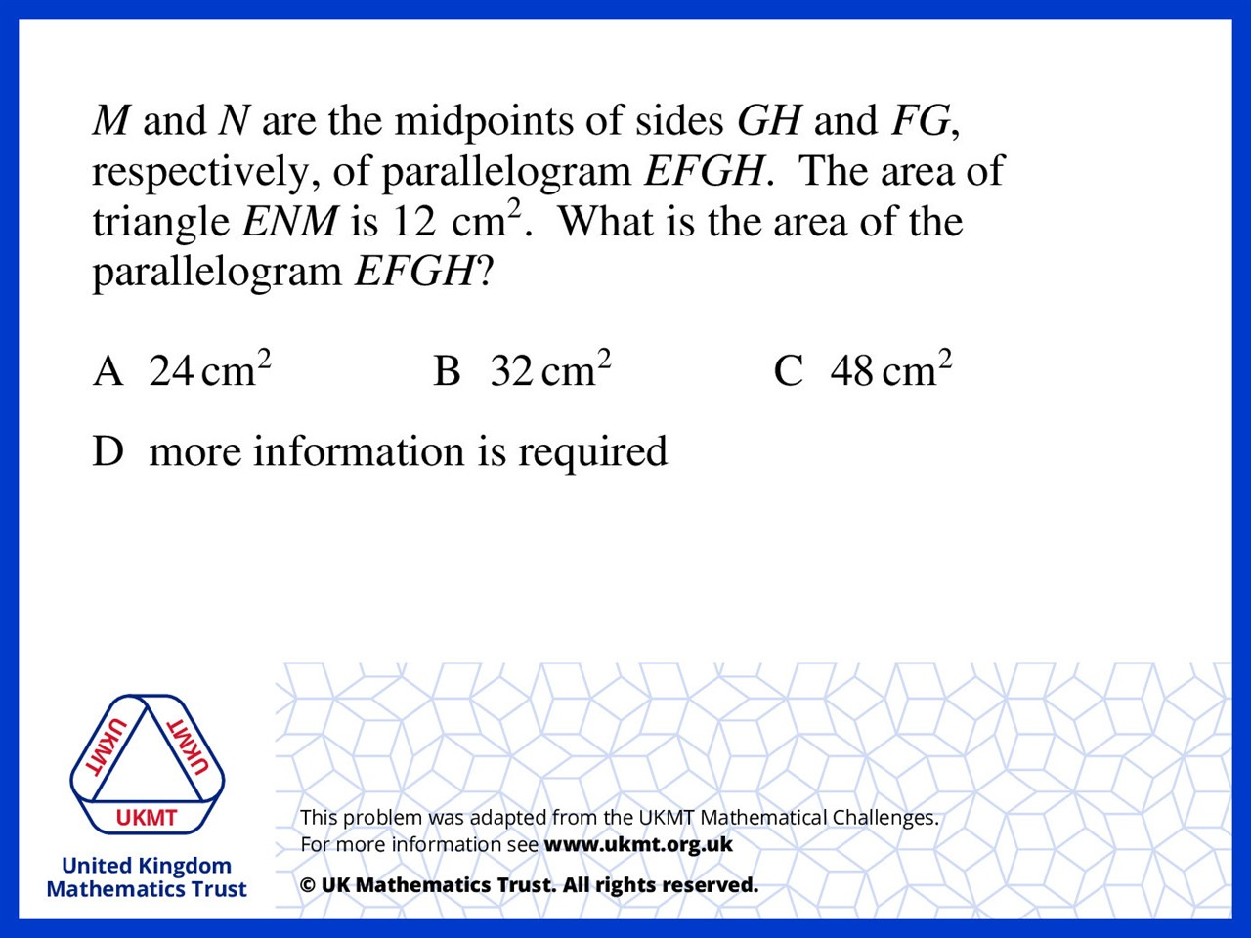
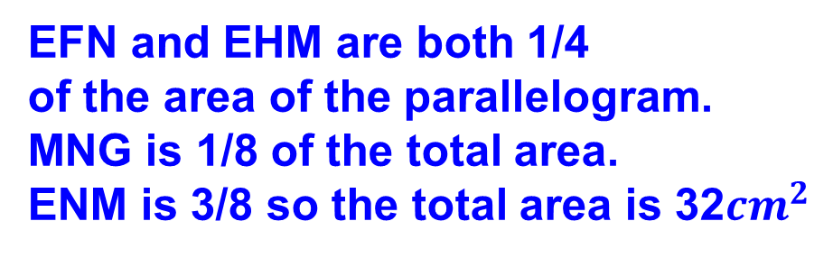
Q4.
EFN and EHM are both 1/4
of the area of the parallelogram.
MNG is 1/8 of the total area.
ENM is 3/8 so the total area is 32${cm}^{2}$

Slide 6
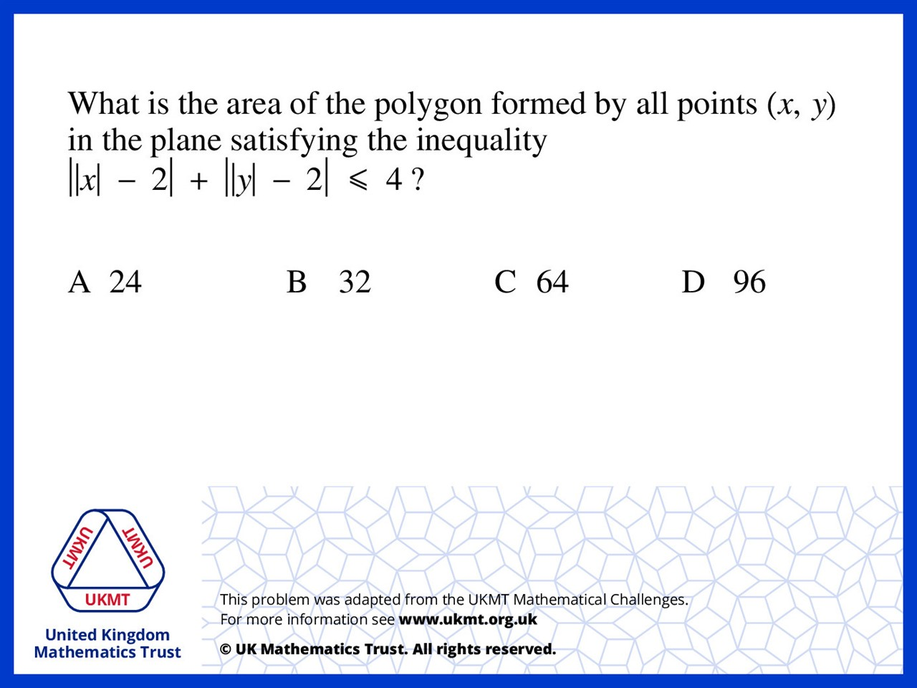
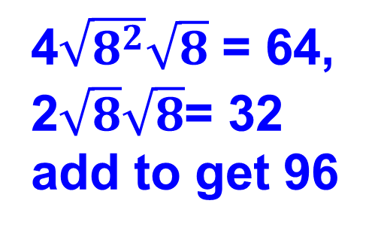
Q5.
4$\sqrt{8^{2}}\sqrt{8}$ = 64,
2$\sqrt{8}\sqrt{8}$= 32
add to get 96

